Slide 1



PS Code: SIH1467
Team Name: TECHNO GEEKS
Team Leader Name: Dhruv Sharma

Slide 2
Basic Details of the Team and Problem Statement
Student Innovation: AICTE, MIC-Student Innovation
PS Code: SIH1467
Problem Statement Title: Student Innovation
Team Name: TECHNO GEEKS
Team Leader Name: Dhruv Sharma
Institute Code (AISHE):
Institute Name: JECRC Foundation
Theme Name: Smart Education

Slide 3
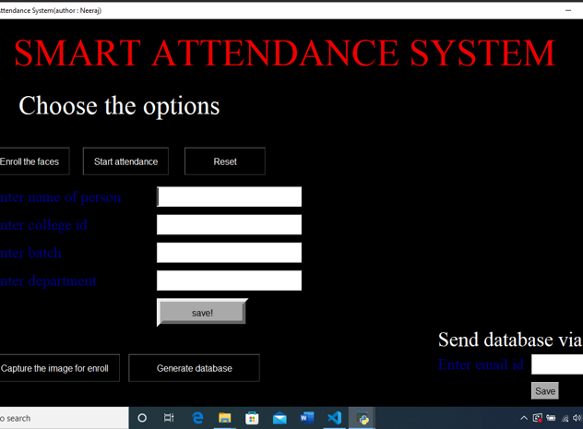
Idea/Approach Details
Add process flow chart or simulated image of prototype or any relevant image related to your idea
Describe your idea/Solution/Prototype here:
The face recognition attendance system is an automated and practical solution for tracking attendance. It eliminates the disturbance and time loss associated with traditional attendance systems.
It offers time attendance tracking that can exclude any time lapses among students, ensuring that everyone arrives on time. With the use of a facial scanning device, students can now easily check in for their classes without any hassle.
Describe your Technology stack here:
Face recognition
OpenCv
Tkinter for GUI
Date Time module
Numpy

Slide 4
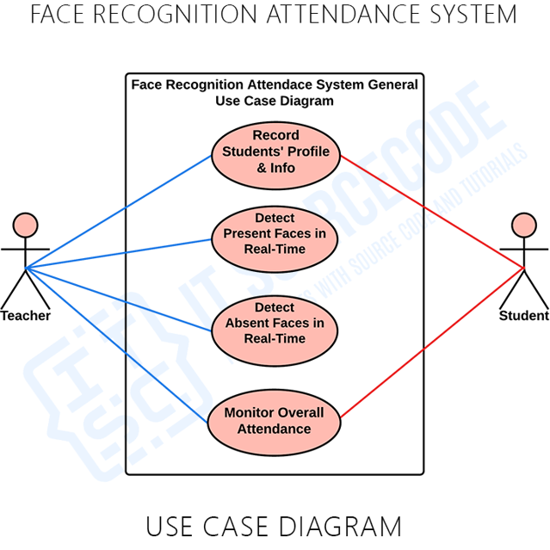
Idea/Approach Details
Describe your Use Cases here
Describe your Dependencies / Show stopper here
OpenCV is a powerful tool for face recognition, as it can detect human faces in real time and mark the attendance accordingly. This ensures the accuracy and reliability of the attendance system.
It will be most accurate face detection model.
No one can mark fake attendance using image.

Slide 5
Team Member Details
Team Leader Name: Dhruv Sharma
Branch :Btech Stream : CSE Year : III
Team Member 1 Name: Shubham Saharan
Branch :Btech Stream : CSE Year : III
Team Member 2 Name: Anusha Tatwal
Branch :Btech Stream : CSE Year : III
Team Member 3 Name: Ragini Joshi
Branch :Btech Stream : CSE Year : III
Team Member 4 Name: Meeta Soni
Branch :Btech Stream : IT Year : III
Team Member 5 Name: Samridhi Sharma
Branch :Btech Stream : IT Year : III
Team Mentor 1 Name: Dr. Sanjay Gaur
Category : Academic Expertise : Data Analytics Domain Experience (in years): 19

Slide 6
Important Pointers
Please ensure below pointers are met while
Kindly keep the maximum slides limit to 4 pages
All the topics should be utilized for description of your idea
Try to avoid paragraphs and post your idea in points
Keep your explanation precisely and easy to understand
Idea should be unique and novel. If it has a business potential more weightage will be given.
Apart from this PPT abstract of your idea will be asked separately while submitting
You need to save the file in PDF and upload the same on portal. No PPT, Word Doc or any other format will be supported
You can delete this slide (Important Pointers) when you upload the details of your idea on SIH portal.

