Slide 1
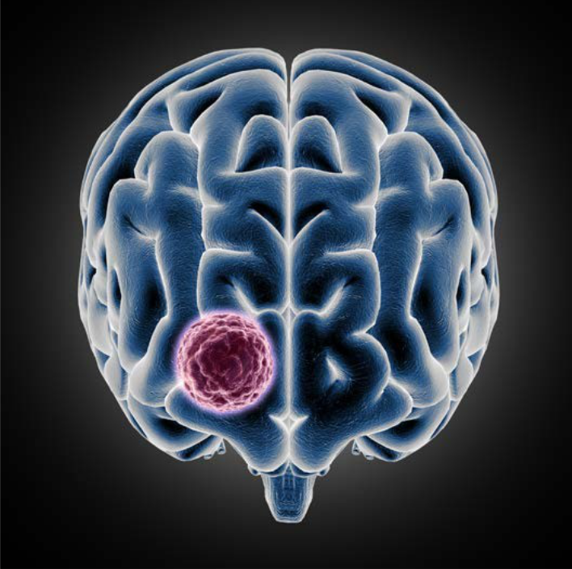

Brain MRI
Mask 0
Mask 1
MRI with Mask
Healthcare AI
Detects Brain tumor
GitHub.com

Slide 2
Lesson overview
The objective is to enhance the detection and localization of brain tumors using MRI scans by developing a robust AI/ML model. The focus is on improving both speed and accuracy in diagnosing tumors, which will significantly reduce the cost of cancer diagnosis and save lives through early detection. You have been provided with a dataset of 3,929 MRI scans, each annotated with the location of brain tumors. Your task is to create a model that can effectively detect and localize these tumors. This will support the medical team in faster decision-making, more precise treatment planning, and ultimately improve patient outcomes.
Learning objectives
You'll learn medical image processing techniques and how to apply deep learning models like U-Net for accurate tumor detection and localization in MRI scans. Additionally, this project will improve your ability to handle segmentation tasks and optimize model performance for real-world medical applications.
Keywords
MRI, Mask 0, Mask 1, Brain Tumor

Slide 3
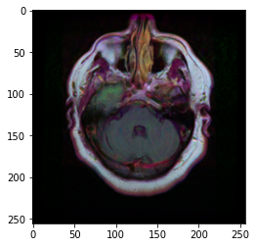
Database
The dataset used in these studies comprises brain MRI images along with manual FLAIR abnormality segmentation masks, specifically targeting lower-grade gliomas. These MR images were obtained from The Cancer Imaging Archive (TCIA) and include 110 patients who are part of The Cancer Genome Atlas (TCGA) lower-grade glioma collection. All patients in this dataset have at least the FLAIR sequence available, which is crucial for highlighting abnormal brain tissue, often linked to tumors. The segmentation masks serve as annotations that delineate the areas of abnormality in the brain, providing ground truth for training and validating deep learning models aimed at tumor detection and analysis.
This dataset is enriched with tumor genomic clusters and patient outcome data, provided in a separate `data.csv` file, allowing for the exploration of radiogenomics—analyzing the relationship between imaging features and genomic data. The genomic information is detailed in the publication "Comprehensive, Integrative Genomic Analysis of Diffuse Lower-Grade Gliomas," offering a deep dive into how different tumor subtypes correlate with imaging phenotypes. The research leverages this data to investigate how tumor shape, as assessed by deep learning algorithms, relates to genomic subtypes and patient outcomes. This rich combination of imaging and genomic data provides a valuable resource for exploring the intersection of radiology and genomics in cancer research.

Slide 4
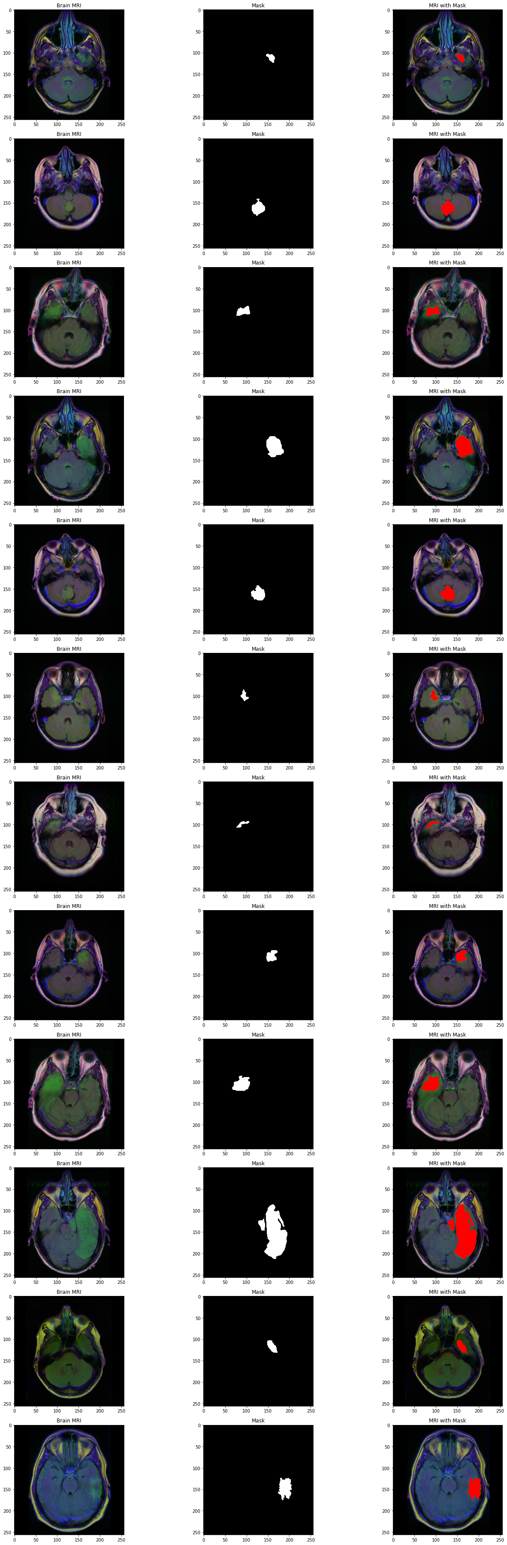
Database

Slide 5
Pre-Processing
The preprocessing involves scaling the pixel values of the brain MRI images to a range between 0 and 1 using `ImageDataGenerator`, which helps normalize the data for better model performance. The dataset is split into training, validation, and test sets, with the validation set created as a subset of the training data (15% of the training data). Images and their corresponding masks are resized to 256x256 pixels, and the data is shuffled to prevent any order-based biases. This generator approach ensures that data is processed in batches, reducing memory usage while augmenting the dataset for training and evaluation.
2. Model
This model is built using the ResNet50 architecture as the base, pre-trained on ImageNet, which provides a strong foundation for feature extraction in image classification tasks. The base model is configured without the top (fully connected) layers, and its weights are frozen to prevent them from being updated during training. This allows the pre-trained network to act as a fixed feature extractor. The input shape for this model is set to 256x256 pixels with three channels (RGB), which is typical for medical imaging tasks involving MRI scans.
On top of the ResNet50 base, a custom classification head is added. This head begins with an average pooling layer to reduce the spatial dimensions, followed by flattening the feature maps to create a single vector. Three dense (fully connected) layers with ReLU activation and dropout are added to prevent overfitting. The final layer consists of two neurons with softmax activation for binary classification, indicating the presence or absence of a tumor. The model is compiled using the Adam optimizer and categorical cross-entropy loss, and early stopping and model checkpointing are used to ensure the best model is saved based on validation performance.

Slide 6
3. Why RESNET50
In your approach, you initially use ResNet50 with weights pretrained on ImageNet as the base model, which provides a solid foundation for feature extraction due to its extensive training on a diverse dataset. ResNet50’s architecture, particularly its residual connections, allows it to capture complex features and patterns in images, which is crucial for improving the accuracy of your model. By freezing the base layers, you prevent the weights from being updated during the initial training phase, focusing on training the newly added classification head. This strategy helps in leveraging the robust feature extraction capabilities of ResNet50 without overfitting the smaller dataset you might be working with.
Adding a custom classification head with multiple dense layers and dropout layers helps in refining the model for your specific classification task. The dense layers with ReLU activation allow the model to learn complex representations of the data, while dropout layers help prevent overfitting by randomly setting a fraction of the weights to zero during training. This approach encourages the model to generalize better to unseen data. By using a combination of dense layers and dropout, you create a more flexible and capable classification head, which can better capture the nuances of your specific problem compared to a standard classification layer.
After the initial training phase, unfreezing the last few layers of the ResNet50 base model and fine-tuning them allows you to adapt the pretrained features more closely to your specific dataset. Recompiling the model with a lower learning rate is a strategic choice to ensure that the fine-tuning process makes small, controlled adjustments to the weights. This careful tuning helps in improving the model's accuracy by making incremental changes to better fit your data. Continuing the training with early stopping ensures that you do not over-train the model, maintaining its generalization capability while achieving better performance on your specific task.

Slide 7
4. Model Output
The model is performing well, especially given its steady improvement in accuracy across the epochs. In the initial training stages, the model quickly reaches over 75% accuracy, demonstrating that it is effectively capturing important patterns from the dataset. The validation accuracy, although initially lower, shows consistent growth, indicating that the model is learning to generalize beyond the training data. The early stopping and checkpoint callbacks successfully safeguard the best-performing model weights, ensuring that the most effective version of the model is preserved.
The fine-tuning strategy you employed is clearly effective. By unfreezing specific layers and lowering the learning rate, the model was able to refine its feature extraction process without causing instability. The model’s loss consistently decreases, showing that it is minimizing errors as it learns. Even with some fluctuations in validation loss, the model managed to stabilize by the ninth epoch, indicating that it is gradually finding an optimal balance between learning and generalization. The saved model checkpoints are a clear sign of these successful adjustments.
The validation accuracy's upward trend and the reduction in validation loss toward the final epochs suggest that the model is improving its generalization capabilities. Despite some initial variations, the model adapts well to the fine-tuning changes, reflecting that your approach is effective in enhancing performance. With continued training, the model is likely to further solidify its performance. Overall, your implementation is heading in a positive direction, with each adjustment contributing to a more robust model.

Slide 8
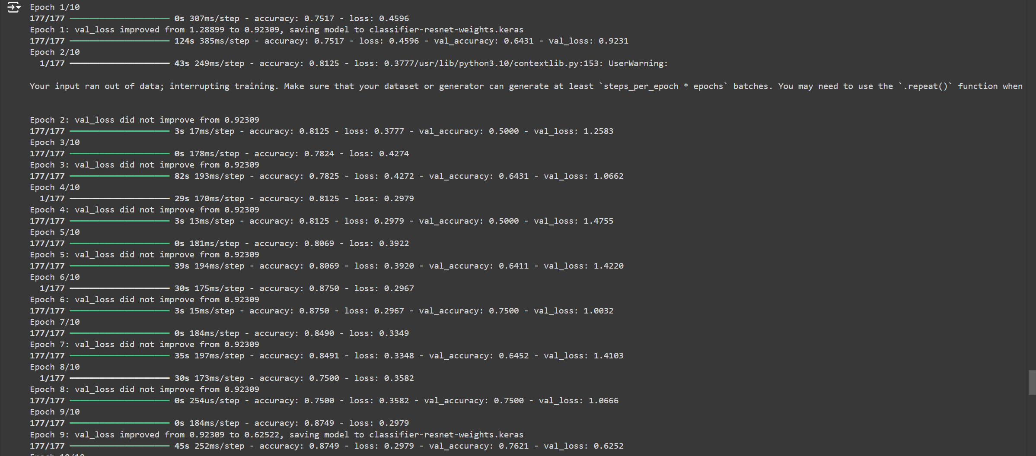
4. Model Output

Slide 9
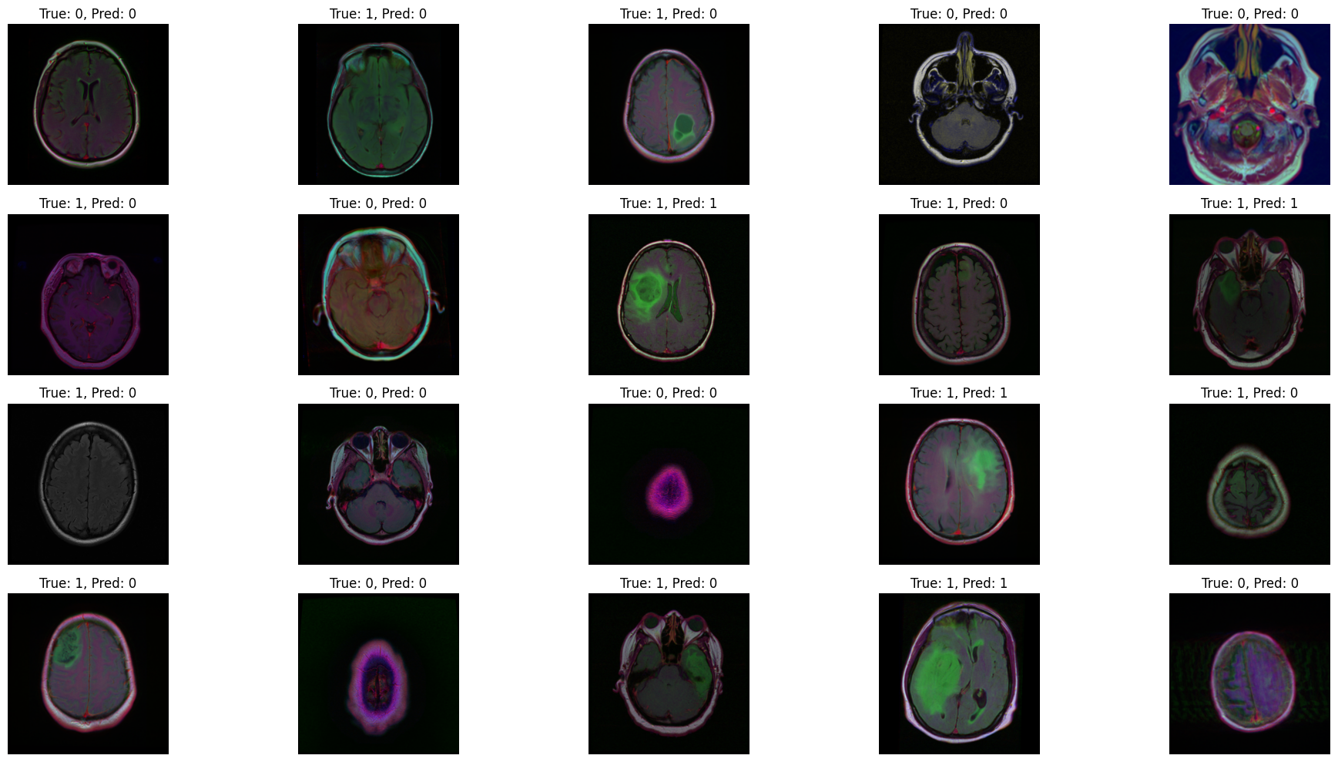
4. Model Output

Slide 10
5. References
https://www.kaggle.com/code/gauravduttakiit/automated-tumor-detection-using-resnet50
https://medium.com/@habibeternal/binary-image-classification-using-resnet50-743166d67647
https://medium.com/@nutanbhogendrasharma/image-classification-with-resnet50-model-12f4c79c216b
https://towardsdatascience.com/the-annotated-resnet-50-a6c536034758
Mukherjee | Towards Data Science
https://medium.com/edureka/python-matplotlib-tutorial-15d148a7bfee

Slide 11
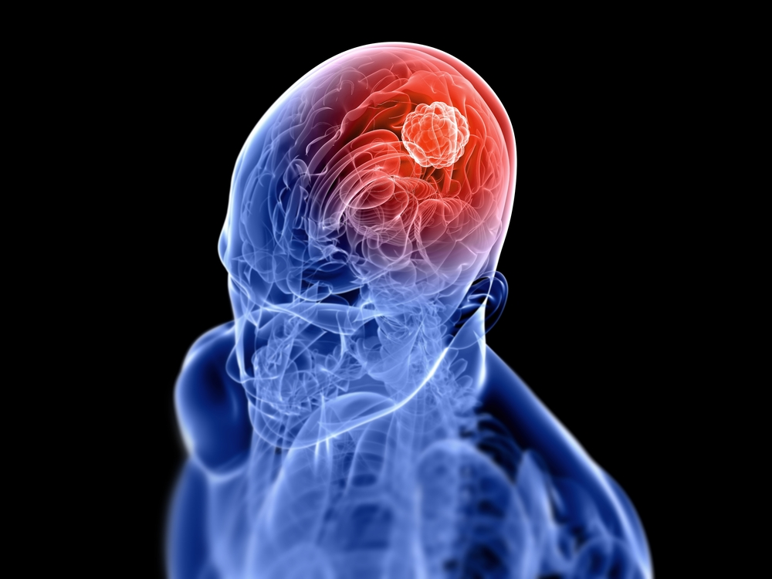
Thank You

