Slide 1

Natural Language processing

Slide 2
INDEX
INTRODUCTION
DATASET
PRE-PROCESSING
MODEL 01
MODEL 02
REFERENCES

Slide 3
“INTRODUCTION”

Slide 4


Sentiment analysis on US airline tweets.
This project aims to develop a sentiment analysis system for US airline reviews using the “Twitter US Airlines Review Sentiment" dataset. The system will classify tweets as positive, negative, or neutral, helping to gauge customer sentiment. Key steps include data preprocessing, feature extraction, model selection, and performance evaluation. The goal is to create an accurate and efficient model for analyzing customer feedback in the airline industry.

Slide 5

“database”
Twitter US Airline Sentiment (kaggle.com)

Slide 6
database
Dataset Overview
Name: U.S. Airline Sentiment Dataset
Source: The dataset was originally created by Crowdflower (now Figure Eight) and is available on platforms like Kaggle.
Size: The dataset contains around 14,000 tweets.
Content
Tweets: The dataset consists of tweets directed at major U.S. airlines. The tweets reflect passengers' experiences and opinions about various aspects of airline services.
Sentiments: Each tweet is labeled with one of three sentiment classes:
Positive: Reflects a favorable sentiment toward the airline.
Neutral: Indicates a neutral sentiment, without strong positive or negative feelings.
Negative: Represents dissatisfaction or negative sentiment toward the airline.

Slide 7
“PRE-PROCESSING”

Slide 8
DATA PRE-PROCESSING
Data Preprocessing with SpaCy:
Tokenization: Splitting text into individual words or tokens.
Lemmatization: Converting words to their base forms.
Stop Words Removal: Filtering out common words that do not contribute to sentiment analysis, such as "and," "the," etc.
Cleaning: Removing unnecessary characters, URLs, and ensuring uniform text structure.

Slide 9
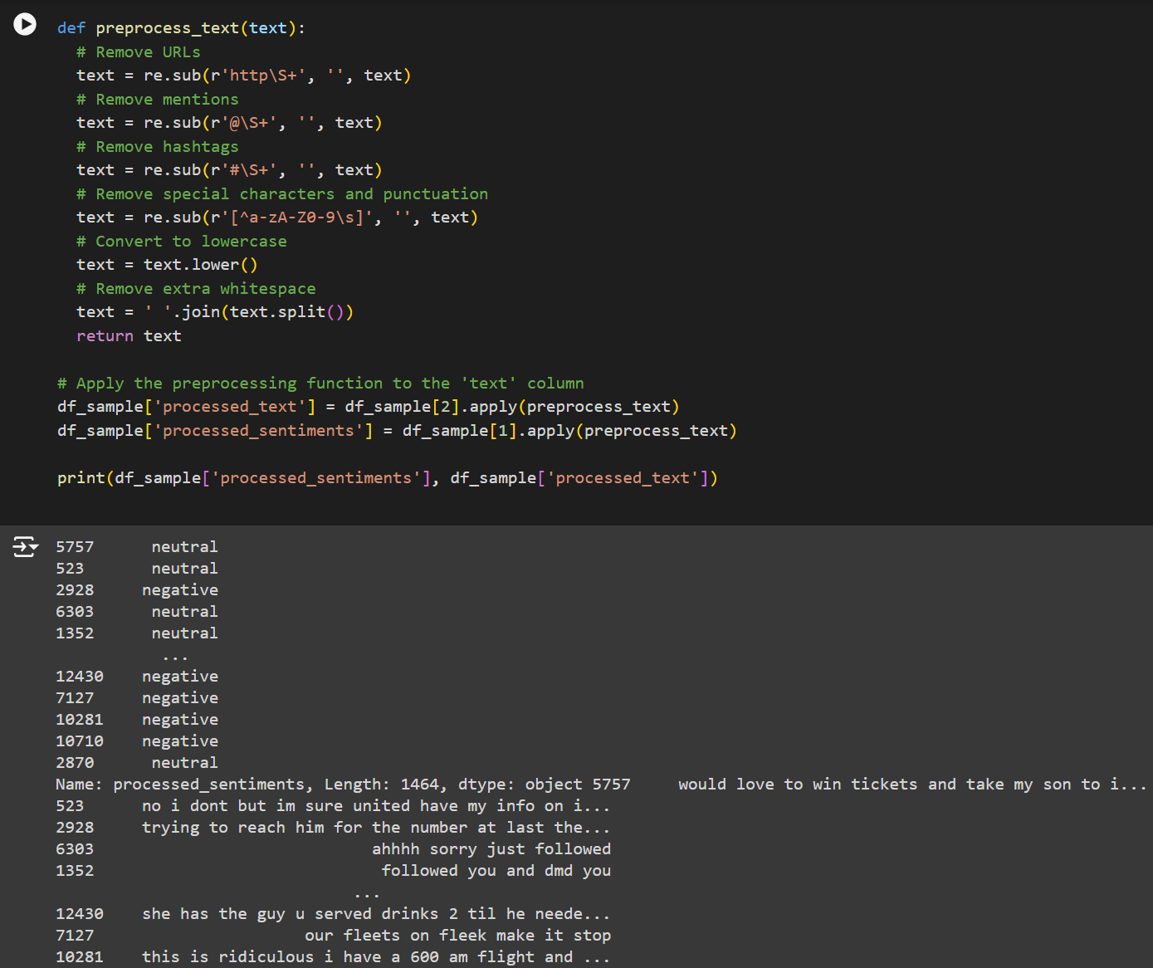
data pre-processing

Slide 10
“model 01”

Slide 11
DATA PRE-PROCESSING
Logistic Regression code implements a Logistic Regression model to classify sentiments in airline tweets. The model is trained using the Bag-of-Words (BoW) representation of the training data, which converts text into numerical features. After training, the model's performance is evaluated on both validation and test datasets by calculating accuracy, which measures the proportion of correctly predicted sentiment labels. The validation accuracy helps fine-tune the model, while the test accuracy assesses its performance on new, unseen data.
Fine-tune the model's performance code experiments with various autoencoder architectures to detect and remove anomalies from the training data. It tests different hidden layer sizes and activation functions, training the autoencoder on the Bag-of-Words (BoW) representation. The autoencoder reconstructs the input data, and the reconstruction error is used to identify anomalies. After filtering out anomalies, a Logistic Regression model is trained on the cleaned data and evaluated on the validation set. The process helps improve model accuracy by removing outliers that could negatively impact performance.

Slide 12
DATA PRE-PROCESSING
Generalization And Robustness code aims to improve the model's generalization and robustness by experimenting with different autoencoder architectures and L2 regularization parameters (alphas). Various hidden layer sizes and activation functions are tested, and anomalies in the training data are identified and removed based on reconstruction error thresholds. The Logistic Regression model is then trained on the filtered data with L2 regularization, and the validation accuracy is used to determine the best configuration. The best-performing autoencoder and Logistic Regression model are then retrained on the full dataset using the optimal parameters.

Slide 13
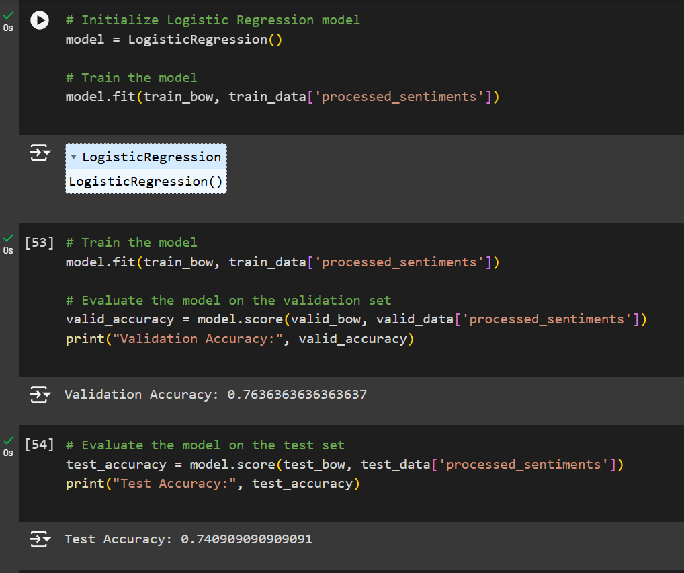
data pre-processing

Slide 14
“model 02”

Slide 15
DATA PRE-PROCESSING
The `RandomForestClassifier` is initialized with 100 trees and a fixed random seed for reproducibility. The model is trained on the training data (`train_bow` features and `processed_sentiments` labels). Its accuracy is assessed on the validation set (`valid_bow` features). The validation accuracy is printed twice, which is likely redundant. Finally, the model's performance is evaluated on the test set (`test_bow` features), and the accuracy is printed.
Fine-tune the model's performance optimizes model performance by experimenting with different autoencoder architectures, including various hidden layer sizes, activation functions, and learning rates. It trains each autoencoder to reconstruct the input data and calculates the reconstruction error to detect anomalies. Anomalies are removed from the training set, and a logistic regression model is then trained on this filtered data. The model's performance is evaluated on a validation set to identify which autoencoder configuration yields the highest accuracy. The best-performing configuration, in terms of validation accuracy, is recorded and reported.

Slide 16
DATA PRE-PROCESSING
Generalization And Robustness code starts by training a Random Forest model and evaluating its accuracy on both the validation and test sets. It then advances to enhancing model robustness and generalization by experimenting with various autoencoder architectures, incorporating dropout, L2 regularization, and learning rate scheduling. Each configuration is tested by training the autoencoder, reconstructing the data, and filtering out anomalies based on reconstruction errors. A logistic regression model is then trained on this cleaned data and evaluated for the best validation accuracy. The best performing configuration is identified based on validation accuracy, and the optimal parameters are reported.

Slide 17
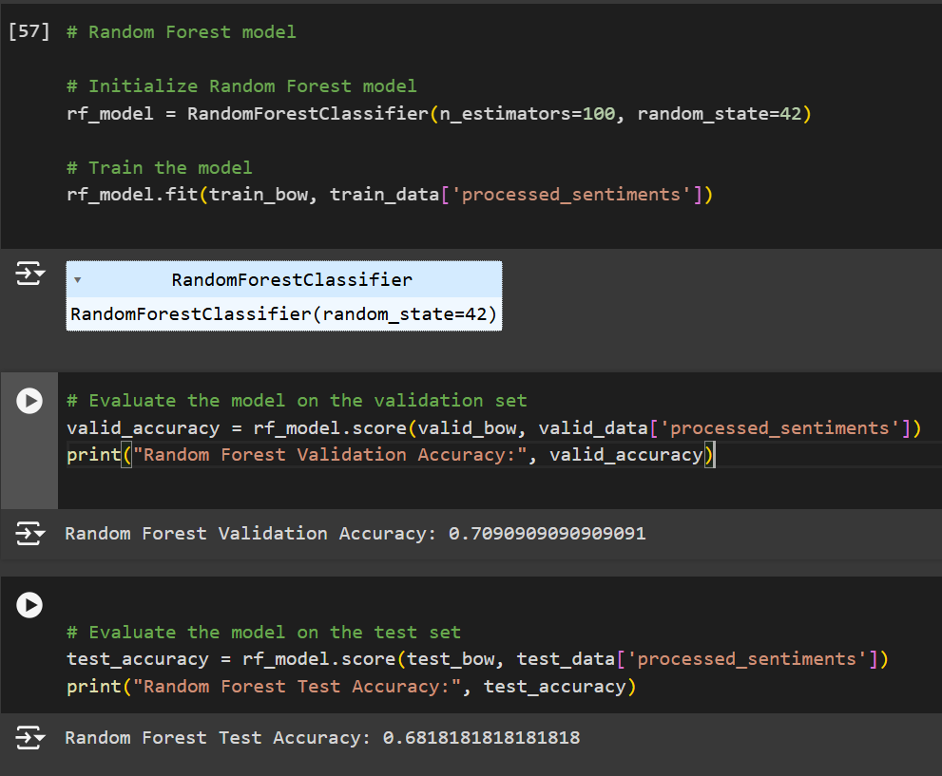
data pre-processing

Slide 18
“References”

Slide 19
References
https://www.kaggle.com/code/ayu1391994/nlp-using-random-forest
https://medium.com/analytics-vidhya/randomforest-classifier-vs-multinomial-naive-bayes-for-a-multi-output-natural-language-2426381a5217
https://towardsdatascience.com/nlp-101-%E2%85%94-linear-models-for-text-classification-8ced8199c2a8
https://lajavaness.medium.com/regression-with-text-input-using-bert-and-transformers-71c155034b13
https://medium.com/@maleeshadesilva21/preprocessing-steps-for-natural-language-processing-nlp-a-beginners-guide-d6d9bf7689c9

Slide 20

Thank You GitHub.com/Dhruv-1603

