Slide 1
WEB SCRAPING

Slide 2
AGENDA
INTRODUCTION
SCRAPE FUNCTION
PAGE FUNCTION
VISUALIZE DATA
FINAL INTO EXCEL

Slide 3

INTRODUCTION

Slide 4
WHAT IS WEB-SCRAPING?
WEB SCRAPING AUTOMATICALLY EXTRACTS DATA FROM WEBSITES, USES CRAWLERS TO SEARCH, AND SCRAPERS TO EXTRACT.
WEB SCRAPING AUTOMATICALLY CONVERTS HTML DATA INTO STRUCTURED FORMATS.
IT CAN USE ONLINE SERVICES, APIS, OR CUSTOM CODE TO OBTAIN DATA.
A CRAWLER SEARCHES FOR DATA, WHILE A SCRAPER EXTRACTS IT.

Slide 5
SCRAPE FUNCTION

Slide 6
SCRAPE FUNCTION
THE FUNCTION SCRAPES IPHONE NAMES, PRICES, REVIEWS, AND LINKS FROM AMAZON SEARCH RESULTS.
IT SENDS A REQUEST TO THE PROVIDED URL AND PARSES THE HTML CONTENT WITH BEAUTIFULSOUP.
THE FUNCTION EXTRACTS PRODUCT DETAILS FROM HTML ELEMENTS LABELED AS SEARCH RESULTS.
IF THE REQUIRED DATA ELEMENTS ARE MISSING, IT ASSIGNS DEFAULT VALUES LIKE "NOT FOUND.“
THE FUNCTION RETURNS LISTS OF EXTRACTED NAMES, PRICES, REVIEWS, AND LINKS.
THE FUNCTION APPENDS "HTTPS://WWW.AMAZON.COM" TO RELATIVE LINKS TO FORM COMPLETE URLs.

Slide 7
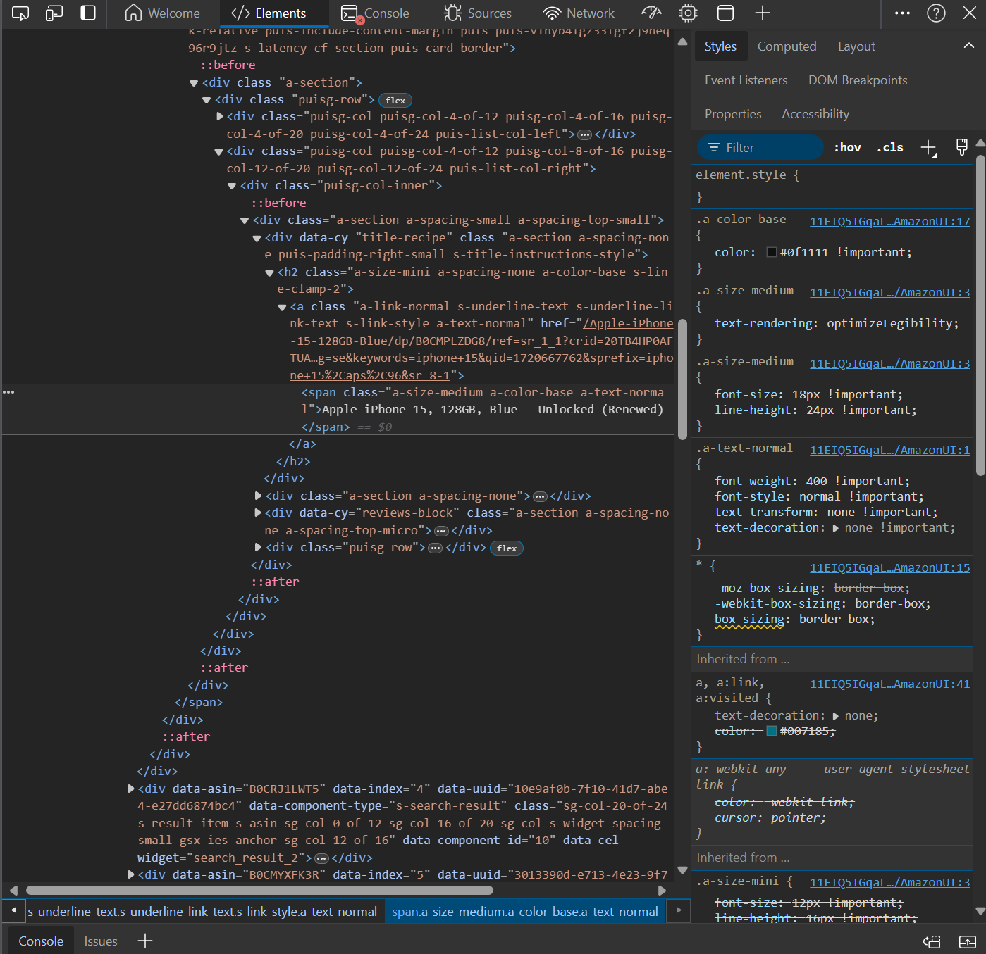
THE PHOTO SHOWS AN AMAZON PRODUCT LISTING FOR IPHONE 15 WITH ITS HTML ELEMENTS INSPECTED USING A BROWSER'S DEVELOPER TOOLS.

Slide 8
PAGE FUNCTION

Slide 9
PAGE FUNCTION
THE LOOP SCRAPES DATA FROM EACH AMAZON PAGE UNTIL NO MORE ITEMS ARE FOUND.
IT PRINTS THE CURRENT PAGE NUMBER BEING SCRAPED.
THE FUNCTION ‘scrape_amazon_page’ IS CALLED WITH THE URL UPDATED FOR EACH PAGE.
THE LOOP BREAKS IF NO NAMES ARE FOUND ON A PAGE, INDICATING THE END OF RESULTS.
SCRAPED DATA (NAMES, PRICES, REVIEWS, LINKS) IS APPENDED TO RESPECTIVE LISTS.
A ONE-SECOND DELAY IS ADDED BETWEEN REQUESTS TO AVOID OVERLOADING THE SERVER.

Slide 10
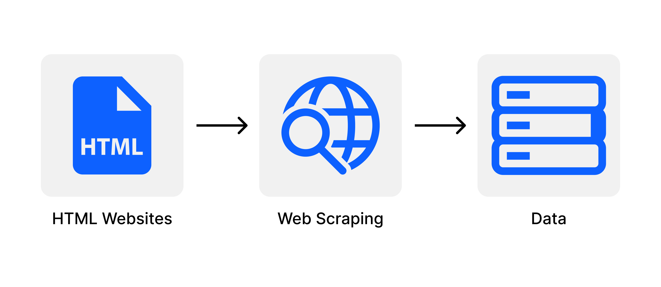
PAGE FUNCTION
THE FUNCTION `SCRAPE_AMAZON_PAGE` IS DESIGNED TO EXTRACT PRODUCT NAMES, PRICES, REVIEWS, AND LINKS FROM AMAZON SEARCH RESULT PAGES. BY PARSING THE HTML CONTENT OF THESE PAGES, IT SYSTEMATICALLY RETRIEVES AND ORGANIZES THE SPECIFIED ELEMENTS ASSOCIATED WITH EACH PRODUCT LISTING. UPON EXECUTION, IT RETURNS COMPREHENSIVE LISTS CONTAINING THE EXTRACTED INFORMATION FOR ALL PRODUCTS FOUND ON THE PAGE.

Slide 11

VISUALIZE DATA

Slide 12
VISUALIZE DATA
COMPARE RELATIONSHIPS: THE SCATTER PLOT (FIG = PX.SCATTER(DF, X="PRICE", Y="REVIEWS", COLOR="NAME", HOVER_DATA=["LINK"])) VISUALLY SHOWS HOW IPHONE 15 MODELS VARY IN PRICE AND REVIEWS, HIGHLIGHTING TRENDS AND OUTLIERS.
HIGHLIGHT DETAILS: BY INCLUDING HOVER_DATA=["LINK"], THE VISUALIZATION ALLOWS INTERACTIVE EXPLORATION OF INDIVIDUAL DATA POINTS, PROVIDING ADDITIONAL CONTEXT SUCH AS DIRECT LINKS TO PRODUCT DETAILS.
COMMUNICATE INSIGHTS: THE TITLE (TITLE="IPHONE 15 COMPARISON: PRICE VS. REVIEWS") AND AXIS LABELS (XAXIS_TITLE="PRICE", YAXIS_TITLE="REVIEWS") CLARIFY WHAT THE VISUALIZATION REPRESENTS, FACILITATING CLEAR COMMUNICATION OF FINDINGS AND COMPARISONS AMONG DIFFERENT IPHONE 15 MODELS.

Slide 13
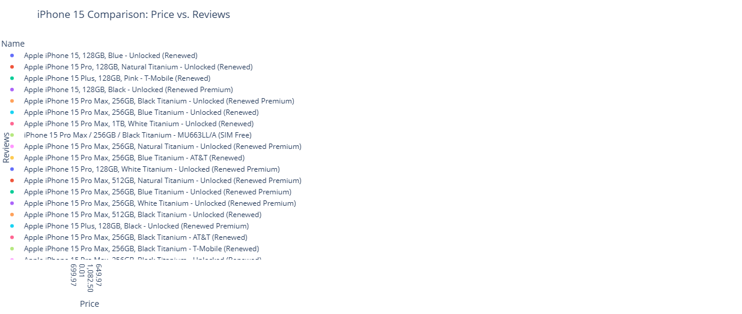
VISUALIZE DATA

Slide 14
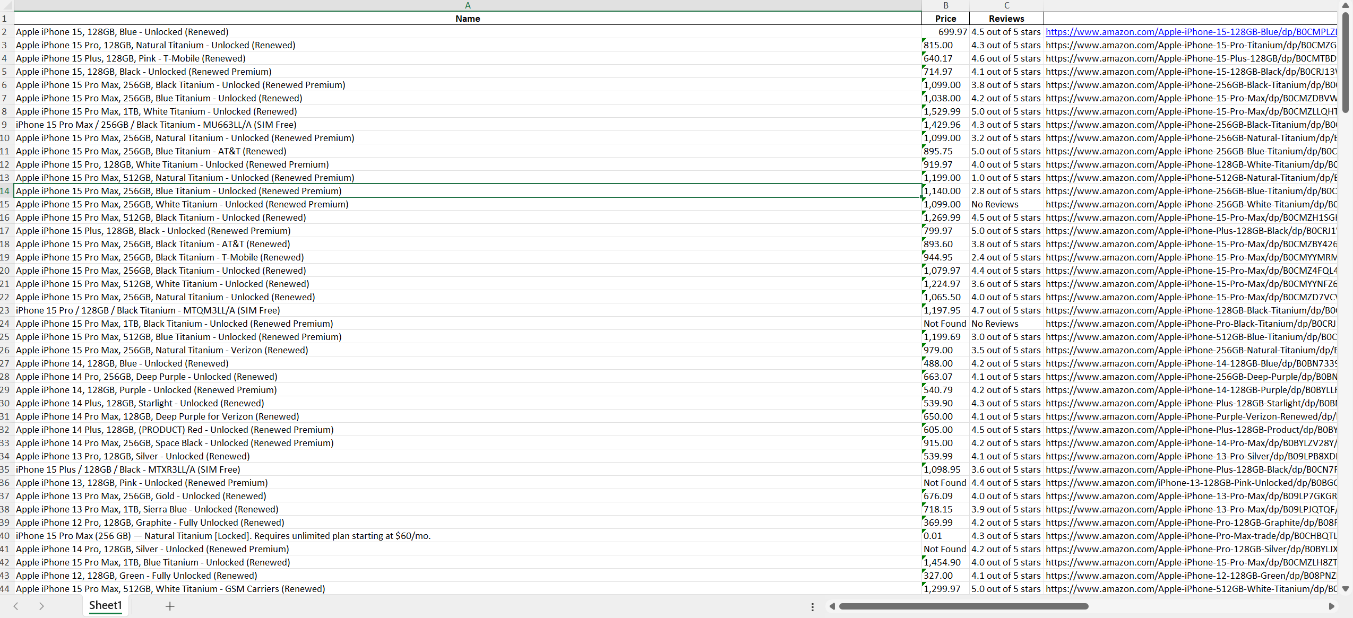
FINAL INTO EXCEL

Slide 15
EXCEL DATA
DATAFRAME CREATION: THE CODE INITIALIZES A PANDAS DATAFRAME (DF) USING DATA FROM LISTS (ALL_NAMES, ALL_PRICES, ALL_REVIEWS, ALL_LINKS) CONTAINING SCRAPED INFORMATION SUCH AS PRODUCT NAMES, PRICES, REVIEWS, AND LINKS.
EXCEL EXPORT: THE DATAFRAME IS EXPORTED TO AN EXCEL FILE (DF.TO_EXCEL('IPHONES.XLSX', INDEX=False)), ENSURING THAT THE DATA STRUCTURE AND CONTENT ARE PRESERVED IN A FORMAT SUITABLE FOR FURTHER ANALYSIS OR SHARING.
COMPLETION MESSAGE: AFTER EXPORTING, THE CODE PRINTS A CONFIRMATION MESSAGE (PRINT('SCRAPING COMPLETE. DATA SAVED TO IPHONES.XLSX.')), INFORMING THE USER THAT THE SCRAPING PROCESS IS FINISHED AND THE DATA HAS BEEN SUCCESSFULLY SAVED TO THE SPECIFIED EXCEL FILE.

Slide 16
Thank you
DHRUV JOSHI
dhruvjoshi2604@gmail.com
https://www.linkedin.com
https://www.github.com

