Slide 1
ML Final Project Presentation
Machine Learning / CSE-343

Slide 2
Motivation & Problem Statement
Problem Statement
Predicting Loan Defaulting using Machine Learning Techniques
Motivation
The rapid growth of India’s banking sector has increased loan applicants, amplifying the challenge of accurately predicting loan defaults.
Recent data from the Reserve Bank of India (RBI) reveals loan write-offs by banks surged to Rs 209,144 crore in the fiscal year ending March 2023, which is a 19.53 % increase from FY22.
Through harnessing the potential of machine learning (ML), we aim to formulate an advanced predictive model to bolster the precision of loan default prediction.
This innovation holds the potential to equip Indian banks with proactive measures against potential defaults, mitigating financial losses and fortifying the lending landscape.

Slide 3
Literature Review
In recent years, the application of machine learning algorithms to predict loan defaults has gained significant attention due to their potential to enhance predictive accuracy and risk assessment.
Some relevant studies and literature on loan default prediction:
“A study on predicting loan default based on the random forest algorithm” by Lin Zhu et al. (2019).
“Loan Default Prediction Using Machine Learning Techniques” by E. Praynlin et al. (2023).

Slide 4

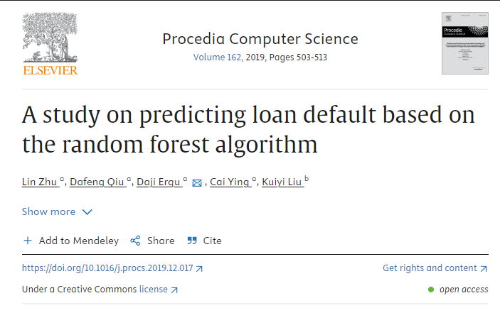

Slide 5

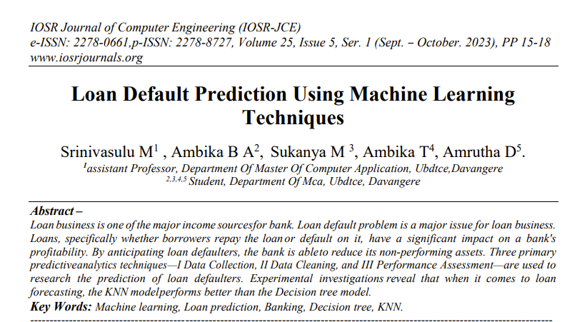

Slide 6
Dataset: Lending Club Loan Dataset
LendingClub is a US peer-to-peer lending company, in California. It contains a complete record of all the loans from 2007 to 2015.
This dataset offered a heterogeneous view of the loan data.
It included several critical attributes like loan amount, interest rates, employee title, employment years, loan purpose, and credit history, among others.
Huge Dataset: An extensive 2,260,668 rows x 145 columns.
A subset of these 145 features was obtained from various pre-processing techniques.

Slide 7
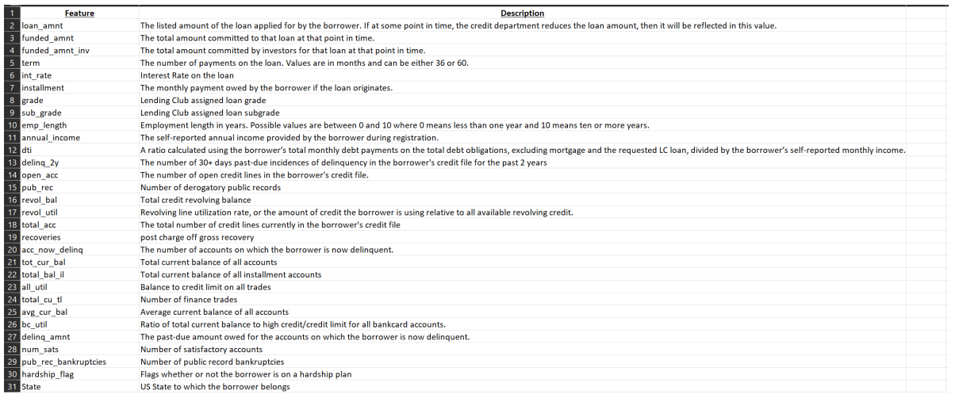
Dataset: Lending Club Loan Dataset
Feature Details

Slide 8
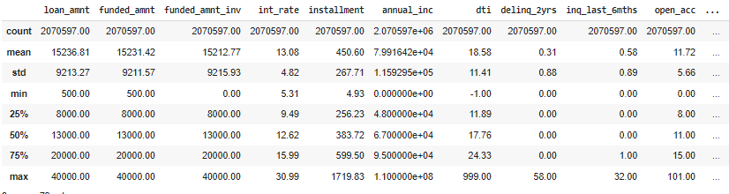
Data Visualization
Dataset Description:-
Dimensions: 2,260,668 rows x 145 columns
2 primary datatypes: float (representing numerical values) & object (representing categorical values).
A statistical analysis of all variables by calculating mean, median, mode, value counts, and percentile values across all variables helped us develop a foundational understanding of the dataset.

Slide 9
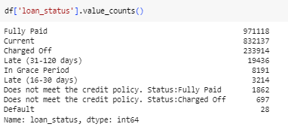
Data Visualization
Target Variable: loan_status
Given our objective of classifying loans as either ’good’ or ’bad,’ we scrutinized the distribution of loan statuses. Rows with a ’current’ loan status were excluded from consideration due to their inconclusive nature.

Slide 10
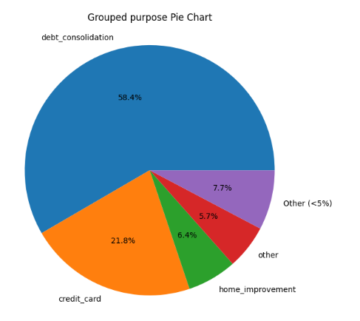
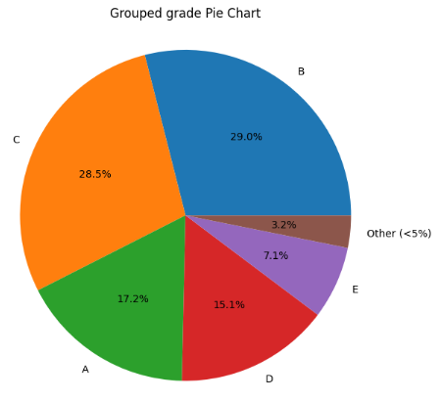
Data Visualization
Categorical Feature Insights
To gain insights into categorical features, we employed pie charts to visualize their distributions.
Distribution of Loan Purpose Distribution of Employee Grade

Slide 11
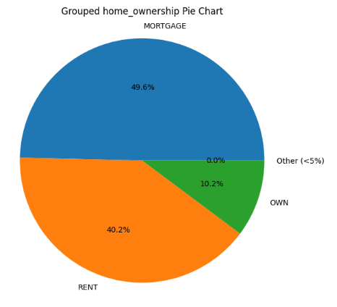
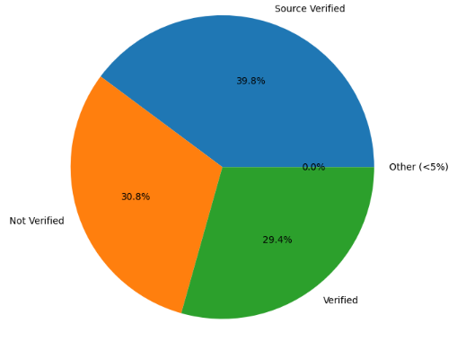
Data Visualization
Distributions of Verification Distribution of Home Ownership Status

Slide 12
Data Visualization
Feature and Target Variable Relationship
Helped in identifying features that could potentially enhance our modeling efforts.
Some common observations were:-
Loan amounts predominantly fell within the range of $5,000 to $25,000.
Loans with lower interest rates showed higher repayment rates, while those with interest rates exceeding 20% experienced a higher default rate.
Common loan purposes encompassed debt consolidation, credit card refinancing, and home improvement.
This exploratory analysis laid the foundation for our modeling efforts, offering invaluable insights into the dataset’s key features influencing loan outcomes.

Slide 13
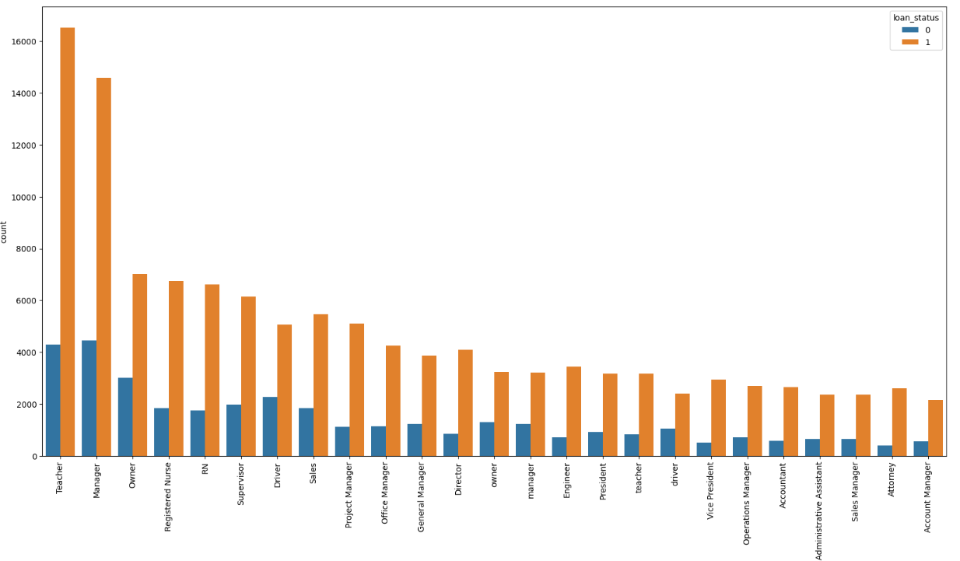
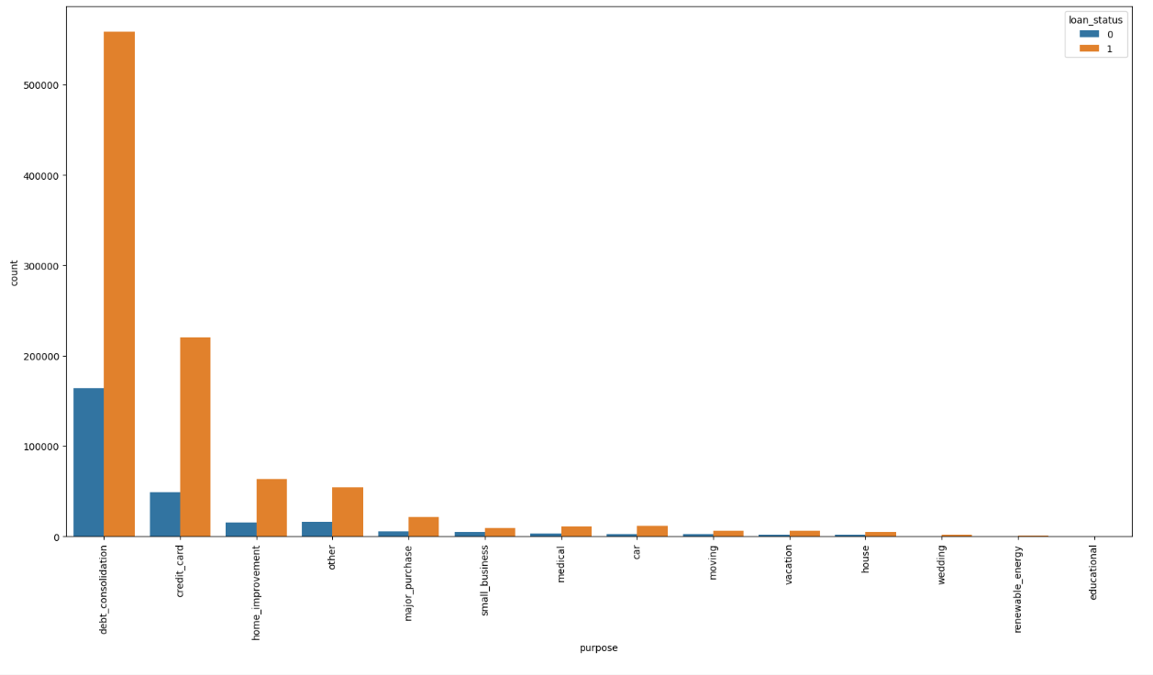
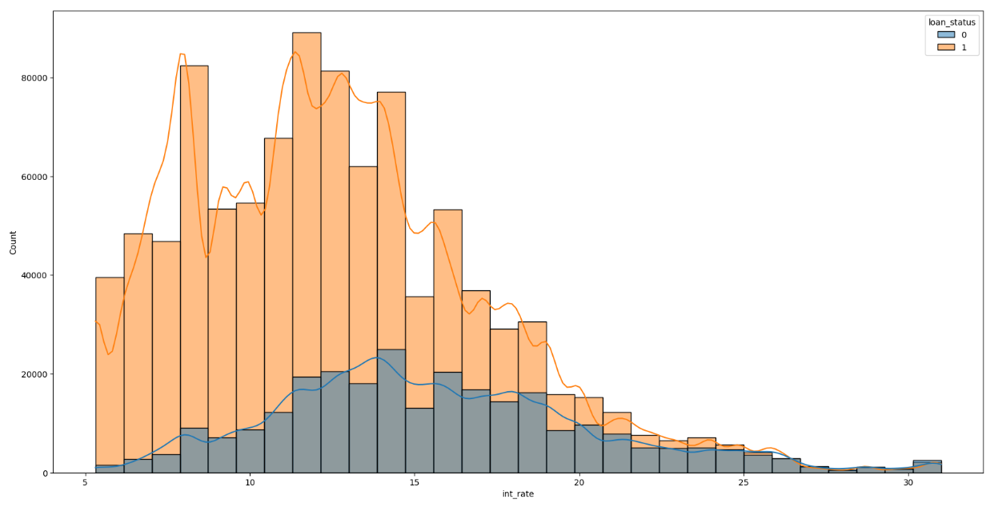
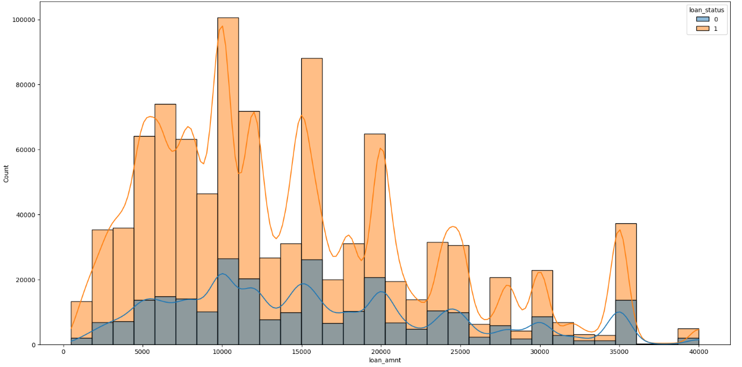
Employee Title
Loan Purpose
Interest Rates
Loan Amount

Slide 14
Data Preprocessing
Handling Missing Data
Identification & Removal
All samples tested for missing target variables.
Dropped columns having more than 50 percent missing values.
Overall, missing values formed 9.87 percent of total values.
All samples found missing one or more categorical data were dropped.
Imputation
Common imputation strategies are replacing by mean, median, mode. To ensure if mean would be a good estimate, the distribution of data was studied via qq plots.
‘median’ was chosen as the imputation strategy.
Total missing values post removal and imputation - 0

Slide 15
Data Preprocessing
Data Cleaning
Duplicate Removal
Checked numerical columns for duplication. None found.
Checked categorical columns for duplication. Columns ‘title’ and ‘purpose’ had the same categorical data.
Data under ‘purpose’ was better presented. Hence, ‘title’ was dropped.
Data Relevance
The target variable ‘loan status’ contained several categorical values.
As per the problem statement, only two classes of data were relevant - ‘Charged Off’ and ‘Fully Paid’.
‘Charged Off’ was represented by 1 and ‘Fully Paid’ by 0. Samples related to all other classes were dropped.

Slide 16
Data Preprocessing
Data Transformation
Encoding categorical variables
Categorical variables were converted into numerical representations, using techniques like -
one-hot encoding - term, grade, emp length, etc.
label encoding - : home ownership, verification status, purpose, etc.
manual mapping - debt settlement flag, pymnt plan, hardship flag, etc.
Dropped Features
zip code
title
emp title
others like ’total rec late fee ’, ’open il 12m’, ’open acc 6m’, ’next pymnt d’ etc.

Slide 17
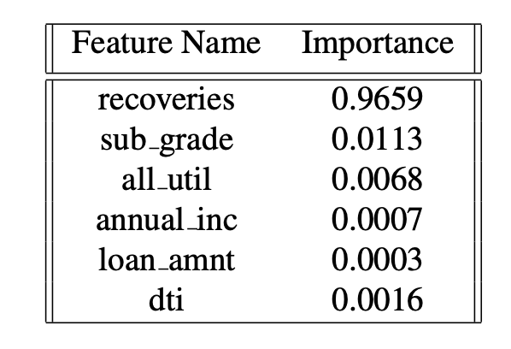
Methodology
After the preprocessing steps, we did a 70-30 train-test split of the data. We standardized the remaining non-encoded columns. We calculated the accuracy, F1 score, precision, and recall after training the different models.
Different ML models used are:
Logistic Regression
Decision Trees
Random Forest
XGBoost
FEATURE IMPORTANCE IN DECISION TREES

Slide 18
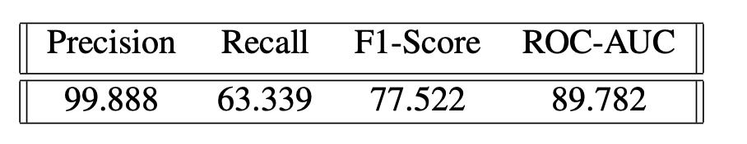
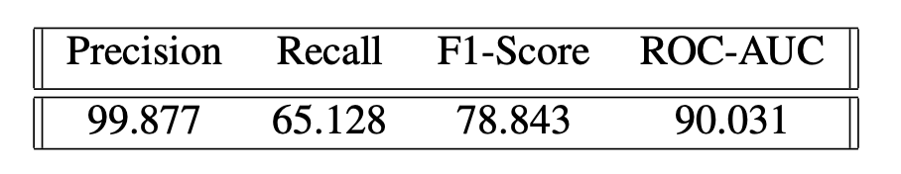
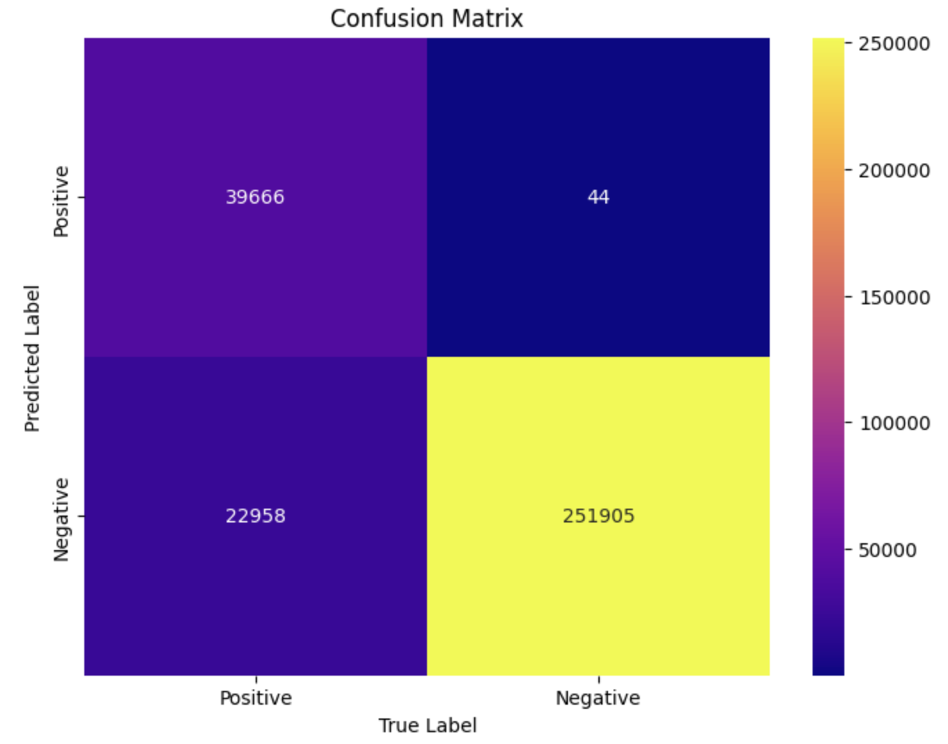
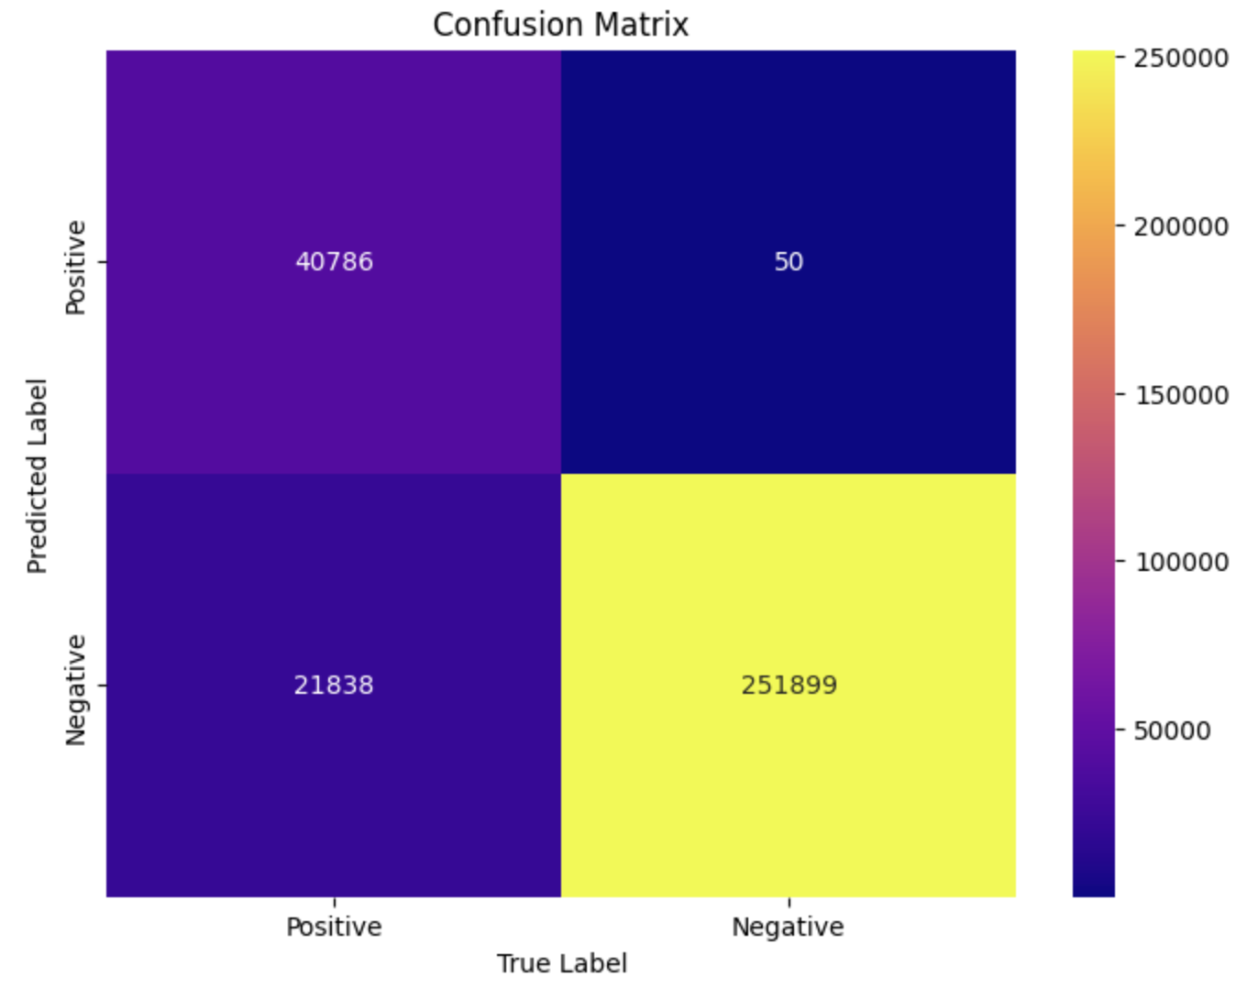
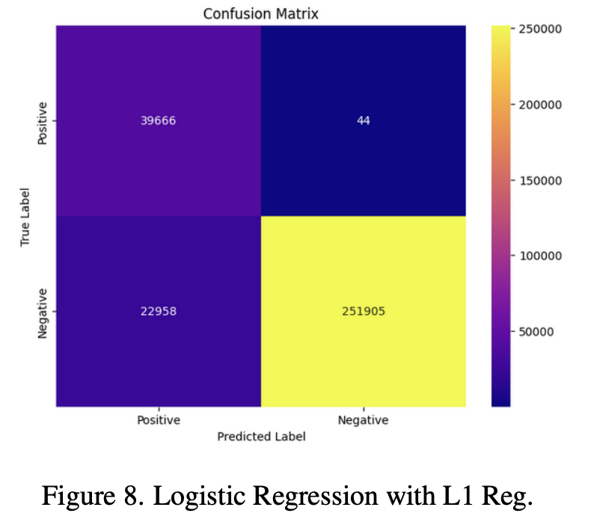
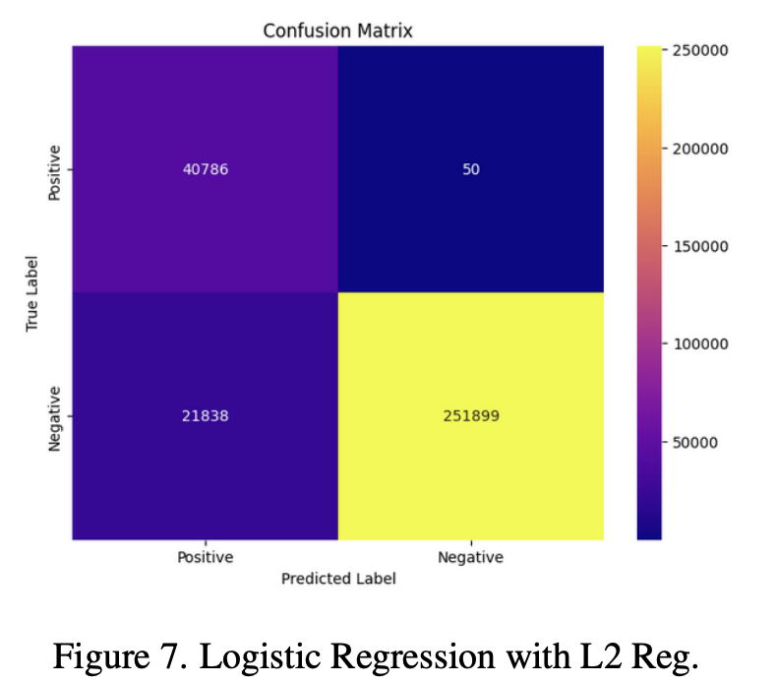
Results & Analysis - Logistic Regression
L1 REGULARIZATION (Acc = 92.6%)
L2 REGULARIZATION (Acc = 93.04%)

Slide 19
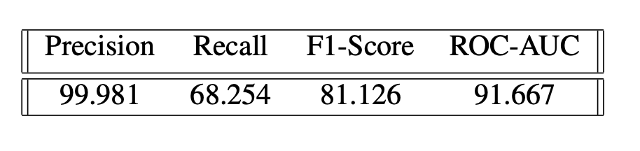
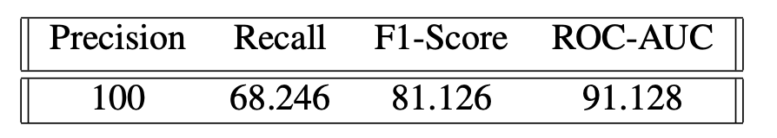
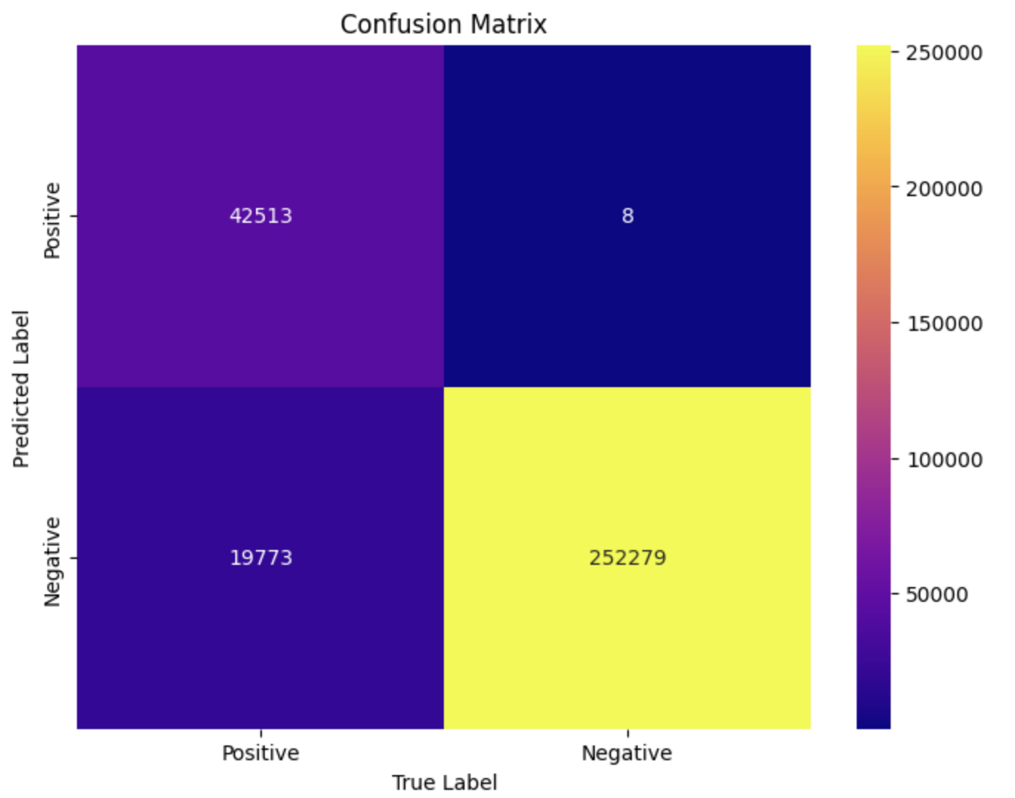

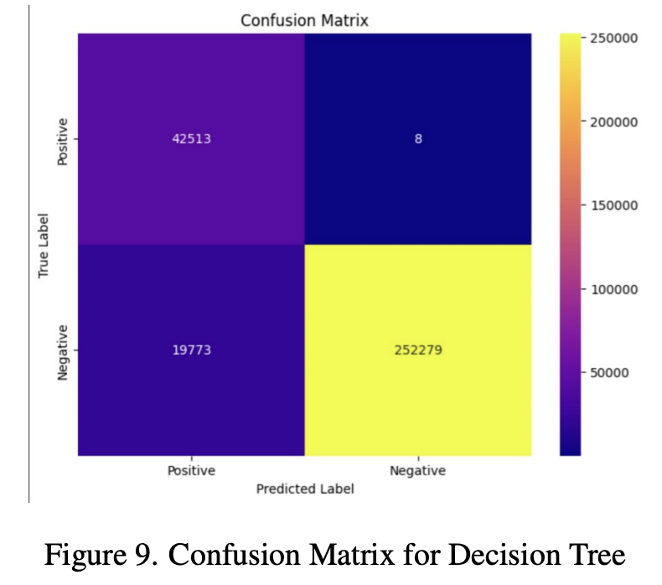
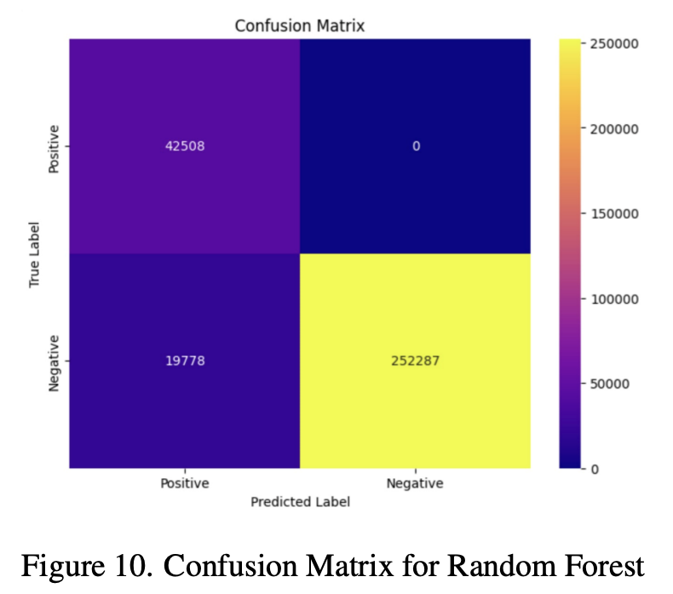
Results & Analysis
DECISION TREE (Acc = 93.8%)
RANDOM FOREST (Acc = 93.7%)

Slide 20
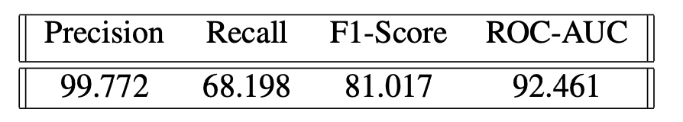

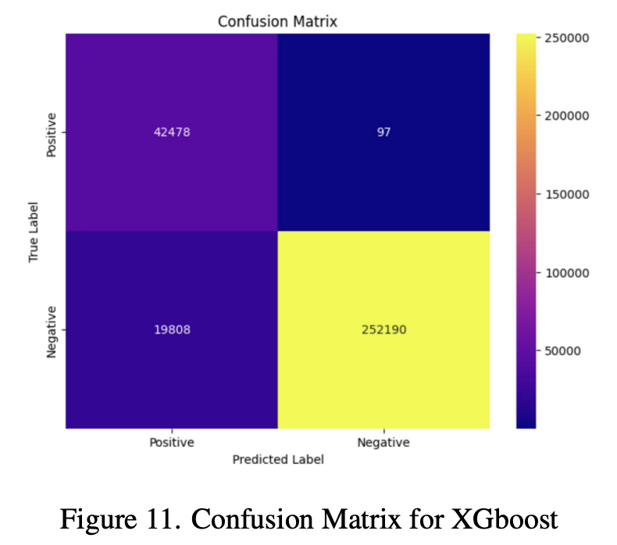
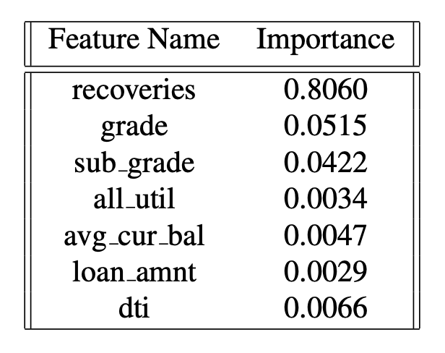
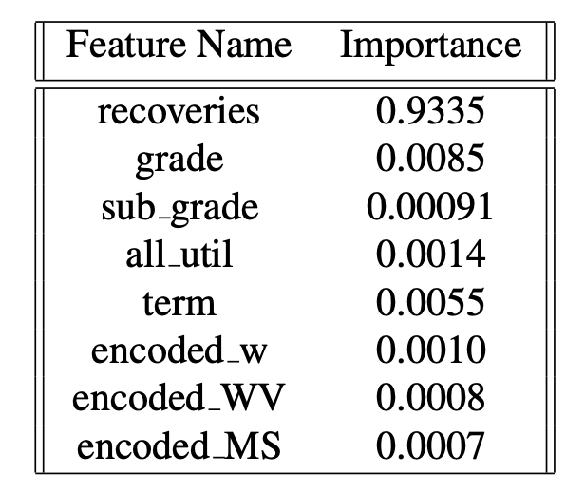
Results & Analysis
XGBOOST (Acc = 93.6%)
FEATURE IMPORTANCE
XGBOOST
RANDOM FOREST

Slide 21
Conclusion
• Best Precision: Random Forest achieved the highest precision, making it the safest choice when minimizing false positives is crucial, ensuring minimal unnecessary loan rejections.
• Best Recall: Decision Tree and XGBoost had the highest recall, indicating their effectiveness in capturing most default cases. They are suitable when identifying potential loan defaults accurately is a priority.
• Best Overall Performance: XGBoost demonstrated the highest ROC-AUC score, showcasing the best overall discrimination ability. It is the top choice for achieving a balanced and robust performance in loan default prediction.

Slide 22
Future Timeline
We will try other boosting methods like AdaBoost and LightGBM Boost and try hyperparameter tuning for these and XGboost.
Next, we will evaluate the performance of Support Vector Classification and ANNs on this task.
We will also try incorporating various fairness measures such as demographic parity, equalized odds and equalized opportunity in the classification process and test models on the same.

Slide 23
Quick RECAP
Problem Statement : Predicting Loan Defaulting using Machine Learning Techniques
Dataset : Lending Club Loan Dataset
Models Used(till now) :
Logistic Regression
Decision Trees
Random Forest
XGBoost
Results :
Best Precision - Random Forest
Best Recall - Decision Trees & XGBoost
Best Overall Performance - XGBoost

Slide 24
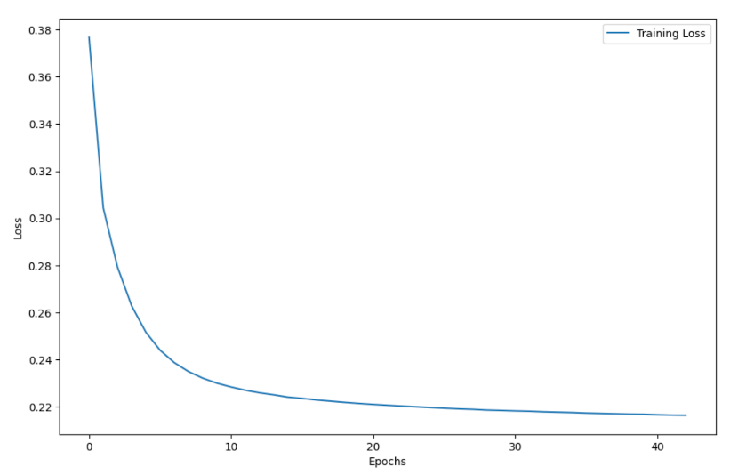

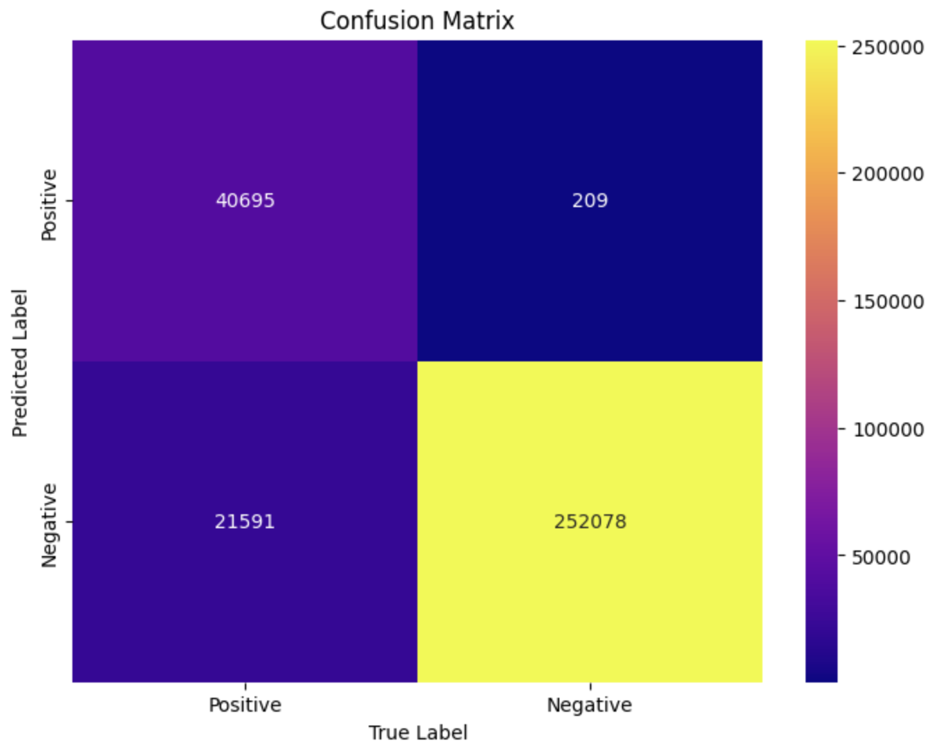
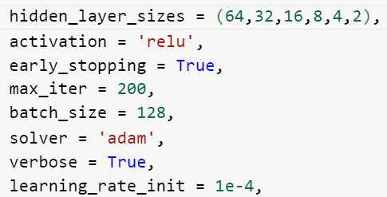
Results & Analysis - MLP
MLP (Acc = 92.68%)
Fig: Training Loss v/s Epochs
Fig: Confusion matrix for MLP
Best Parameters

Slide 25

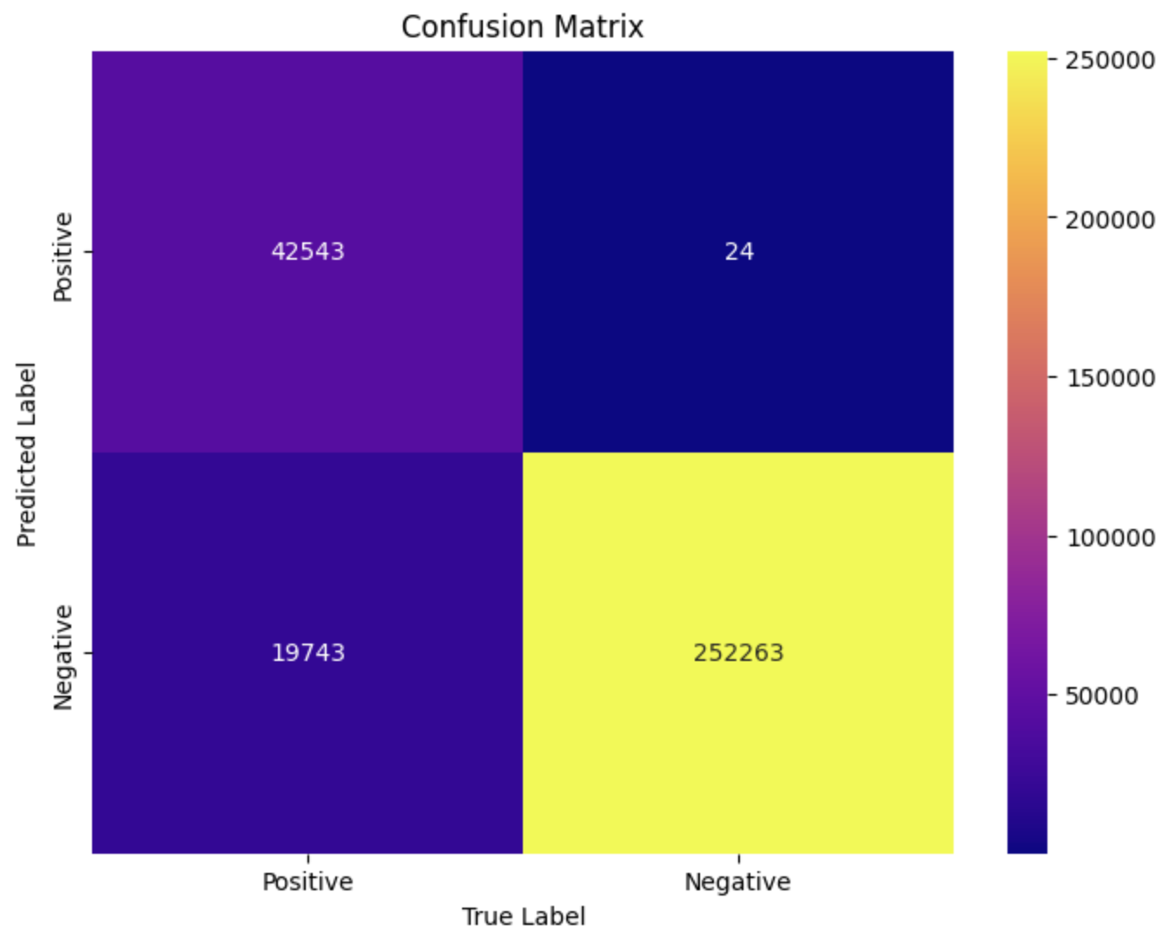
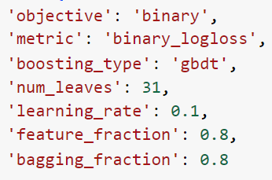
Results & Analysis - LightGBM
LightGBM (Acc = 93.72%)
Fig: Confusion matrix for LightGBM
Best Parameters

Slide 26
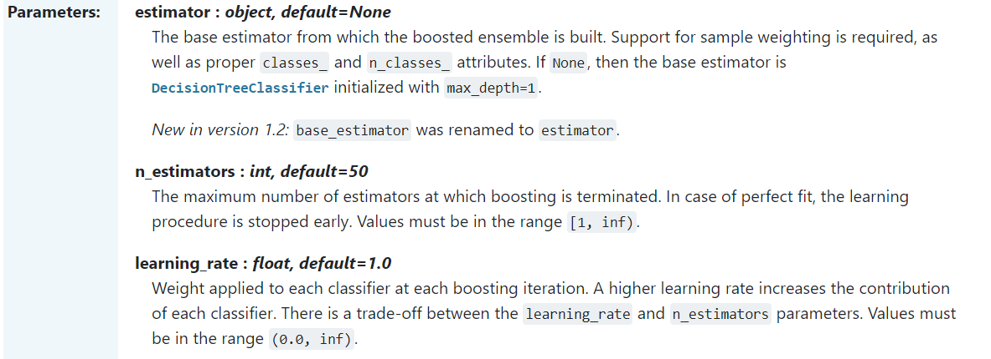
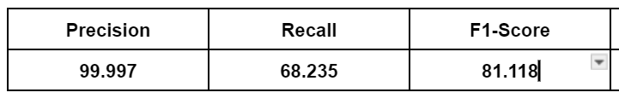
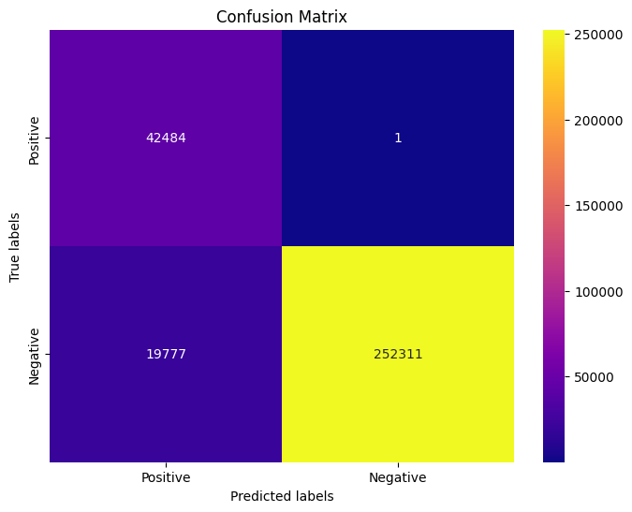
Results & Analysis - AdaBoost
AdaBoost (Acc = 93.71%)
base_estimator = DecisionTreeClassifier(max_depth=8, min_samples_leaf=125, criterion = 'gini', max_leaf_nodes=249)
adaboost_model = AdaBoostClassifier(estimator = base_estimator, n_estimators=15, learning_rate = 0.1, random_state=42)
Fig: Confusion matrix for AdaBoost

Slide 27
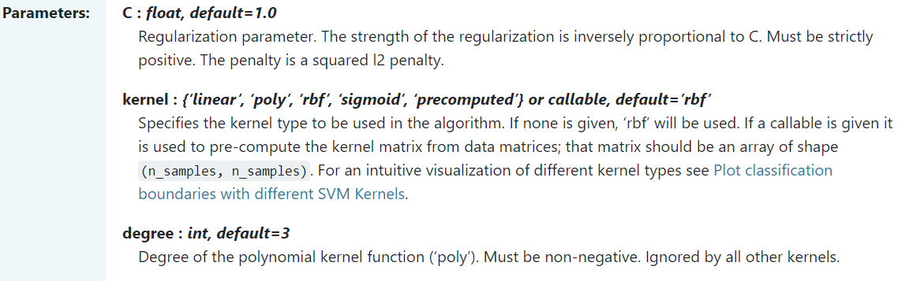
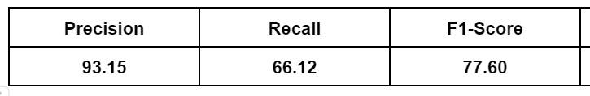

Results & Analysis - SVM
SVM (Acc = 92.33%)
Features = ['recoveries', 'int_rate', 'dti', 'sub_grade', 'avg_cur_bal', 'tot_cur_bal', 'revol_bal', 'bc_util', 'revol_util', 'annual_inc', 'installment', 'total_acc', 'grade', 'funded_amnt_inv', 'funded_amnt', 'total_bal_il', 'loan_amnt', 'all_util', 'open_acc', 'num_sats']
Top 20 features based on RF Gini score
Fig: Confusion matrix for SVM

Slide 28
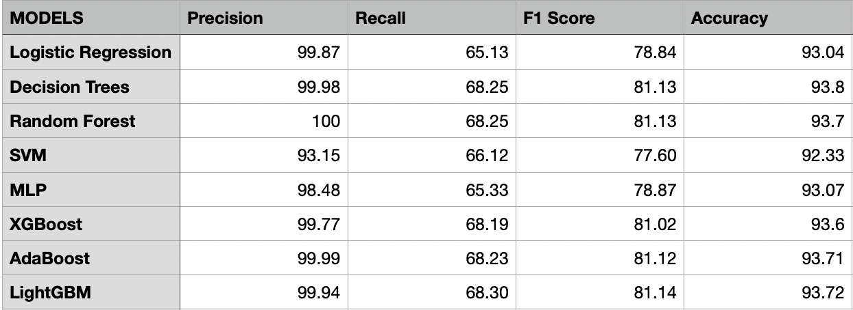
Summary

Slide 29
Conclusion
(98.89%) Very high precision means that when the model predicts a loan default, it is likely to be correct. However, the recall (67.22%) is relatively lower, indicating that the model may miss some actual loan defaults.
High overall accuracy (93.37)
Low False Positives: Predicting a loan default when it doesn't happen can lead to unnecessary actions like denying a loan to a creditworthy individual, potentially harming customer relationships and business growth.
High False Negatives : Missing an actual loan default can have severe financial consequences for the lending institution, including losses and increased default risk.
Precision vs. Recall Trade-off: Depending on the business objectives and the tolerance for false positives and false negatives, you may choose a model that balances precision and recall. For instance, a conservative approach might prioritize precision to avoid making incorrect decisions at the expense of potentially missing some defaults.
In practice, the choice of model depends on the specific risk tolerance, cost considerations, and the business impact of false positives and false negatives in the context of loan default prediction.

Slide 30
Fairness Evaluation
Fairness in ML refers to treating everyone justly without bias, avoiding discrimination based on sensitive features.
Fairness is crucial for responsible AI to prevent biased models from creating discriminatory outcomes & worsening social inequalities.
Thus, evaluating a model goes beyond measuring its accuracy and assessing potential biases in predictions becomes essential.

Slide 31
Fairness Evaluation (Methodology)
We introduced a bias variable for each dataset row, randomly assigned based on a binary probability distribution, but it's not used in training.
For defaulted loans (class 1), bias is set with a 65% chance of being 0; for non-defaulted loans (class 0), it's assigned with a 35% chance of being 0.
After model training, we compute metrics, like Demographic Parity, Equalized Odds etc. focusing on parity between privileged (bias_variable = 1) and non-privileged groups.
Fairness is checked by aiming for metric ratios close to 0 for different groups. Significantly above or below 0 may indicate bias, prompting a closer examination.

Slide 32
Fairness Evaluation
Fairness Metrics
Demographic Parity Difference : A measure in fairness evaluation that assesses the difference in positive outcome rates between different classes, aiming for equal representation.
Equalized Odds Difference : An evaluation metric in fairness assessment that measures the difference in error rates between privileged and unprivileged groups, ensuring equal opportunities for favorable and unfavorable outcomes.

Slide 33
Fairness Evaluation (Results)
Demographic Parity Difference (0.1463): This value indicates the difference in the rate of positive predictions between the two groups (0 and 1 in your bias_variable). Our results suggests a moderate disparity, with one group receiving positive outcomes at a rate approximately 14.63% higher than the other. This can imply a potential bias in how the model treats different groups.
Equalized Odds Difference (0.0182): This metric measures the difference in both false positive rates (FPR) and false negative rates (FNR) between groups. A lower value, like 0.0182, indicates that both FPR and FNR are relatively similar across groups, suggesting that the model is more fair in terms of both false alarms and correctly identified positive cases.
True Positive Rate (TPR): Group 0 has a TPR of 0.6981, and Group 1 has a TPR of 0.6799. These values are relatively close, indicating that both groups have a similar likelihood of being correctly identified as positive by the model.
False Positive Rate (FPR): Group 0 has an FPR of 0.0088, while Group 1 has a significantly lower FPR of 0.0001. This suggests that Group 0 is more likely to experience false alarms compared to Group 1.

Slide 34
Contributions
Ashhar Aziz : Feature Selection, Logistic Regression, XGboost, Fairness Evaluation, Report
Lakshya Goel : Exploratory Data Analysis, Data Visualization, Data Preprocessing, SVM, AdaBoost, Report
Sanmay Sood : Decision Trees, Random Forest, XGboost, MLP, LightGBM, Report
Srimant Mohanty : Exploratory Data Analysis, Data Visualization, Data Preprocessing, Fairness Evaluation, Report

