Slide 1
IOTA EVM NFT-BASED LIFE CYCLE MANAGEMENT
Bridging Physical Manufacturing with Immutable Web3 Digital Twins
Layer 0 Digital Product Passport for Enterprise IIoT Ecosystems
UFG Student Team: Manikant Kumar, Abhijeet Ranjan, Dhruv Maji
Blockchain & IoT Engineering Group · 2026

Slide 2
The Core Problem It Solves
• Fragmented Data Silos: Traditional manufacturing logs are scattered across isolated databases, Excel sheets, and disconnected MES/ERP systems, preventing end-to-end visibility.
• Lack of Trust & Auditability: Quality records, maintenance history, and emissions reports are stored in mutable databases prone to unauthorized editing, loss, or intentional tampering.
• Compliance & Tracking Gaps: Regulators struggle to verify physical component provenance, compliance certifications, and environmental impact (ESG/Carbon metrics) across multi-tiered supply chains.
• Circular Economy Fraud: No secure mechanism exists to prevent retired, fatigued, or uncertified parts from fraudulently re-entering the active assembly pipeline.

Slide 3
The Web3 Solution: Digital Product Passport
• Layer 0 Foundations: Establishes the immutable, decentralized 'source of truth' layer that anchors all higher-level autonomous controls, AI prognosis, and metaverse digital twins.
• On-Chain NFT Identity (ERC-721): Mints a unique blockchain identity token for every component, tracking structural lineage and operational history permanently.
• Decentralized Metadata Storage: Pins heavy telemetry data (sensor logs, certificates, chemical compositions) to IPFS, storing the immutable IPFS Content Identifiers (CIDs) on-chain.
• Role-Based Gated Permissions: Restricts update capabilities to verified keys assigned to specific roles (Foundry, OEM, MRO, Carbon Reporter, Quality Inspector) to ensure data authenticity.

Slide 4
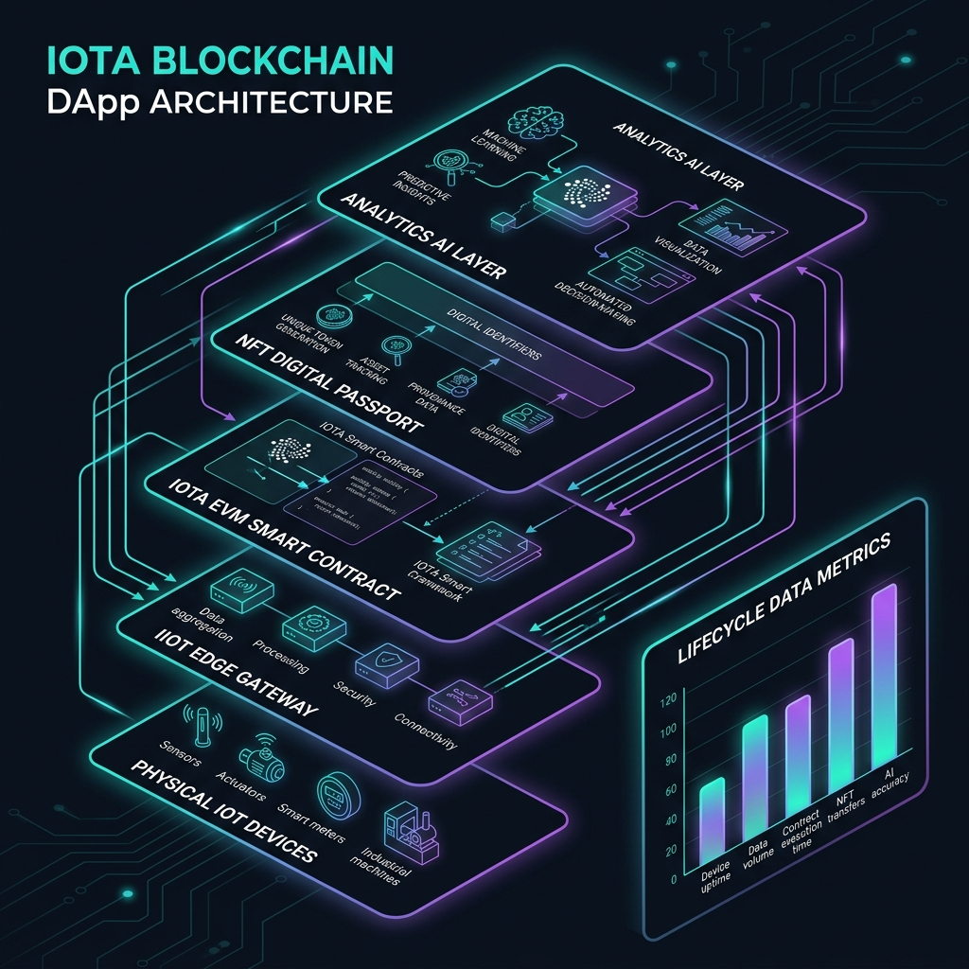
8-Layer Manufacturing Stack Integration
End-to-End Traceability Flow:
• Physical Components & IIoT Sensors: Real-time streaming data from CNC machines, temperature probes, and room sensors.
• Edge Data Acquisition Layer: Streams formatted JSON data summaries to IPFS and calculates cryptographic content hashes.
• IOTA EVM Blockchain Layer: Anchors the IPFS CIDs inside immutable transaction records via smart contracts.
• Digital Twin Validation Loop: Synchronizes the physical asset's state with the Metaverse/Ontology layers prior to triggering autonomous closed-loop actions.

Slide 5
Decoupled Multi-NFT Framework
To resolve EIP-170 code size limitations and separate concerns, the architecture is decoupled into 7 distinct NFT contracts orchestrated by a coordinator portal:
✔ EquipmentNFT: Represents the physical fabrication machinery and production equipment assets.
✔ ManpowerNFT: Credentials worker identities, roles, and mandatory safety/operating skill certifications.
✔ ProcessNFT: Records individual manufacturing steps (minting, machining, assembly) with equipment/operator links.
✔ ProductNFT: Represents the final manufactured item, mapping parent-child structural Bills of Materials.
✔ QualityNFT: Appends inspection reports, deviation flags, and regulatory compliance certificates.
✔ MaintenanceNFT: Logs MRO (Maintenance, Repair, Overhaul) repair records and technician signatures.
✔ BusinessNFT: Manages enterprise custody changes, sales, commercial contracts, and ownership transfers.

Slide 6
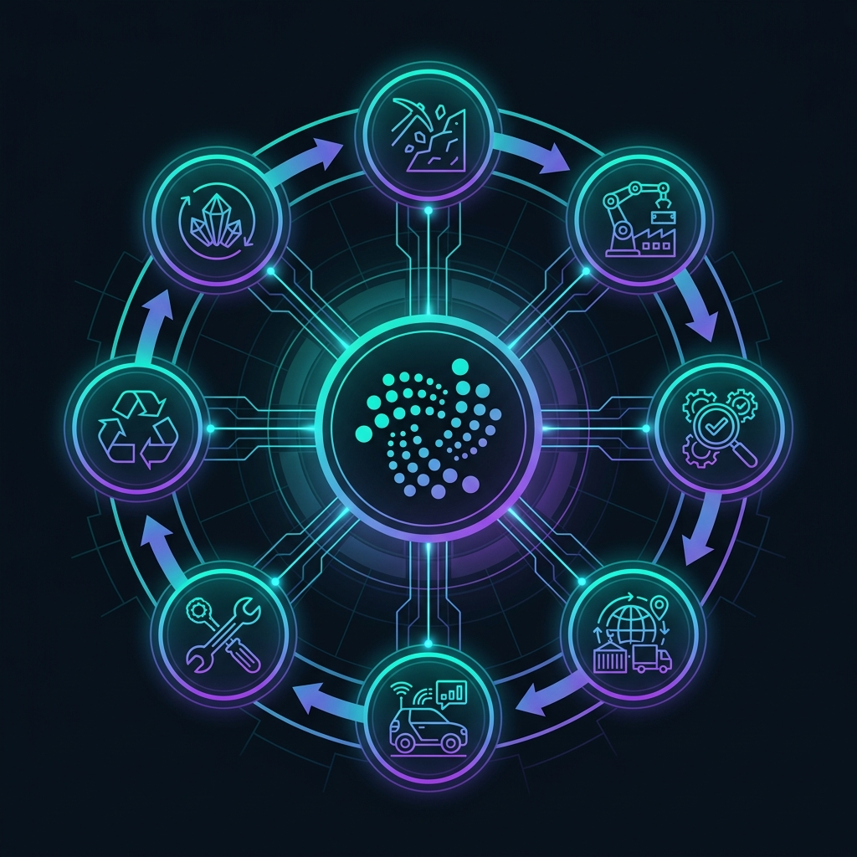
7-Stage Lifecycle State Machine
Rigorous State Transition Rules:
• Irreversible Sequential Path: Assets advance sequentially: Raw Material → Manufacturing → QA → Supply Chain → In Service → Maintenance → End of Life.
• Cryptographic Metadata Gating: Update permissions shift dynamically. E.g., only certified MRO keys can push maintenance logs during the In-Service stage.
• Permanent End-of-Life Freeze: Transitioning to stage 6 (End of Life) permanently freezes the NFT metadata. No further transfers, updates, or modifications are allowed.

Slide 7
Sustainability: Carbon & Emissions Auditing
• Lifecycle Carbon Ledger: Supports recording CarbonData records for each asset stage, registering environmental impact metrics directly on the IOTA ledger.
• Key Tracked Emissions Parameters: Logs energy usage (kWh), carbon dioxide emissions (kg CO2 weight), carbon score (1-100 rating), and notarized metadata hash links.
• Supply Chain Carbon Aggregation: Standardized JSON schema enables supply chain platforms to recursively sum emissions profiles from child components to parent assemblies.
• Audit-Ready ESG Compliance: Provides an unalterable audit trail for global carbon-border taxes (CBAM), scope-3 emissions reporting, and green certifications.

Slide 8
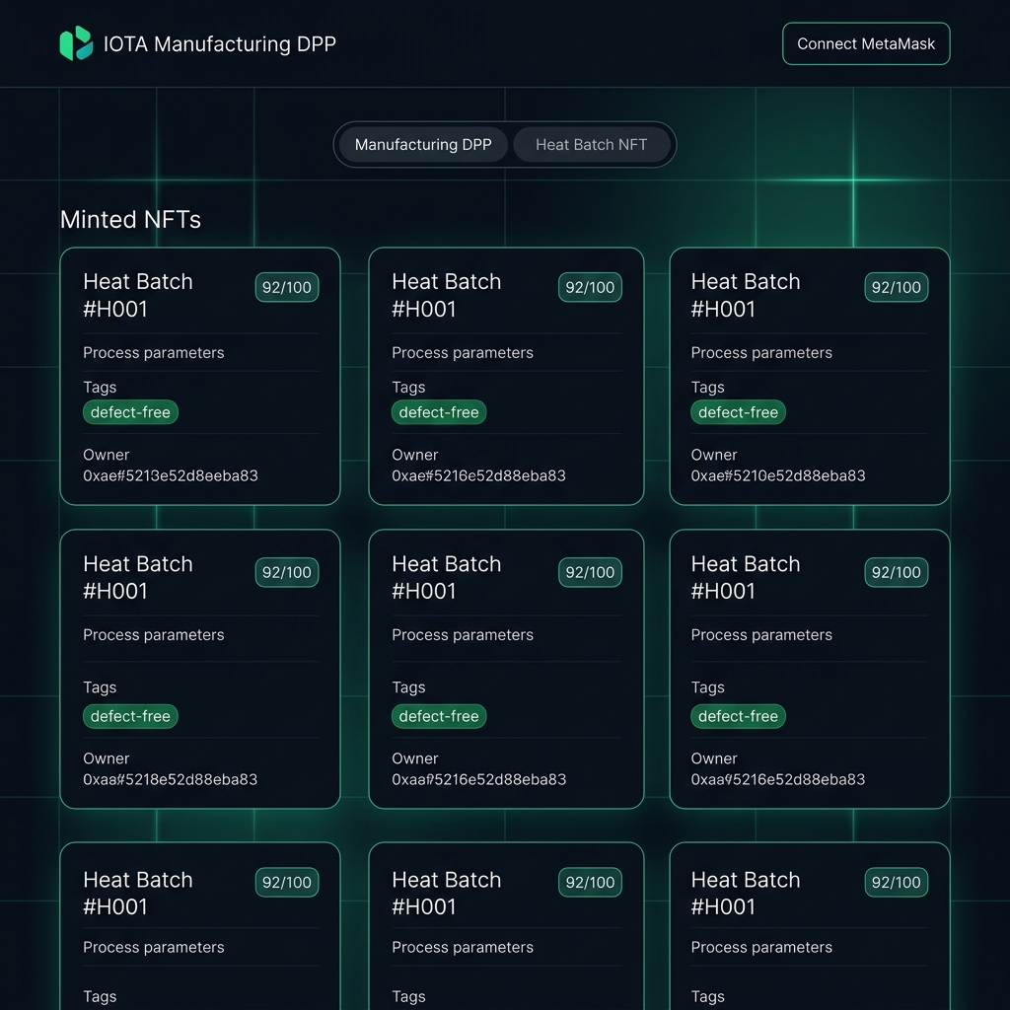
Unified Portal Frontend Dashboard
Key Interactive Portal Features:
• Dynamic System Switcher: Instantly toggles the layout, tabs, and form logic between the Manufacturing DPP and Heat Batch NFT subsystems.
• Real-time History lookup: Resolves full NFT details, stage badges, carbon score, parent-child links, and interactive lifecycle timeline dots.
• MetaMask Wallet Integration: Automatically detects networks, handles role loading badges, and handles write transactions seamlessly on the Sepolia network.

Slide 9
Roadmap: The Future of Semantic IIoT
• AI-Driven Prognosis: Feed real-time telemetry from Maintenance NFTs to AI models for automatic predictive maintenance alerts (gated via smart contracts).
• IOTA Oracle Integration: Remove human operators from state-updates by using hardware-anchored secure enclaves and IoT data oracles to push logs directly to the chain.
• Decentralized Worker IDs (DIDs): Secure employee signatures using W3C DID standards, mapping specific operating skills and certifications onto the Manpower NFT.
• Cross-Chain Interoperability: Build bridges to link the IOTA EVM digital twins to corporate supply chain platforms on mainnet Ethereum, Arbitrum, or private Hyperledger networks.

