Slide 1
Indic-English translation

Slide 2
Transliteration
Translation : meaning of a given text is rendered from one language to another.
how are you -> आप कैसे हैं
Transliteration : conversion of text from one script to another
how are you -> हौ आर यू
Notes:
Translation preserves meaning, transliteration preserves sounds/pronunciation.

Slide 3
IndicTrans models
IndicTrans models multilingual NMT models based on transformer architecture
Supports Indic-Indic, Indic-English and English-Indic translation

Slide 4
IndicTrans models
 | IndicTrans | IndicTrans2
Languages supported | 11 | 22 (all scheduled languages)
Training dataset | Samanantar | BPCC (Bharat Parallel Corpus Collection) and BPCC-back translation (BPCC-BT)
Reference | https://ai4bharat.iitm.ac.in/indictrans/ | https://ai4bharat.iitm.ac.in/indic-trans2/

Slide 5
Try out the demo site -
https://models.ai4bharat.org/#/nmt/v2

Slide 6
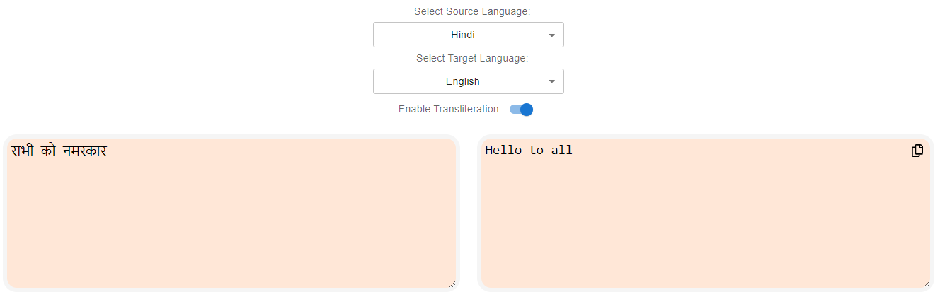
Fig1. Translate (Hindi-English) using IndicTrans2

Slide 7
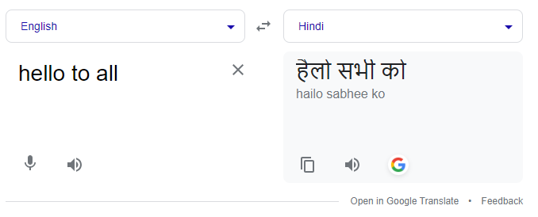
Fig2. Back-translate (English-Hindi) the previous output using Google Translate

Slide 8
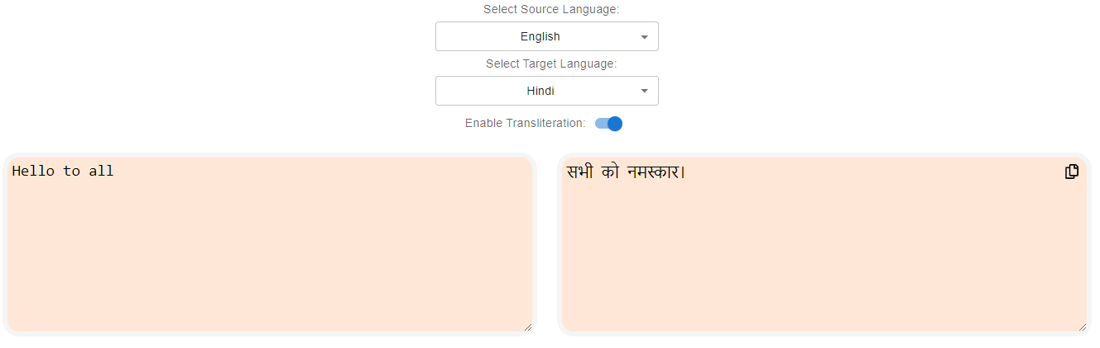
Fig3. Back-translate (English-Hindi) the previous output using IndicTrans2

Slide 9
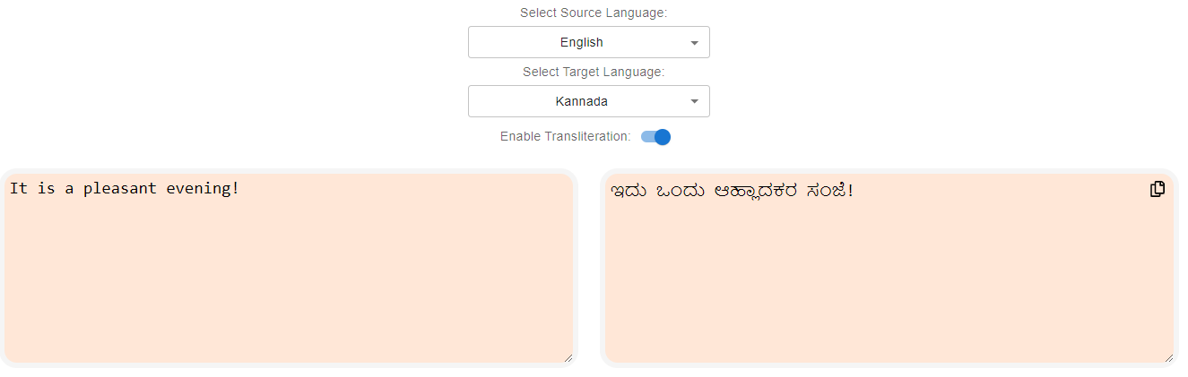
Fig4. Translate (English-Kannada) using IndicTrans2

Slide 10
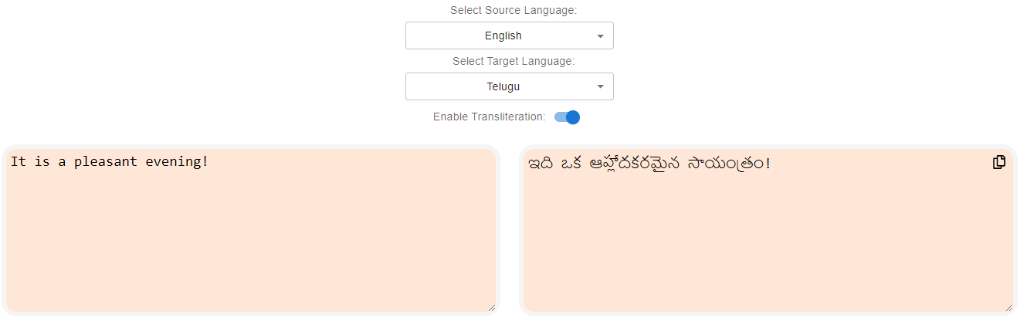
Fig5. Translate (English-Telugu) using IndicTrans2

Slide 11
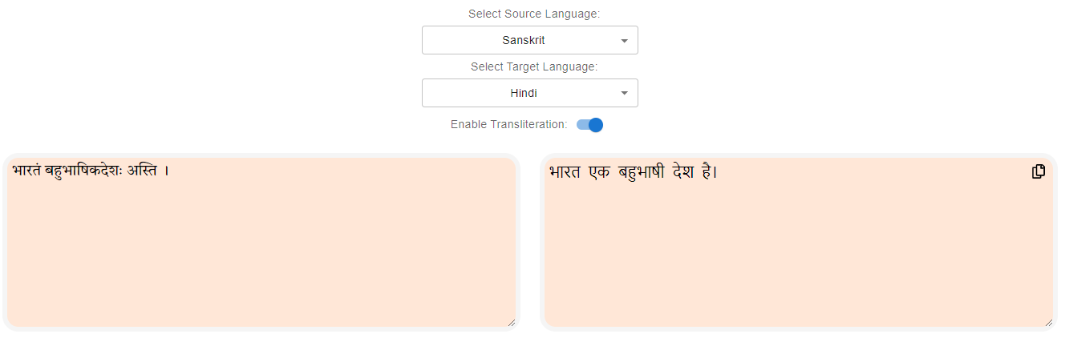
Fig5. Translate (Sanskrit-Hindi) using IndicTrans2

Slide 12
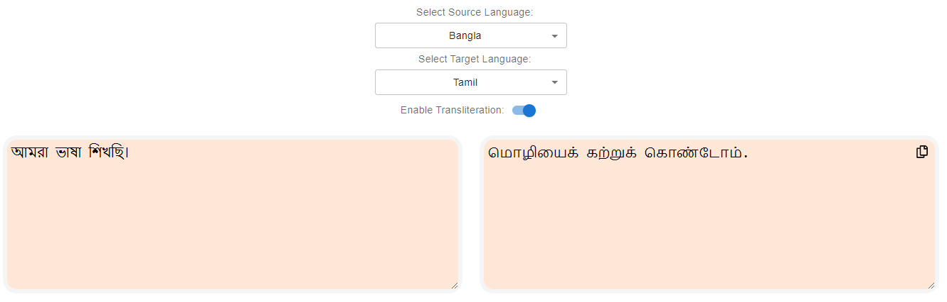
Fig7. Translate (Bangla-Tamil) using IndicTrans2

Slide 13
Shortcomings?
(Transliteration option turned off in the IndicTrans2 demo site)

Slide 14
Wrong language code

Slide 15
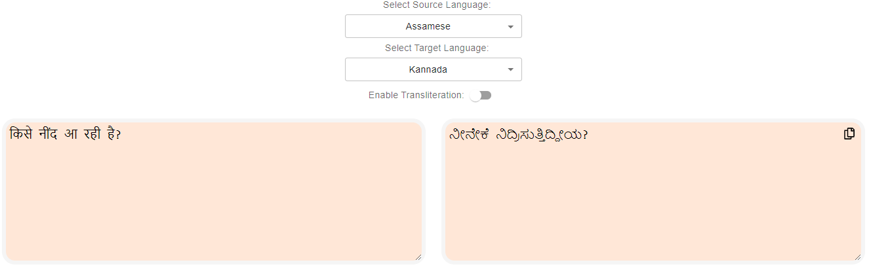
( who is sleepy? )
( why are you sleeping? )
Fig6. Translate (Assamese-Kannada) but input is in Hindi

Slide 16
Different script

Slide 17
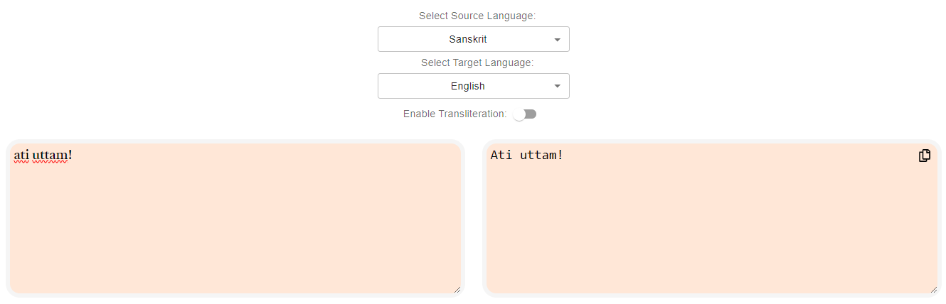
Fig7. Translate (Sanskrit-English) but input is transliterated

Slide 18
Useful links
Samanantar
Bharat Parallel Corpus Collection
indic-trans (transliteration)
DakshinaDataset

Slide 19
Colab notebook-
https://colab.research.google.com/drive/1PHdMfM4zTi7GtU_V3bd3JGySCgovIQ9G?usp=sharing

