Slide 1
Embedding Models
Natural Language Processing - AI829
March 30, 2024

Slide 2
Contents
tf-idf for feature extraction
Word2Vec models: Skip-gram and CBOW
Feature extraction and fine-tuning BERT
Sentence embedding using Universal Sentence Encoder (USE)

Slide 3
TF-IDF
A simple bag of words (BOW) method treats both common words and rare words as the same.
The TF-IDF representation takes into account the importance of each word in a document.
Similar words need not have similar representation in either techniques.

Slide 4
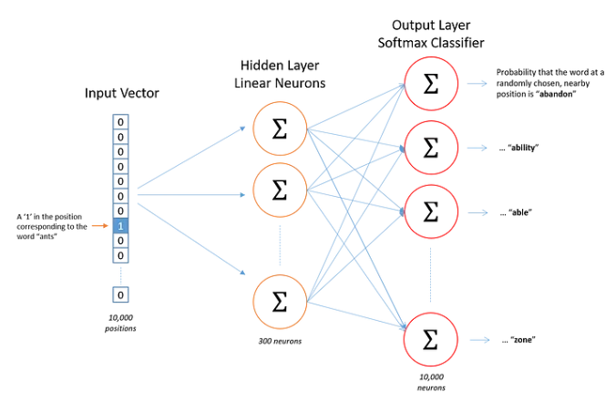
Word2Vec
Word2Vec is a technique for for obtaining vector representations of words
A simple neural network with a single hidden layer
[1]

Slide 5
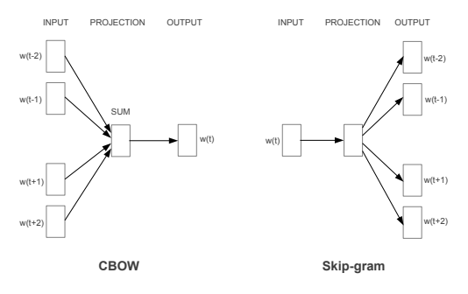
Word2Vec can use either of the two model architectures; Skip-gram or Continuous Bag of Words (CBOW)
Both architectures take a corpus of text as input and produce a vector space with representation for each unique word in the corpus

Slide 6
Continuous Bag Of Words : distributed representations of context (surrounding words) are combined to predict the word in the middle
Skip-gram model : distributed representation of the input word (target word) is used to predict the context
paper : https://arxiv.org/abs/1301.3781

Slide 7
Bidirectional Encoder Representation from Transformers (BERT)
BERT uses the Transformer architecture. It uses only the encoder to produce a language model that is bidirectionally trained.
Input : the embedding tokens of one or more sentences. The first token is always [CLS] and the sentences are separated using [SEP] token.
Output : an embedding (hidden state) for each token
BERT can be used for both extracting embeddings and for fine-tuning for a specific downstream task.

Slide 8
BERT used two training strategies;
Masked Language Modeling (MLM); 15% of the words (token) in an input are replaced with the [MASK] token and BERT has to try to figure out the masked word.
Next Sentence Prediction (NSP); two sentences are given in input to BERT separated by a [SEP] token. BERT learns to predict whether the second sentence is semantically following the first one.
paper : https://arxiv.org/abs/1810.04805

Slide 9
Universal Sentence Encoder (USE)
A basic method for obtaining sentence embeddings is to calculate embeddings of individual words in the sentence and use their average as the sentence’s representation
In USE, an encoder provides a 512-dimension (fixed size) embedding for any given sentence
paper : https://arxiv.org/abs/1803.11175

Slide 10
Colab notebook - https://colab.research.google.com/drive/1N6hqxygZy2cn_SNEvnXQ6SS_8UGDwMJt?usp=drive_link

Slide 11
Visualization tools
Word Embedding Visual Inspector(wevi)
https://ronxin.github.io/wevi/
TF-IDF demo
https://remykarem.github.io/tfidf-demo/
Embedding projector
https://projector.tensorflow.org/

Slide 12
Further reading
McCormick, C. (2016, April 19). Word2Vec Tutorial - The Skip-Gram Model. Retrieved from http://www.mccormickml.com
word2vec by TensorFlow
A hands-on intuitive approach to Deep Learning Methods for Text Data - Word2Vec, GloVe and FastText
Visualizing Data using the Embedding Projector in TensorBoard
USE visually explained

