Slide 1
Sutex Bank College of Computer Application & Science, Amroli
Wedding-planner

Slide 2
Introduction :-
Project Description
Create unforgettable memories for couples by meticulously planning and executing their dream weddings.
As a wedding planner, you'll coordinate every detail, from venue selection and decor to catering and entertainment, ensuring a seamless and magical celebration.
Wedding Planner management system have contained two panels:
Admin panel
User panel

Slide 3
Admin panel :-
It is mandatory to login with an Admin account.
Admin can update his / her profile.
Admin can add, update or delete Venue , Place and Book.
Add new admin also.
The login admin can see all users of the system including admins, Users.
Admin can add Venue for all users only. Admin can add Event Places for all users only.
Admin can update Event Places for all users only.
Admin Can Delete Event Places for all users only.
Admin Can Delete Booking Orders for all users only.

Slide 4
User panel :-
It is mandatory to login with a Users account.
Users can book Venue.
Users can Add Enquiry.
Users can see Blog.
or new Users registration must be contact admin

Slide 5
Project profile :-
 | Wedding Planner Management System
Project title: | Wedding Planner Management System
Frontend: | HTML5, CSS3, JavaScript (ECMA 6)
Backend: | PHP and MySQL
Browser: | Chrome
Platform: | vs code, xampp
Documentation tool: | MS Word
Internal Guide: | Sanskruti Ramani
Submitted to: | Sanskruti Ramani

Slide 6
Objectives :-
Collecting information for system (Requirement Gathering and Analysis).
Preparing the design of the system through information.
Creating table definition and implementation.
Integration of Front-end and Back-end.
Custom Functions & Validations.
Testing.
Debugging and code optimization.

Slide 7
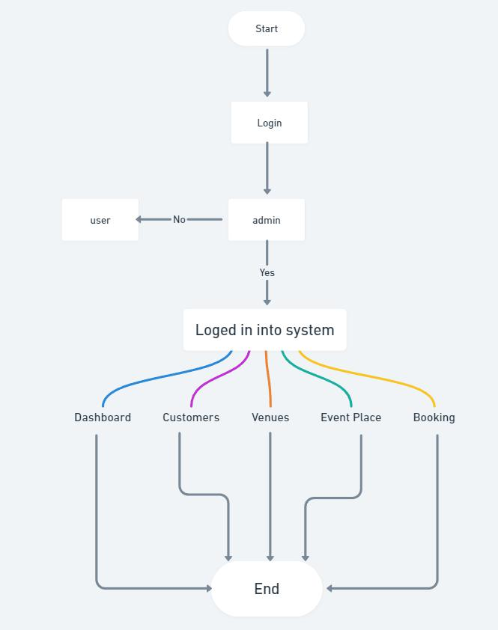
System Flow Diagram :- Admin Process Flow Diagram

Slide 8
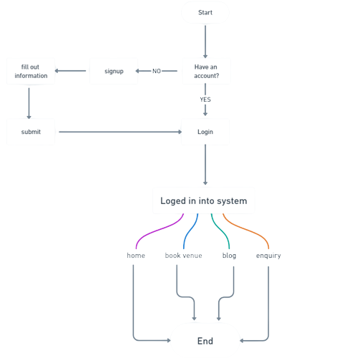
User Process Flow Diagram:

Slide 9
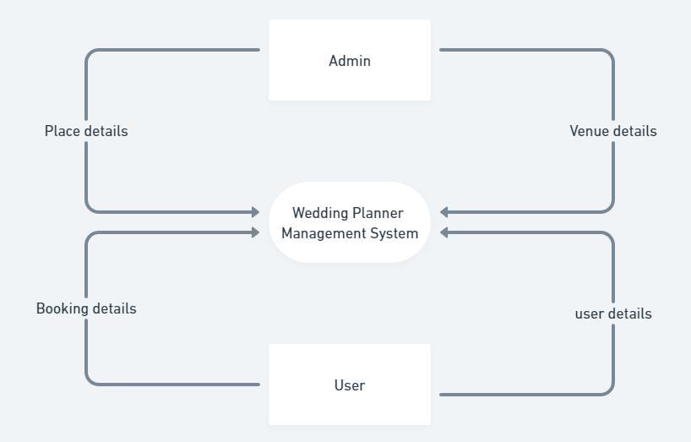
DFD/ UML Diagram :- 0 Level Diagram (Context Diagram):

Slide 10
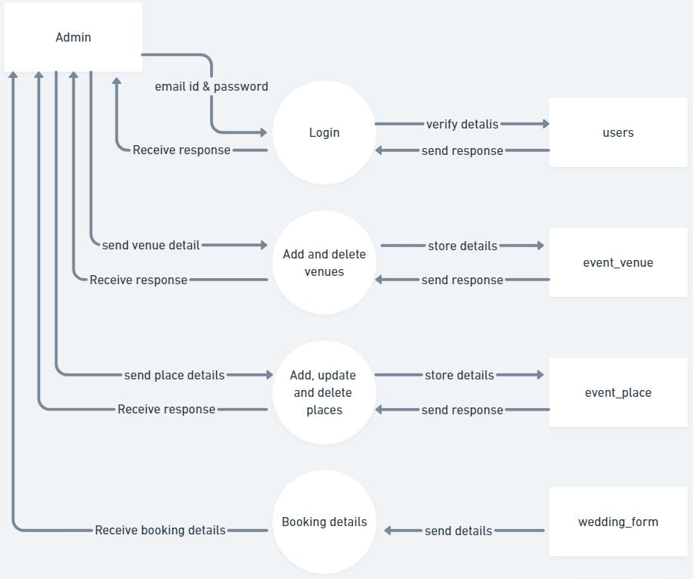
1st Level Admin Diagram:

Slide 11
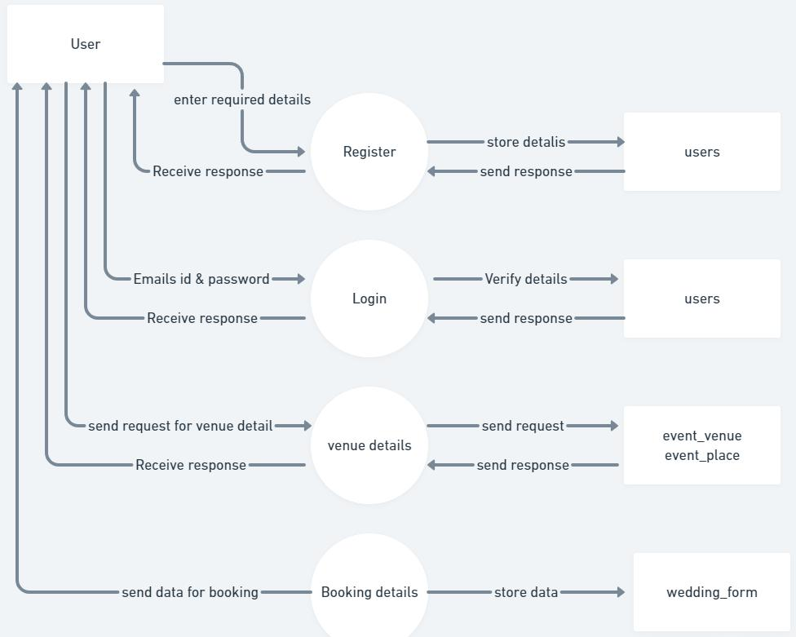
1st Level User Diagram :-

Slide 12
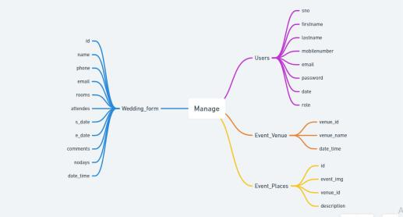
ER Diagram :-

Slide 13
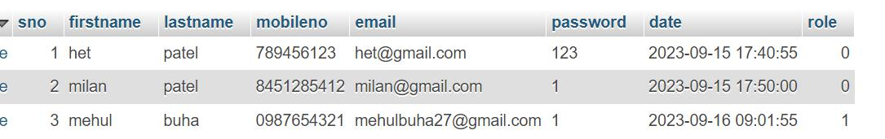
Users Table :-

Slide 14
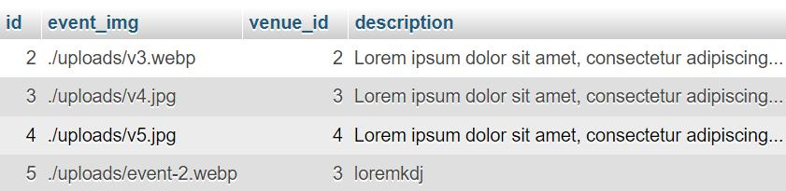
Event_Place Table :-

Slide 15
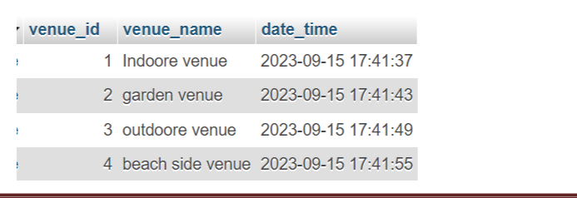
Event_Venue Table :-

Slide 16
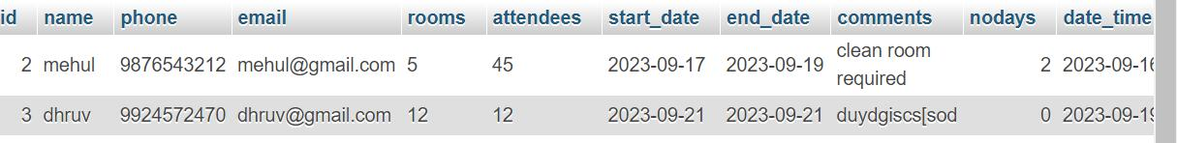
Wedding_Form Table :-

Slide 17
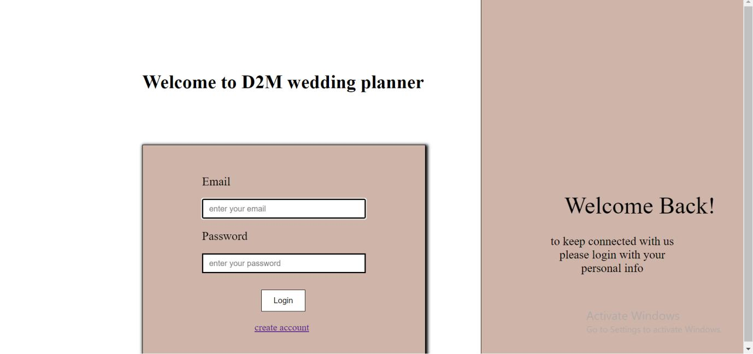
System Design :-
Login Form

Slide 18
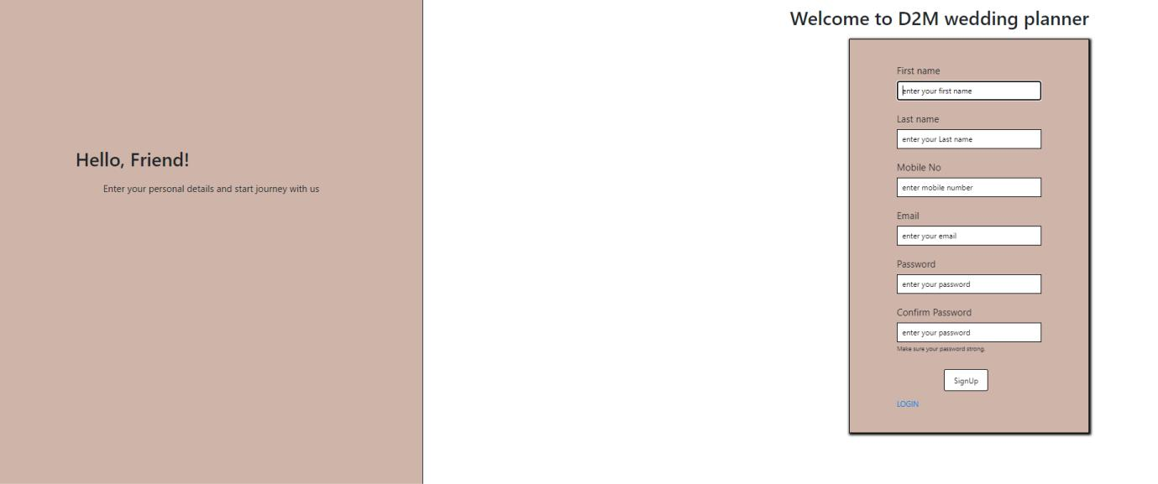
Registration Account

Slide 19
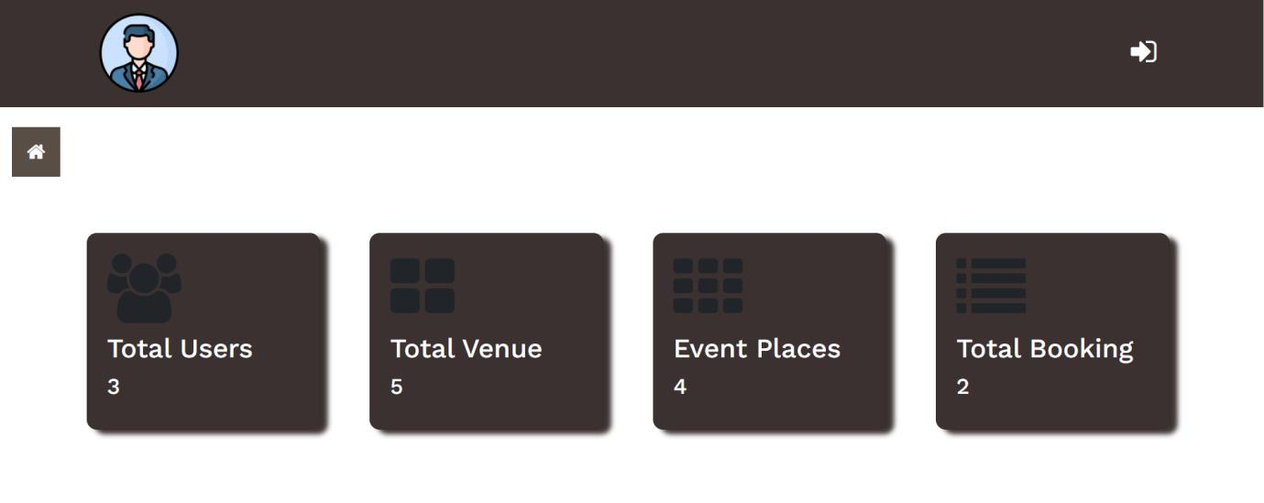
Admin side: Dashboard

Slide 20
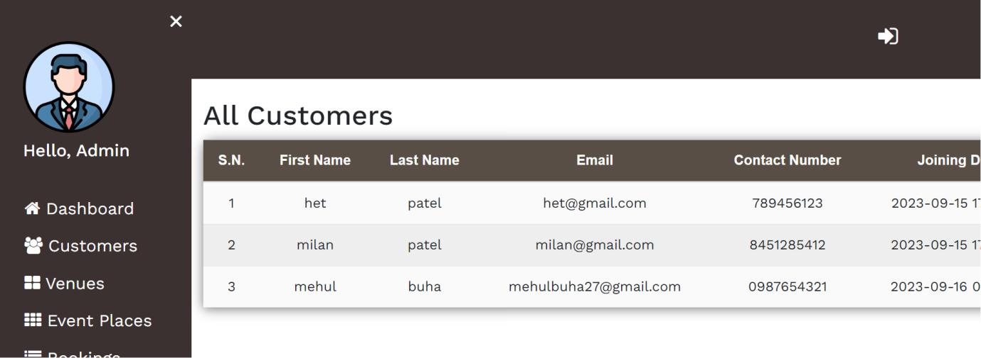
Customers

Slide 21
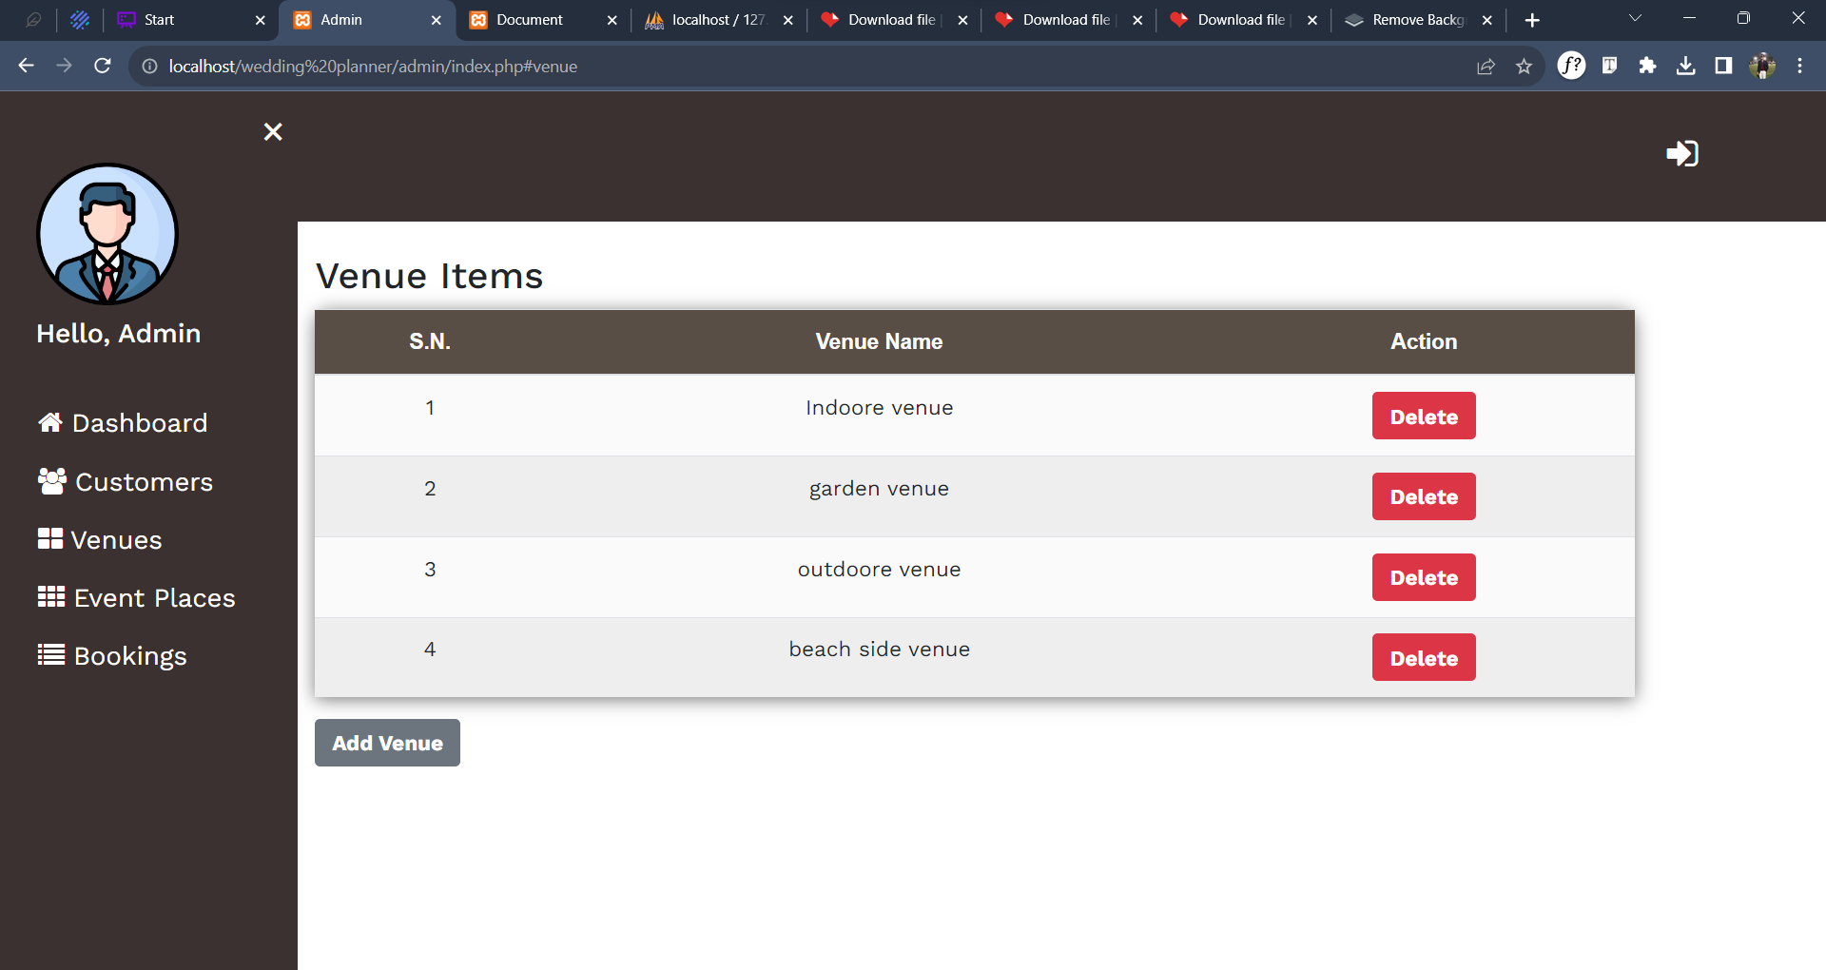
Venues

Slide 22
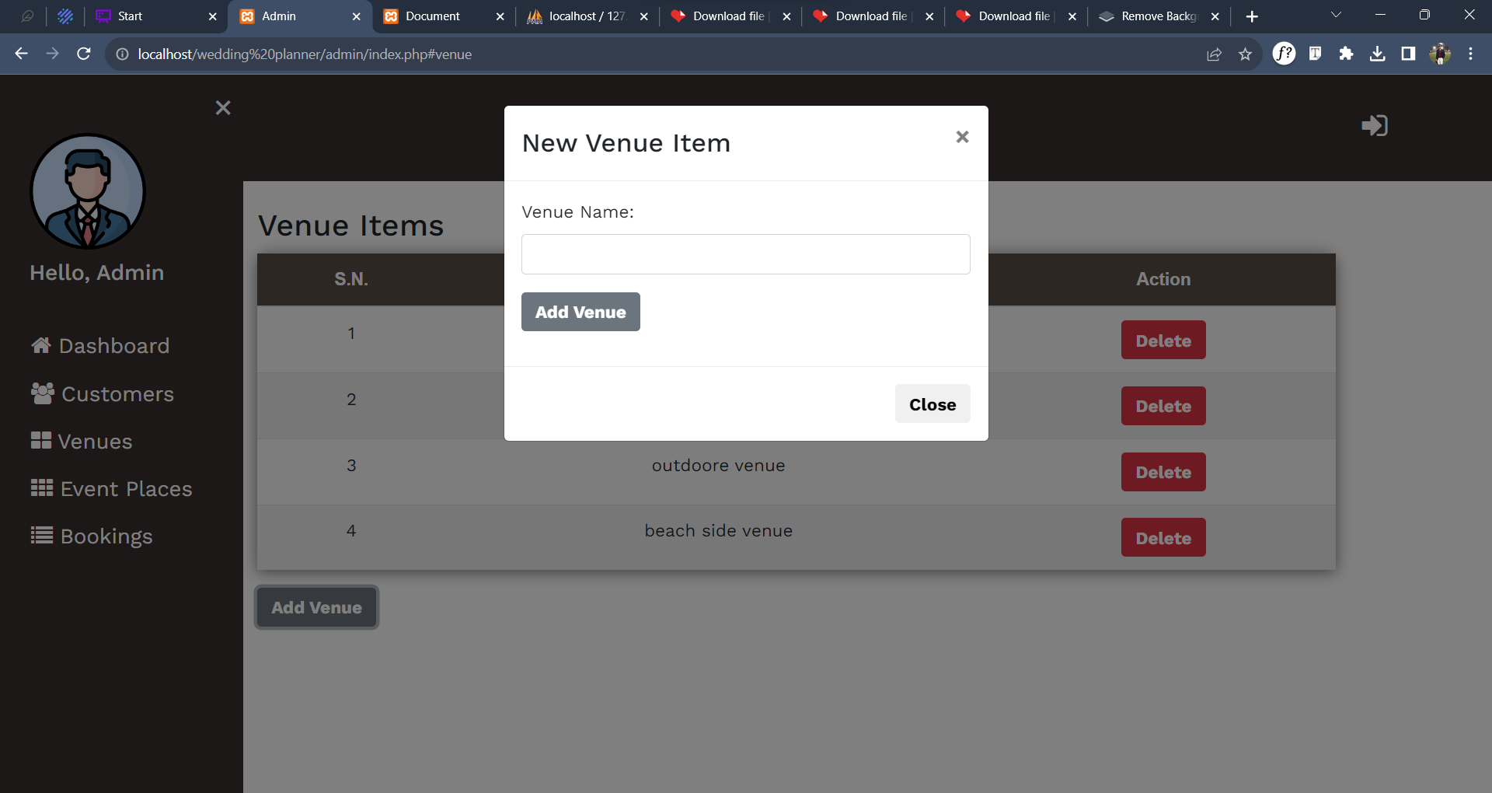

Slide 23
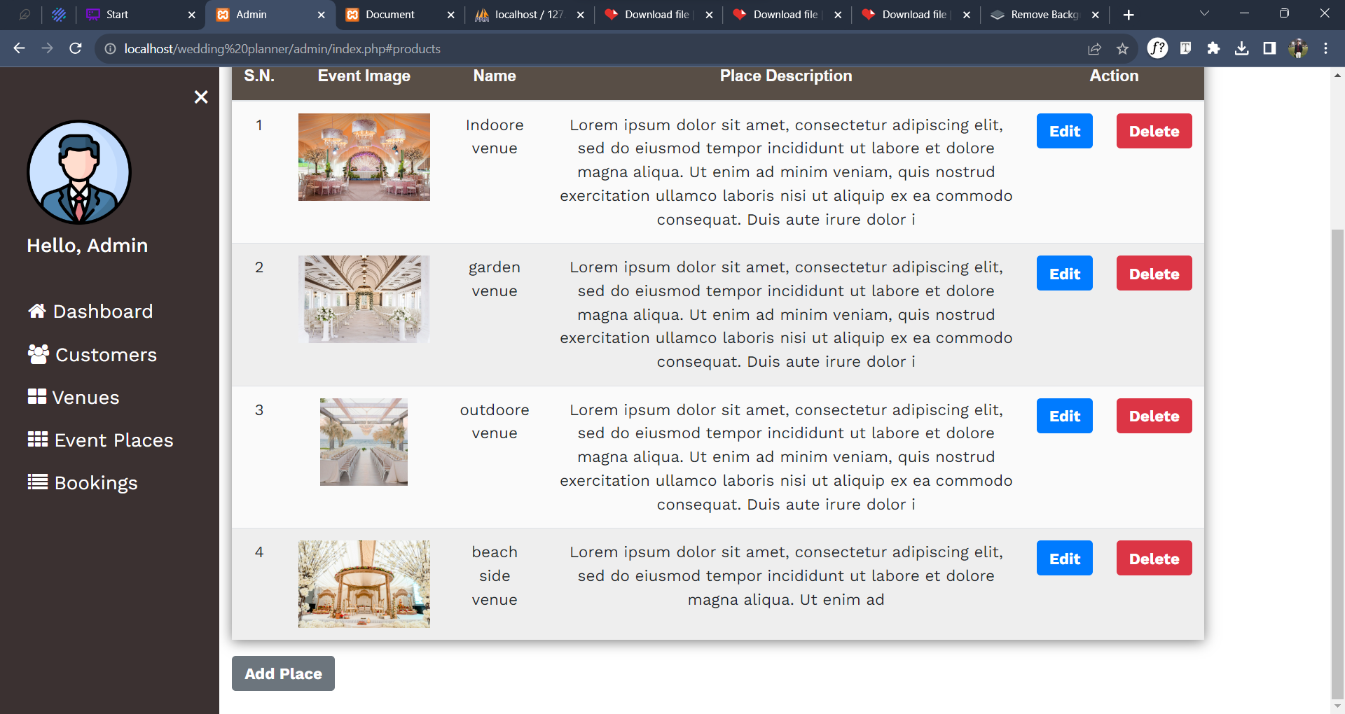
Event Places

Slide 24
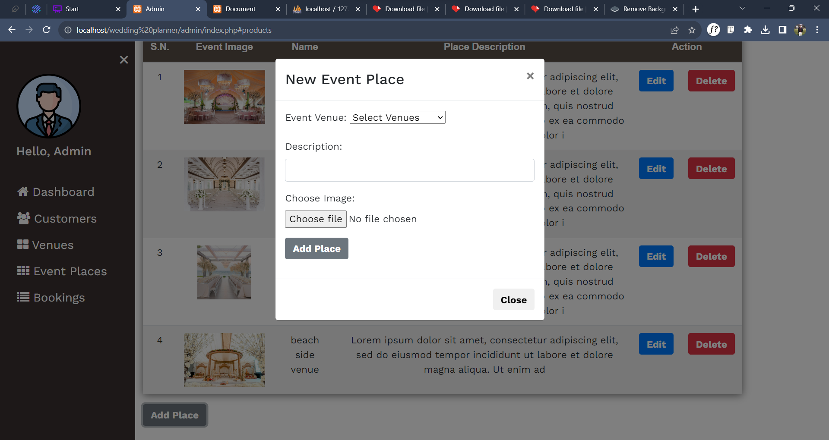

Slide 25
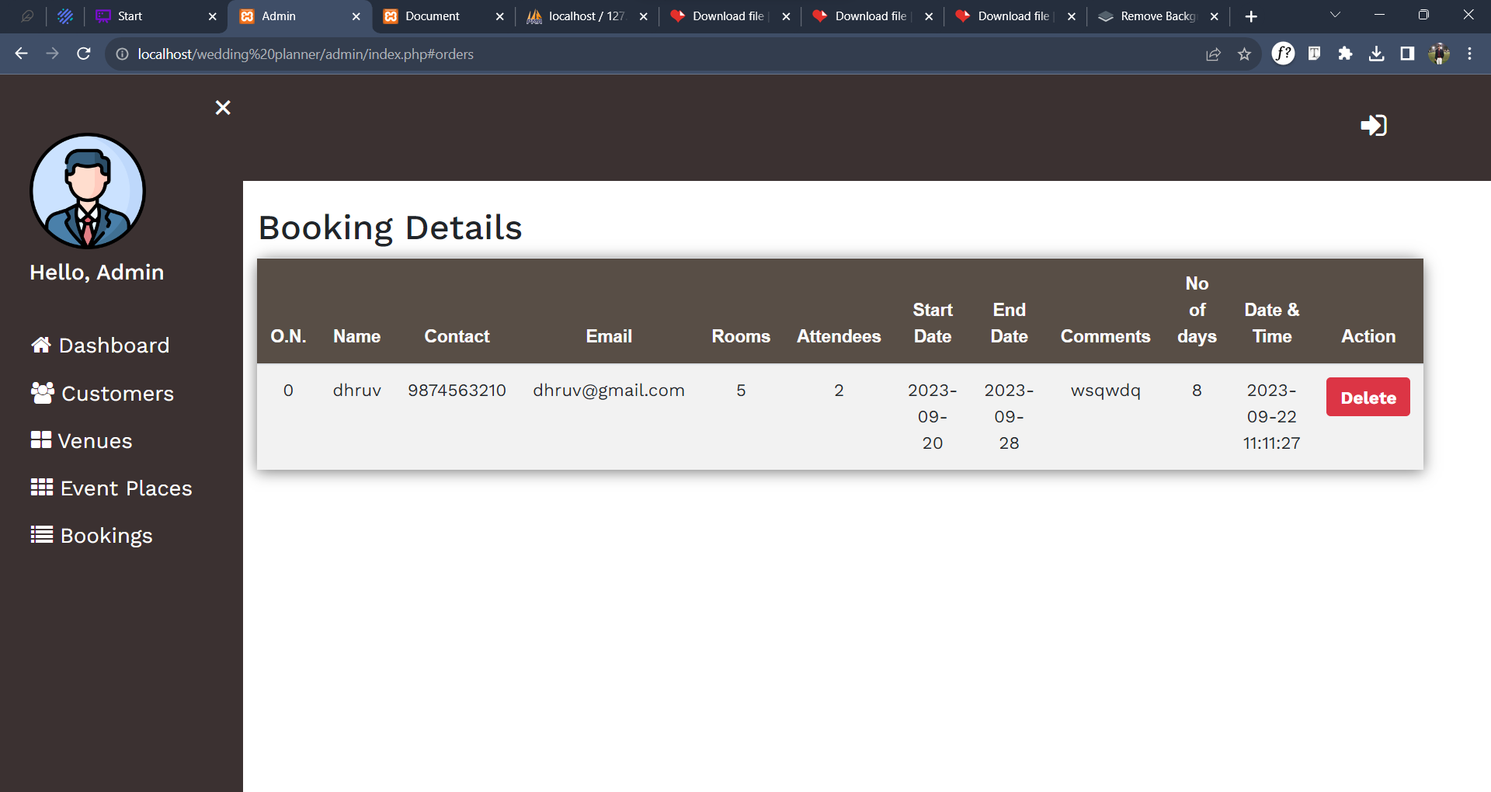
Booking

Slide 26
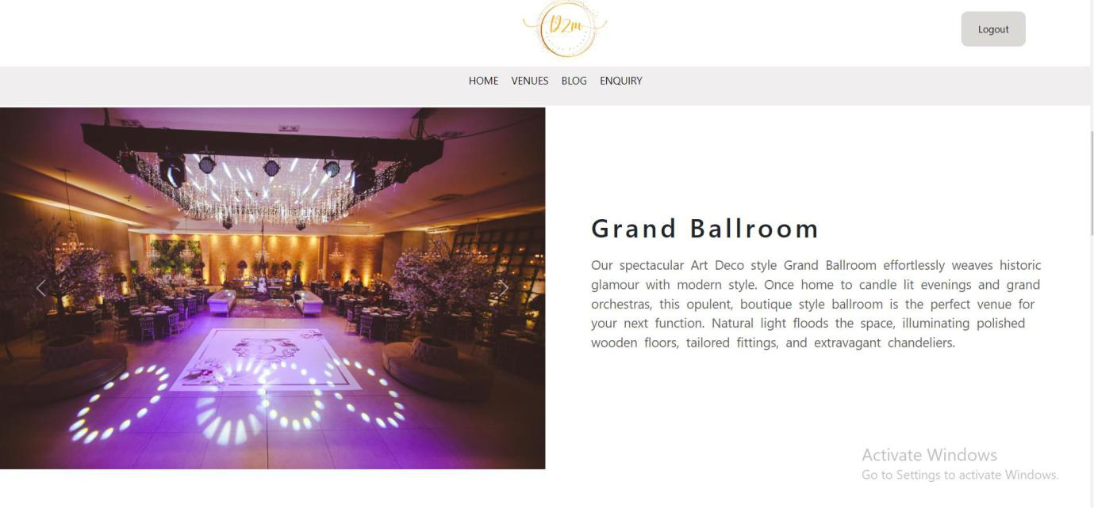
Home

Slide 27
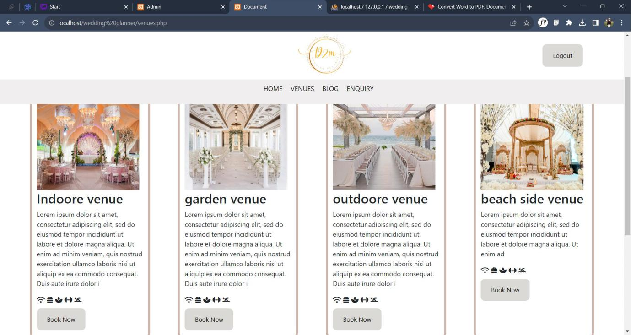
Venues

Slide 28
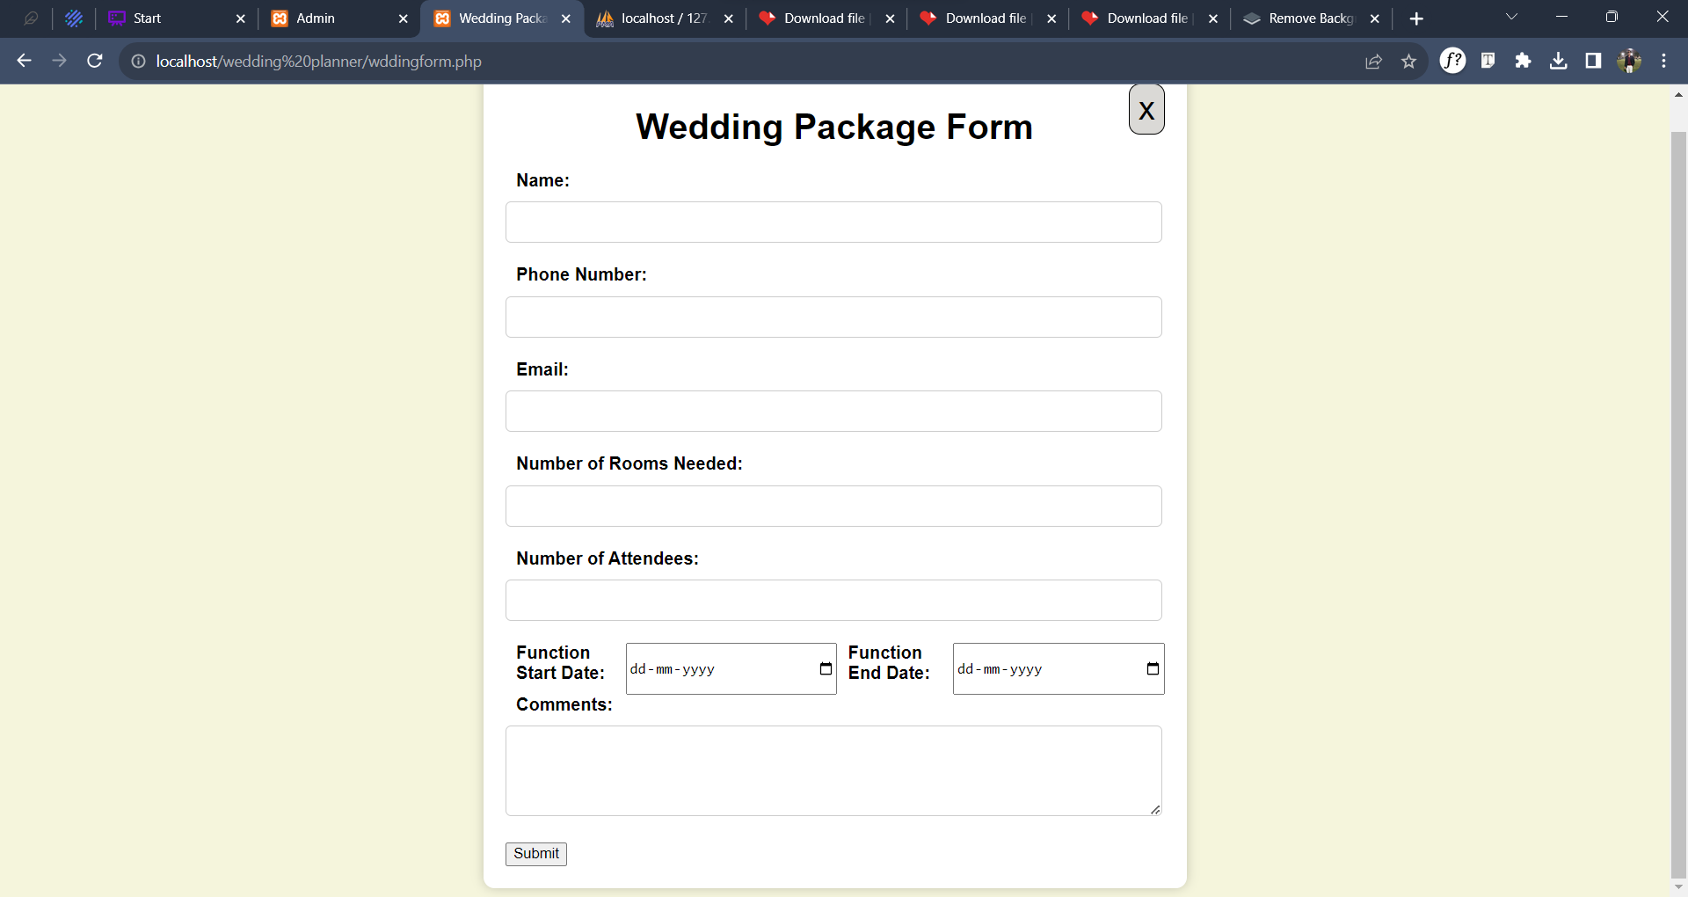
Booking Form

Slide 29
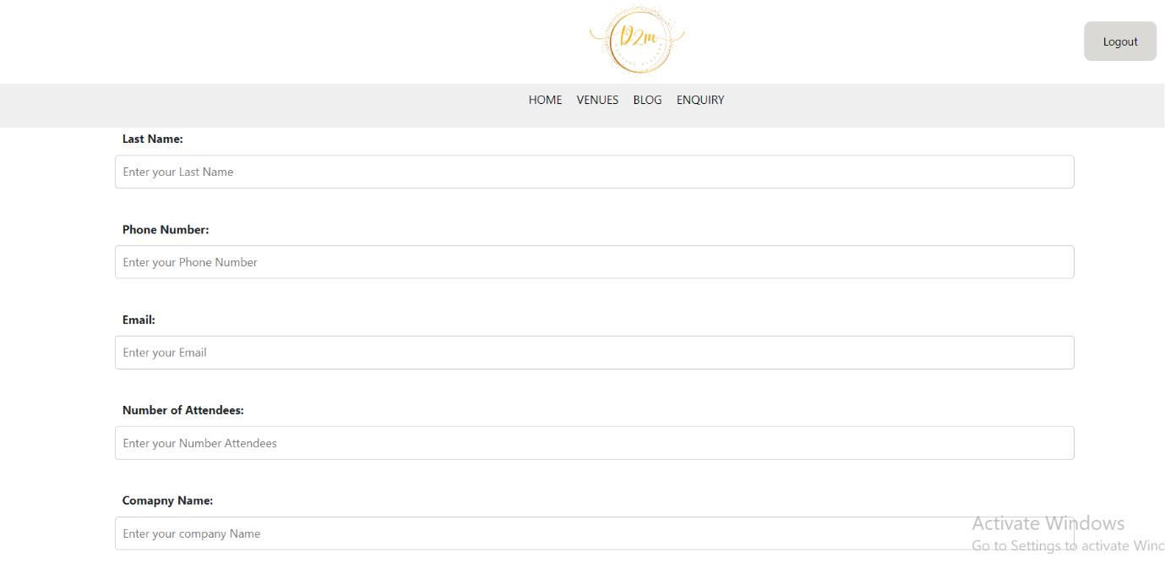
Enquiry Page

Slide 30
References :-
https://sorrento.intercontinental.com/events-and-wedding?gclid=CjwKCAjwtuOlBhBREiwA7agf1m3NM9ewl0XQPMuFw6mgKO_ kFvTirAoXX37YktUtjihG-Z6hUibCLRoCfLAQAvD_BwE
https://www.w3schools.com/php/default.asp
https://www.yahoobaba.net/courses/php
https://getbootstrap.com/docs/5.3/getting-started/introduction

