Slide 1
MINI PROJECT II
Presented by:
DHRUV KUMAR AGARWAL (2101CS26)
DHRUV CHOUDHARI (2101CS25)

Slide 2
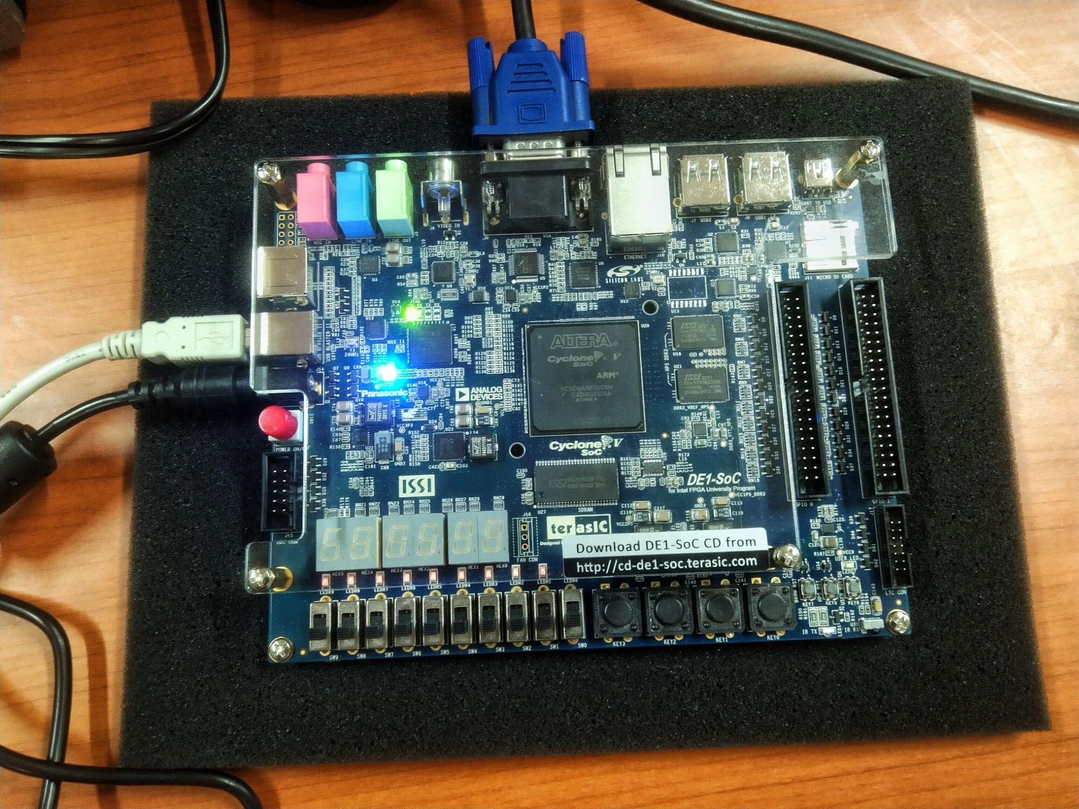
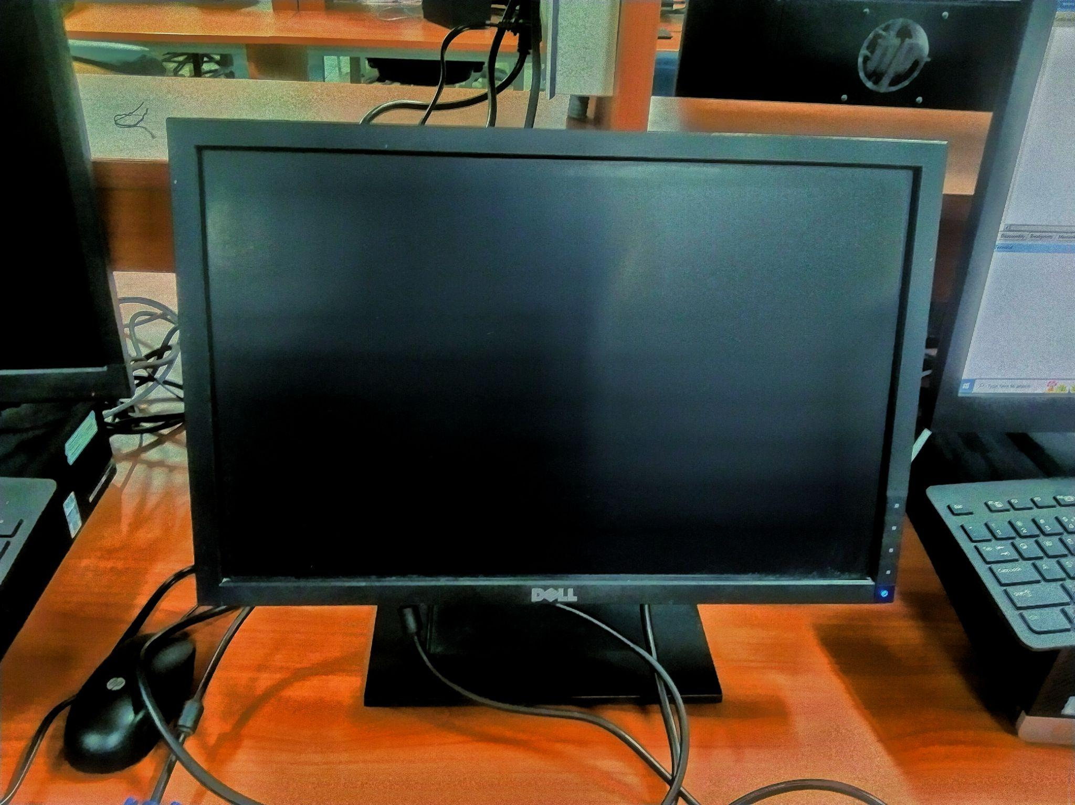
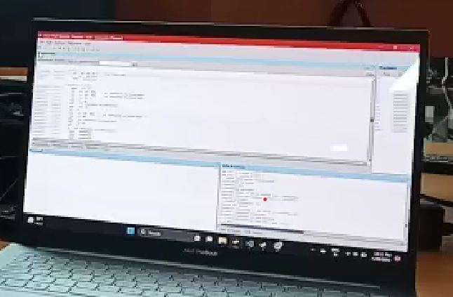
COMPONENT’S REQUIRED:
DE1-SOC
2. DISPLAY
3. PC TO OPERATE
DE1-SOC
Display Screen
Laptop to connect to DE1 SOC

Slide 3
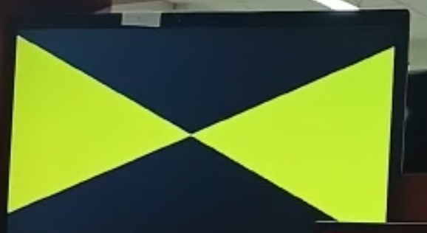
Phase 1 of Game : ANIMATION
Animation is there which starts from zero and spreads as line changing colour of screen to yellow where ever it has traversed .

Slide 4
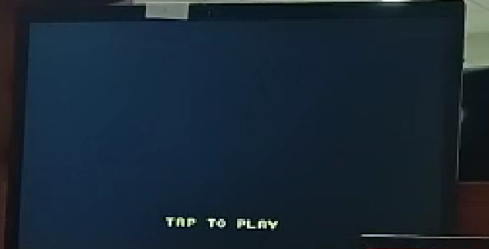
Phase 2: START GAME
Tap to play option which interacts with Button of Board. After Pressing 4th Button from right screen changes and game starts
Here the UFO attacking on dinosaur is shown so if the dinosaur hits first by laser of UFOs then you will lose the game elsewhere you win the game by flushing out the UFOs, parallely the score will kept counting on seven segment display.

Slide 5
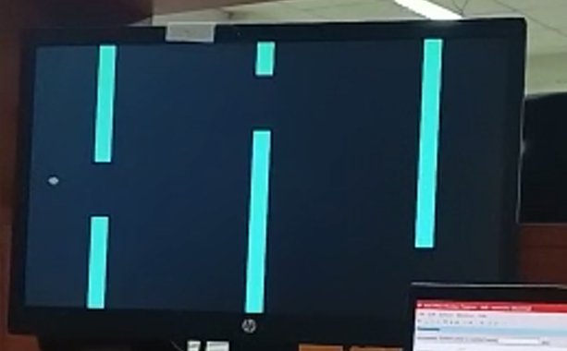
Phase 3 : THE GAME
The main game. Player can hop the character by pressing 2 nd Button from right on board. Bird has to pass through gaps, if it hits the gap then game ends.

Slide 6
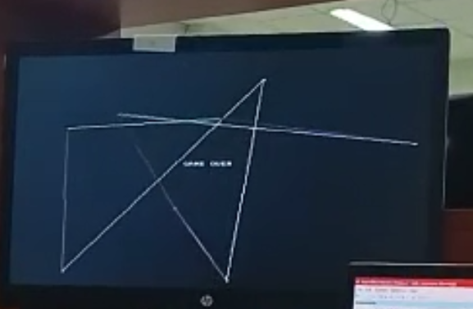
PHASE 4: GAME OVER
After hitting a pipe, Game ends. Screen refreshes quickly and “GAME OVER ” is written on middle of screen with an animation in background

Slide 7
THANK YOU

