Slide 1
MINI PROJECT II
Presented by:
NIKHIL PATHAK (2101CS50)
NAITIK RAJ (2101CS49)

Slide 2
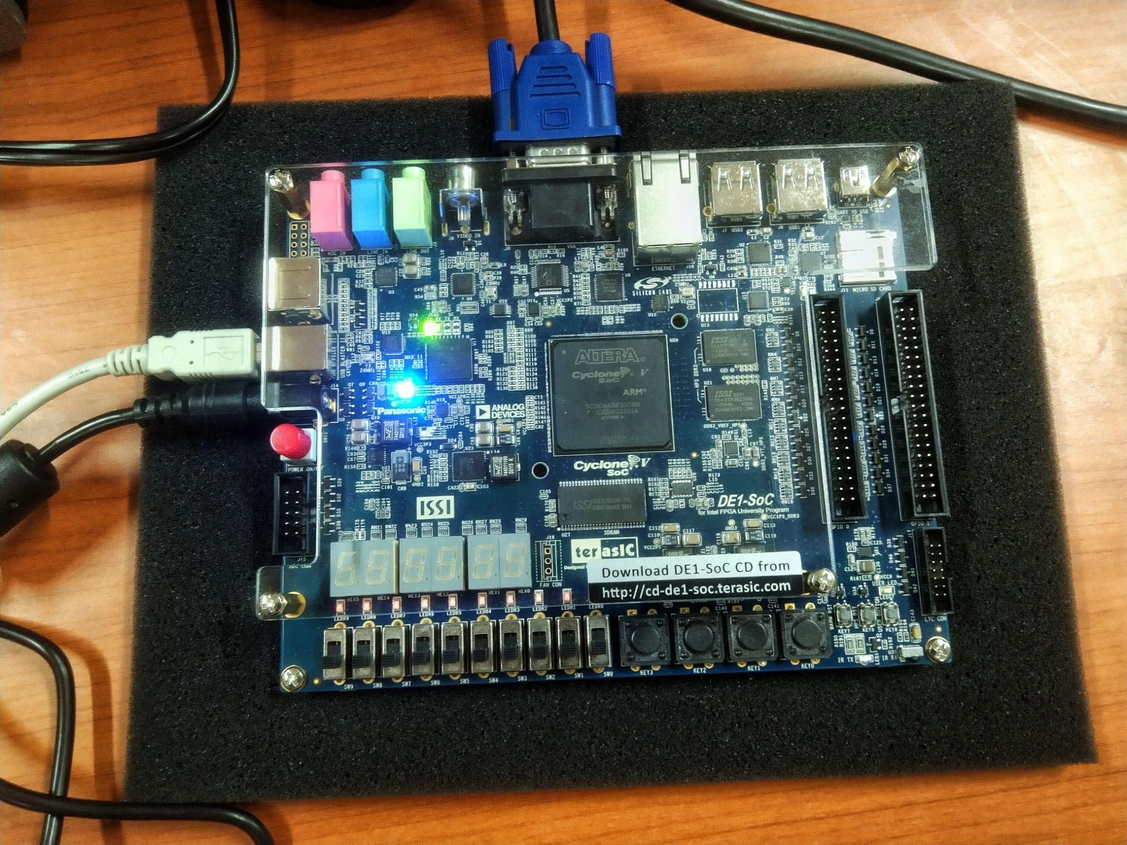
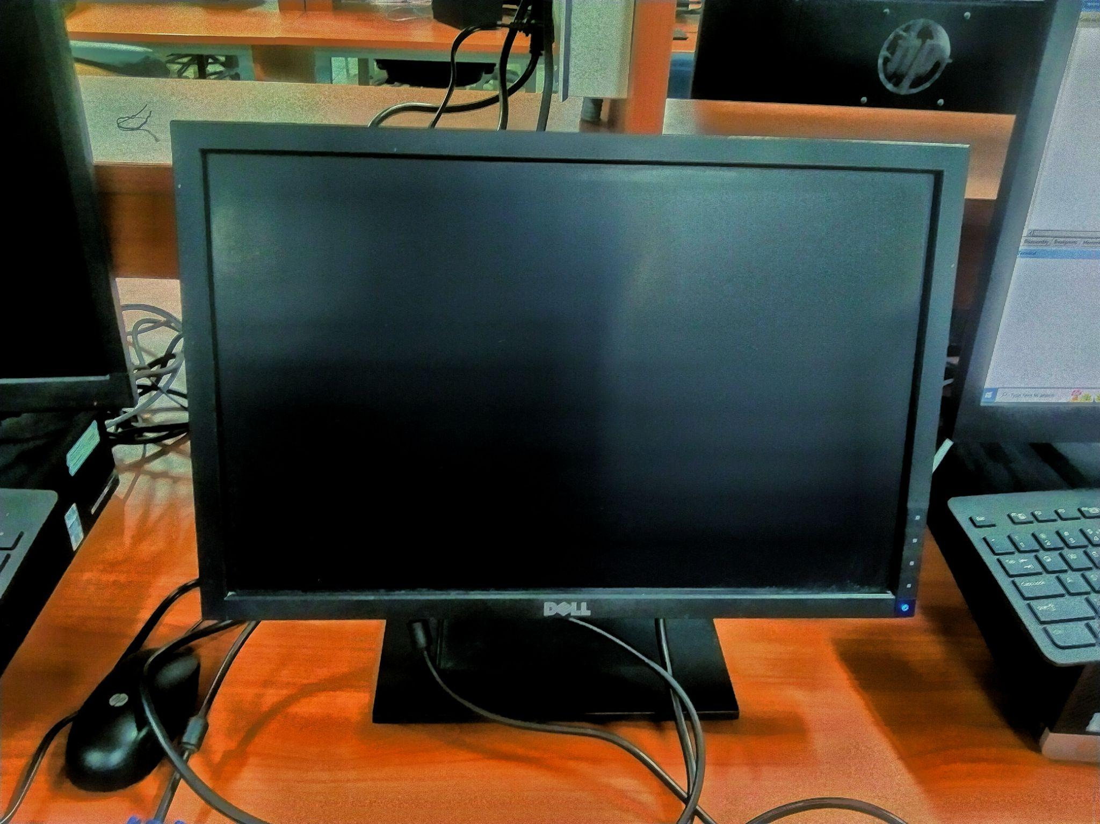
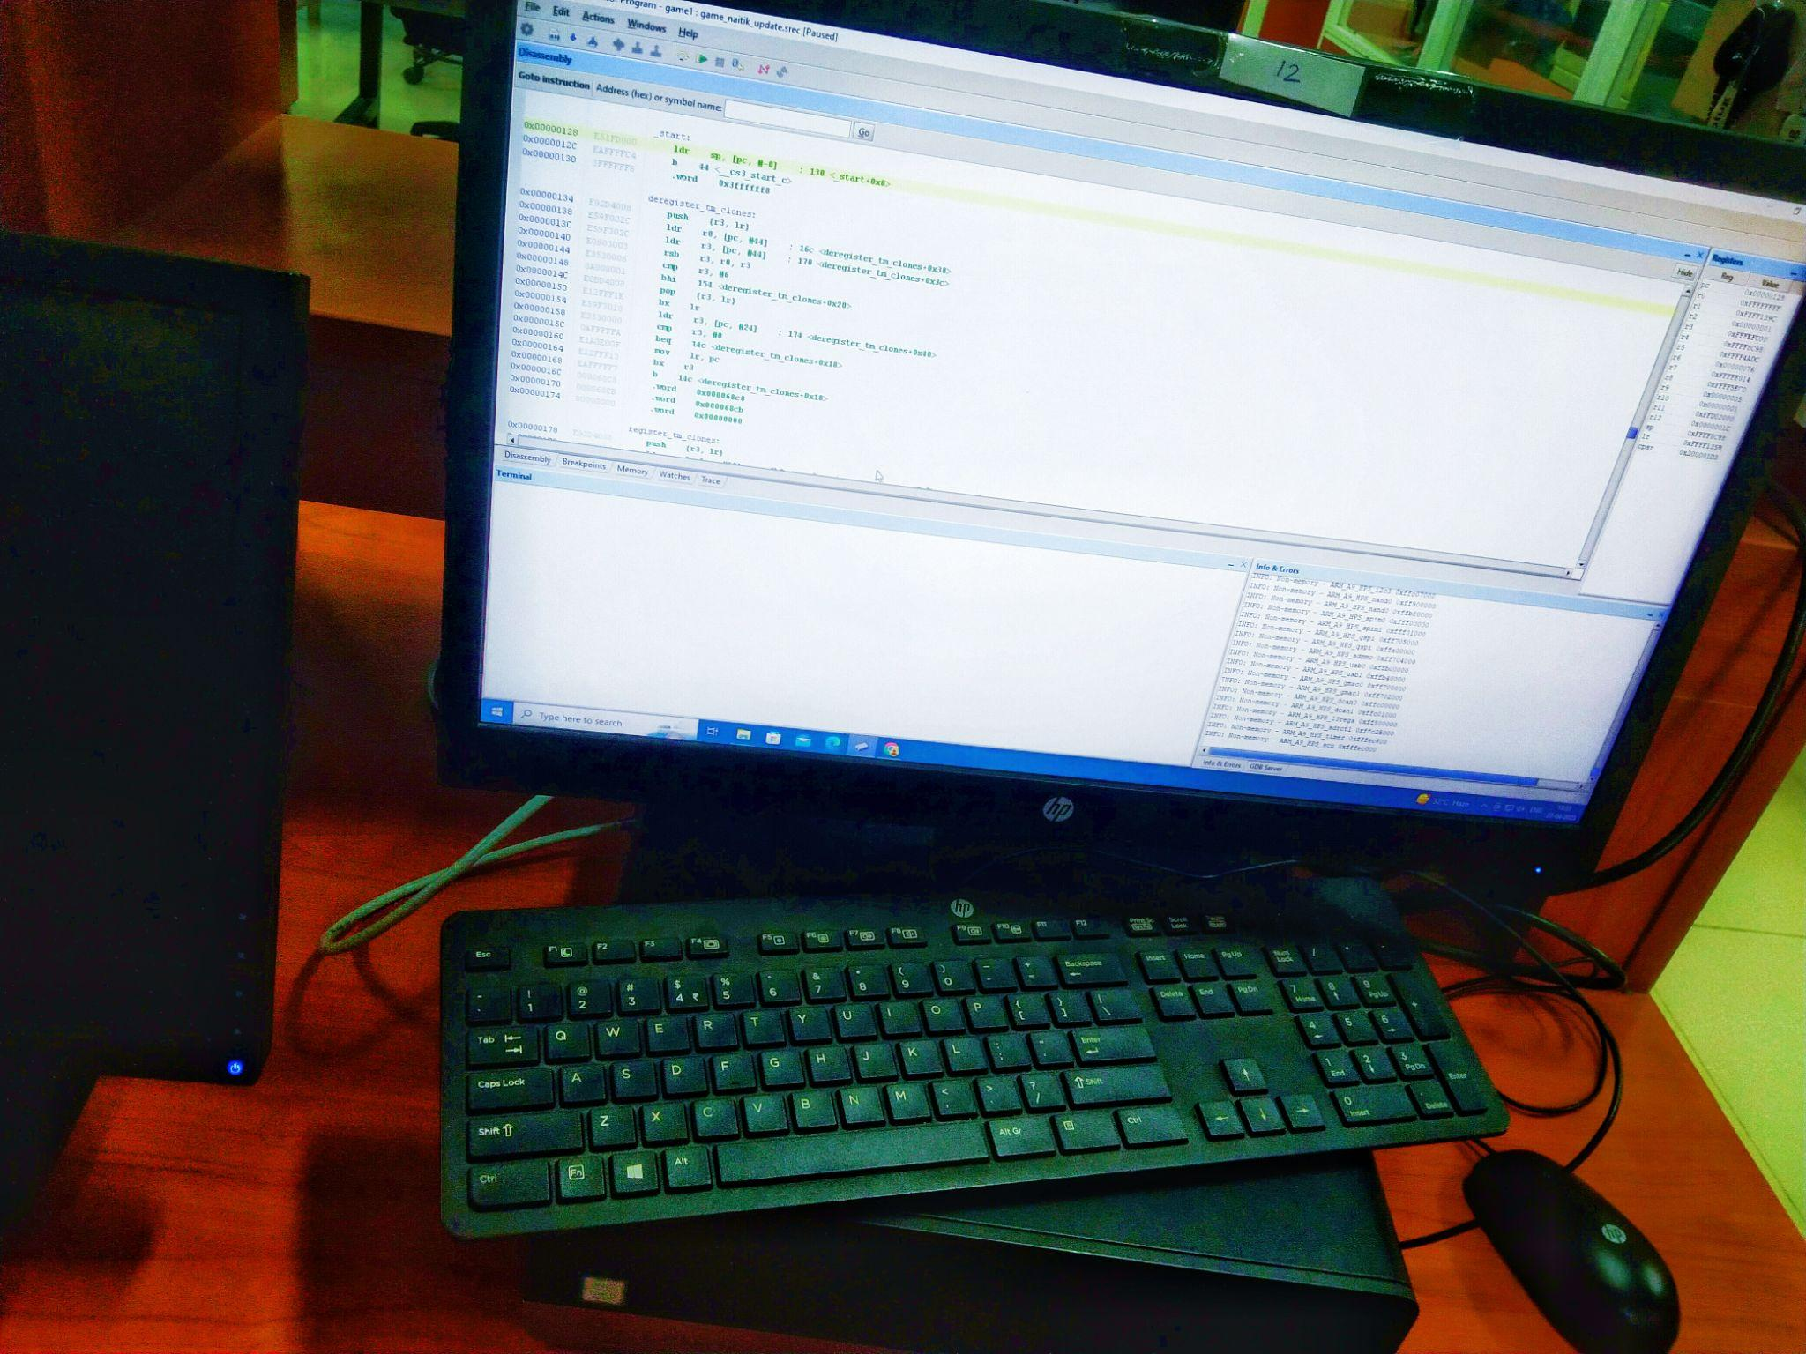
COMPONENT USED:
DE1-SOC
2. DISPLAY
3. PC TO OPERATE

Slide 3
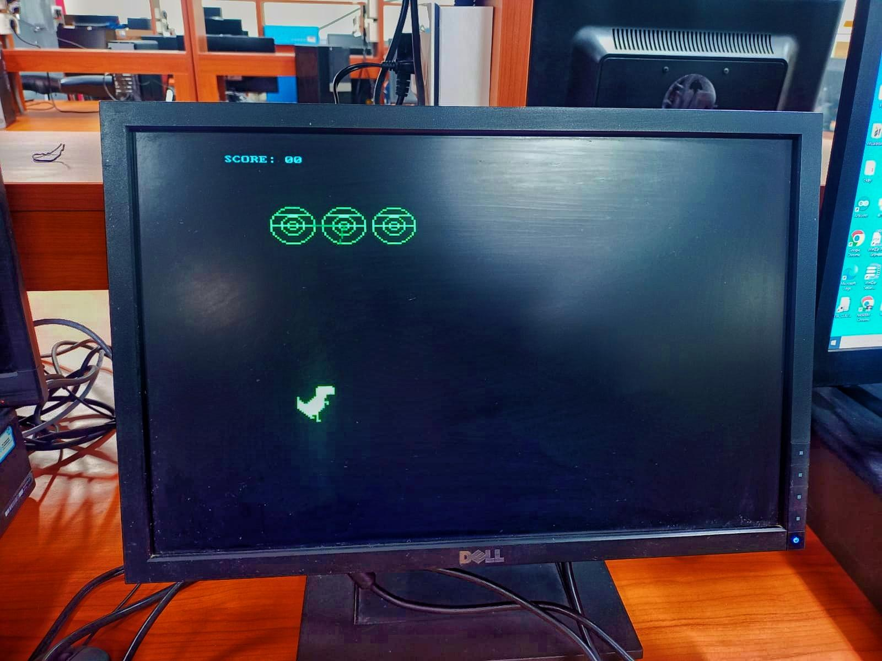
Starting Phase of GAME:
In starting phase of the game the score is 0. There are three UFOs and and a Dinosaur both are ables to attacks on each other. UFOs follow the dinosaur to attack , also dinosaur can escape by moving right, left, upward or downward. Dinosaur can also able to attack on UFOs.

Slide 4
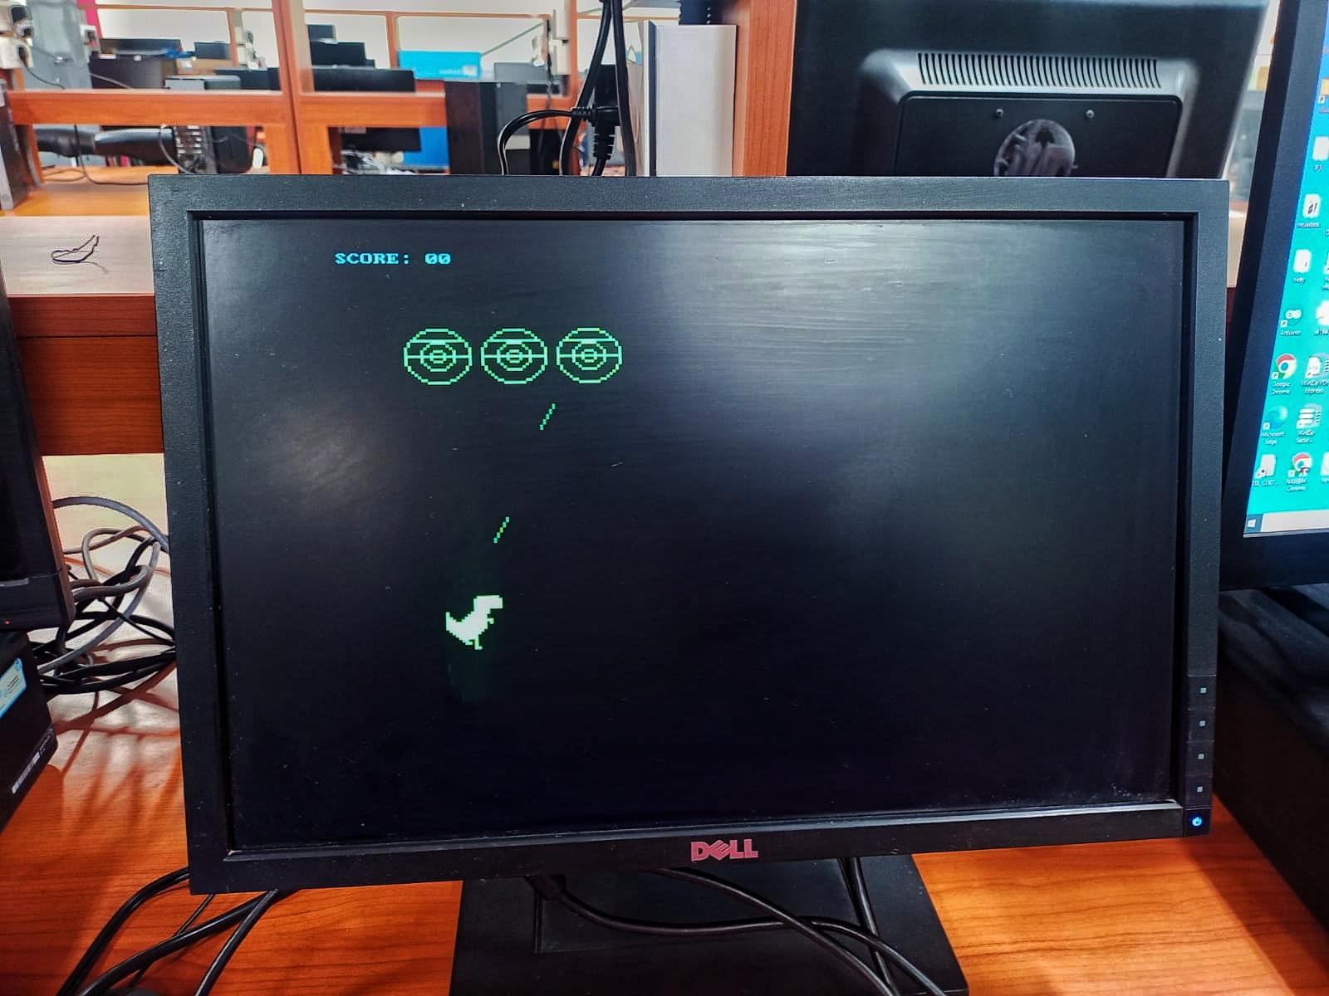
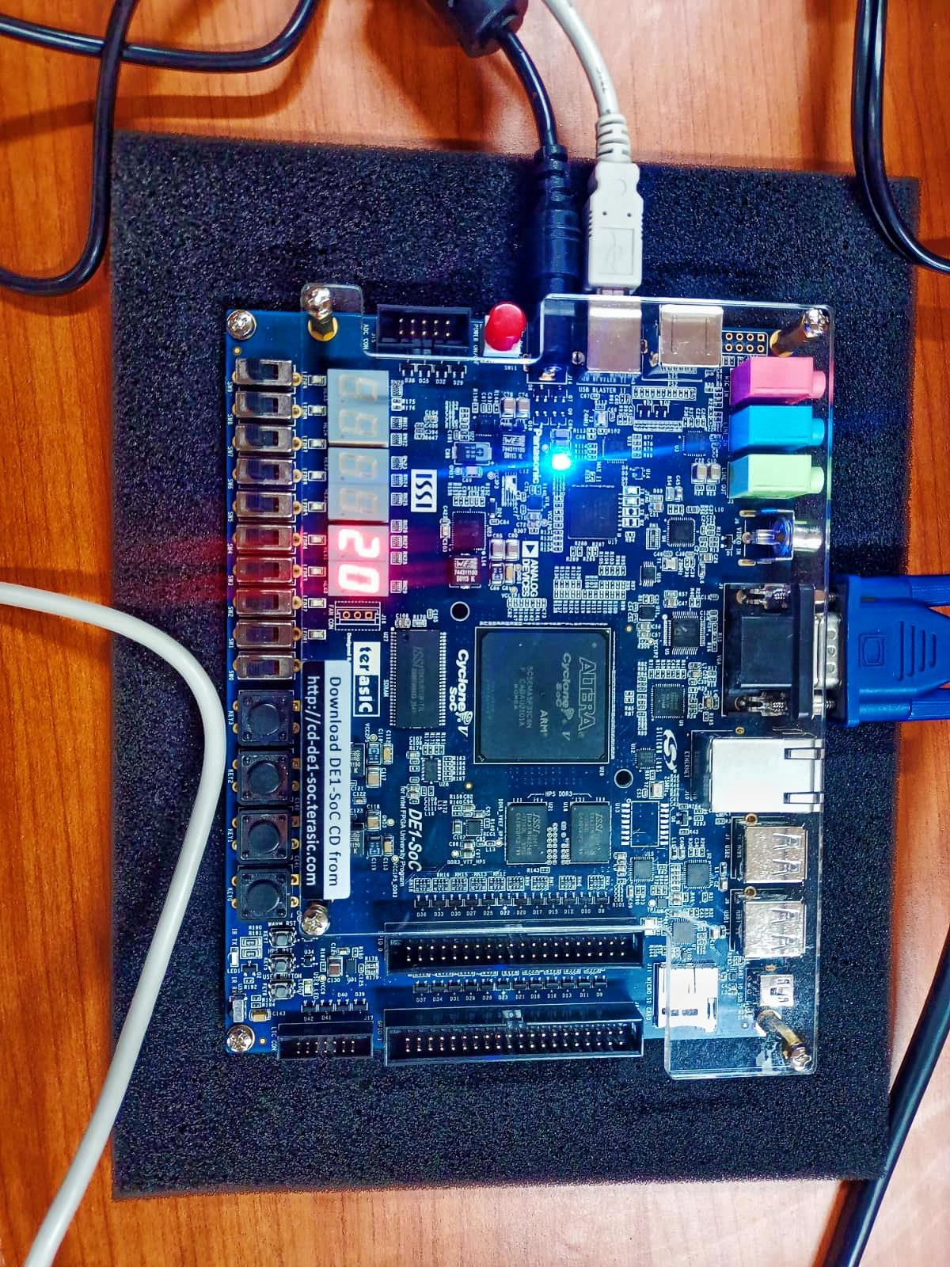
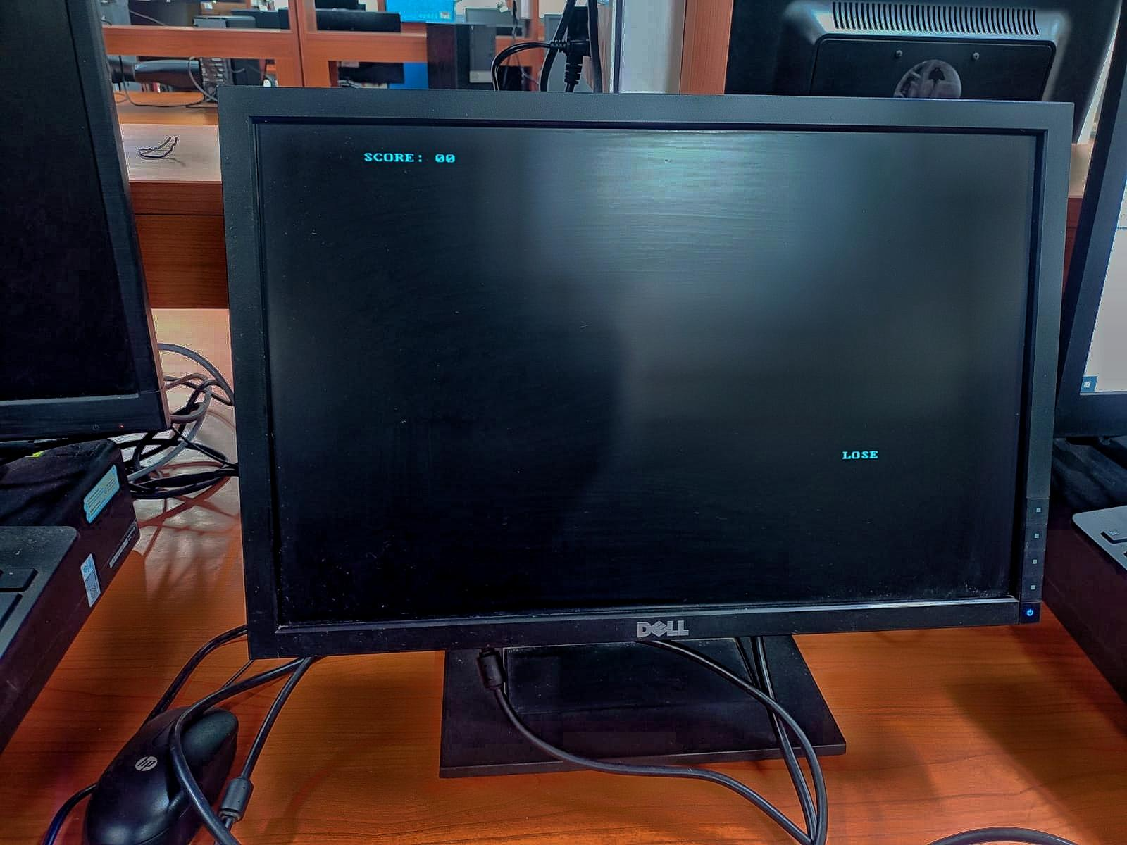
ATTACKING & DECIDING PHASE:
Here the UFO attacking on dinosaur is shown so if the dinosaur hits first by laser of UFOs then you will lose the game elsewhere you win the game by flushing out the UFOs, parallely the score will kept counting on seven segment display.

Slide 5
THANK YOU

