Slide 1
Poker Player Modeling
Dhruv Dadhania

Slide 2
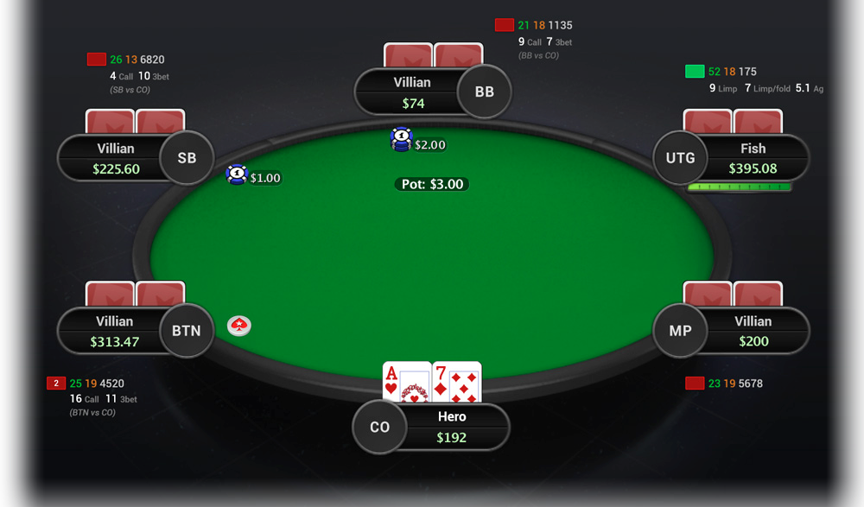
Poker Overview
Objective: have the best five card hand
Important concepts:
4 rounds of betting
Hand Strength
Position
Stack Size
“Incomplete information”

Slide 3
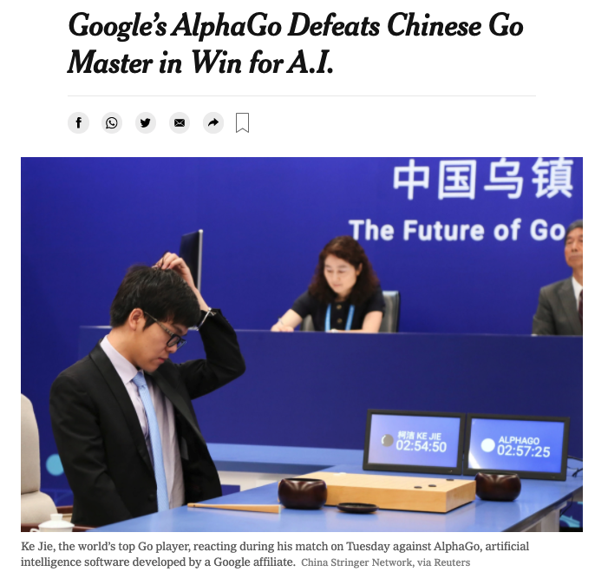
Motivation
Computers have overtaken human players in difficult games (Go and chess)
Other than heads up poker, poker is still unsolved
Player modeling may allow for better trained models

Slide 4
Research Questions
Can we capture player differences in pre-flop raise decisions?
Is there a relationship between experience and the cards brought to showdown?
Do players change their behavior after winning hands?

Slide 5
Data Source
IRC Poker Database
Free-money internet gameplay
Data collected from 1995-2001
More than 10 million complete hands
Many more partial observations
Actively researched by the University of Alberta Computer Poker Research Group

Slide 6
Variables of Interest
Variable Name | Description | Potential Values
Hand Strength | The rating of the pocket cards | Integer in [1 , 4]
Position | The position relative to the dealer | Integer in [1 , 8]
Stack Size | The amount of money the player has | Integer in [1 , infinity)
Games Played | The prior number of games played | Integer in [0, infinity)
Prior Win | If the player won the last game | True or False

Slide 7
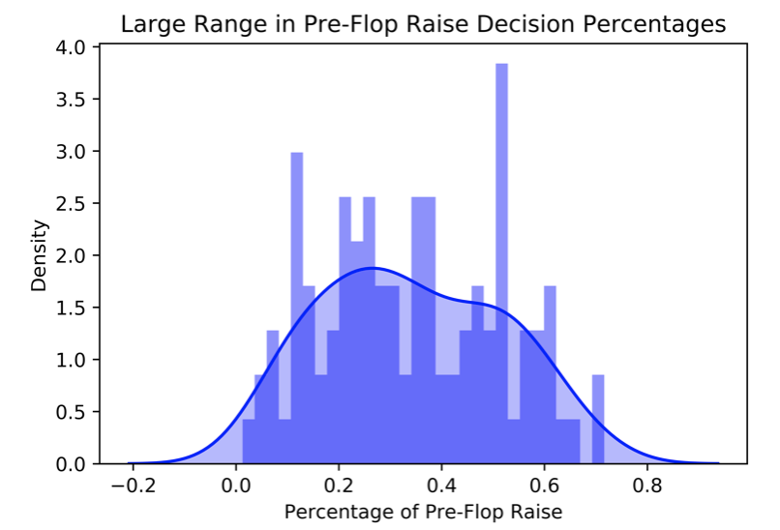
Q1: Pre-Flop Raise
Does player have a significant effect on our model?
Compare model with and without player dummy variables

Slide 8
Q1: Pre-Flop Raise Results
Name | Estimate | P-Value | 0.025th | 0.975th
Intercept | 2.428 | <0.001 | 2.336 | 2.519
Hand Strength | -0.661 | <0.001 | -0.670 | -0.652
Position | -0.892 | <0.001 | -0.911 | -0.872
Stack Size | 6.797 x 10⁻⁸ | 0.010 | 1.632 x 10⁻⁸ | 1.196 x 10⁻⁷
The likelihood ratio test was significant at the 0.05 level, comparing models with and without player coefficients.

Slide 9
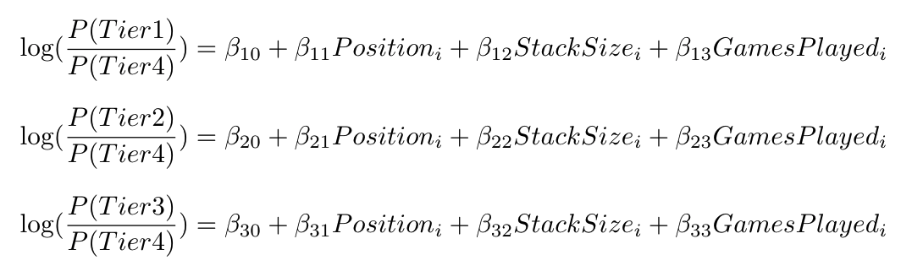
Q2: Showdown Cards
Does experience impact the range of cards brought to showdown?
Games played is a proxy for experience
Compare model with and without games played

Slide 10
Q2: Showdown Cards Results
Tier (vs. Baseline 4) | Estimate | P-Value | 0.025th | 0.975th
Tier 1 Games Played | -1.414 x 10⁻⁵ | <0.001 | -2.100 x 10⁻⁵ | -7.286 x 10⁻⁶
Tier 2 Games Played | -1.929 x 10⁻⁵ | <0.001 | -2.617 x 10⁻⁵ | -1.242 x 10⁻⁵
Tier 3 Games Played | -4.030 x 10⁻⁵ | <0.001 | -4.573 x 10⁻⁵ | -3.487 x 10⁻⁵
The likelihood ratio test was significant at the 0.05 level, comparing models with and without games played coefficients.

Slide 11
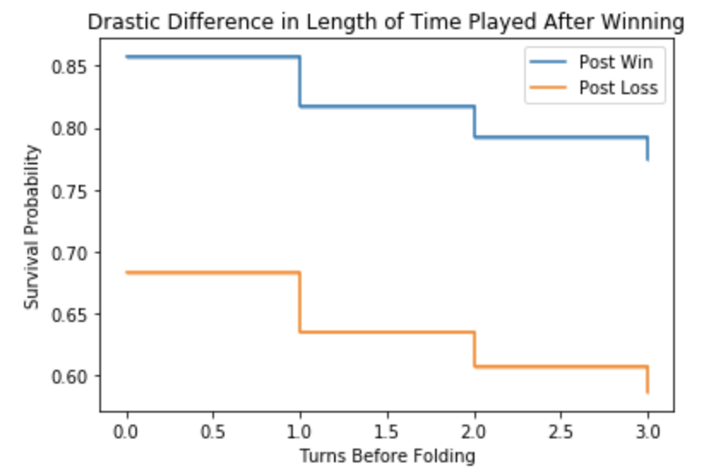
Q3: Past Performance
Do players change their behavior after winning hands?
Fold is event of interest
Everyone else folding or reaching the last round of betting is a censoring event
Discrete time
Compare model with and without prior win

Slide 12
Q3: Past Performance Results
Name | Estimate | P-Value | 0.025th | 0.975th
Intercept | -2.023 | <0.001 | -2.050 | -1.996
Position | 0.419 | <0.001 | 0.414 | 0.425
Stack Size | -1.401 x 10⁻⁶ | <0.001 | -1.587 x 10⁻⁶ | -1.215 x 10⁻⁶
Prior Win | -0.467 | <0.001 | -0.501 | -0.433
D₁ | -2.001 | <0.001 | -2.038 | -1.965
D₂ | -2.525 | <0.001 | -2.570 | -2.479
D₃ | -2.591 | <0.001 | -2.639 | -2.543
The likelihood ratio test was significant at the 0.05 level, comparing models with and without prior win coefficients.

Slide 13
Limitations + Extensions
Poker has changed substantially in the past two decades
Results from this dataset may be outdated
The players in this dataset represent a large range of skill level
Majority of research focuses on outperforming professionals
Do these analyses generalize to modern professional play?

Slide 14
Conclusions
Player modeling is extremely difficult, but breaking down the full space into interesting questions can allow us to make gains
Players have capturable difference in play style, and play style is generally associated with external factors (games played and prior win)
There is more to be done!

