Slide 1
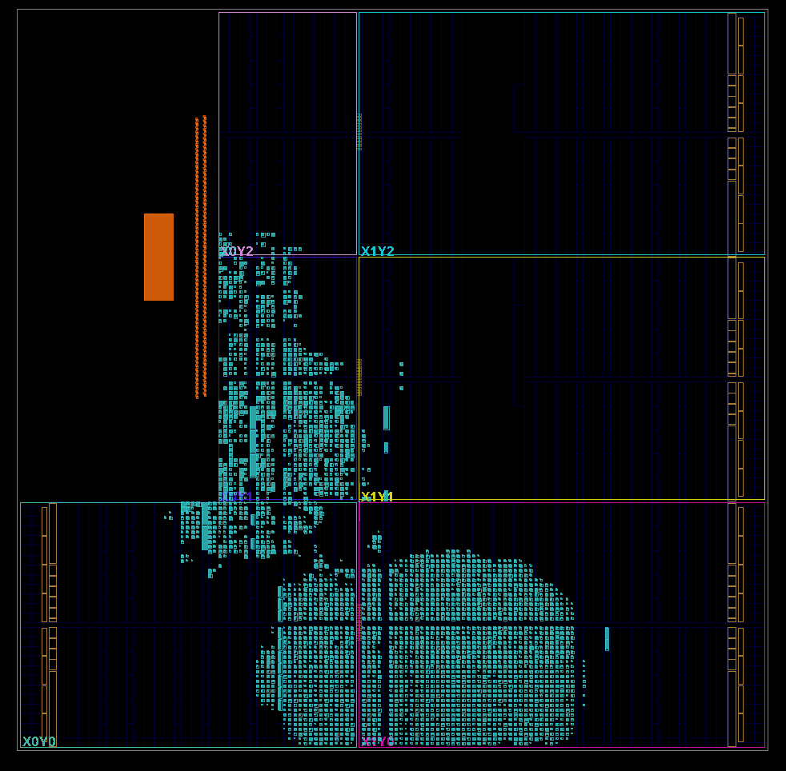
2D Convolution Accelerator
A single channel 2D Convolution accelerator for the PYNQ-Z2.
Dhruv Deshmukh (dad10090)
Luka Kitamura (lk3283)
Faiza Zahin Tasfia (ft2335)

Slide 2
Overview
Introduction to 2D convolution
Architecture
Verification. A
BD Implementation
Verification. B
Benchmarking
Device Demo
Future Improvements

Slide 3
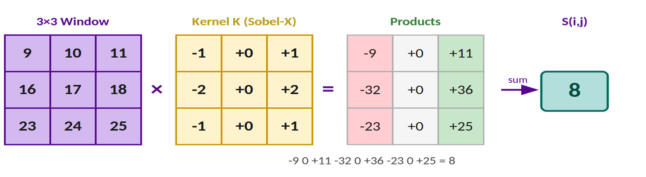
2D Convolution
• Kernel slides across the input image and computes a dot product for each 3×3 region
• The same 9 kernel weights are reused across the entire image
• Valid convolution (no padding) reduces output to (M−2) × (N−2)

Slide 4
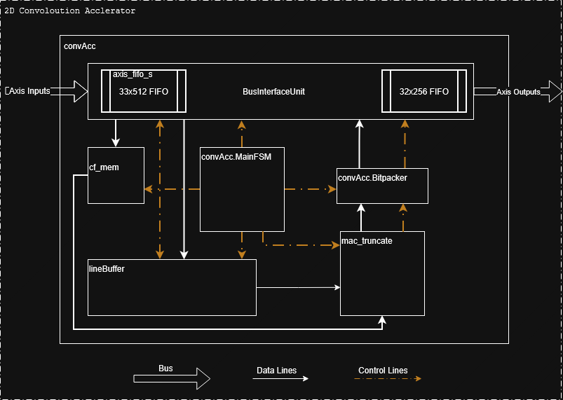
Design Architecture
In/Out FIFO
Manage for output Backpressure through line buffer
cf mem
Stores config information
Line Buffer
Perpetually loading rows of matrix
Mac & Truncate
Performs the computation and clipping
Bit packer
8-to-32-bit packer

Slide 5
CF(Config) Memory
31 | 30 | 29 | 28 | 27 | 26 | 25 | 24 | 23 | 22 | 21 | 20 | 19 | 18 | 17 | 16 | 15 | 14 | 13 | 12 | 11 | 10 | 9 | 8 | 7 | 6 | 5 | 4 | 3 | 2 | 1 | 0
Reserved |  |  |  |  |  |  |  |  |  |  |  |  |  |  |  | Number of Rows |  |  |  |  |  |  |  |  |  | elements in a row
Reserved |  |  |  |  | K02 |  |  |  |  |  |  |  |  | k01 |  |  |  |  |  |  |  |  | K00
Reserved |  |  |  |  | K12 |  |  |  |  |  |  |  |  | k11 |  |  |  |  |  |  |  |  | K10
Reserved |  |  |  |  | K22 |  |  |  |  |  |  |  |  | k21 |  |  |  |  |  |  |  |  | K20
First 4 transfers go to CF memory
Elements in row from 0 – 64 to include 0 – 60 supported size
Number of rows from 0 – 1024 to include 0 – 1023 rows support
All K’s are 8-bit signed integers so each are 9 bits.

Slide 6
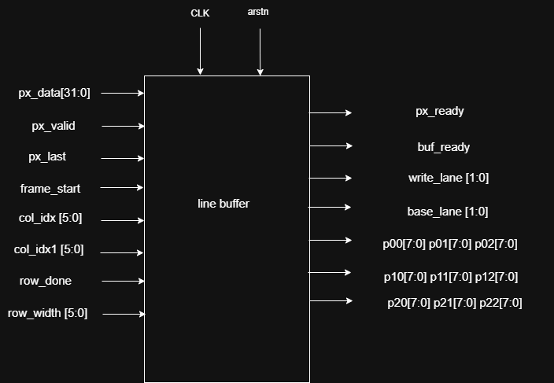
Line Buffer
Receives 32 bit every cycle
Stores it as 8 bit elements
Async access to 3 elements at a time from each row
4 total rows, access 3 at a time

Slide 7
Line Buffer
Line buffer
Reference Matrix & computation
1 | 2 | 3 | 4 | 5 | 6 | 7
8 | 9 | 10 | 11 | 12 | 13 | 14
15 | 16 | 17 | 18 | 19 | 20 | 21
22 | 23 | 24 | 25 | 26 | 27 | 28
29 | 30 | 31 | 32 | 33 | 34 | 35
36 | 37 | 38 | 39 | 40 | 41 | 42
43 | 44 | 45 | 46 | 47 | 48 | 49
1 | 2 | 3 | 4 | 5 | 6 | 7
8 | 9 | 10 | 11 | 12 | 13 | 14
15 | 16 | 17 | 18 | 19 | 20 | 21
22 | 23 | 24 | 25 | 26 | 27 | 28

Slide 8
Line Buffer
Line buffer
Reference Matrix & computation
1 | 2 | 3 | 4 | 5 | 6 | 7
8 | 9 | 10 | 11 | 12 | 13 | 14
15 | 16 | 17 | 18 | 19 | 20 | 21
22 | 23 | 24 | 25 | 26 | 27 | 28
29 | 30 | 31 | 32 | 33 | 34 | 35
36 | 37 | 38 | 39 | 40 | 41 | 42
43 | 44 | 45 | 46 | 47 | 48 | 49
29 | 30 | 31 | 32 | 33 | 34 | 35
8 | 9 | 10 | 11 | 12 | 13 | 14
15 | 16 | 17 | 18 | 19 | 20 | 21
22 | 23 | 24 | 25 | 26 | 27 | 28

Slide 9
Line Buffer
Line buffer
Reference Matrix & computation
1 | 2 | 3 | 4 | 5 | 6 | 7
8 | 9 | 10 | 11 | 12 | 13 | 14
15 | 16 | 17 | 18 | 19 | 20 | 21
22 | 23 | 24 | 25 | 26 | 27 | 28
29 | 30 | 31 | 32 | 33 | 34 | 35
36 | 37 | 38 | 39 | 40 | 41 | 42
43 | 44 | 45 | 46 | 47 | 48 | 49
29 | 30 | 31 | 32 | 33 | 34 | 35
36 | 37 | 38 | 39 | 40 | 41 | 42
15 | 16 | 17 | 18 | 19 | 20 | 21
22 | 23 | 24 | 25 | 26 | 27 | 28

Slide 10
Line Buffer
Line buffer
Reference Matrix & computation
1 | 2 | 3 | 4 | 5 | 6 | 7
8 | 9 | 10 | 11 | 12 | 13 | 14
15 | 16 | 17 | 18 | 19 | 20 | 21
22 | 23 | 24 | 25 | 26 | 27 | 28
29 | 30 | 31 | 32 | 33 | 34 | 35
36 | 37 | 38 | 39 | 40 | 41 | 42
43 | 44 | 45 | 46 | 47 | 48 | 49
29 | 30 | 31 | 32 | 33 | 34 | 35
36 | 37 | 38 | 39 | 40 | 41 | 42
43 | 44 | 45 | 46 | 47 | 48 | 49
22 | 23 | 24 | 25 | 26 | 27 | 28

Slide 11
Line Buffer
Line buffer
Reference Matrix & computation
1 | 2 | 3 | 4 | 5 | 6 | 7
8 | 9 | 10 | 11 | 12 | 13 | 14
15 | 16 | 17 | 18 | 19 | 20 | 21
22 | 23 | 24 | 25 | 26 | 27 | 28
29 | 30 | 31 | 32 | 33 | 34 | 35
36 | 37 | 38 | 39 | 40 | 41 | 42
43 | 44 | 45 | 46 | 47 | 48 | 49
29 | 30 | 31 | 32 | 33 | 34 | 35
36 | 37 | 38 | 39 | 40 | 41 | 42
43 | 44 | 45 | 46 | 47 | 48 | 49
0 | 0 | 0 | 0 | 0 | 0 | 0

Slide 12
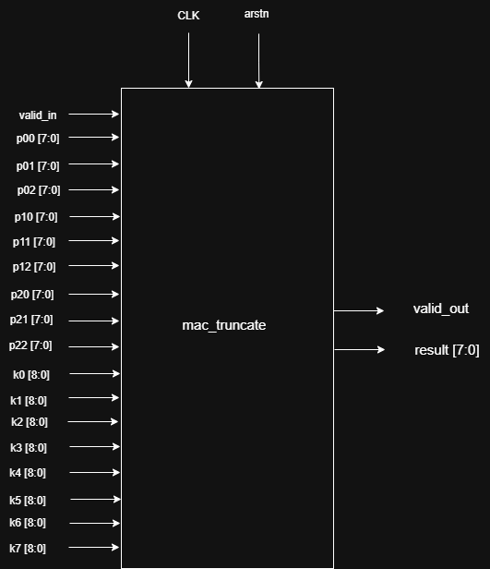
MAC and Truncate
4 stage pipelined
9 multiplications
Additions
0 - 255 Clipping
Answer valid signal
1 pixel per cycle after pipeline fills

Slide 13
WB Message
31 | 30 | 29 | 28 | 27 | 26 | 25 | 24 | 23 | 22 | 21 | 20 | 19 | 18 | 17 | 16 | 15 | 14 | 13 | 12 | 11 | 10 | 9 | 8 | 7 | 6 | 5 | 4 | 3 | 2 | 1 | 0
Pixel 3 |  |  |  |  |  |  |  | Pixel 2 |  |  |  |  |  |  |  | Pixel 1 |  |  |  |  |  |  |  | Pixel 0
(M X N) = (M – 2 X N – 2)
Limitation of %4 elements per row
Scalable number of rows

Slide 14
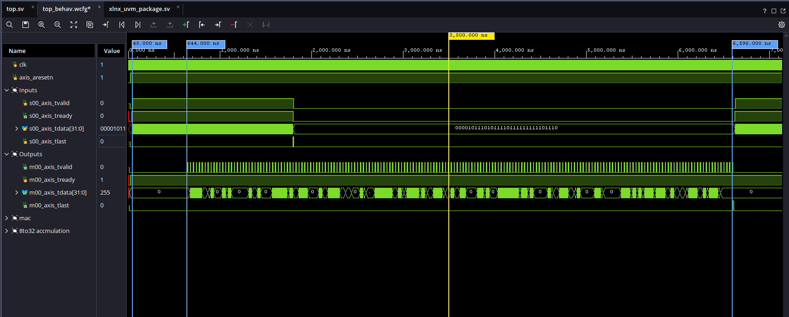
Transaction example

Slide 15
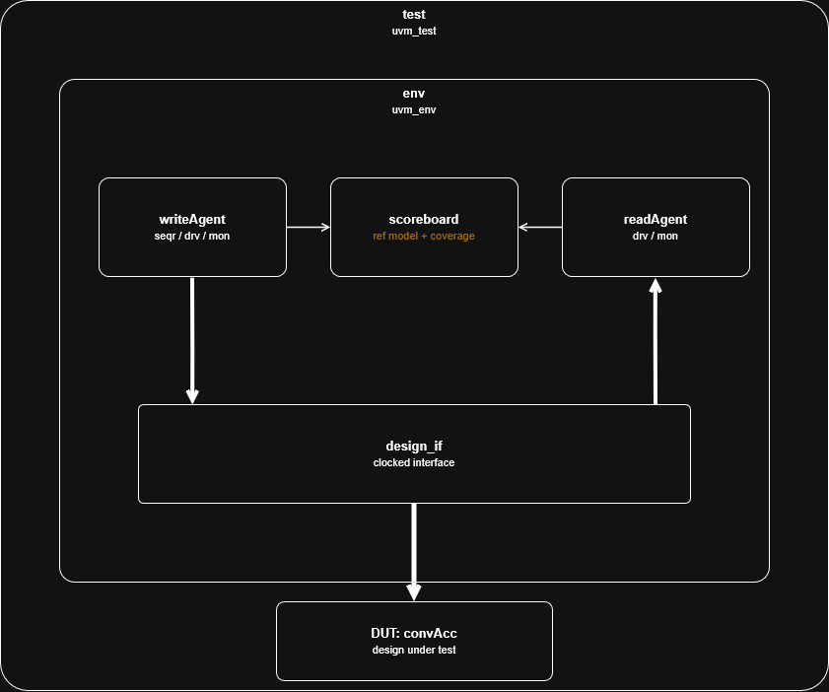
Verification. A
Transactions generated in all supported sizes
Simulation depends on 100% Coverage
RTL verified for
B2B transactions
Supported images 16x16 to 60x60

Slide 16
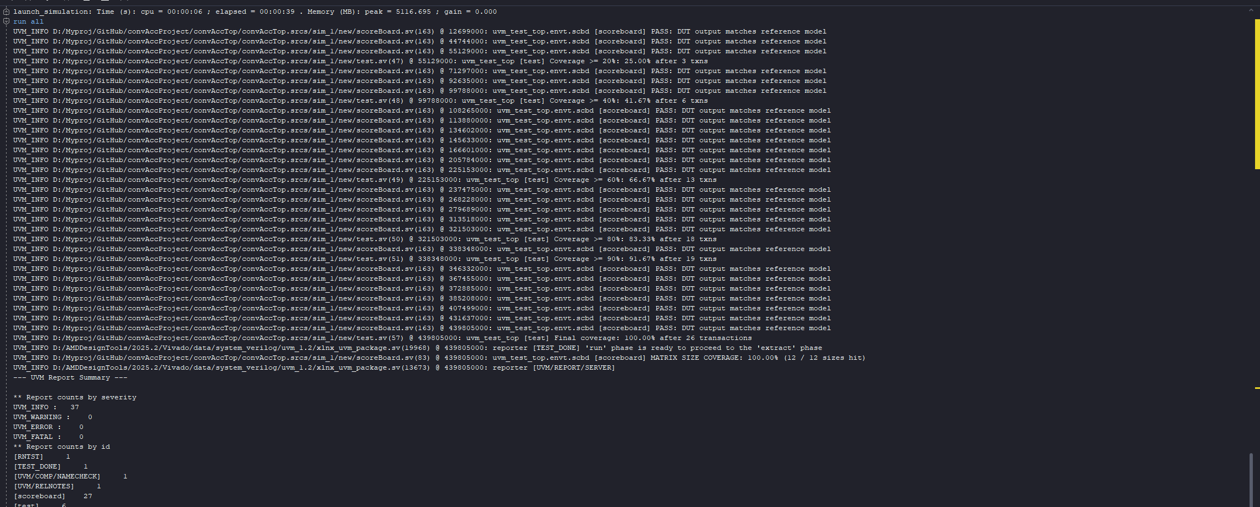
Testbench Outputs

Slide 17
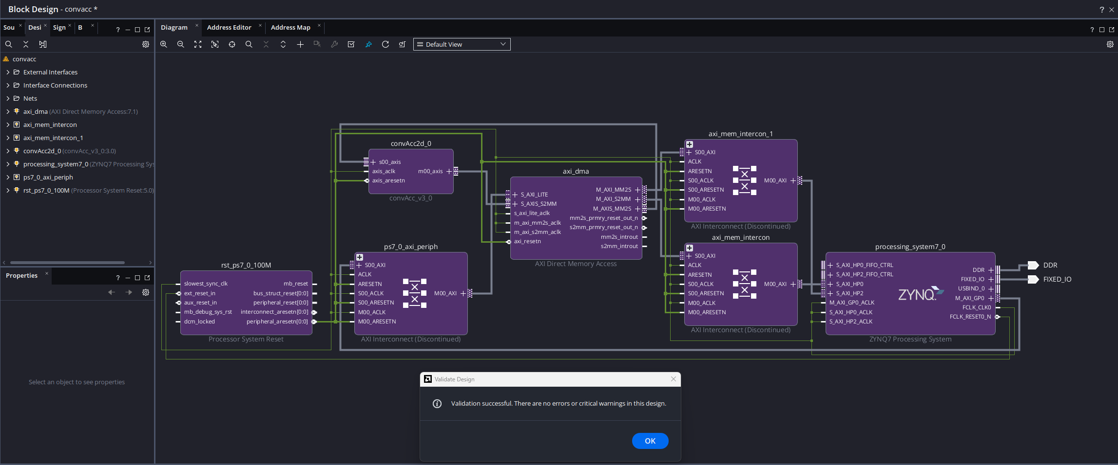
BD Implementation

Slide 18
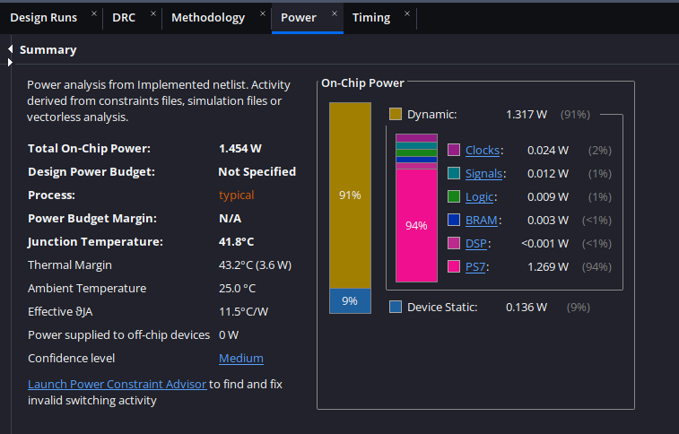
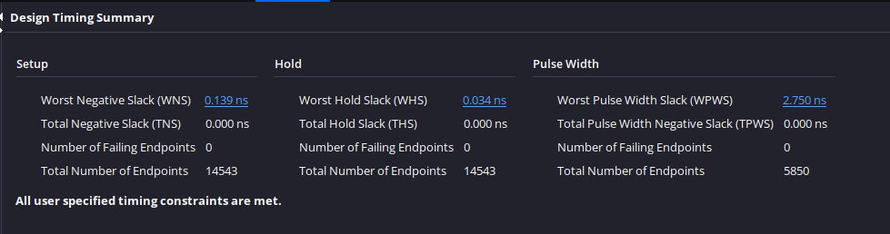
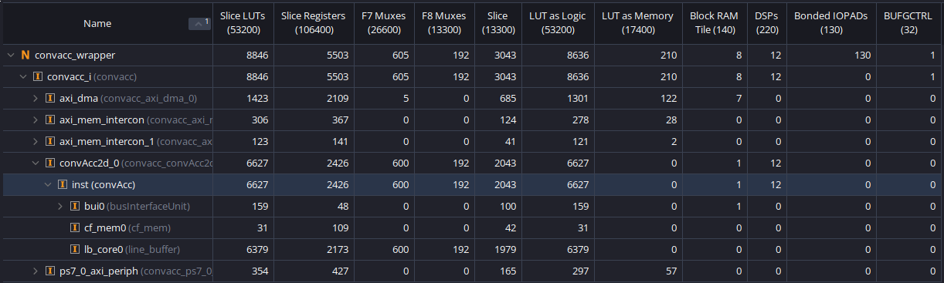
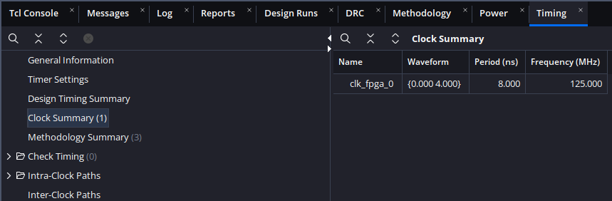
BD Implementation

Slide 19
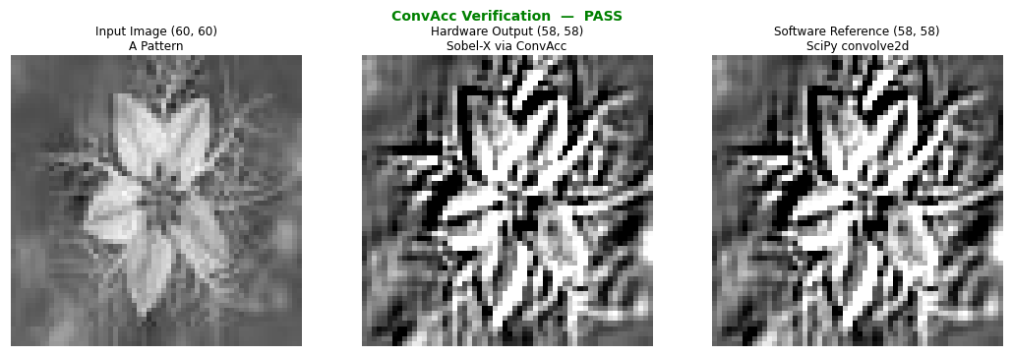
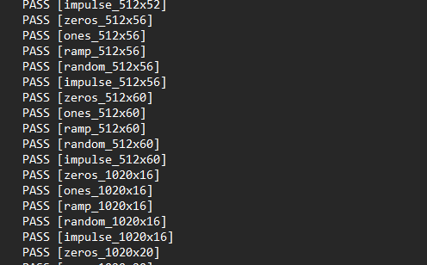
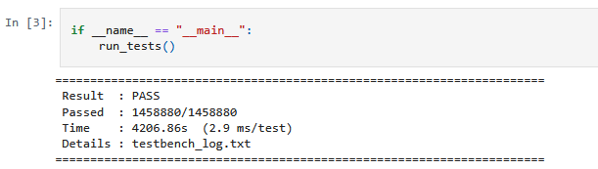
Verification. B
Verified implemented design in Hw/Sw
Test case verified against SciPy convoloution2d
Sustained test over 1hr for functionality
If interested the log file can be read here

Slide 20
Benchmarking
Benchmarking done against CPU-only implementation using scipy.signal.convolve2d on an ARM Cortex-A9
Two testcases:
A: Fixed width of 16 pixels, height varies 16 –> 1000 pixels
B: Fixed width of 60 pixels, height varies 16 –> 1000 pixels
20,000 random input matrices with random 3x3 kernels for each test
Only timing is measured
FPGA implementation includes DMA overhead – measures end-to-end accelerator times

Slide 21
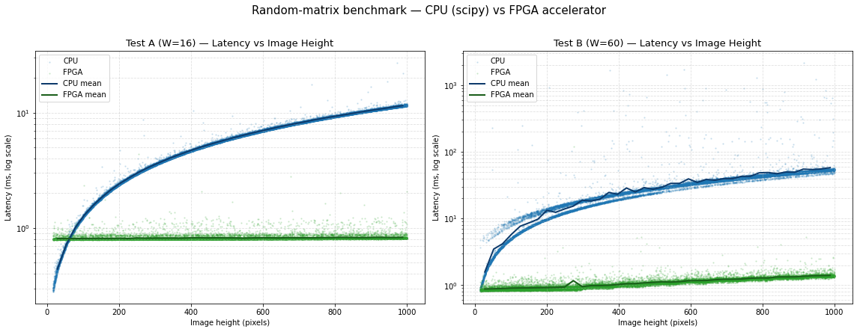
Benchmarking

Slide 22
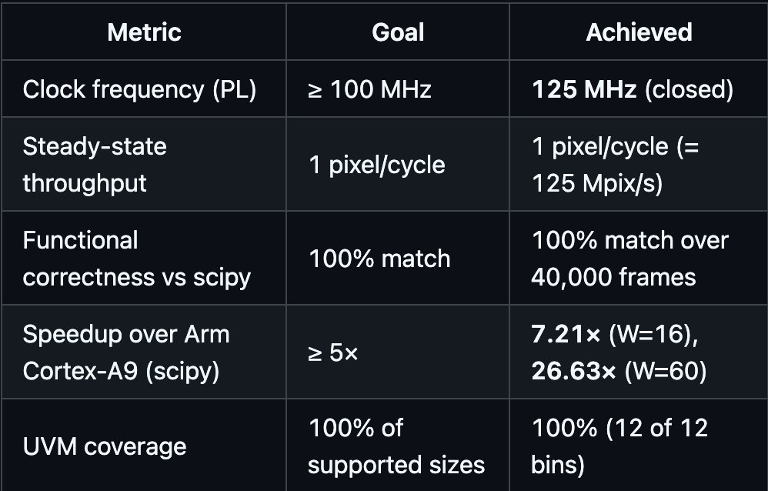
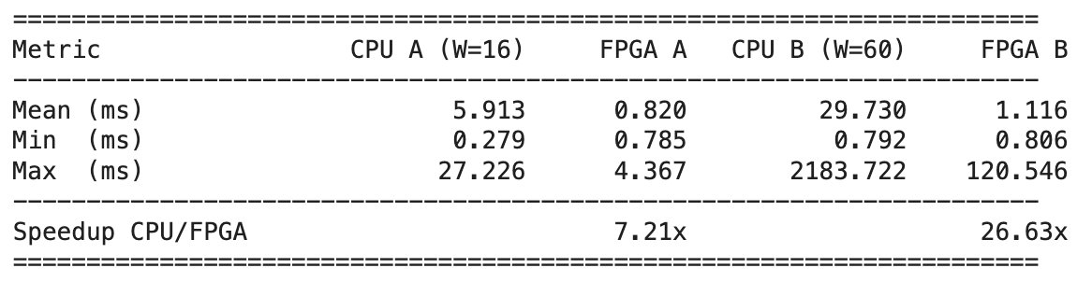
Results

Slide 23
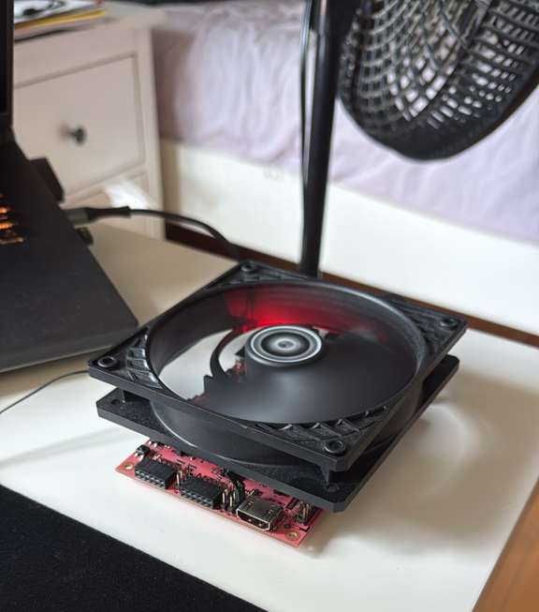
Device Demo
Walk through the projects demo.ipynb to demonstrate the functioning of the device.

Slide 24
Future Improvements
Multi channel (RGB) Support
Advantage of 4 possible AXIS channels to DMA
Better encoding of data, less wasted bits
Multi Core Design
Reduce lag between buffer fill and computation
Reduce Technical Debt
Approach design with new knowledge than current implementation
Higher Clock Frequency
Reduce timing paths, currently (BRAM -> BUFFER -> MAC)

