Slide 1
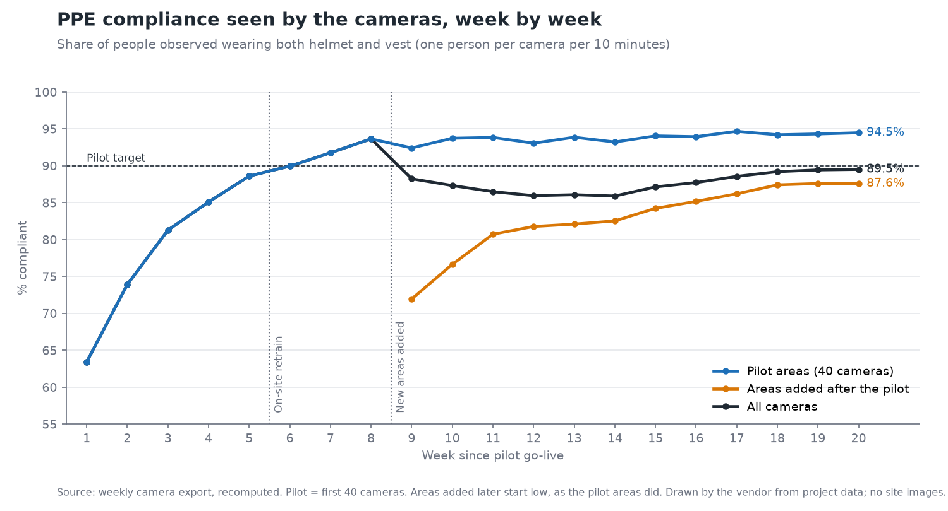
Case study (anonymised) | Indian cement manufacturer | AI safety on existing CCTV
Real PPE compliance rose from 69% to 91% in an eight-week pilot
• Restricted-zone entries down 77% after the client added guards the camera data pointed to
• Alerts acknowledged in about 2 minutes, down from nearly 9
• False alarms under 10% on the client's own sample review, down from 20%
• Truck turnaround down 24% on like-for-like data, credit shared with the client's own gate changes
• No video left the plant network: on-premises, no internet egress
Anonymised draft pending client approval. Every figure traces to the project record.

