Slide 1
THE PROBLEM
Our best proof is locked in email threads - and the easy version of it is wrong
The sales draft for this project said: 74% → 97% compliance, zero accidents, ₹2.3 Cr saved.
Every one of those fails against the record: mixed baselines, seven months of no injuries claimed as a result, savings the client's finance team had already rejected.
The client said no to the WhatsApp approval, and warned that 'cement major' with those numbers names them.
Today a person spends days digging, and still gets it wrong.
What a buyer, a plant team and a legal team need instead:
• numbers measured the way the client signed for
• missed targets shown as missed, and how they were fixed
• credit shared with what the client did
• nothing that identifies the client, alone or combined

Slide 2
THE ENGINE
Nine agents, one rule: no line leaves without a file behind it
Librarian → Extractor → Historian → Analyst → Exposure officer → Writer → Fact-checker → Media → Approval clerk → STOP for a person
• 157 evidence items, every quote verified word-for-word to file:line
• 54 metrics recomputed from raw data; reproduces the client's acceptance certificate exactly (91.1%, −46%, 4.9 min, 9.7%)
• Refuses: untraceable numbers, ruled-out claims (zero LTIs, 97%), identifiers (names, places, capacity, camera count, weighbridge press release, GPS in a photo)
• Two signed approvals, tied to the pack's hash; plant approval alone does not count
Runs on another project untouched: only project.json changes (tested on a second, different library).
9 automated checks pass, incl. a refusal test and a stop-for-a-person test.
Claude writes and extracts with --llm; the checker, calculator and gate are code, so the model can propose but never publish.

Slide 3
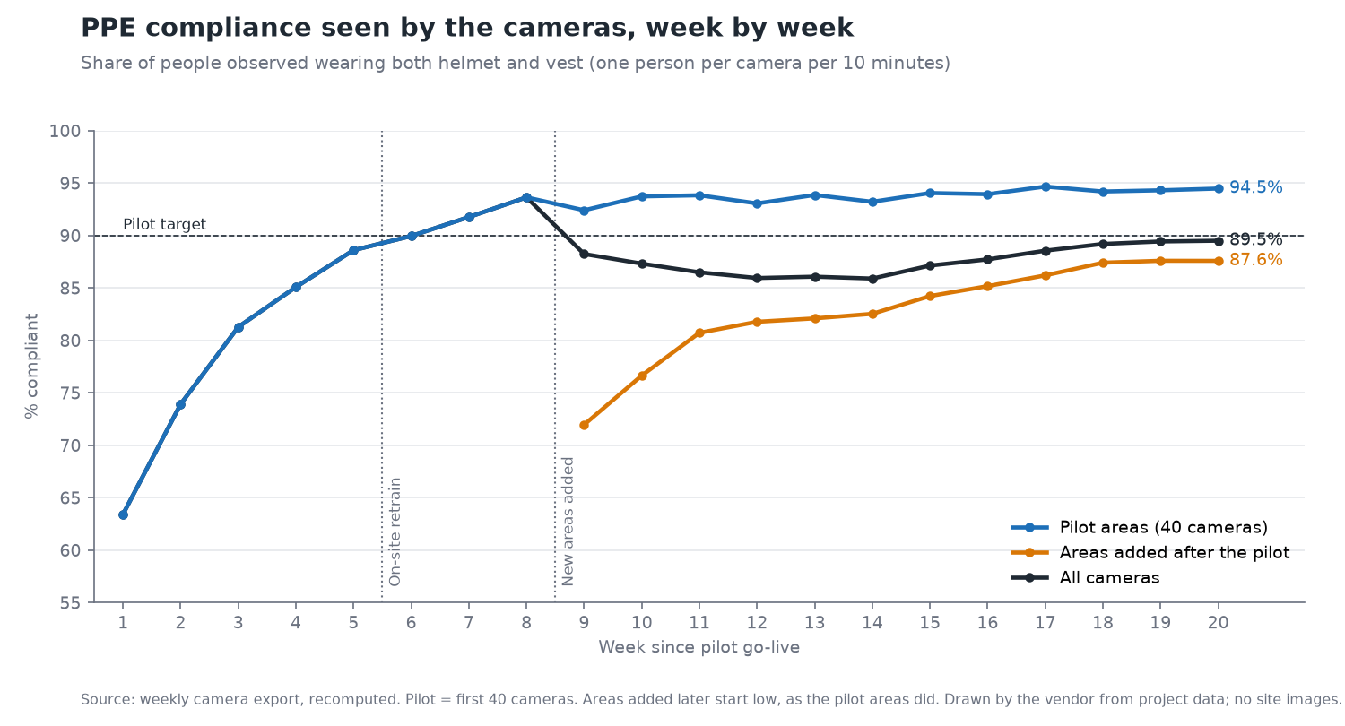
THE RESULT, READY FOR A YES
Real PPE compliance 69% → 91% in an eight-week pilot - and the story a client can sign
Gatekeeper: one-page fact sheet - no video leaves the plant, text-only alerts, outage owned and fixed.
User: 'I showed the photo. After that, no argument.' False alarms 20% → under 10%, alerts acknowledged in ~2 min.
Buyer: gate turnaround −24% like-for-like, money only where finance measured it, payback in the client's own words.
Approval: anonymised / named later / internal only / no - reply by 18 Nov, withdraw any time.

