Slide 1




Real-time Pose Estimation and Activity Guidance on a CPU
- Dhruv Jawalkar, Aashish Adhikari, Sudha Ravi Javvadi
State: current_stage
Activity: [Stages] Stage : { correction_checks : [] ref_image: }
checks: Angle
Distance
Per Frame:
Lightweight OpenPose Network with our changes
Predicted Person Pose
Controller
Guidance: Bring feet together Rest arms on hip

Slide 2
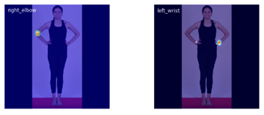
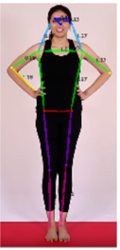
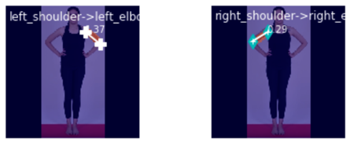

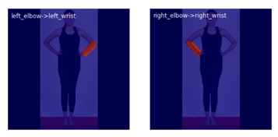
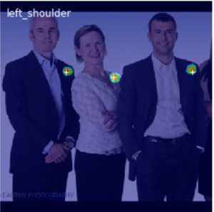

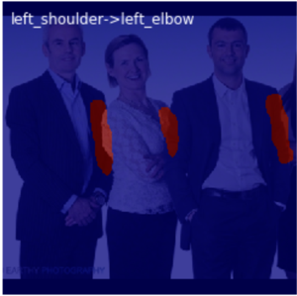
Pose Estimation Primer
Heatmap -> point (x,y) (local maxima)
Proceeds part-pair wise. match joints acc. To PAF score.
NN Model
Occluded part (left_elbow) in one instance
Prevent forced matches (Shoulder -> elbow) allow only one to one, (Hungarian Algorithm)
Prevent cross connections by thresholding

Slide 3
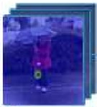

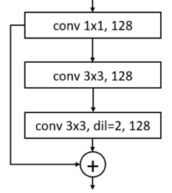
Lightweight OpenPose
Initial Stage
Refinement Stage
MobileNetv1
Image
Initial Stage
Refinement Stage
Refinement Block
Conv 1*1, 512
Conv 1*1, 128
Conv 3 * 3, 128
Conv 3 * 3, 128
Conv 3 * 3, 128
Refinement Block
Refinement Block
Refinement Block
Refinement Block
Refinement Block
Conv 1*1, 512
Conv 1*1, 128

Slide 4

Proposed Lighter OpenPose 1
Initial Stage
With
Less Filters
Refinement Stage with less Refinement Blocks and less filters
MobileNetv1 with a Skip Connection and Layers Removed
Image
New Initial Stage
New Refinement Stage
New Refinement Block
Conv 1*1, 256
Conv 1*1, 128
64
64
64
Conv 3 * 3, 128
Conv 3 * 3, 128
Conv 3 * 3, 128
Refinement Block
Refinement Block
Refinement Block
Conv 1*1, 256
Conv 1*1, 128

Slide 5
Results for Lighter OpenPose1
Average Per-Frame Processing Time for LightWeight OpenPose
Average Per-Frame Processing Time for Lighter OpenPose1

Slide 6
Proposed Lighter OpenPose 2
MobileNet-V1
- Conv7, 11, 12 removed
-Max #Filters:128
-Skip-connection (Conv5->9)
-Backbone features extracted using feature pyramid
Initial Stage
Refinement Stage
Image
New Initial Stage
New Refinement Stage
New Refinement Block
Conv 1*1, 128
Conv 1*1, 128
64
64
64
Conv 3 * 3, 128
Conv 3 * 3, 128
Conv 3 * 3, 128
Refinement Block
Refinement Block
Refinement Block
Conv 1*1,
128
Conv 1*1, 128

Slide 7
Modified MobileNetv1 with Feature Pyramid
P1 and P2 are obtained by MaxPooling Conv10 features. 2x2, stride=2 and 2x2 stride=4
Conv5 3*3, 128
Conv9 3*3, 128
Input 368*368
Conv4 3*3, 128
Conv10 3*3, 128
Conv3 3*3, 128
Conv7 3*3, 128
Conv1 3*3, 32
Conv8 3*3, 128
Conv2 3*3, 64
Conv6 3*3, 128
P1
P2
P3
Initial Stage
Denotes 1x1 Conv, Upsample x2, element wise addition to higher layer

Slide 8
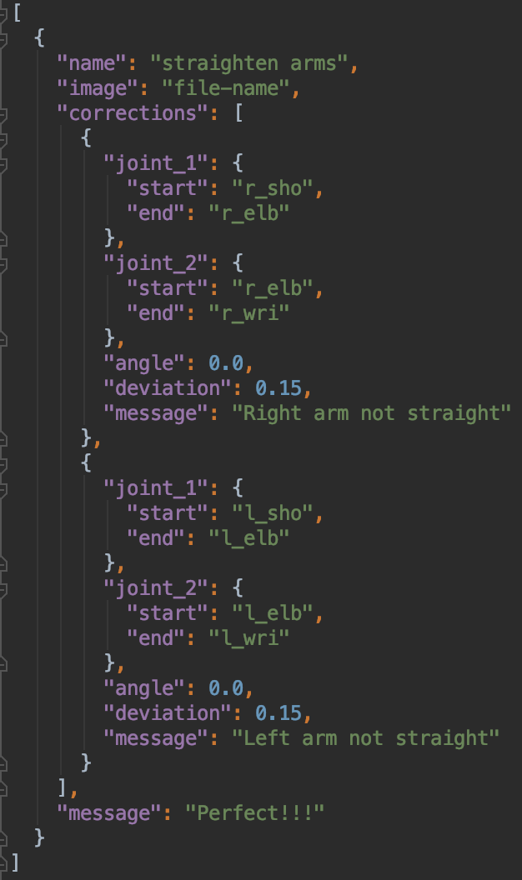
Configurable Activity Guidance
Add new activities using json configuration.
Allow users to choose from multiple activities.
Currently, not integrated to show the corresponding expected pose in the camera view.

Slide 9
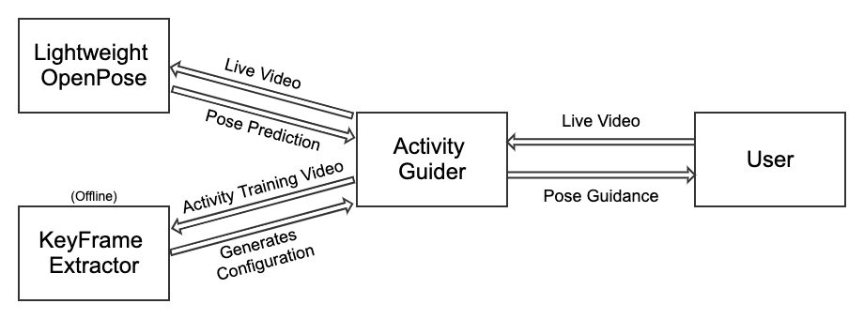
Model to extract the keyframes in a video

Slide 10
Future Improvements
Application
Integrate configurable activity guidance in the application
Add a keyframe detector to detect key frames in video and generates the above configuration
Lightweight OpenPose Model
Reduce the network parameters, explore other techniques
Elimination of unwanted keypoints to reduce computation. For e.g., eyes, ears

