Slide 1

Capstone 2
asd
Group member:
Dhruv Mistry(XXX035)
Kar chun Kan (XXX724)

Slide 2
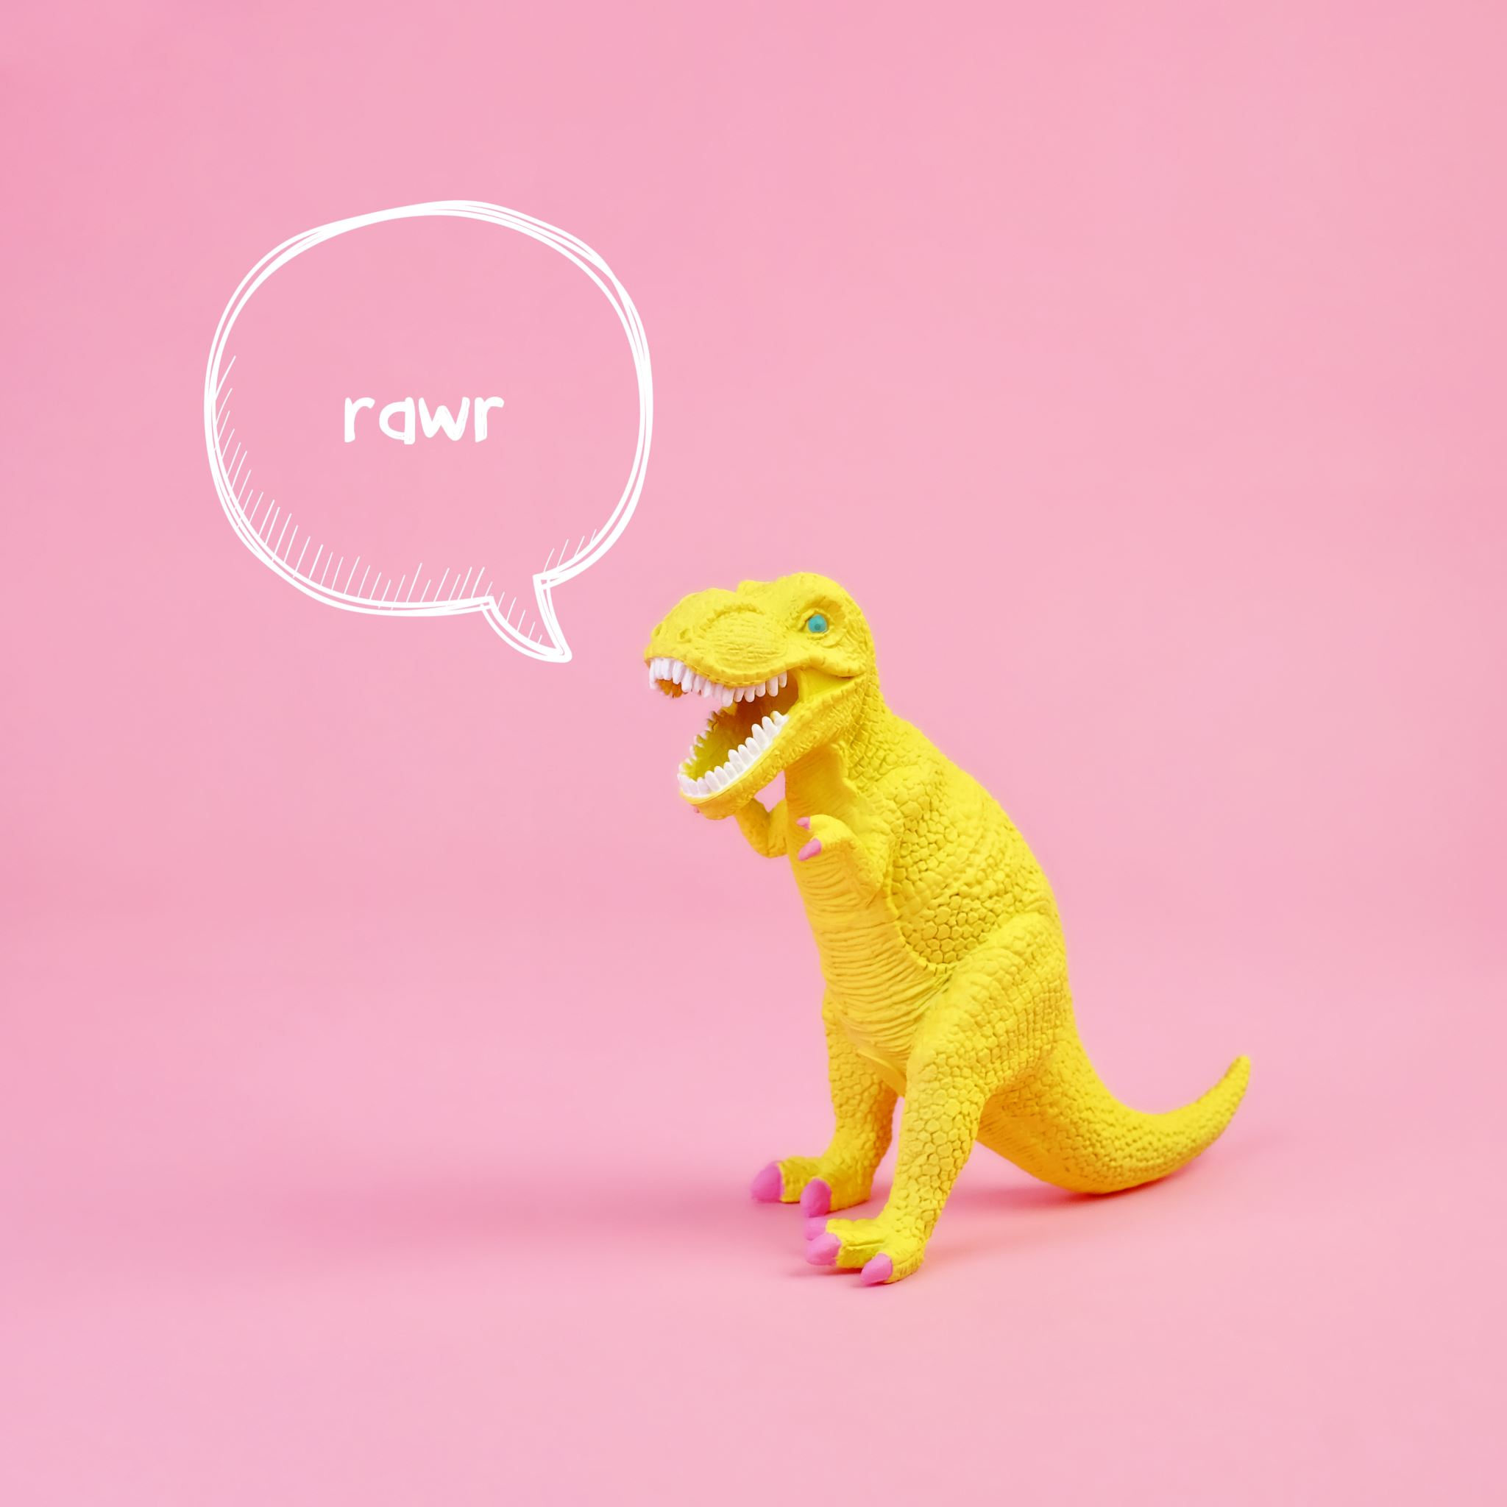
Trex Dino Bot
Project selected

Slide 3
Features and functions
3 obstacle
Single tree
Multiple tree
Bird
Mode 1
Played by user
Save AI model according to user play style
Mode 2
Played by saved AI model
Web application deployed on cloud

Slide 4
Technology stack
Python
JavaScript
HTML
Azure / AWS / Google Cloud

Slide 5
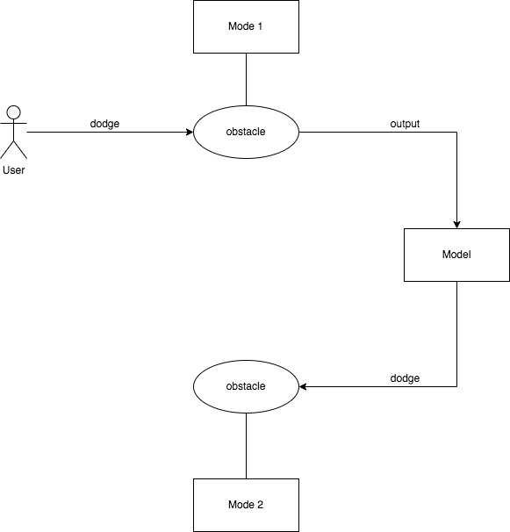
High level architecture

Slide 6
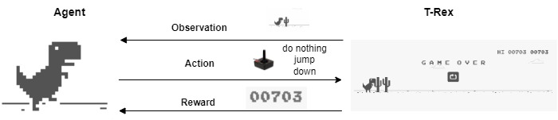
High level architecture

