Slide 1

Asset Management Portal
(Batch : DA-3)
Dhruv Kaushal
Ronak Agarwal
Ayushman Mishra
Himanshu Agrawal
Abhishek Nayyar
Nidhi Sebastian
Aditya Babu
Vishal Tandale
Shravani Mulkalwar
Group members

Slide 2
Objectives
Keep track of several assets that can be borrowed, their availability, their current status, current borrower and the asset history
Borrower can search for asset and if available, they can borrow them
Each asset will have a deadline, different assets will have different deadlines
Fine is imposed on borrower if deadline is not met
User is banned for a particular banned period on late return of asset

Slide 3

Application Features
Borrowing anything is a click away!!
User friendly interface
Effective searching makes every service simple to discover
Password encrypted using MD5 hashing algorithm
Generates unique ID for each user
Normalisation of database to remove redundancy
Admin has privilege to manage all the asset details
Ban a user if the deadline is not met
Communication with the user before deadlines
Import users using json feature

Slide 4
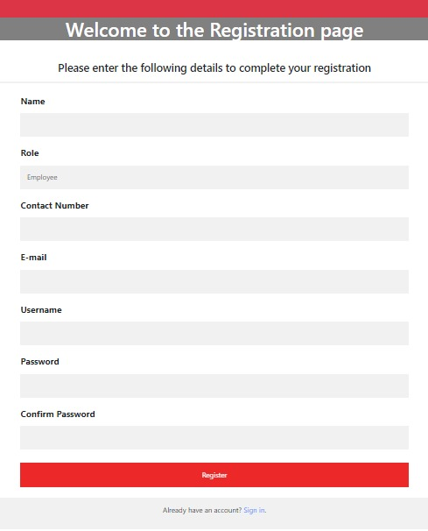
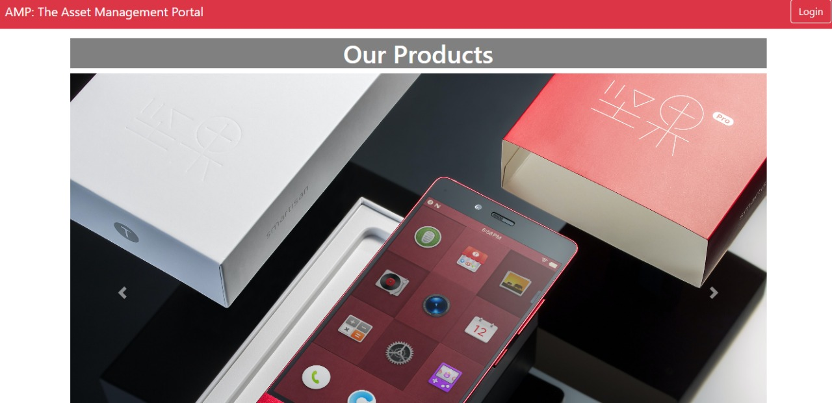
Snapshots

Slide 5
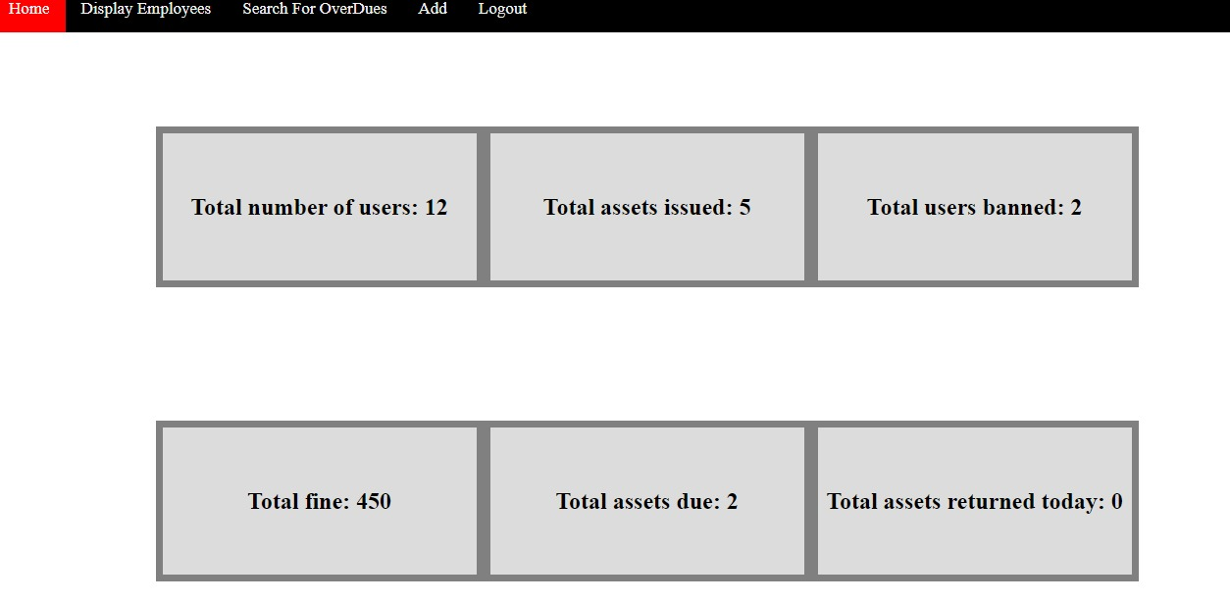
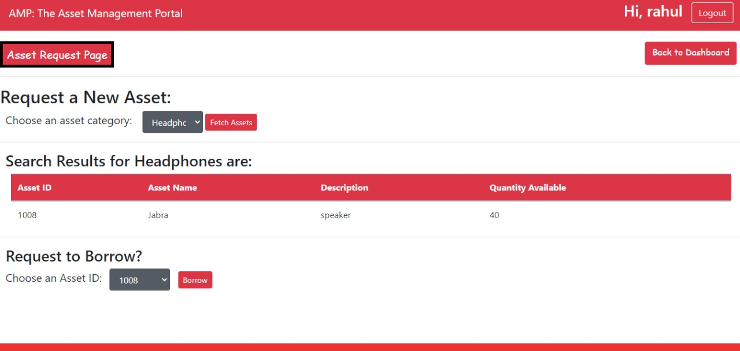
Snapshots

Slide 6

Learnings
Professional
learning
Technical
Learning
Future
scope
Time management
Collaborative engagement in the task
Dividing the tasks in a team so as to achieve the outcome within a deadline
Arranging daily meetings to track the progress
Goal management
Critical and Analytical thinking
Version control and source code management using GitHub
MVC architecture
Eclipse for Dynamic Java Web Application
Apache Tomcat Server
Database Management
OOPs concept
Web full stack
UML Diagrams
Employee to admin message functionality
Scheduler for automating certain processes
Tracking request for borrow status

Slide 7
THANK YOU

