Slide 1
Dynamic Access Control Evaluation
Phase 1: Architecture Modeling

Slide 2
Proposed Methodology

Slide 3
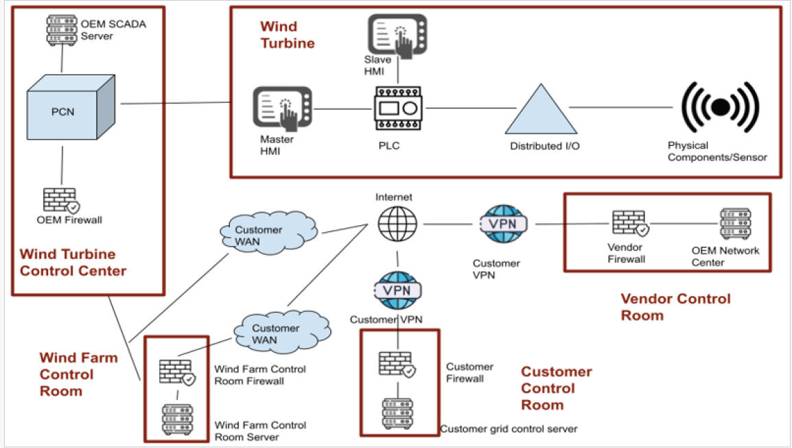
Reference Architecture-Wind Farm

Slide 4
Structured Information Ext.- Concept
Systematic extraction of architectural data
Network topology – zones, conduits, network segmentation, and interconnections
Industrial protocols- operational roles, communication boundaries
Authorization-centric representation- Modeling authorization relationships as first class entities
Subjects- operational roles, services, and other accounts
Objects- devices, services, configuration and control interfaces
Actions- read, write, control and configure
Attributes-roles
This aligns with RBAC
Authorization Attack Surface Graph (AASG)
Nodes as subjects, roles and protected resources
Edges- policy permitted actions
Edge constraints- RBAC predicates, cross-zone and protocol specific constraints

Slide 5
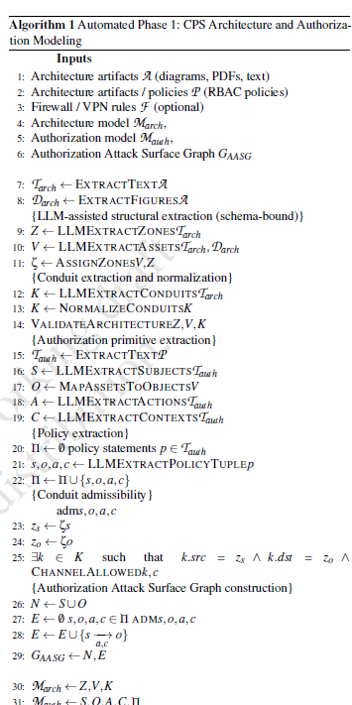
Algorithm for Architecture Modeling

Slide 6
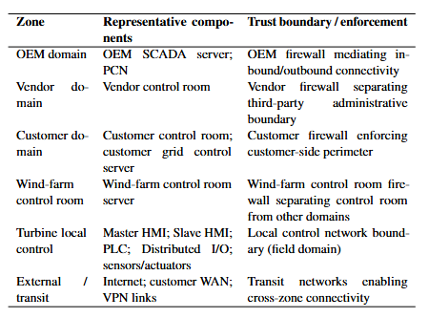
Architecture Modeling of Wind Farm Architecture- Security Zones and Trust Boundaries

Slide 7
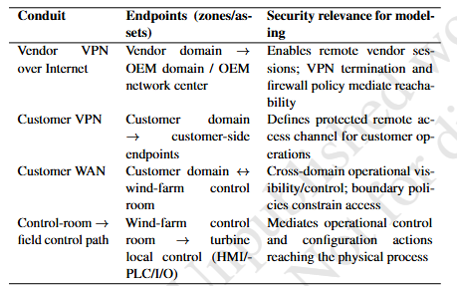
Architecture Modeling of Wind Farm Architecture- Cross zone conduits-Communication Paths

Slide 8
Architecture and Authorization- Formal Definition

Slide 9
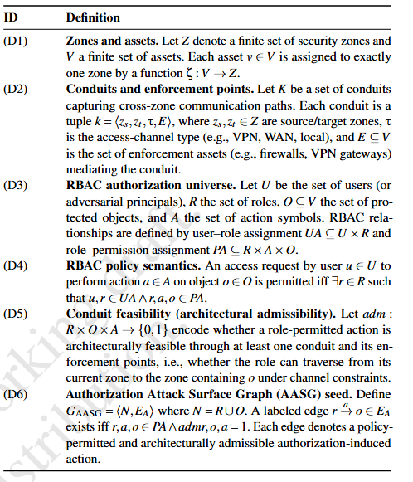
Architecture and Authorization- Formal Definition With RBAC

Slide 10
AASG – Authorization Attack Surface Graph
Graph based representation of authorization-induced reachability
Nodes represent roles and protected assets
Edge represent policy permitted actions that are architecturally admissible
Captures how permissions translate into concrete, multi-hop reachability paths
Bridges policy and attacks- transforms RBAC authorization rules into a reachability model
Enables threat identification- Policy-permitted edges and paths in AASG are interpreted as policy-induced threats when they enable high-impact actions (HMI control or PLC logic modification)
Foundation for automation- Serves as input abstraction for planning-based attack generation, attack graph construction, and empirical evaluation.
Explains hidden risk- reveals transitive cross-zone attack paths that are inevitable in topology-only or permission-only models
Supports what-if analysis: changes to authorization or conduits directly reshape the AASG, enabling quantitative evaluation of policy hardening
Traditional attack graphs explain how system fail, ASSG explains how system can be attacked while working exactly as designed

Slide 11
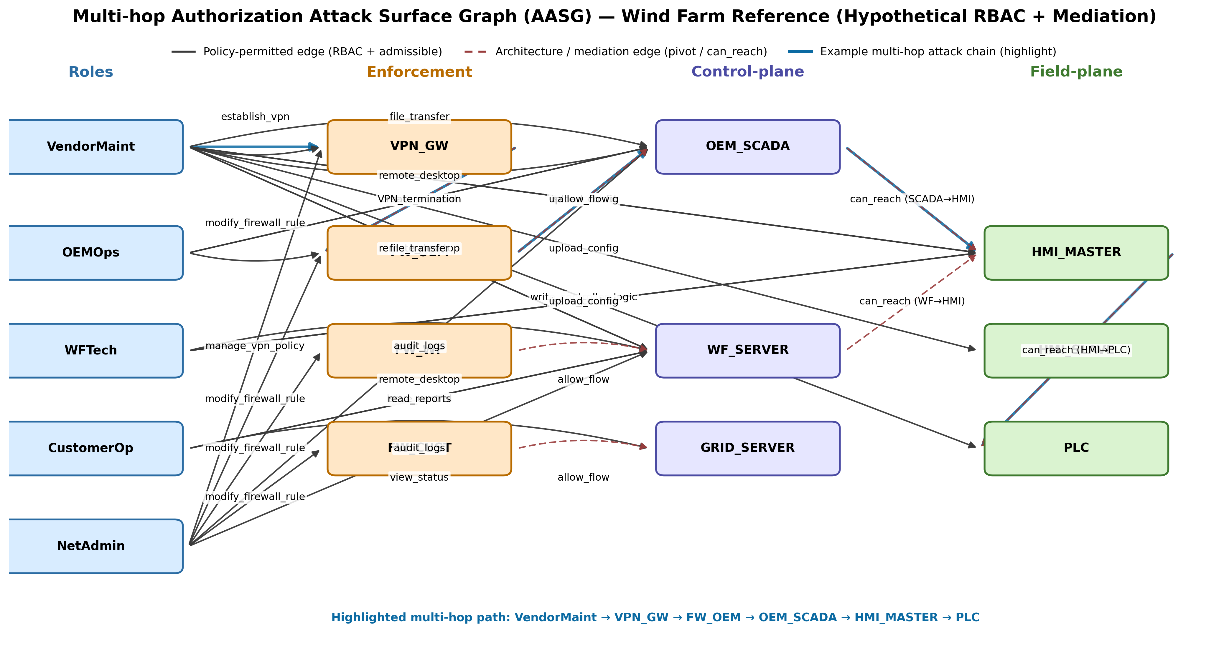
Example AASG for Ref. Architecture

Slide 12
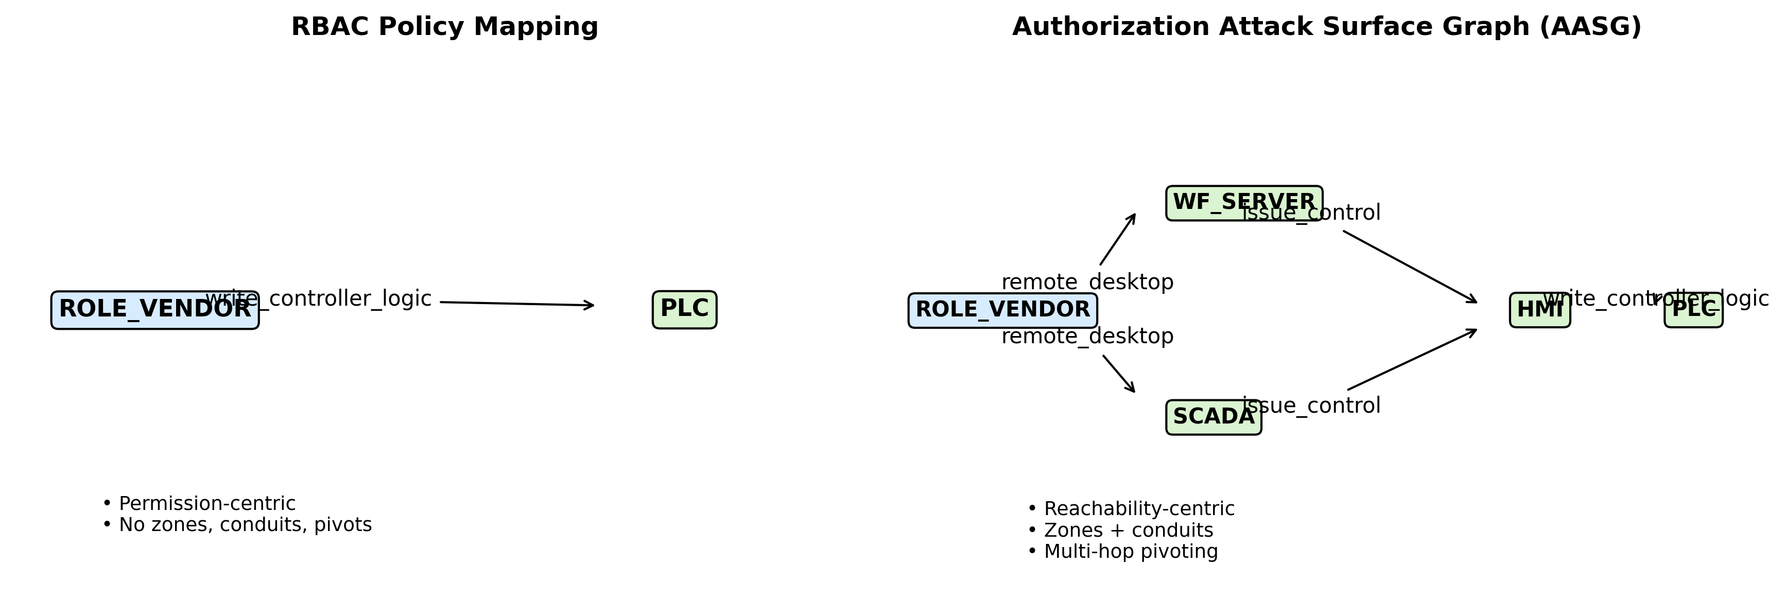
Difference between RBAC and AASG

