Slide 1



Business Data Scientist Challenge 2019/2020
MBA 6693 Data Analytics for Business Decisions
University of New Brunswick
Group 5
Zeeshan Ahmed (3631526, syed.zeeshan.ahmed@unb.ca)
Dhruv Mehandiratta (3674414, dmehandi@unb.ca)
Roopali Taluja (3633638, rtaluja@unb.ca)
Vedang Goswami (3637670, vgoswami@unb.ca)

Slide 2

Table of contents
Introduction
Dataset collection
Approach
Data cleaning
Final Dataset
EDA
Modeling
Results
Challenges Faced

Slide 3

Introduction
We aim to apply data analytics or analysis techniques to generate timely estimates of nominal GDP using publicly available datasets. While the data for most variables in the accessible tables are available up to the most recent year of reference, the nominal GDP data by industry are available with a 3-years-lag. In this challenge, measuring nominal GDP using publicly available data sources, methods for producing more timely estimates, and methods for benchmarking are some of the key tasks.

Slide 4
Dataset Collection
We have made use of multiple Dataset tables. Below mentioned is the list of Datasets that we have used: -
Variation of Salaries and Wages in Canada with time.
Variation of Trade values (Imports and Exports) of Canada with time.
Variation of FDI for Canada with time.
Variation of Unemployment rates in Canada with time.
Variation of Total Reserve values of Canada with time.
Variation of Household Income values in Canada with time.
Variation of Real Estate Growth in Canada with time.
Variation of Inflation Rate in Canada with time.
Variation of GDP rates and Annual GDP value in Canada over time.
Variation of Tourism gross domestic product, constant prices
Variation of Retail trade sales by industry

Slide 5
Dataset Description
Variation of Salaries and Wages in Canada with time.
The data set contains the monthly canadian salary values for different sectors. The values are represented in thousands of canadian dollars. We have applied filters to consider the data for “Wages and salaries” sector and adjustment type “Unadjusted” for every year in millions of canadian dollars. (every Jan for each year).
Variation of Trade values (Imports and Exports) of Canada with time.
The dataset contains the monthly trade values in millions of canadian dollars by various classification systems, adjustment values and on various basis. We have applied filters to consider the unadjusted data for “Total of All Merchandise” on custom basis, annually.

Slide 6

Dataset Description
Variation of Real Estate Growth in Canada with time.
The data set contains the monthly gross domestic product value for different sectors. The values are represented in millions of canadian dollars. We have applied filters to consider the data for “Real Estate and Real estate and rental and leasing” sector and adjustment type “Seasonally adjusted at annual rates” for every year in millions of canadian dollars. (every Jan for each year) and Prices “2012 constant prices”.

Slide 7
Retail trade sales by industry: This dataset available on statics Canada website shows record of retail trade sales in Canada by industry from Jan-1991 to Dec-2019 [1]. The values are represented in thousands of Canadian dollars. We have applied filters to consider the unadjusted data for “Retail trade”.
Tourism gross domestic product, constant prices: This dataset holds data of tourism gross domestic product from Jan-1986 to Jul-2019 of Canada [2]. The values are represented in millions of Canadian dollars. We have applied filters to consider the unadjusted data for “Tourism gross domestic product”. Key indicators:
Trips abroad by Canadian residents (seasonally adjusted)
Trips to Canada by travelers from abroad (seasonally adjusted)
Dataset Description

Slide 8
Dataset Description
International Payments: This dataset holds the data for all the International accounts (capital and current) balances and payments done by Canada [7]. We have selected the feature “International payments” made by Canada to “all countries” towards its Current Account. This data is available annually in millions of dollar units.
Investments: This dataset holds the data for all the investments made by Canada abroad and all the invested by foreign countries in Canada [8]. We have selected the total book values of Canadian Direct Investment abroad in all countries and Foreign Direct Investment in Canada by all foreign countries as the features. This data is available annually in million dollar units.

Slide 9
Dataset Description
Canada’s official International Reserves: This dataset holds the position and values of all the International Reserves of Canada [13]. From this dataset we have selected the following features:
US Dollar reserves
International Monetary Fund position
Total International Reserves of Canada
All the selected features are available monthly and we have selected the January value of each year as the data.

Slide 10
Approach
Steps that we followed: -
Create preliminary dataset: A Master dataset we created by merging all the variables by “REF DATE” attribute.
EDA analysis: We have performed EDA in order to define and refine the selection of feature variables that will be used for building models.
Distribution study: We plotted graphs and studied about the distribution of variables.
Feature selection: We applied PCA to filter out the irrelevant variables.
Modeling: We applied various models.
Our results: We decided the best model on the basis of RMSE values.

Slide 11
Preliminary Dataset
After selecting our variables from all the datasets from stats canada website, we applied filters of each of them:
Converting every value in millions for consistency
Using ‘Canada’ values from geography attributes
And then using these filtered datasets to create a Master dataset through merging "REF_DATE".

Slide 12

Exploratory Data Analysis
Exploratory Data Analysis (EDA) is an approach for summarizing, visualizing, and becoming intimately familiar with the important characteristics of a data set. We have performed EDA in order to define and refine the selection of feature variables that will be used for building models.
Methods of EDA: -
Univariate Visualization
Bivariate Visualization
Multivariate Visualization
Dimensionality Reduction

Slide 13
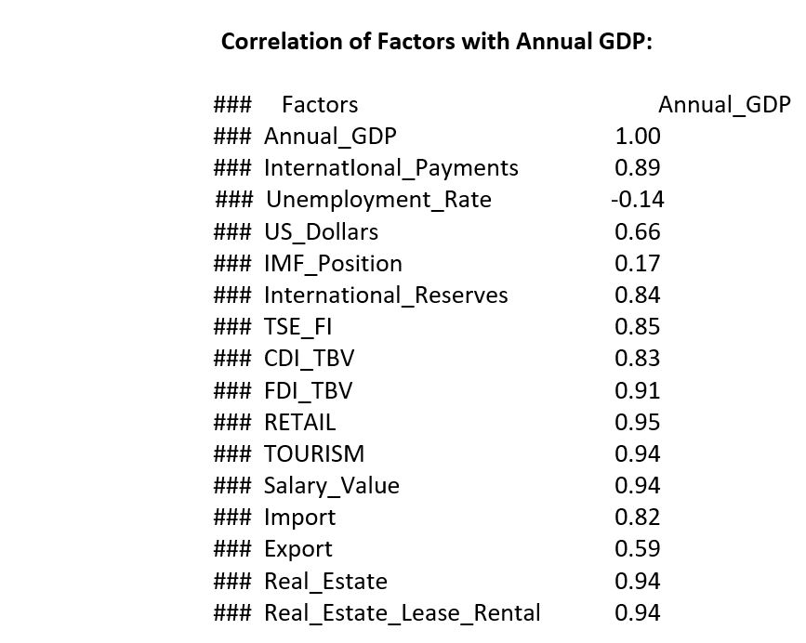
Exploratory Data Analysis
Correlations: -
We have found correlation of various factors with Annual GDP values, to learn about the dependency of GDP with factors better.

Slide 14
Exploratory Data Analysis
Graphs and Plots of all variables: -
Now, in order to know about the variables better and to learn about the distribution of each variable, we have plotted the frequency bar graphs, line graphs and box plots of each variable that is considered in our GDP calculation.

Slide 15
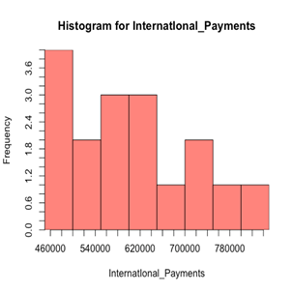
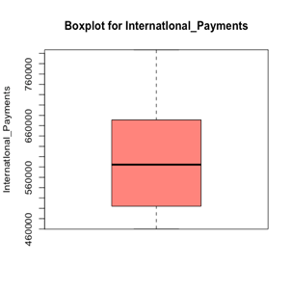
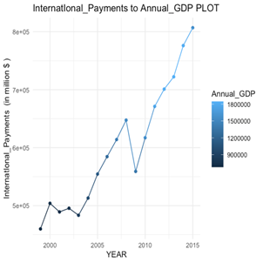
Exploratory Data Analysis
1.2.1 Variable Name: International Payments

Slide 16
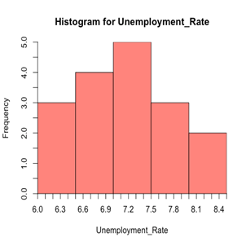
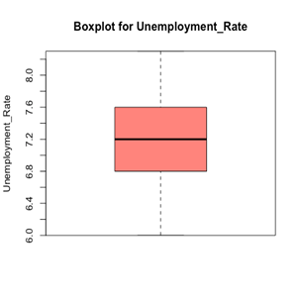
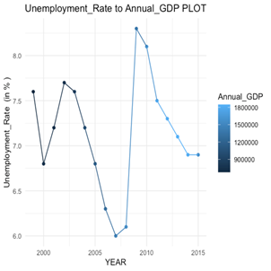
Exploratory Data Analysis
1.2.2 Variable Name: Unemployment Rate

Slide 17
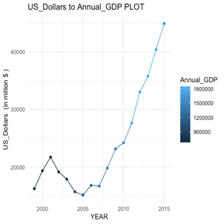
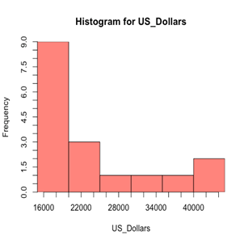
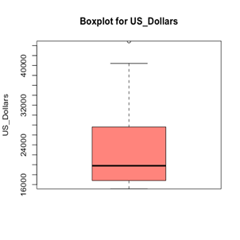
Exploratory Data Analysis
1.2.3 Variable Name: US_Dollars

Slide 18
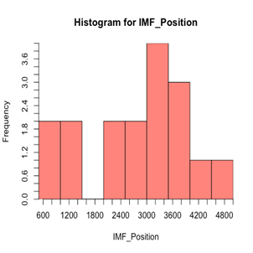
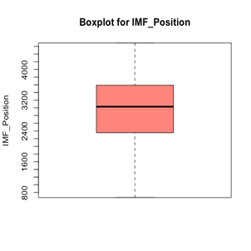
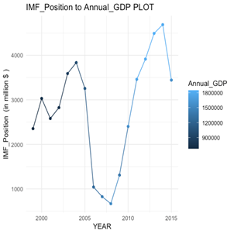
Exploratory Data Analysis
1.2.4 Variable Name: IMF_Position

Slide 19
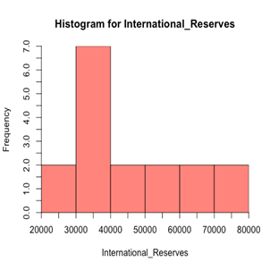
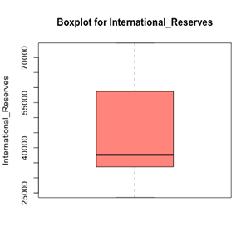
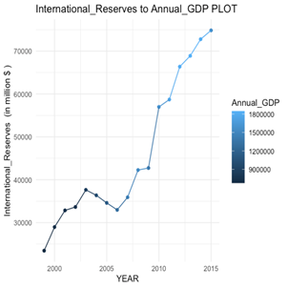
Exploratory Data Analysis
1.2.5 Variable Name: International Reserves

Slide 20
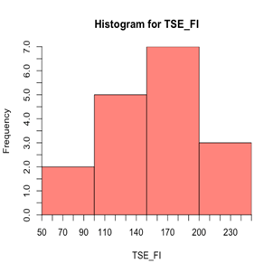
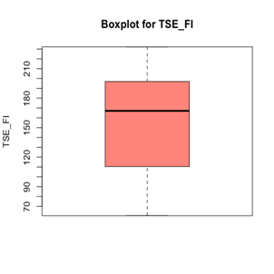
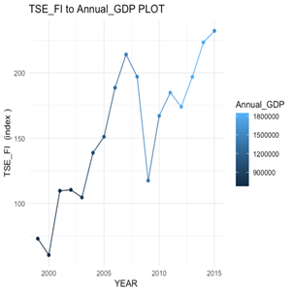
Exploratory Data Analysis
1.2.6 Variable Name: TSE_FI

Slide 21
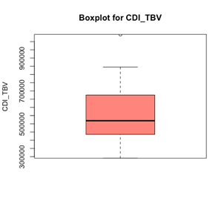
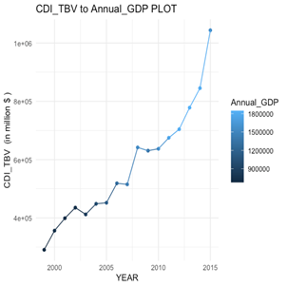
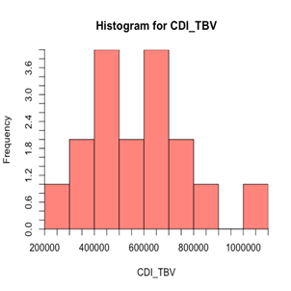
Exploratory Data Analysis
1.2.7 Variable Name: CDI_TBV

Slide 22
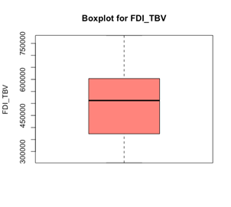
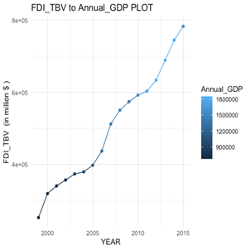
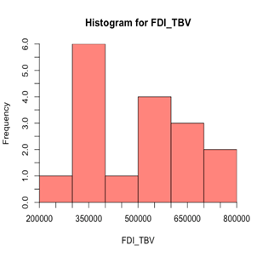
Exploratory Data Analysis
1.2.8 Variable Name: FDI_TBV

Slide 23
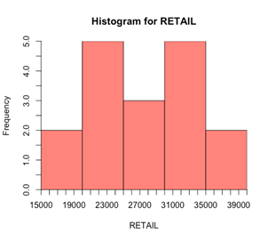
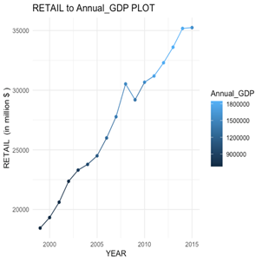
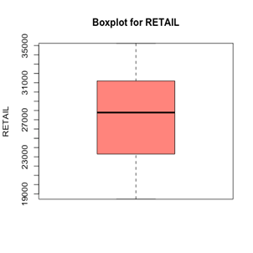
Exploratory Data Analysis
1.2.9 Variable Name: Retail

Slide 24
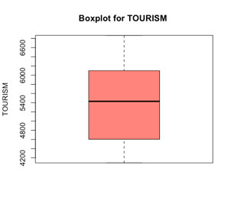
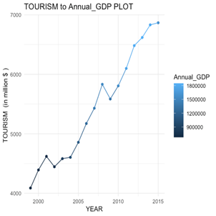
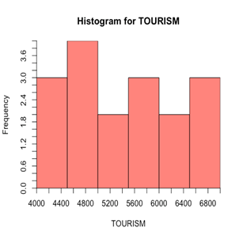
Exploratory Data Analysis
1.2.10 Variable Name: Tourism

Slide 25
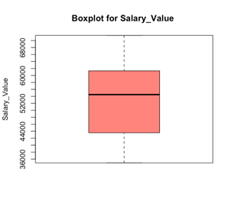
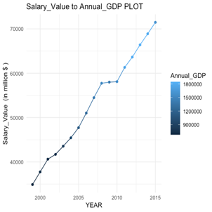
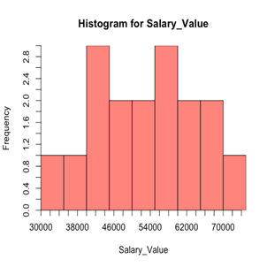
Exploratory Data Analysis
1.2.11 Variable Name: Salary Value

Slide 26
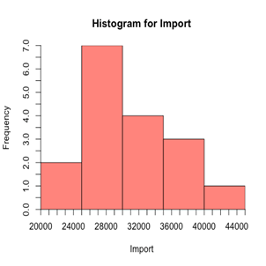
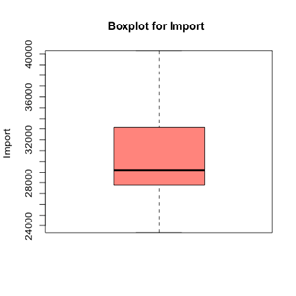
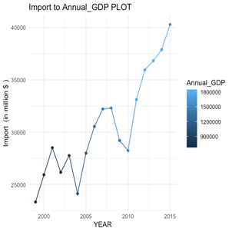
Exploratory Data Analysis
1.2.12 Variable Name: Import

Slide 27
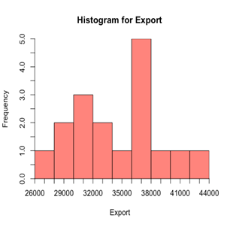
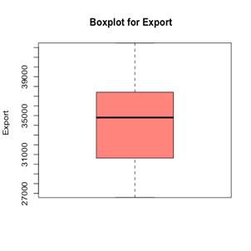
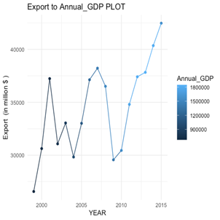
Exploratory Data Analysis
1.2.13 Variable Name: Export

Slide 28
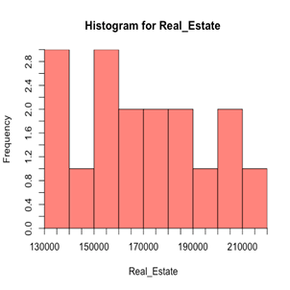
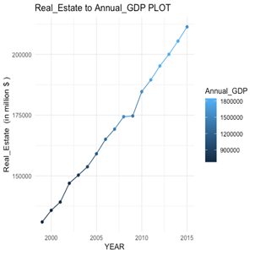
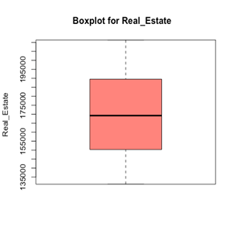
Exploratory Data Analysis
1.2.14 Variable Name: Real Estate

Slide 29
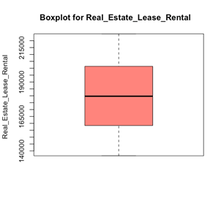
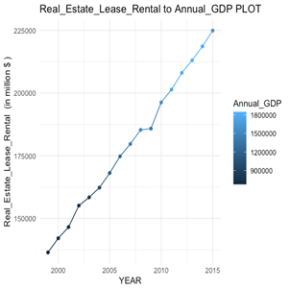
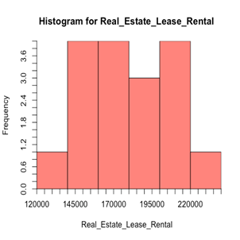
Exploratory Data Analysis
1.2.15 Variable Name: Real Estate Lease Rental

Slide 30
Feature Selection
The goal of this step is to reduce the multi-collinearity between the selected features. By applying Principal Component Analysis we reduced the number of originally selected feature from 16 to 10 now. The features are selected based on the highest contribution of features in the first dimension.
Selected Features:
Tourism
International_Payments
Real_Estate
CDI
Retail
Real_Estate_Lease_Rental
Import
FDI
Salary
International_Reserves

Slide 31
Data Modeling
The goal of a model is to provide a simple low-dimensional summary of a dataset. In the context of this book we’re going to use models to partition data into patterns and residuals. Strong patterns will hide subtler trends, so we’ll use models to help peel back layers of structure as we explore a dataset.
Types of models:
Multiple linear Regression Model
Random Forest Model
Regression Tree Model

Slide 32
Multiple Linear Regression Model
Background and Reason For choosing:
In statistics, linear regression is a linear approach to modeling the relationship between a scalar response (or dependent variable) and one or more explanatory variables (or independent variables). The case of one explanatory variable is called simple linear regression. For more than one explanatory variable, the process is called multiple linear regression.
So, we are using multiple regression model to predict Annual GDP (dependent variable ) with the help of multiple independent variables such as International Payments, Unemployment rate, US dollars, Reserve position in the International Monetary Fund (IMF), International reserves, Canadian Direct Investment, Foreign Direct Investment, Retail, Salary, Import, Export, Real Estate, Real Estate, Lease and Rental.

Slide 33
Multiple Linear Regression Model
without scaling
Results obtained in our case: When applying Linear regression model with scaling on our master dataset, we get the following results:
Residual standard error: 52460 on 4 degrees of freedom
Multiple R-squared: 0.9965
Adjusted R-squared: 0.9836
F-statistic: 76.9 on 15 and 4 DF
p-value: 0.000375
For 2016: Actual value = 1530024 Predicted value = 1530627 RMSE = 603
For 2017: Actual value = 1649934 Predicted value = 1634087 RMSE = 15847
For 2018: Actual value = 1712479 Predicted value = 1729176 RMSE = 16697

Slide 34
Multiple Linear Regression Model
without scaling.
Results obtained in our case:
First the regression as a whole is significant i.e, shown by F-statistic and p-value. As the p-value is less than any value of significance. So, the regression relation does exist.
Multiple R-squared shows that 99.65% of the Annual GDP has been explained by the regression.
The RMSE is the square root of the variance of the residuals. It indicates the absolute fit of the model to the data–how close the observed data points are to the model’s predicted values. Whereas R-squared is a relative measure of fit, RMSE is an absolute measure of fit. As the square root of a variance, RMSE can be interpreted as the standard deviation of the unexplained variance, and has the useful property of being in the same units as the response variable. Lower values of RMSE indicate better fit. RMSE is a good measure of how accurately the model predicts the response, and it is the most important criterion for fit if the main purpose of the model is prediction.

Slide 35
Multiple Linear Regression Model
with scaling.
Results obtained in our case: After applying Linear regression model with scaling on our master dataset, we get the following results:
Residual standard error: 0.1359 on 2 degrees of freedom
Multiple R-squared: 0.9979
Adjusted R-squared: 0.9829
F-statistic: 66.67 on 14 and 2 DF
p-value: 0.01487
For 2016: Actual value = 0.43044068 Predicted value = 0.6270653 RMSE = 0.1966246
For 2017: Actual value = 0.72329693 Predicted value = 1.024896 RMSE = 0.3015991
For 2018: Actual value = 0.87605062 Predicted value= 1.836856 RMSE = 0.9608054
RMSE values are much lower which proves that with scaling this model predicts the value of Annual GDP more accurately.

Slide 36
Random Forest Model
Background and Reason For choosing:
Random Forest is a supervised learning algorithm which uses ensemble learning methods for regression and classification. It develops lots of decision trees based on random selection of data and random selection of variables. These decision trees are made by simply applying feature selection and row selection on a Dataset.
There are two major beliefs that are quite advantageous for using Random forests:
1. Most of the trees can provide correct prediction of class for most part of the data.
2. The trees are making mistakes at different places.
The main reason for choosing Random Forest while determining the value of Annual GDP is that the decision trees are less biased and the variance value is also reduced when the trees are joined to make a forest.

Slide 37
Random Forest Model
Results obtained in our case:
In our case, in order to determine the value of Annual GDP, we have divided our Master Data set into Training set (14 rows) and Testing set (3 rows). We applied random forest to determine the value of Annual GDP for years 2016 to 2018.
The number of trees taken in random forest is 2001. It has been observed that four variables are tried at each split, and the percentage of var explained is 87.94%.

Slide 38
Regression Tree Model
Background and Reason For choosing:
Regression tree is a type of decision tree where prediction is made for a target variable that can take continuous values.
Advantages of using a regression tree model:
Users can understand decision tree models after a brief explanation.
Trees can also be displayed graphically in a way that is easy for non-experts to interpret.
It is robust against co-linearity, particularly boosting.

Slide 39
Regression Tree Model
Results obtained in our case:
CP nsplit rel error xerror xstd
0.01 0 1 0 0
Node number 1: 11 observations
Mean = 1389202, MSE = 1.622467e+11
Year | Actual Value | Predicted Value | RMSE
2016 | 1530024 | 1304892 | 334597.1
2017 | 1649934 | 1304892
2018 | 1712479 | 1304892

Slide 40
Results (after RMS values on Models)
So from the results we got from different models we can conclude that Multiple Linear Regression Model with Scaling is the best fit for our datasets and Regression Tree is worst as RMSE value in the Regression Tree is very high.

Slide 41
Challenges Faced
From data collection to building models, we have encountered numerous challenges in our path. Some of the major challenges are listed below: -
Finding appropriate and reliable dataset sources other than StatsCanada.
Extracting proper features from datasets.
Cleaning the data and making the same data format and units throughout.
Selecting and applying appropriate regression models.ork

Slide 42
References
The Datasets are imported from the below mentioned links: -
Table 36-10-0208-01 Multifactor productivity, value-added, capital input and labour input in the aggregate business sector and major sub-sectors, by industry
Table 36-10-0434-03 Gross domestic product (GDP) at basic prices, by industry, annual average (x 1,000,000)
Table 36-10-0223-01 Implicit price indexes, gross domestic product, provincial and territorial
Table 18-10-0030-01 Industrial product price index, by product, monthly
Table 20-10-0008-02 Retail trade sales by industry (x 1,000)
Table 36-10-0234-01 Tourism gross domestic product, constant prices (x 1,000,000)
Balance of international payments, current account and capital account, annual (x 1,000,000)
International investment position, Canadian direct investment abroad and foreign direct investment in Canada, by North American Industry Classification System (NAICS) and region, annual (x 1,000,000)
Table 36-10-0205-01 Wages, salaries and employers' social contributions (x 1,000)
Table 12-10-0121-01 International merchandise trade by commodity, monthly (x 1,000,000)
Table 36-10-0434-02 Gross Domestic Product(GDP) at basic prices, by industry, monthly, growth rates(x 1,000,000)
Candian Inflation Rate
Canada's official international reserves, millions of United States dollars, Bank of Canada, monthly (x 1,000,000)

Slide 43


Thank You!

