Slide 1
Customer Quality Prediction
By - Dhruv Modi

Slide 2
Aim
To determine which set of customers the firm should contact to maximize profit.
Available Data:
Customer data: age, education, profession, loans, marital information
Last campaign data: outcome, last contacted month, day, how long back
Social and Ecometric parameters: consumer confidence index, employment variation rate etc.
Target variables: responded and profit

Slide 3
Approach
On the basis of given data, to predict the Customer Quality, in order to optimize the profit, we can target only customers who would respond and would be predicted as profitable.
By doing so, we can weed out the customers who would respond but would turn out to be a loss making or the customers who would never respond. Hence, helping in increasing profit margin during Marketing.
First Response Model (classification: 1 or 0) is built and then customer who responded, Profit model (regression) is built for them.

Slide 4
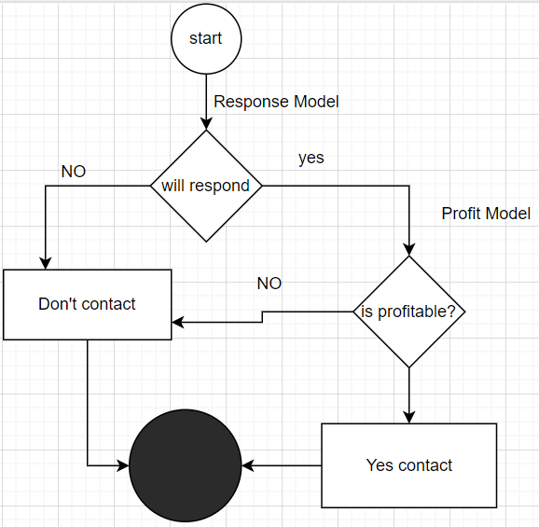
Flow chart

Slide 5
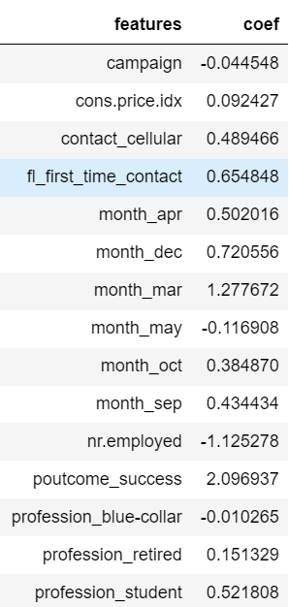
Response Model
Coef means Model Coefficient. Coef indicates higher the absolute value, more important a feature is. If coef is positive it means with increase in feature value the response rate increases. Visa versa for negative coef.
Most effective feature in response rate is success status of previous call. Least important feature is campaign.

Slide 6
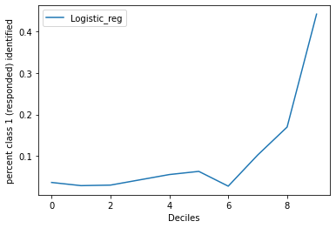
The probability from the model is divided into deciles and in each deciles the number of responded cases have been identified.
It shows that with increase in probability the number of cases responding increases. Hence the output is rank ordering well with the target variable.

Slide 7
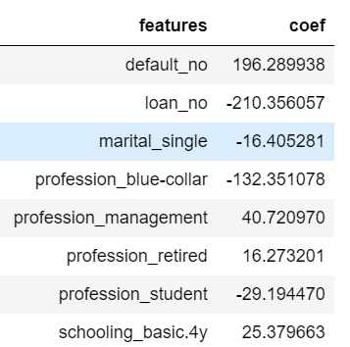
Profit Model
Coef means Model Coefficient. Coef indicates higher the absolute value, more important a feature is. If coef is positive it means with increase in feature value the response rate increases. Visa versa for negative coef.
Most effective feature in predicting the profit is the number of loans. Higher the number of loans, lower is the profit. Least important feature is profession_retired.

Slide 8
95% Prediction Interval is taken to decide the cut-off for the profit.
(A prediction interval for a single future observation is an interval that will, with a specified degree of confidence, contain a future randomly selected observation from a distribution)
To optimize the profit during the campaign, we can shortlist customers whose Model predicted at least 106 profit. Because, we saw that ~96% of customers whose profit is predicted falls in the range of 95% Prediction interval. i.e. Even if a person's profit is predicted as 106 (actual profit is 1) we will be on safer side.

Slide 9
Thank you

