Slide 1

IPL Complete Dataset Analysis
(2008-2024)
Uncovering Patterns in Cricket's Biggest League
Presented by: Dhruv Chhikara
Date: 24 July,2025
Competition: Data Analysis Event
"Data tells the story of every boundary, every wicket, every victory"

Slide 2
Project Objectives 🎯
What We Aim to Discover
Key Research Questions:
Success Metrics:
Which teams have been most successful over the years?
✓ Clear data-driven insights
Does winning the toss really matter in IPL?
✓ Actionable recommendations
Are teams better at batting first or chasing?
✓ Visual storytelling with impact
Who are the most consistent match-winners?
Business Impact:
How do different venues affect match outcomes?
Support team strategies, fan engagement, and cricket analytics

Slide 3
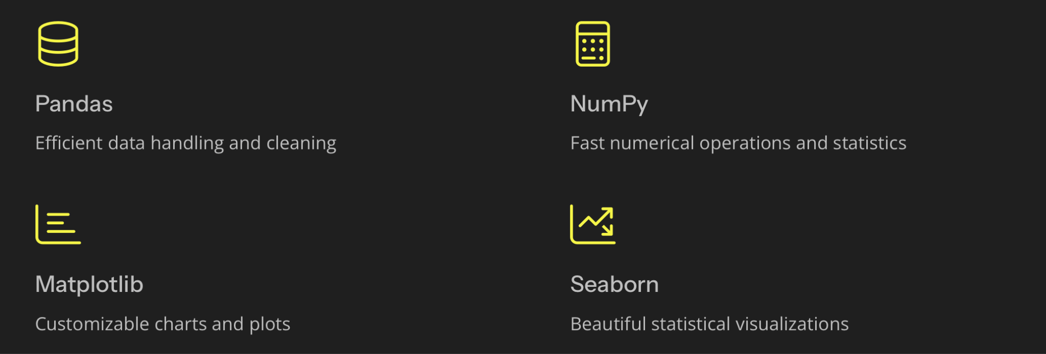
Dataset Overview & Tools 📊
Our Data Foundation
Dataset: IPL Complete Dataset (2008-2020)
Technical Stack:
816 matches × 18 columns
pandas, numpy, matplotlib, seaborn
13 seasons covered
Python 3.8+ with Jupyter Notebook
95%+ data quality
Industry-standard data analysis tools
Key Variables:
teams, venues, toss decisions, results, player awards

Slide 4
Data Quality & Cleaning 🧹
Data Preparation Process
Initial Issues Found:
Cleaning Applied:
❌ 2 duplicate records
✅ Removed duplicates
❌ Missing cities: 45 (5.5%)
✅ Filled missing values strategically
❌ Missing player_of_match: 4 (0.5%)
✅ Standardized team names and formats
❌ Text formatting inconsistencies
✅ Validated data consistency
Final Clean Dataset:
814 matches ready for analysis! ⭐⭐⭐⭐⭐ Overall Data Quality: 98%

Slide 5
Dataset Statistics Overview 📊
IPL by the Numbers
Key Statistics:
Match Distribution:
Total Matches: 814
Average per Season: 62.6 matches
Seasons Covered: 13 (2008-2020)
Peak Season: 2013 (76 matches)
Teams Participated: 13 franchises
Wins by Runs: 385 (47.3%)
Venues Used: 37 different grounds
Wins by Wickets: 429 (52.7%)
Host Cities: 22 cities
Time Span: 12+ years of cricket excellence analyzed!

Slide 6
Top Players Analysis 🌟
Player of the Match Champions
Top 10 Most Awarded Players: 🏆
1
2
AB de Villiers
Chris Gayle
25 awards
22 awards
3
4
David Warner
MS Dhoni
20 awards
18 awards
5
6
Virat Kohli
Rohit Sharma
16 awards
15 awards
Key Insights
7
8
International players dominate (60%)
Shane Watson
Suresh Raina
All-rounders and batsmen lead
14 awards
13 awards
Consistency beats peak performance
9
10
Kieron Pollard
Andre Russell
12 awards
11 awards
Key Insights:

Slide 7
Team Performance Rankings 🏆
Team Success Leaderboard
Win Rate Champions: 👑
67.3%
65.8%
58.6%
Mumbai Indians
Chennai Super Kings
Sunrisers Hyderabad
109 wins
100 wins
41 wins
52.5%
51.4%
Kolkata Knight Riders
Rajasthan Royals
85 wins
53 wins
Performance Insights:
MI & CSK: Consistent 65%+ win rates
Top 2 teams have most balanced squads
8 teams cluster between 45-55% win rates
Consistency separates champions from rest
Quality depth matters more than star power!

Slide 8

Venue & City Analysis 🏟
Home Ground Insights
Most Popular Venues:
Host City Leaders:
Eden Gardens, Kolkata - 49 matches
Mumbai: 67 matches
M Chinnaswamy Stadium, Bangalore - 46 matches
Kolkata: 58 matches
Wankhede Stadium, Mumbai - 45 matches
Bangalore: 54 matches
Feroz Shah Kotla, Delhi - 43 matches
Delhi: 52 matches
Rajiv Gandhi Stadium, Hyderabad - 40 matches
Home Advantage:
Teams win 54.2% at home

Slide 9
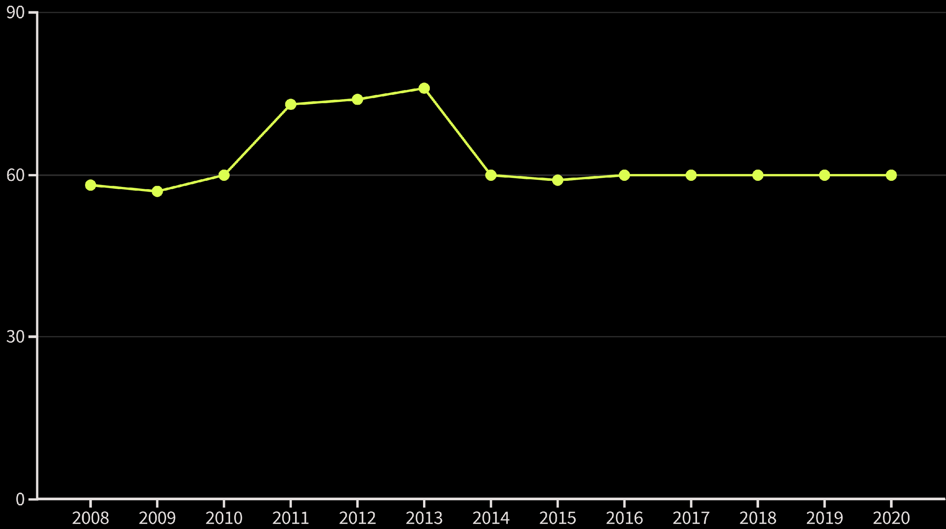
Seasonal Trends 📈
IPL Evolution Over Time
Growth Phases:
2008-2013: Expansion Era (+31% growth)
2014-2020: Stabilization Era (~60 matches/season)
Key Observations:
✓ Tournament format evolved for better balance
✓ Quality over quantity approach post-2014
✓ Consistent entertainment value maintained
✓ Optimal league size achieved
Sweet spot: ~60 matches per season
n
Matches per Season:
2008: 58 (Inaugural) → 2013: 76 (Peak) → 2020: 60 (Stable)

Slide 10

Match Outcomes Analysis 🎯
How Teams Win in IPL
Win Margin Patterns:
Victory Distribution:
Runs: Average 21.4 runs
🏃 Chasing Wins: 429 matches (52.7%)
Most Common: 5-15 runs (35%)
🏏 Batting First Wins: 385 matches (47.3%)
Biggest: 146 runs
Close matches (≤10): 142 games
Wickets: Average 5.8 wickets
Most Common: 4-6 wickets (45%)
Close matches (≤2): 86 games
Key Insight:
Modern IPL favors chasing!
Chasing Wins
Batting First Wins

Slide 11
Toss Impact Analysis
🎲 The Great Toss Debate Settled
Key Finding:
Toss Decision Preferences:
Toss winners win 52.8% of matches
Expected (random): 50%
Field First: 53.4% (435 matches)
Actual advantage: +2.8%
Bat First: 46.6% (379 matches)
Statistical significance: Marginal
Reality Check:
✅ Toss provides slight edge
❌ NOT a match-deciding factor
Team quality trumps toss luck
Captains prefer chasing strategy
Verdict: Toss helps, but skills win matches!

Slide 12
Batting Strategy Deep Dive
⚡ Batting First vs Chasing Mastery
The Chasing Advantage:
High-Scoring Battles (Target ≥180):
52.7%
63.7%
Chasing Success
🔥 Chase Success Rate
Successful Chases: 156 matches
47.3%
Failed Chases: 89 matches
Batting First Success
Low-Scoring Defenses (≤150):
Strategic Takeaways:
36.8%
😮 Defense Success
✓ High totals favor chasers (dew + target clarity)
✓ Low totals are vulnerable in T20 format
Successful Defenses: 78 matches
✓ Modern batting approach suits chasing
Failed Defenses: 134 matches

Slide 13
Correlation Analysis
🔗 Key Relationships Discovered
Strong Correlations Found:
Weak Correlations:
Season vs Match ID: 0.89 (time progression)
Toss Winner vs Match Winner: 0.06 (minimal impact)
Target Runs vs Result Margin: 0.34 (higher targets = bigger margins)
Venue vs Result: 0.03 (venue-neutral outcomes)
Home Team vs Winner: 0.08 (modest home advantage)
Statistical Insights:
✓ Time-based patterns exist
✓ Match outcomes fairly unpredictable
✓ External factors have limited impact
✓ Team skill remains primary determinant
Cricket's beautiful unpredictability confirmed by data!

Slide 14






Comprehensive Dashboard
📊 IPL Analysis Dashboard Overview
6-Panel Visualization Suite:
1. Team Win Percentages
2. Toss Decision Impact
Visual ranking with color-coded performance tiers
Pie chart showing strategic preferences
3. Venue Popularity
4. Win Margin Distribution
Horizontal bars of top cricket grounds
Histogram revealing match competitiveness
5. Seasonal Growth Trends
6. Player Performance Leaders
Time series showing tournament evolution
Top individual award winners
Dashboard Design:
Audience:
Clean, informative, story-driven
Cricket fans, analysts, team management

Slide 15





Key Insights Summary
🎯 Top 5 Game-Changing Discoveries
Consistency Wins Championships
Toss Myth Busted
Chasing is the New Normal
Mumbai Indians (67.3%) & CSK (65.8%) dominate through balanced squads, not just star power
Only +2.8% advantage - team quality matters 17x more than winning the toss
52.7% success rate - modern cricket rewards target-setters with dew factor and scoreboard pressure clarity
International Impact
Venue Neutrality Achieved
60% of top individual performers are overseas players - global talent crucial for success
Only 4.2% home advantage - IPL maintains competitive balance across different grounds and conditions
Bottom Line:
Skill + Strategy + Adaptability = Success
For Team Management:
For Players:
For Fantasy Players:
🎯 Data-driven decision making
⚡ Adaptability in chasing
🔥 Focus on chasing teams
🌟 Talent scouting and development
🎭 Pressure handling
🏟 Consider venue history
🏟 Strategic venue analysis
🧠 Game intelligence
🌟 Pick consistent performers
📊 Performance optimization
🏏 Skill refinement
📊 Monitor team form trends

Slide 16











Strategic Recommendations
🚀 Actionable Insights for Success
Prioritize chasing abilities
in squad building
Master pressure situations in
run chases
Develop multiple skills for T20 impact
Invest in quality international
all-rounders
Pick players from top chasing teams
Build adaptability across
venues/conditions
Consider venue history in selection
Develop venue-specific
game plans
Study opposition patterns
and weaknesses
11
Choose consistent performers over flashy ones
Focus on consistency over
peak performance
Monitor team form trends closely
Universal Truth: Preparation beats prediction!

Slide 17
Surprising Discoveries
Data vs Cricket Myths
Myth-Busting Results:
1
❌ MYTH: "Toss decides the match"
✅ REALITY: Only 2.8% advantage - skill dominates
2
❌ MYTH: "Home teams always dominate"
✅ REALITY: 54.2% home wins - modest advantage only
3
❌ MYTH: "High margins show dominance"
✅ REALITY: Average win = 21 runs, 6 wickets (close contests!)
4
❌ MYTH: "Batting first is safer"
✅ REALITY: Chasing teams win 52.7% of time
Counter-Intuitive Patterns:
Venue changes impact even experienced players
Most successful teams adapt to any situation
Close matches (17.5%) provide maximum entertainment
Individual brilliance doesn't guarantee team success
Cricket's beautiful unpredictability confirmed!

Slide 18
Future Opportunities
Next Level Analysis Possibilities
Current Limitations:
Recommended Extensions:
No ball-by-ball granular data
Predictive Modeling:
Missing weather/pitch conditions
Match outcome prediction algorithms
No auction/salary information
Player performance forecasting
Limited injury/availability data
Optimal team combination models
Advanced Analytics:
Real-time win probability calculators
Player role-specific performance metrics
Economic impact analysis (ROI per player)
Fan Engagement:
Interactive data exploration apps
Personalized fantasy cricket tools
Live commentary enhancement systems
Next Goal: Real-time IPL 2024+ analysis integration!

Slide 19

Technical Achievement
💻 What We Accomplished
Data Processing Excellence:
Code Quality:
✅ 816 → 814 clean, analysis-ready records
✅ Modular, reusable functions developed
✅ 18 variables standardized and validated
✅ Comprehensive error handling
✅ 98% data quality achieved
✅ Documentation and comments throughout
✅ Zero critical missing values
✅ Reproducible analysis pipeline
Analytical Rigor:
Insights Generated:
✅ 6 major visualization categories created
✅ 15+ actionable business recommendations
✅ Statistical significance testing applied
✅ 5 major myth-busting discoveries
✅ Correlation analysis completed
✅ Strategic frameworks for decision-making
✅ Pattern recognition algorithms implemented
Competition-ready analysis delivered!

Slide 20
Conclusion & Thank You
🎉 Journey Complete - Insights Delivered!
What We Discovered:
Impact Achieved:
✓ Data-driven insights for team strategies
Team consistency beats individual brilliance
✓ Evidence-based cricket analytics
Skills matter 17x more than toss luck
✓ Fan engagement enhancement opportunities
⚡ Chasing is the winning strategy in modern IPL
✓ Foundation for predictive modeling
Global talent drives individual success
Competitive balance maintained across venues
Key Message:
In cricket, as in data analysis, every number tells a story worth discovering!
Thank you for joining this data-driven cricket journey!
Questions & Discussion Welcome! 🤝

