Slide 1
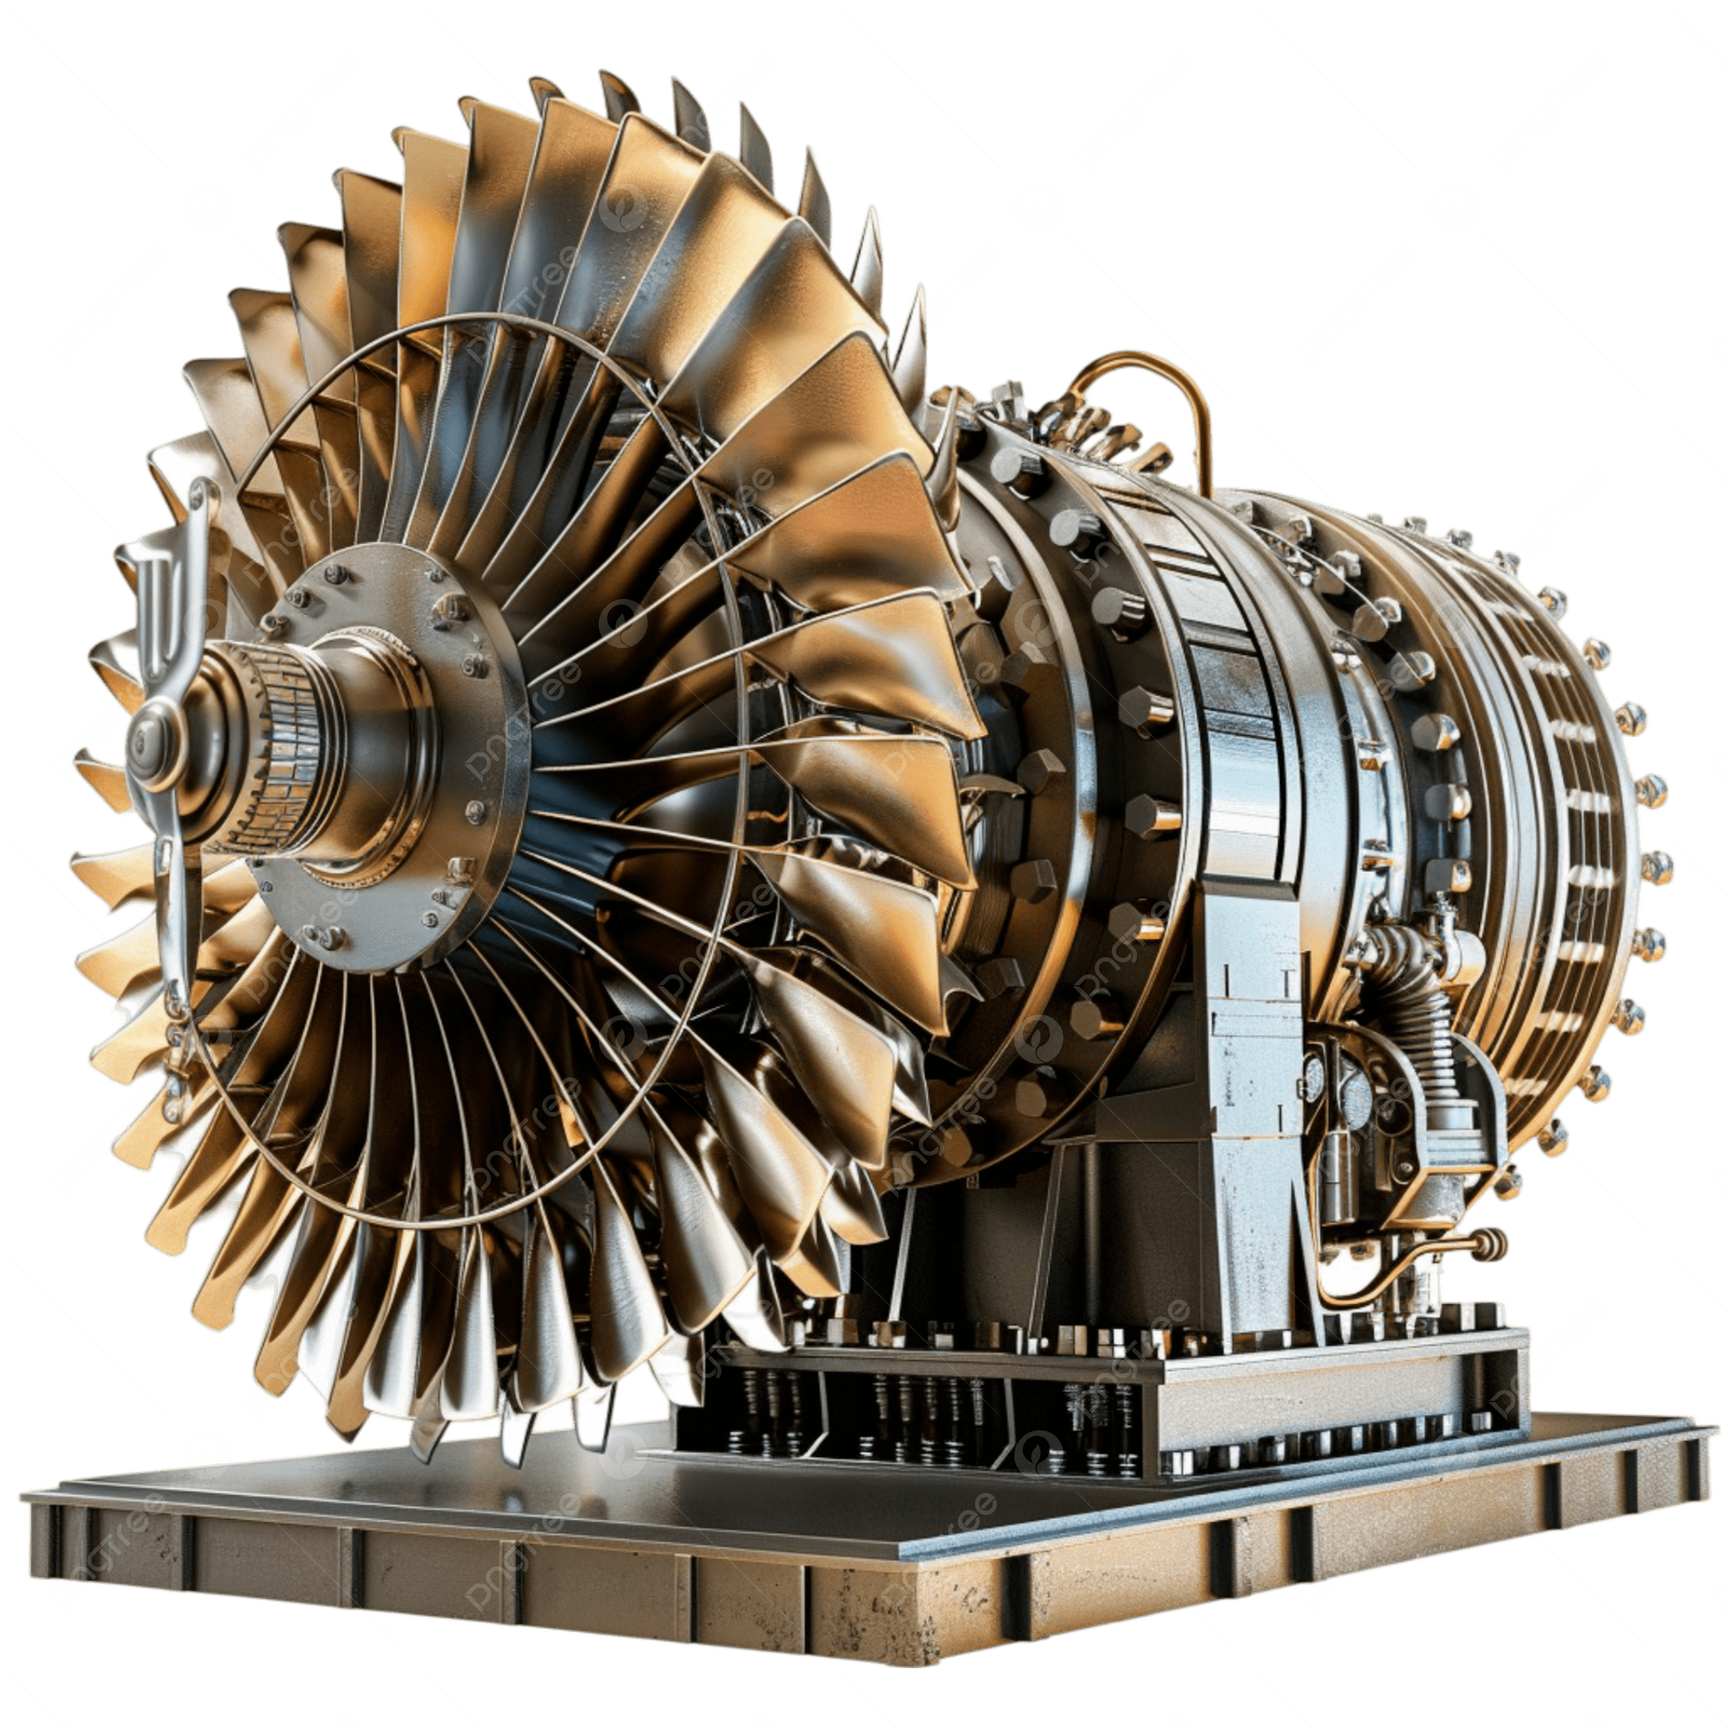
NASA CMAPSS · IT 402 APPLIED FORECASTING METHODS
Group - 13
Aircraft Engine Failure Forecasting
FD004 DATASET
248 TRAINING ENGINES
Contributors:
U - Ummesalma Diwan (202518017)
D - Dhruv Parmar (202518030)
A - Aditya Jana (202518035)
S - Shrey Pandya (202518045)

Slide 2
CONTEXT
The High Cost of Engine Failures
$500K+
72%
40%
Cost of a single unplanned engine removal
Of aviation accidents involve mechanical failure
Of maintenance costs are unplanned & reactive
Unplanned engine failures ground aircraft, disrupt schedules, and endanger lives. Predictive maintenance can shift the industry from reactive repair to proactive prevention.

Slide 3
MOTIVATION
Why Predictive Maintenance
Avoid catastrophic failure — act before the engine reaches its end of life
Traditional Approach
Optimise maintenance windows — schedule downtime without over-servicing
Fixed-interval servicing — often too early (wasted cost) or too late (failure risk)
Reduce fleet-wide cost — target only engines that actually need attention
Predictive Approach
Extend engine lifespan — data-driven decisions replace fixed intervals
Forecast Remaining Useful Life (RUL) from sensor data — act precisely when needed

Slide 4
PROJECT OVERVIEW
Project Overview
1
Load FD004 with unique engine IDs from NASA CMAPSS dataset
↓
2
Compute & cap Remaining Useful Life (RUL at 125 cycles), drop sensor leakage columns
↓
3
EDA + Preprocess — drop zero-variance sensors, cluster operating conditions (KMeans k=6), per-cluster StandardScaler, rolling features
↓
4
Build Health Index via PCA · Train classical models (AR, ARMA, ARIMA) · Train deep learning models (RNN, LSTM, GRU, Transformer)
↓
5
Evaluate with RMSE, NASA asymmetric score, R² · Compare all models

Slide 5
DATASET
NASA CMAPSS Dataset
C-MAPSS : Commercial Modular Aero-Propulsion System Simulation
Subset
Op Conditions
Fault Modes
Train Engines
FD001
1
1
100
Simulates realistic turbofan engine degradation over hundreds of flight cycles
FD002
6
1
260
FD003
1
2
100
4 subsets (FD001–FD004) with varying operating conditions and fault modes
FD004
6
2
248
Each engine is run to failure — true RUL known from training data
This project focuses on FD004 — the most complex subset

Slide 6
DATASET
FD004: The Hardest Dataset
248
248
61,249
Training engines
Test engines
Total training rows
Challenge 1: Six Operating Conditions
Challenge 2: Two Failure Modes
Engine flies at varying altitudes, speeds, and throttle settings. Sensor s3 (HPC temperature) reads 1590°R at sea level, 1420°R at altitude — same health state, different conditions.
HPC blade erosion (temperatures rise, pressure drops) OR fan degradation (vibration increases, efficiency drops). One model must learn both signatures simultaneously.

Slide 7
DATASET
Dataset Structure
26 columns per row: 3 operational settings + 21 sensor measurements + engine ID + cycle
Column Group
Columns
Role
Engine ID
1
Unique engine identifier
Each row = one flight cycle for one engine
Cycle
1
Flight cycle counter
Engines run from cycle 1 until failure (training) or truncation (test)
Op Settings
op1, op2, op3
Operating condition
Sensors
s1 – s21
Physical measurements
Test set is truncated — RUL must be predicted , not observed
RUL (computed)
1
Target variable
RUL capped at 125 cycles — prevents dominance of long early-life phases

Slide 8
CONCEPTS
Remaining Useful Life (RUL)
RUL = number of flight cycles left before the engine fails
Train set: true RUL computed from the maximum cycle per engine
RUL(cycle t) = max_cycle − t
Test set: RUL must be predicted at the truncation point
Capped at 125 cycles — early healthy cycles contribute equally
125
78
0
Cap value
Mean test RUL
At failure
Ground truth provided separately as rul.txt for evaluation

Slide 9
PART 1
Exploratory Data Analysis
Understanding the data before modelling

Slide 10
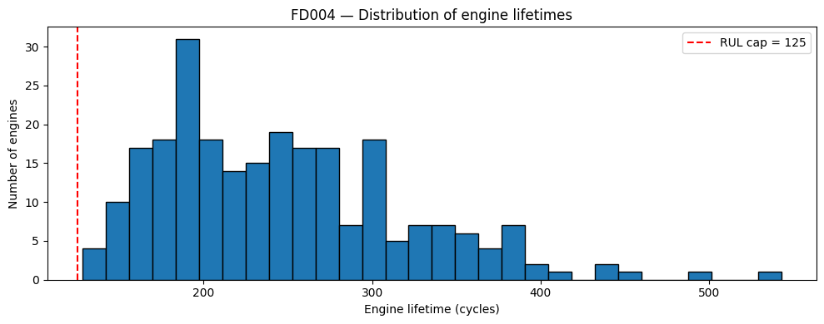
EDA
Engine Lifetime Distribution
248 training engines with lifetimes from 128 to 543 cycles
Mean lifetime: 246 cycles
Median: 234 cycles
All engines live longer than the RUL cap of 125 — cap is always effective
Minimum lifetime (128) > RUL cap (125)
Distribution is right-skewed — most engines live 150–300 cycles with a long tail

Slide 11
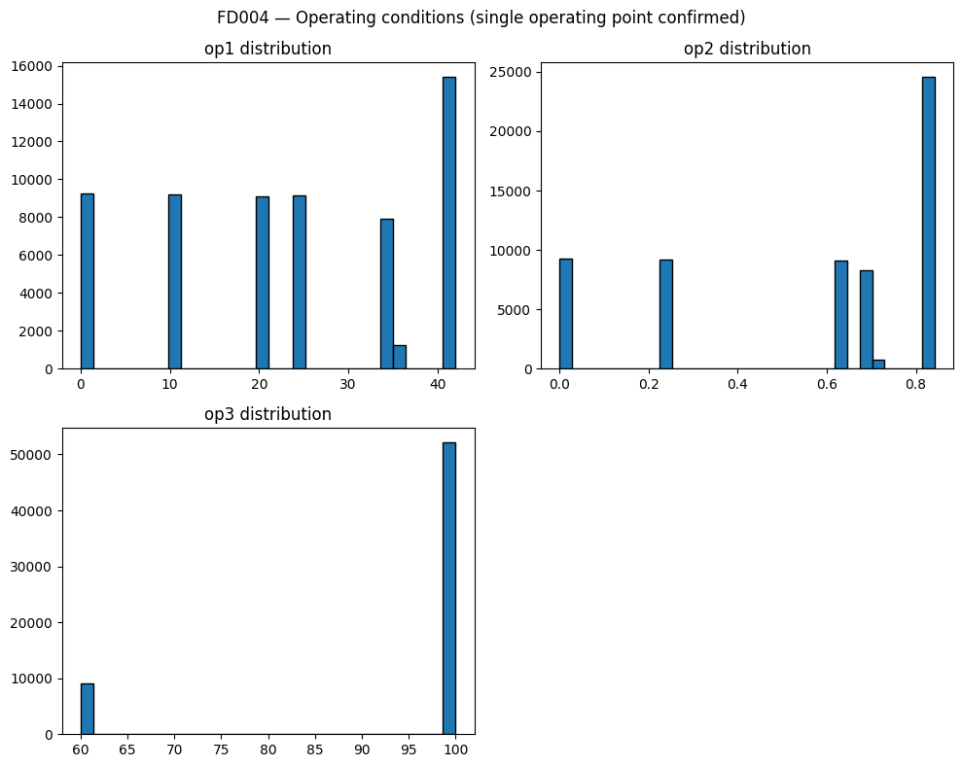
EDA
Operating Conditions — 6 Distinct Clusters
op1: 536 unique values — continuous throttle setting (altitude-linked)
op2: 105 unique values — Mach/speed-related setting
op3: 2 unique values — altitude band (binary: ~60 or ~100)
The discrete clusters in histograms visually confirm 6 operating regimes
KMeans on (op1, op2, op3) separates these 6 conditions cleanly
Operating conditions cause large sensor jumps between consecutive cycles — not degradation. Clustering removes this confounding effect before modelling.

Slide 12
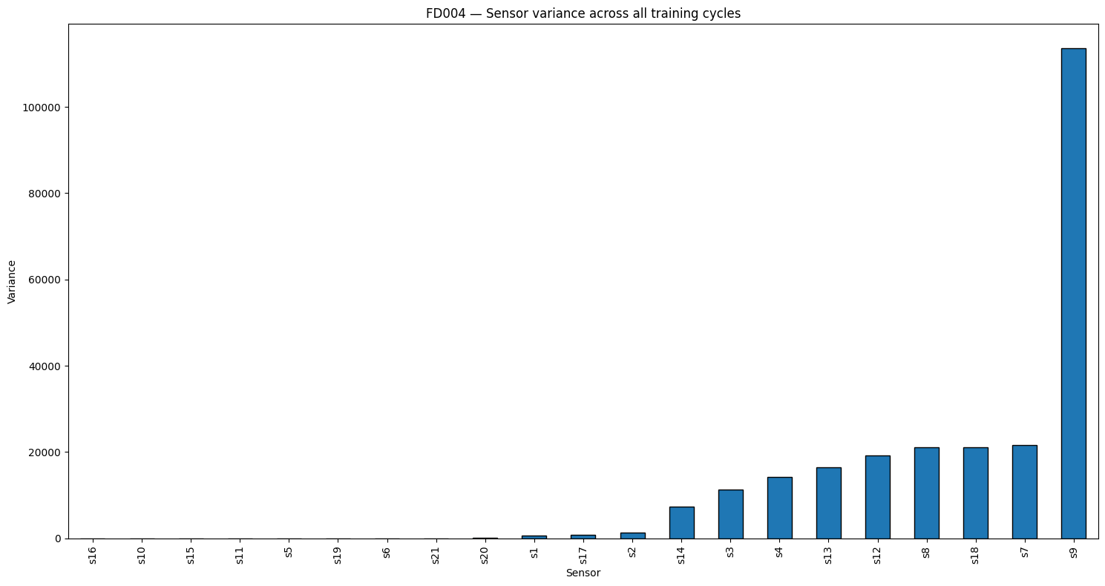
EDA
Sensor Variance — Identifying Useless Sensors
s16, s10, s15 — near-zero variance; s16 variance = 0.000022
s9 — highest variance (113,520) — most spread, highly informative
Sensors with very low variance carry almost no information about degradation
Final drop decision combines variance + correlation + visual trajectory check
Decision
Sensors
Reason
s1, s5, s6, s10, s16, s18, s19
Near-zero variance + flat trajectory
DROP
14 sensors
Visible degradation trend
KEEP

Slide 13
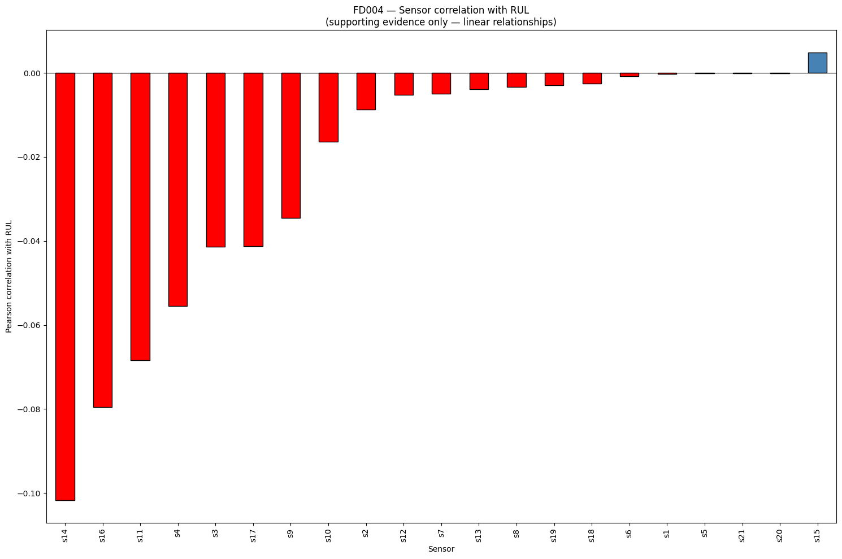
EDA
Sensor Correlation with RUL
Most sensors are negatively correlated with RUL — as engine degrades (RUL falls), sensor values rise
s14 has the strongest linear relationship (corr = −0.102)
s15 is the only positively correlated sensor (corr = +0.005)
Correlations are small — relationship is nonlinear, not captured by Pearson alone
Low Pearson correlation does not mean a sensor is useless — it means the relationship is nonlinear .

Slide 14
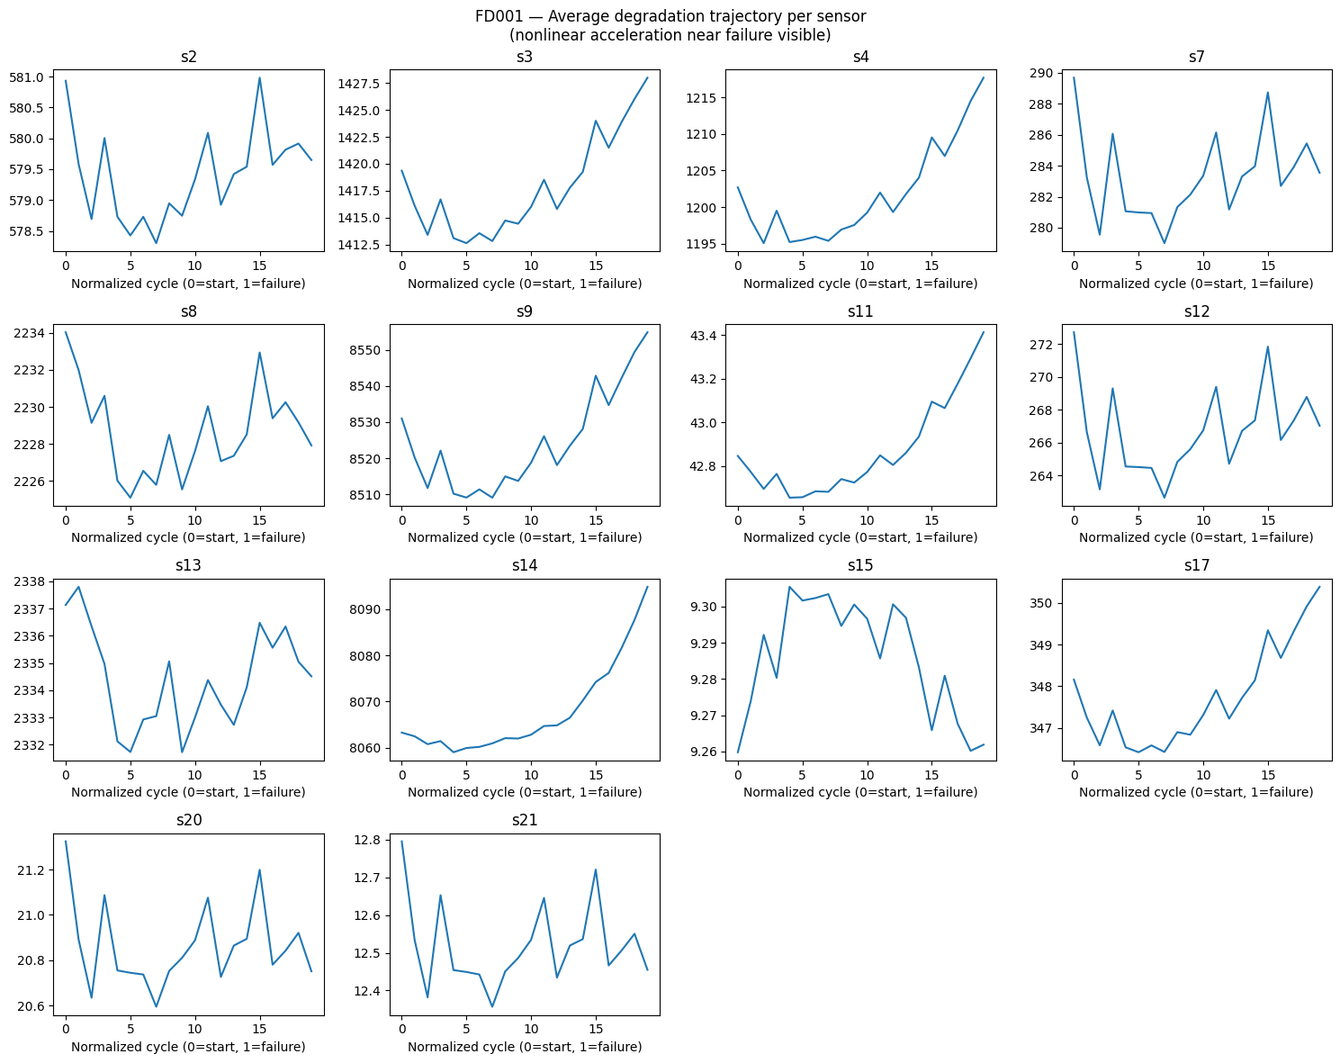
EDA
Average Degradation Trajectories — 14 Retained Sensors
X-axis: normalised cycle (0 = engine start, 1 = failure)
s3, s4, s9, s11, s14 — clear upward trend as engine degrades
s7, s15, s17 — downward drift toward failure (sensors that fall with degradation)
Acceleration near failure (x > 0.7) is visible in many sensors — nonlinear

Slide 15
EDA
Key EDA Insights
Engine Variability
Multi-Modal Operating Conditions
Nonlinear Degradation
Engine lifetimes range from 128 to 543 cycles. Models must generalize across very short and very long-lived engines.
Average sensor trajectories show healthy phase followed by steep acceleration near failure.
6 distinct operating regimes create sharp sensor jumps cycle-to-cycle.
EDA directly motivates every design decision: the 7-sensor drop, KMeans k=6, per-cluster scaling, health index, and the PCA detrending step.

Slide 16
PART 2
Data Preprocessing
Setting up the sensor data for modelling

Slide 17
PREPROCESSING
Dropping Useless Sensors
Of 21 sensors, 7 are near-constant across all rows
Standard deviation < 0.1 — they carry zero information about degradation
7
14
→
Sensors dropped (near-constant)
Sensors retained (informative)
Keeping them adds noise to every model
Dropped: s1, s5, s6, s10, s16, s18, s19
Variance-based selection
14 sensors remain: s2, s3, s4, s7, s8, s9, s11, s12, s13, s14, s15, s17, s20, s21

Slide 18
PREPROCESSING
Operating Condition Clustering (KMeans)
Three operating columns (op1, op2, op3) define the flying condition each cycle
Why k = 6?
KMeans fitted on training data only — then applied to test data
FD004 has exactly 6 distinct operating conditions. KMeans k=6 captures each condition as a separate cluster.
Each row gets a label op_cluster ∈ {0, 1, 2, 3, 4, 5}
Fitting on training data ensures a consistent coordinate system across train and test

Slide 19
PREPROCESSING
Per-Cluster StandardScaler
For each of the 6 clusters, compute mean & std of each sensor across training rows only
scaled = (raw − cluster_mean) / cluster_std
Removes altitude/speed baseline — what remains is deviation from normal
A healthy engine in any condition has sensor values near zero
A degrading engine has increasingly large z-scores — signal preserved, not clipped

Slide 20
FEATURE ENGINEERING
Rolling Features
For each of 14 sensors: compute rolling mean and rolling std
Shared Conventions
Window sizes: 5 cycles and 10 cycles
Setting
Value
Result: 14 × 2 (mean/std) × 2 (windows) = 56 rolling features
RUL cap
125 cycles
Sequence window (DL)
30 cycles
Sorted by (engine_id, cycle) first — prevents cross-engine contamination
Train/val split
80 / 20 by engine_id
Random seed
42
Rolling windows
5, 10 cycles (mean + std)

Slide 21
Evaluation Metrics
RMSE
NASA
R²
√(Σ(pred−true)²/n)
late: e^(d/10)−1 early: e^(−d/13)−1
1 − SS_res/SS_tot
Standard measure of prediction error in cycle units. Lower is better.
Proportion of variance explained. 1.0 = perfect; <0 = worse than predicting the mean.
Asymmetric — late predictions penalised more than early. Reflects real safety cost of missing a failure.

Slide 22
PART 3
Building the Health Index
Compressing 14 sensors into one degradation signal

Slide 23
HEALTH INDEX
Why We Need a Health Index
ARIMA is univariate
The Goal
We have 14 sensor columns per row
A single scalar that starts low (~−1) when healthy and rises monotonically toward ~3–4 at failure — for any engine, any operating condition
Need one number that: starts near baseline when healthy, increases monotonically with degradation, and is comparable across all engines
Why simple averaging fails
Different sensors move in opposite directions — s3 rises, s7 falls. Averaging cancels the signal. Picking one sensor misses the second failure mode.

Slide 24
HEALTH INDEX
PCA: The Right Tool
PCA finds the direction in 14-dimensional sensor space where data varies the most
The Critical Step for FD004
Since degradation drives the dominant variation, PC1 captures degradation better than any single sensor
Subtract the per-cluster mean from each sensor before PCA. This removes the altitude/speed baseline. PCA then finds only the degradation direction in the residual.
FD004 subtlety: operating condition switching causes large sensor jumps — PCA would capture condition , not degradation
After detrending: a healthy engine deviates near zero from its cluster's mean — in any condition. Degradation = increasing deviation from this zero baseline.
Fix: subtract per-cluster mean from each sensor before running PCA

Slide 25
HEALTH INDEX
Health Index: Step-by-Step
1
Rolling Mean Smoothing — replace each sensor with its 10-cycle rolling mean per engine (removes measurement noise)
2
Per-Cluster Mean Detrending — subtract each cluster's sensor mean; removes operating condition baseline
3
Global PCA on Detrended Sensors — first principal component (PC1) is the degradation direction
4
Sign Flip — if PC1 is negatively correlated with −RUL, multiply by −1 so higher = more degraded. Always.
5
Standardisation — normalise using training mean/std only (no leakage); healthy ≈ −1, near failure ≈ 3–4
6
Isotonic Regression — enforce monotonic non-decrease (physical reality: engines do not self-repair)

Slide 26
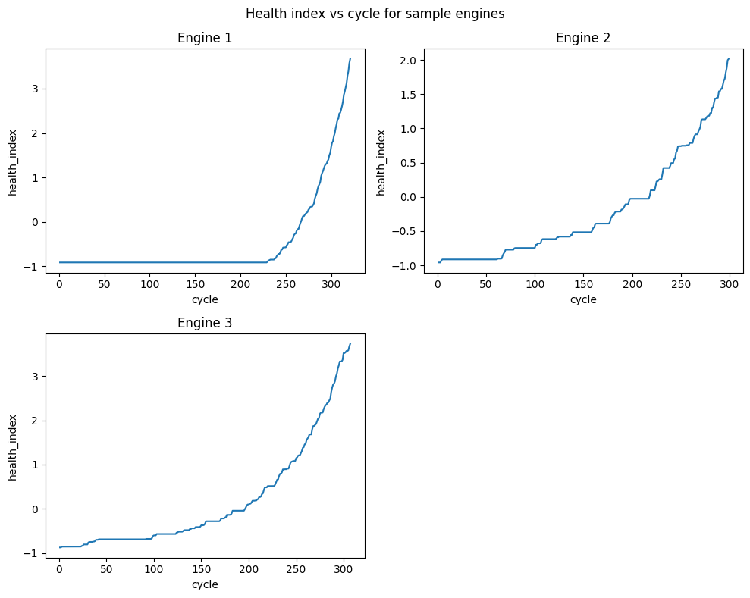
HEALTH INDEX
Health Index in Action — Three Engines
All engines start near −1.0 (healthy baseline)
All engines end at 2.0–3.5 (severely degraded, near failure)
Shape: long flat healthy phase → steep acceleration near failure
Engine lifespans: 305–325 cycles — each engine is unique
Monotonic rise confirmed — isotonic regression worked correctly
Health index range: [−1.597, 4.402] · Failure threshold = 1.685

Slide 27
HEALTH INDEX
Failure Threshold Selection
Threshold = value below which 95% of near-failure rows lie
Quantile
Threshold
Test engines reached
q=0.05 ✓
1.685
22 / 248 (9%)
Near-failure defined as RUL ≤ 5 cycles
q=0.10
1.747
20 / 248 (8%)
Chosen threshold (q=0.05): 1.685
q=0.20
1.840
17 / 248 (7%)
Only 22 of 248 test engines (9%) ever reach it in observed history — most are truncated early
q=0.50
2.166
13 / 248 (5%)
q=0.70
3.363
0 / 248 (0%)
This is why a fallback mechanism is required for 91% of engines

Slide 28
PART 4
Classical Time Series Models
AR · ARMA · ARIMA on the Health Index

Slide 29
CLASSICAL MODELS
ARIMA Framework
ARIMA doesn't predict RUL directly — it forecasts the Health Index forward
RUL = number of forecast steps until Health Index ≥ 1.685
Forecast → RUL Conversion
Three parameters define the model:
1. Observe health index up to cycle T
2. Fit ARIMA(1,2,1) on observed series
p
AR order — how many past values to use for prediction
3. Forecast 150 steps forward
4. Find first step where h.i. ≥ 1.685
d
Integration order — how many times to difference for stationarity
5. That step number = predicted RUL
q
MA order — how many past forecast errors to use for correction

Slide 30
CLASSICAL MODELS
Finding d: ADF Stationarity Test
ARIMA requires stationarity — constant mean and variance over time
ADF Results — Engine 118 (543 cycles)
Health index clearly trends upward — non-stationary at level
Level
ADF p-value
Verdict
Raw (d=0)
1.000
NON-STATIONARY
ADF test (Augmented Dickey-Fuller): p < 0.05 → stationary, stop differencing
Diff-1 (d=1)
0.974
NON-STATIONARY
First difference removes linear trend (d=1); second difference removes acceleration (d=2)
Diff-2 (d=2)
0.000
STATIONARY
→ Modal d = 2 across 248 training engines
FD004: 206/248 engines need d=2 — degradation accelerates

Slide 31
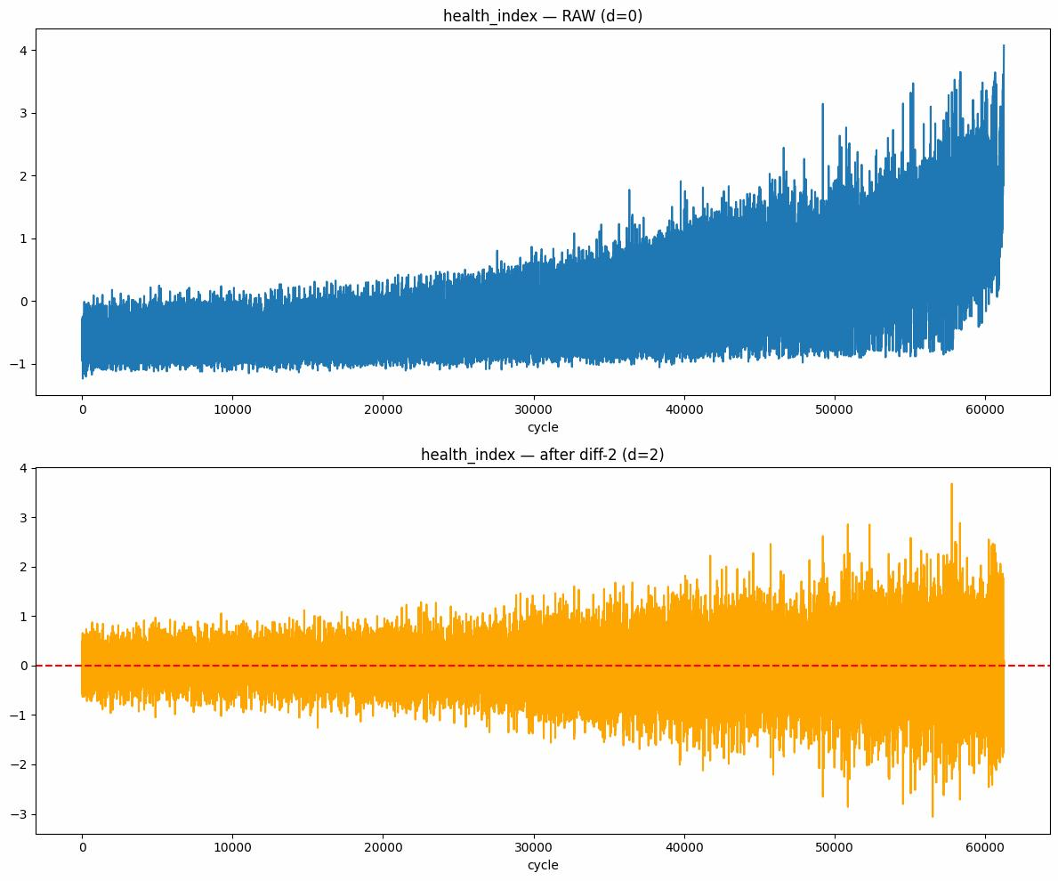
CLASSICAL MODELS
Raw vs. After First Differencing
Left (d=0): clear upward drift — non-stationary; ADF p=1.0
Right (d=1): linear trend removed; but variance spreads at higher indices — still non-stationary; ADF p≈0.97
FD004 degradation accelerates near failure — rate of change itself trends upward
Second difference (d=2) (acceleration of health index) becomes approximately constant → stationary

Slide 32
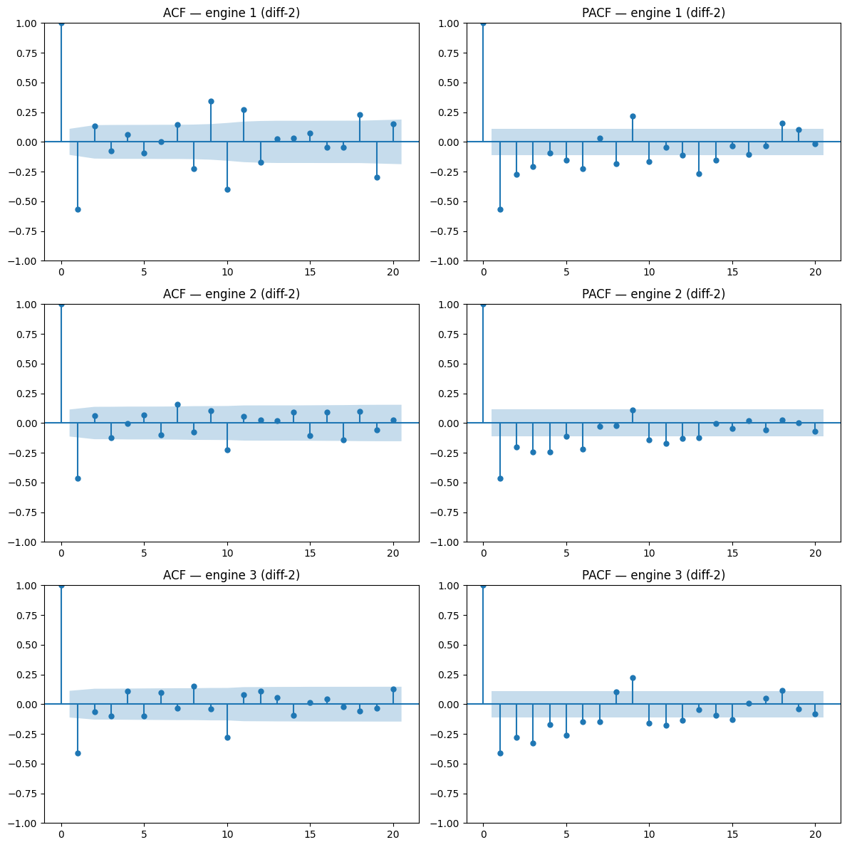
CLASSICAL MODELS
Finding p and q: ACF / PACF (Twice-Differenced Series)
ACF : correlation at each lag → guides q (MA order). Cuts off → pure MA
PACF : removes indirect effects → guides p (AR order). Cuts off → pure AR
Large spike at lag 1 in both ACF and PACF (~−0.5) — introduced by double-differencing
After lag 1: bars mostly inside confidence band → MA(1) dominant structure
Both tailing off → mixed ARMA → ARIMA(1, 2, 1)

Slide 33
CLASSICAL MODELS
AIC Grid Search — Final Model Orders
Every (p,q) combination tested on 15 representative training engines
Final Model Orders
Model
Order
Interpretation
Modal winner across 15 engines is chosen as final order
AR
(10, 2, 0)
10 lagged values, 2 differences
AR: p=10 wins— 10 past cycles carry predictive information
ARMA
(1, 2, 1)
1 AR + 1 MA term, 2 differences
ARIMA
(1, 2, 1)
MA error-correction dominant
ARIMA: (p=1, q=1) wins — MA error-correction is the dominant structure

Slide 34
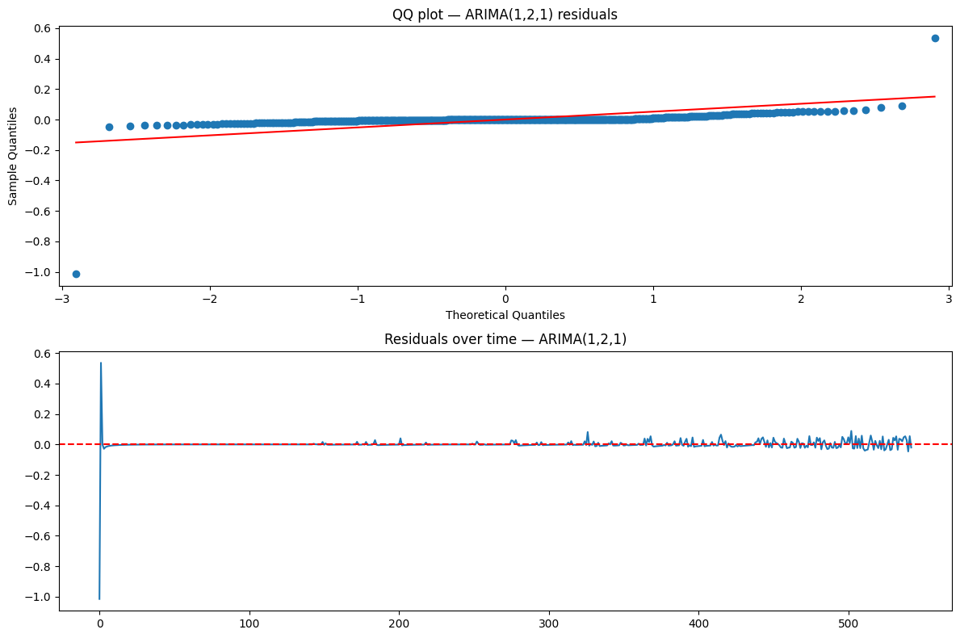
CLASSICAL MODELS
Residual Diagnostics — ARIMA(1,2,1)
QQ Plot (left): heavy tails — kurtosis = 7.95 vs 3 for normal. Occasional large errors expected
Residuals over time (right): fluctuate around zero; initial spike = model warm-up
Ljung-Box test: all p-values near 0 — residual autocorrelation remains
Imperfect residuals are acceptable: our goal is long-horizon RUL estimation , not perfect one-step forecasting. Rolling RMSE of 0.028 confirms practical usability.

Slide 35
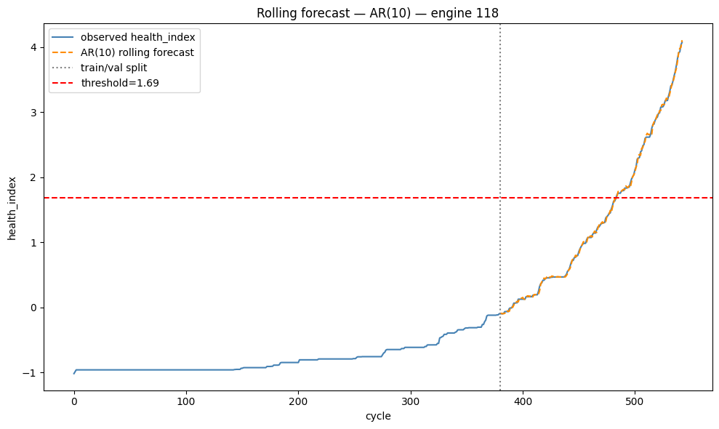
CLASSICAL MODELS
Rolling Forecast Validation — Engine 118
Blue line: observed health index (543 cycles)
Orange dashed: AR(10) walk-forward rolling forecast (last 30%)
Red dashed: failure threshold = 1.685
Rolling RMSE = 0.028 — one-step-ahead accuracy
Forecast crosses threshold at cycle ~480

Slide 36
CLASSICAL MODELS
The Main Mechanism
RUL = slope × health_index + intercept
Safety factor 0.88 applied — makes all predictions slightly conservative
Why the Safety Factor?
NASA scoring penalises late predictions more than early ones. A 0.88 multiplier shifts all predictions slightly downward — accumulating fewer late-prediction penalties.

Slide 37
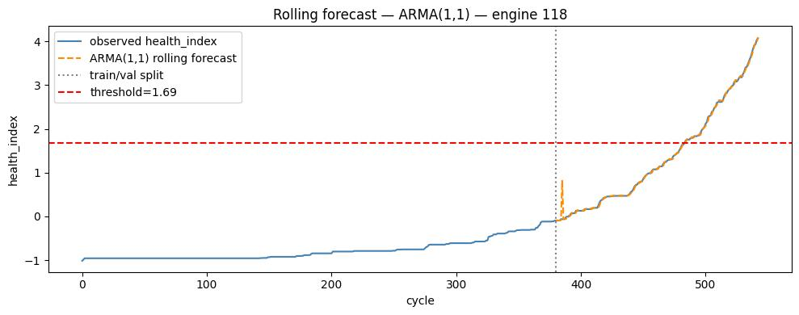
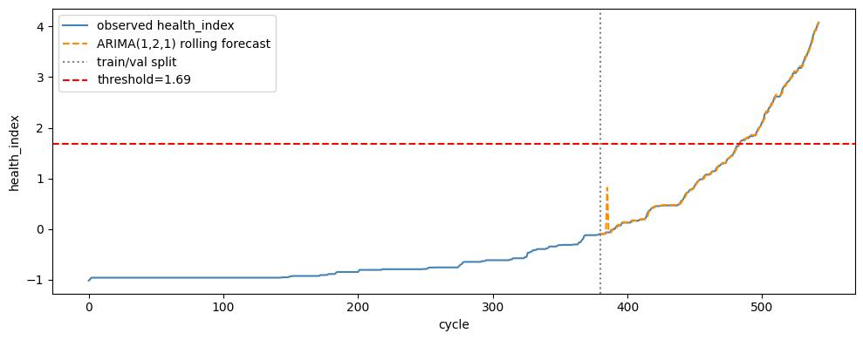
CLASSICAL MODELS
Classical Model Performance
Model
RMSE
NASA Score
R²
AR(10,2,0)
27.67
25,742
0.586
ARMA(1,2,1)
26.19
17,514
0.629
ARIMA(1,2,1)
24.76
13,791
0.668
ARIMA(1,2,1)
Adding the MA term (q=1) allows error-correction — ARIMA outperforms both AR and ARMA on all metrics.

Slide 38
PART 4
Deep Learning Models
RNN · LSTM · GRU · Transformer

Slide 39
DEEP LEARNING
Why Deep Learning?
Classical models are univariate & linear — work on health index only
Feature Engineering for DL
Deep learning uses all 14 sensors simultaneously — no information compression
14 sensors × 3 rolling windows (5, 10, 20 cycles) = 42 features per cycle
Can learn complex, nonlinear mappings from sensor patterns to RUL
Rolling means embed multi-scale temporal context at each step
Designed for sequential data — temporal dependencies propagated through time
Sliding window of 30 cycles → one input sequence per sample
Trained on all 248 engines at once — learns a universal degradation model
Train/val split: 80/20 by engine_id (not by row — prevents leakage)

Slide 40
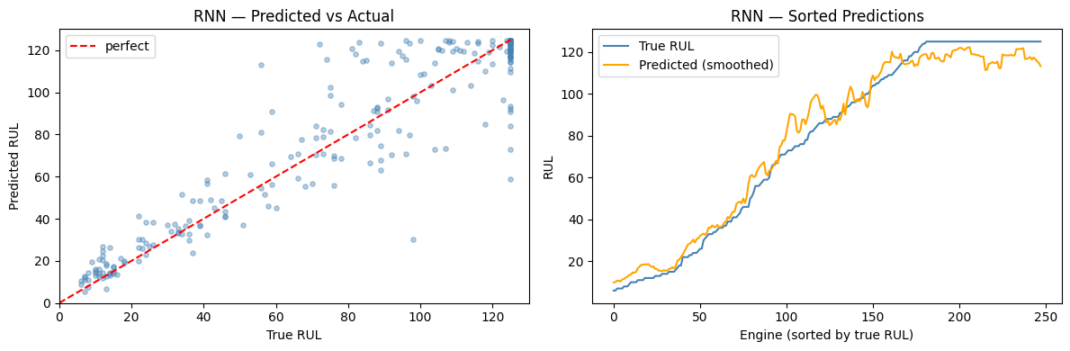
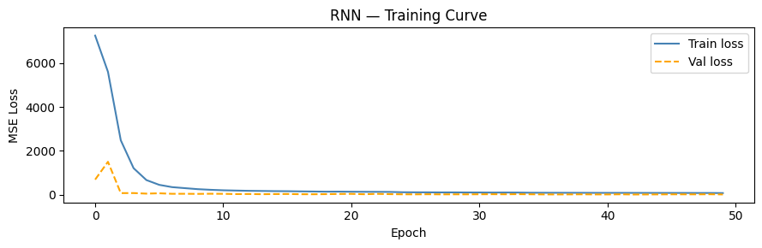
DEEP LEARNING
RNN (Recurrent Neural Network)
Simplest sequential model — passes hidden state forward each cycle
Suffers from vanishing gradient — struggles to retain long-range information
Fastest to train — good baseline for comparison

Slide 41
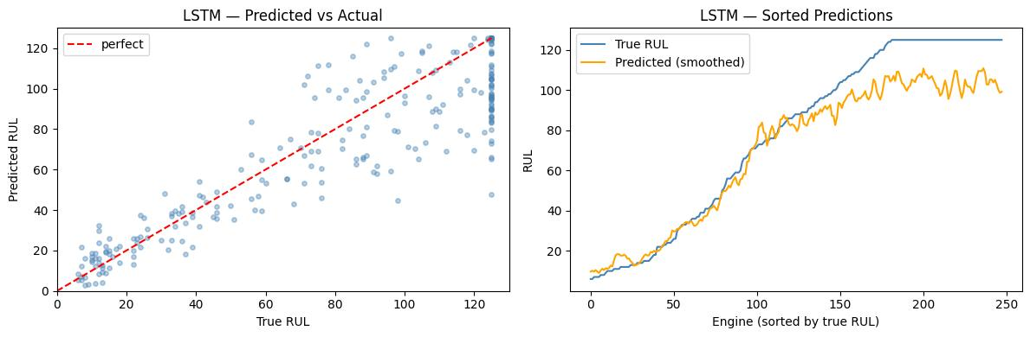
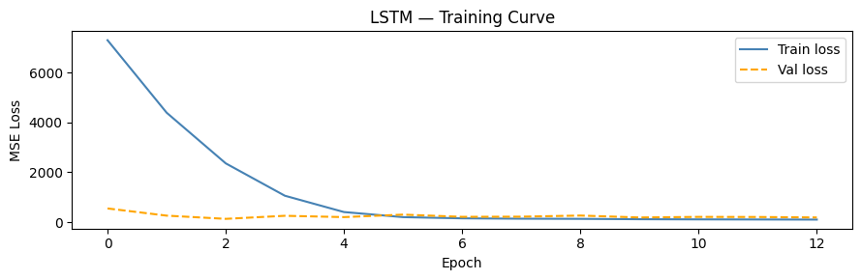
DEEP LEARNING
LSTM (Long Short-Term Memory)
Introduces forget, input, and output gates — learns what to retain and discard
Solves the vanishing gradient problem — can remember dependencies over hundreds of cycles
Particularly well-suited for long engine degradation sequences

Slide 42
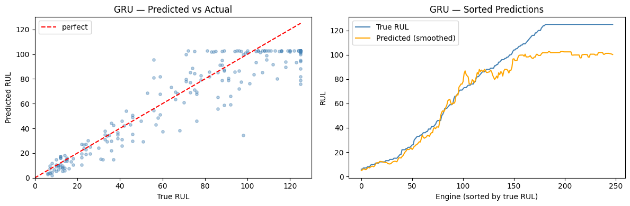
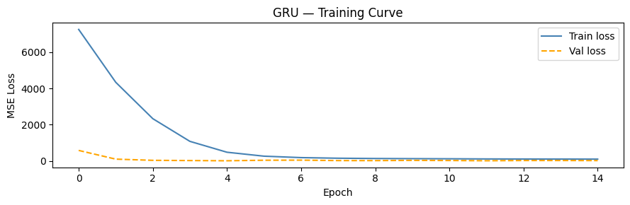
DEEP LEARNING
GRU (Gated Recurrent Unit)
Simplified LSTM — merges forget and input gates into a single update gate
Fewer parameters → faster training, often comparable performance to LSTM
Strong choice for shorter sequences or when training time is a constraint

Slide 43
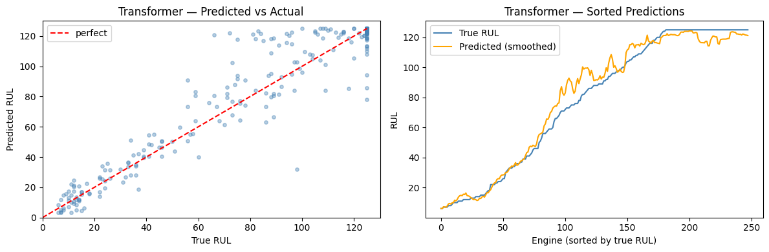
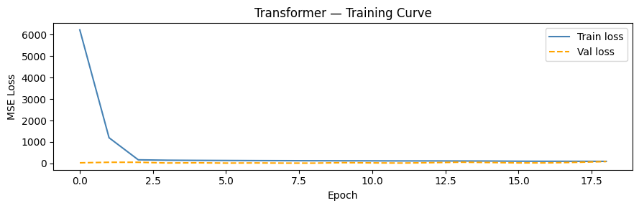
DEEP LEARNING
Transformer
Uses self-attention — each cycle can directly attend to any other cycle in the window
No recurrence — processes sequence in parallel; faster training on GPUs
Best at capturing long-range dependencies without gradient issues
More parameters → needs more data to generalise well

Slide 44
PART 5
Quantile Regression Models
Probabilistic forecasting with uncertainty bounds

Slide 45
QUANTILE MODELS
Quantile Regression: Beyond Point Estimates
Classical & DL models give a single point estimate of RUL
Why Uncertainty Matters
Quantile regression gives a distribution — lower bound, median, upper bound
A prediction of "50 cycles" hides whether the true value could be 20 or 80. Quantile models expose this uncertainty so operators can act conservatively.
Critical for safety: "We are 90% confident the engine will last at least X more cycles"
Conservative (lower quantile) predictions → schedule maintenance with a safety margin
Pinball Loss
Quantile models are trained with the pinball (quantile) loss — an asymmetric loss that penalises underprediction at upper quantiles and overprediction at lower quantiles.
Enables risk-aware decision-making across the fleet

Slide 46
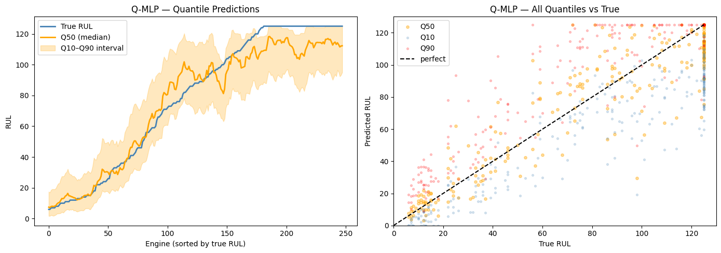
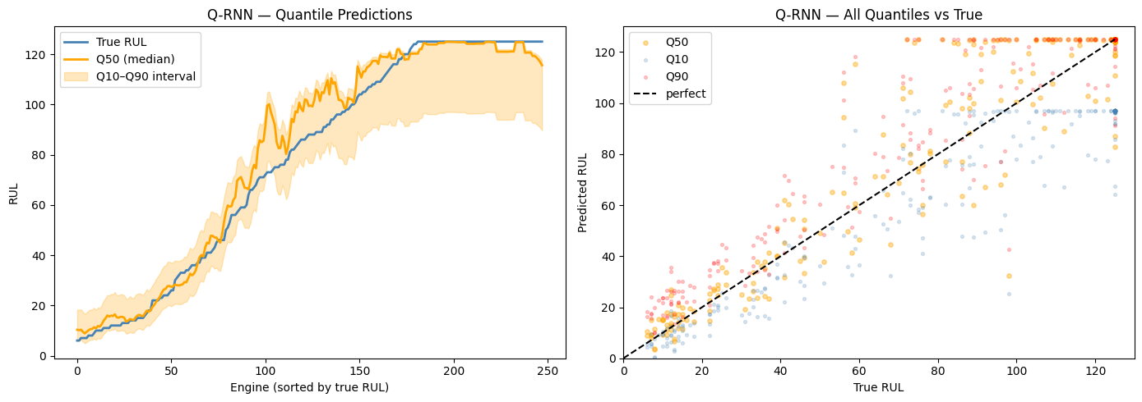
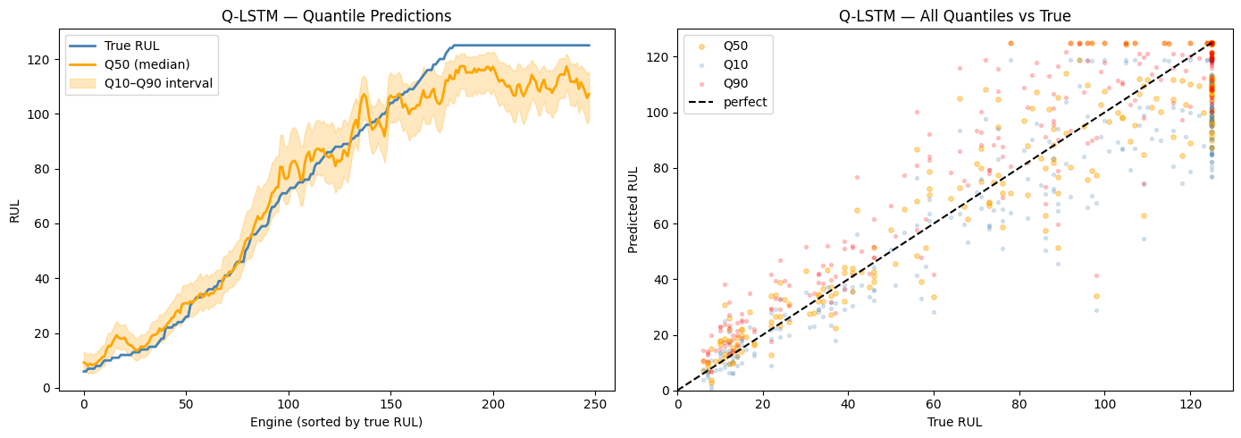
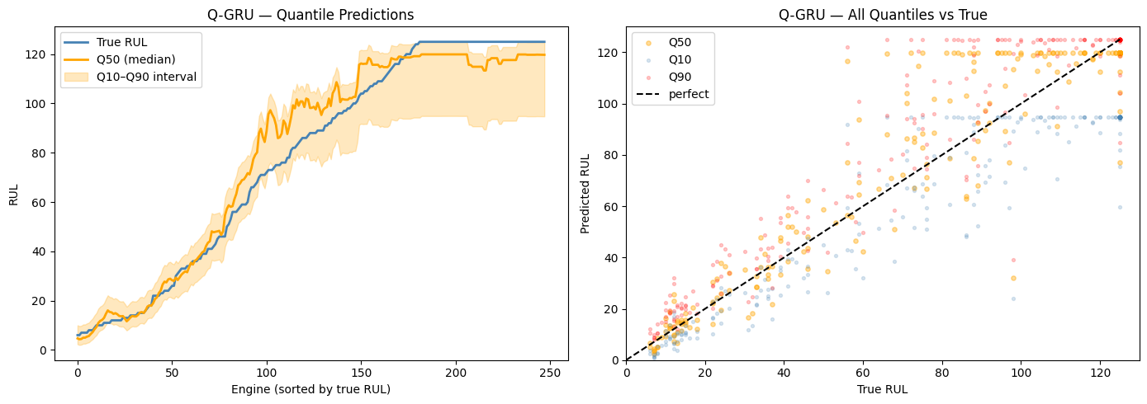
QUANTILE MODELS
Quantile Forecast Examples — Probabilistic RUL Bounds

Slide 47
PART 6
Results & Conclusions
key findings

Slide 48
RESULTS
Key Findings
ARIMA beats AR and ARMA — the MA error-correction term is critical for FD004's accelerating degradation
Conservative bias (safety factor 0.88) aligns with NASA's asymmetric scoring — early predictions penalised less than late ones
d=2 is essential — FD004 degradation accelerates, not just trends — two differences required for stationarity
Per-cluster detrending is the most important preprocessing step — without it, PCA captures operating conditions, not degradation
Deep learning captures multi-sensor interactions that classical univariate models fundamentally cannot

Slide 49
Thank You

