Slide 1


1 VANS
POWER UP YOUR
CONSTRUCTION
Comprehensive Construction Solutions
Presented By
1 VANS

Slide 2
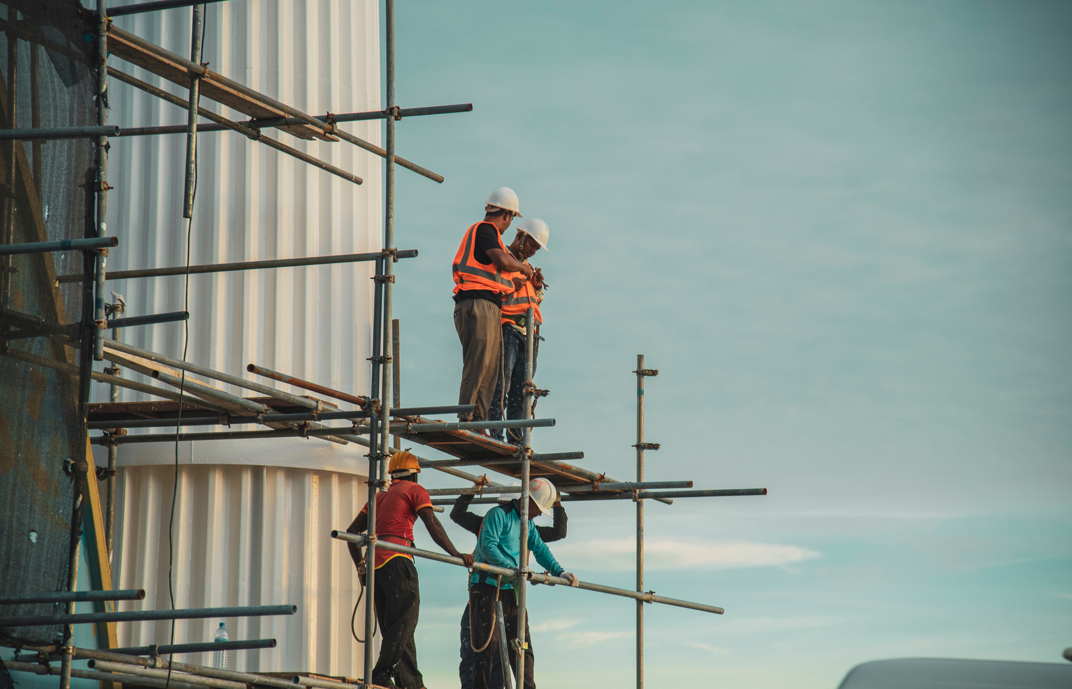

1 VANS
INTRODUCTION
1VANS is a modern, cloud-based Construction Project Management Platform designed to bridge the gap between field engineers and administrative teams.
Who We Are
With its dual-access model—via a mobile app for field reporting
&
web-based admin dashboard—1VANS streamlines project workflows, ensures real-time communication, and enhances on-site accountability.

Slide 3
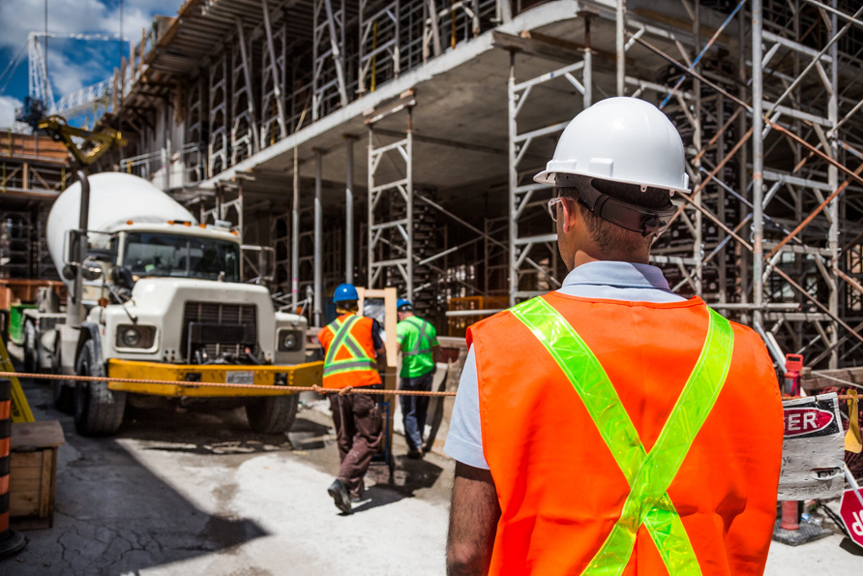

Comprehensive Construction Solutions
OUR EXPERTISE
At 1VANS, we specialize in delivering end-to-end digital solutions tailored for the construction industry. Our platform is designed to simplify complex workflows, enhance communication, and ensure data-driven decision-making across every stage of your project.
We combine on-site practicality with back-office intelligence—bridging the gap between field engineers and project managers through real-time updates, secure reporting, and powerful analytics. Whether it's tracking daily progress, managing resources, or ensuring compliance, our tools are built to support your team's success on the ground.

Slide 4

Trusted Technology. Built for Construction. Powered by Insight.
1 VANS
Industry-Focused Innovation
  We understand the unique demands of construction sites and have built our platform specifically to meet those real-world challenges.
Real-Time Field Reporting
  Our mobile app allows engineers to submit location-verified reports, photos, and equipment logs—keeping everyone aligned in real time.
Centralized Project Oversight
  The web-based dashboard gives admins and managers complete visibility into daily progress, issues, and resources across all active sites.
Secure & Scalable
  Built with enterprise-grade security, role-based access, and scalable infrastructure that grows with your business.
Data-Driven Decisions
  Access insightful analytics and reports that help you make smarter decisions, improve efficiency, and reduce delays.
WHY CHOOSE US?

Slide 5

1 VANS
OUR PROCESS
At 1VANS, we streamline the construction lifecycle by digitizing every critical step—from planning to on-site reporting to final delivery. Our platform ensures clarity, consistency, and control at every stage.
Step 1 – Project Setup & Team Onboarding
Engineers submit daily progress reports with geo-tagged photos, material logs, manpower data, and issues—all directly from the site using the 1VANS app.
Step 2 –
Daily Site Reporting
Engineers submit daily progress reports with geo-tagged photos, material logs, manpower data, and issues—all directly from the site using the 1VANS app.
Step-by-Step to Success
Step 3 – Dashboard
Review & Analytics
Project managers monitor live updates via the web dashboard, analyze trends, track productivity, and generate reports for faster, data-driven decisions.

Slide 6
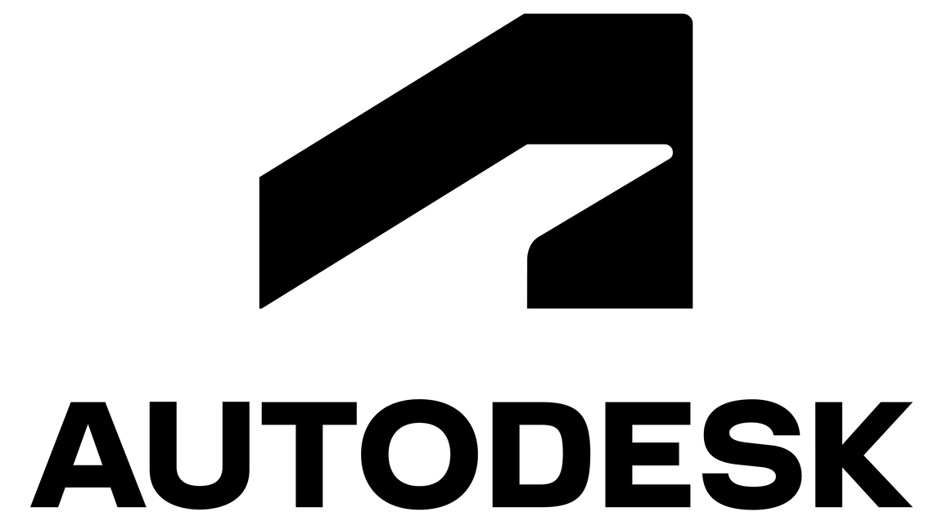
1 VANS
1VANS is a powerful construction project management platform that connects field engineers and project managers through a seamless mobile and web-based ecosystem. Designed specifically for the construction industry, it streamlines reporting, enhances visibility, and enables real-time data sharing for faster, smarter decisions.
Through integration with Autodesk Viewer, 1VANS enables engineers and project managers to:
- Access & View CAD Drawings and 3D Models directly within the platform
- Collaborate on technical documents with markups, annotations, and version tracking
- Visualize architectural and structural details on-site using any device
- Maintain secure access control with read-only document sharing
AUTODESK INTEGRATION

Slide 7
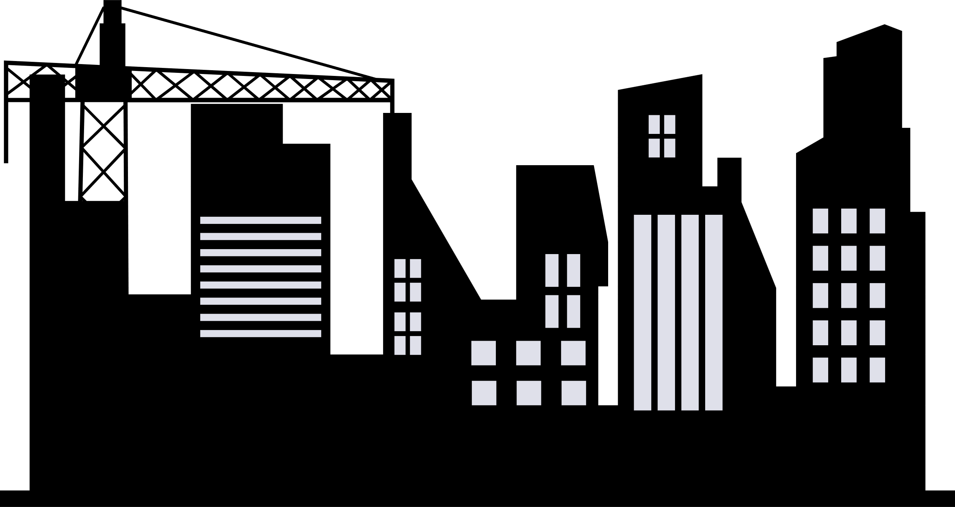
OUR STOREY
1 VANS
At 1VANS, we’re transforming how construction companies manage their day-to-day site operations. The idea was born from real-world experience — when our founder, Mr. Akash Singh Parmar, encountered repeated challenges in site reporting, labour tracking, equipment logs, and overall project transparency during his 12+ years in the construction industry.
Frustrated by the inefficiencies, he partnered with the expert software team at Prayosha Technology to create a solution built specifically for the construction ecosystem.
That solution is 1VANS — a smart, cloud-based platform designed to simplify construction management. From daily reports to workforce tracking, equipment records, and real-time progress updates, everything is managed digitally — quickly, securely, and efficiently.
What Makes 1VANS Different?
✅ Simple interface, built for site teams
✅ Real-time insights from any location
✅ Automated daily reports in PDF
✅ Centralized data — no paperwork, no delays
✅ Designed for engineers, managers, and company owners
Today, 1VANS is helping construction companies take control of their projects, reduce delays, and work smarter

Slide 8
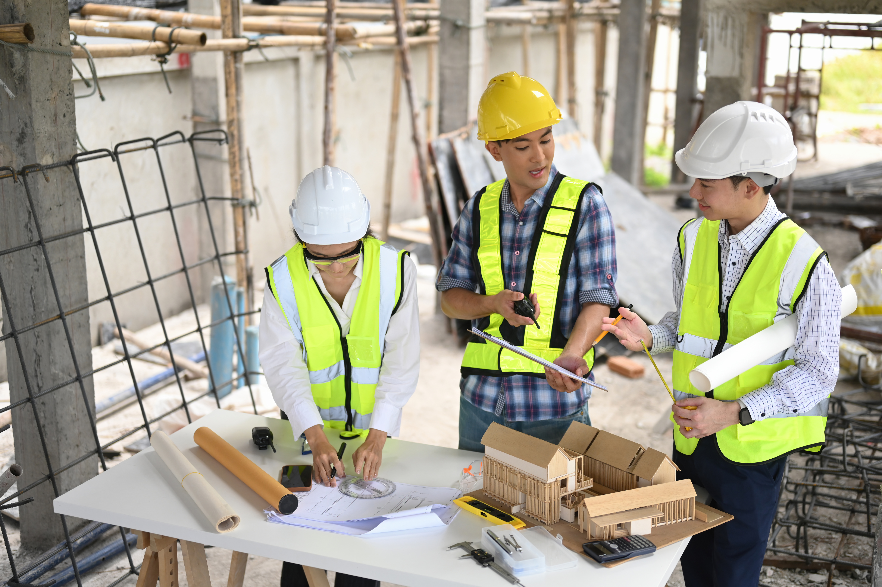




1 VANS
THANK YOU
Get In Touch
+91 77788 81307
WWW.1VANS..IN
Let’s Build Together!
HELLO@1VANS.IN
434, BOARDWAY SIGNATURE, ,4RD FLOOR,391101 VADODARA

