Slide 1
Store Sales - Time Series Forecasting
Group-19
Dhruv Prajapati AU1940192
Harshil Doshi AU1940279
Aaryan Mori AU1940194
Dhaval Chaudhary AU1940180

Slide 2
Introduction
We have been provided data from Corporación Favorita, a large Ecuadorian-based grocery retailer from kaggle.
We will be implementing time series forecasting for predicting the store sales.
We'll be building a model that more accurately predicts the unit sales for thousands of items sold at different Favorita stores.
More accurate forecasting can decrease food waste related to overstocking and improve customer satisfaction.

Slide 3
Problem Statement
Every Grocery Store keeps thousands of products and Transaction.
Due to poor predictions, Sometimes there can be shortage of products or a bunch of products which aren’t sold.
Also, There are many small amount of transactions happens. Often the shopkeeper does not even get the correct account statement.
This affects loss for the store and a lack of customer satisfaction as well.

Slide 4
Existing body of works
●Defined Problem statement.
●Exploratory Data Analysis
●Data Pre-processing
●Feature Engineering
●Implemented Best fit model

Slide 5
Approach

Slide 6
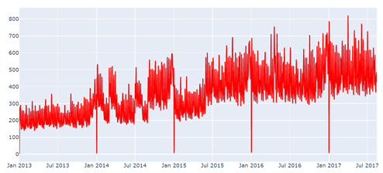
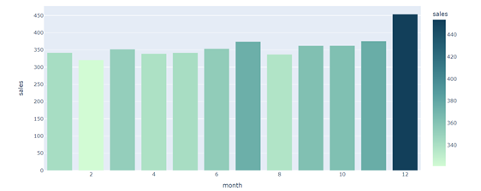
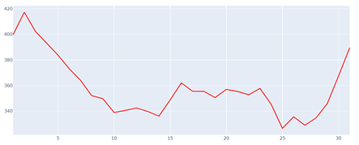
Results
The shown graph indicates the gross sales over different years.
We can derive that the store sales have grown significantly.
For various smaller period parameters, we have analysed the sales for months and days over the years.
Sales over Years
Sales over Months
Sales over Month Days

Slide 7
Results
The shown graph indicates the gross sales over different years.
We can derive that the store sales have grown significantly.
For various smaller period parameters, we have analysed the sales for months and days over the years.
Sales over Years
Sales over Months
Sales over Month Days

Slide 8
Results
The shown graph indicates the gross sales over different years.
We can derive that the store sales have grown significantly.
For various smaller period parameters, we have analysed the sales for months and days over the years.
Sales over Years
Sales over Months
Sales over Month Days

Slide 9
Future Goals

Slide 10
Contribution

Slide 11
Reference

Slide 12
Thank You!

