Slide 1
Store Sales - Time Series Forecasting
Group-19
Dhruv Prajapati AU1940192
Harshil Doshi AU1940279
Aaryan Mori AU1940194
Dhaval Chaudhary AU1940180

Slide 2
Introduction
We will be implementing time series forecasting for predicting the store sales.
The project involved analysis of the store sales dataset with proper data preprocessing.
We will train different models and implement various machine learning algorithms for best accuracy.
More accurate forecasting can decrease food waste related to overstocking and improve customer satisfaction.

Slide 3
Problem Statement
Every Grocery Store keeps thousands of products and Transaction.
Due to poor predictions, Sometimes there can be shortage of products or a bunch of products which aren’t sold.
Also, There are many small amount of transactions happens. Often the shopkeeper does not even get the correct account statement.
This affects loss for the store and a lack of customer satisfaction as well.

Slide 4
Existing body of works
Define Problem statement.
Data Exploration
Data Analysis
Research that which model is useful
Data processing

Slide 5
Approach and Result
We had observed Data containing CSV files and analyze it on graph paper.
With implementing Exploratory Data Analysis on the data we analyze each CSV files and plotting it.

Slide 6
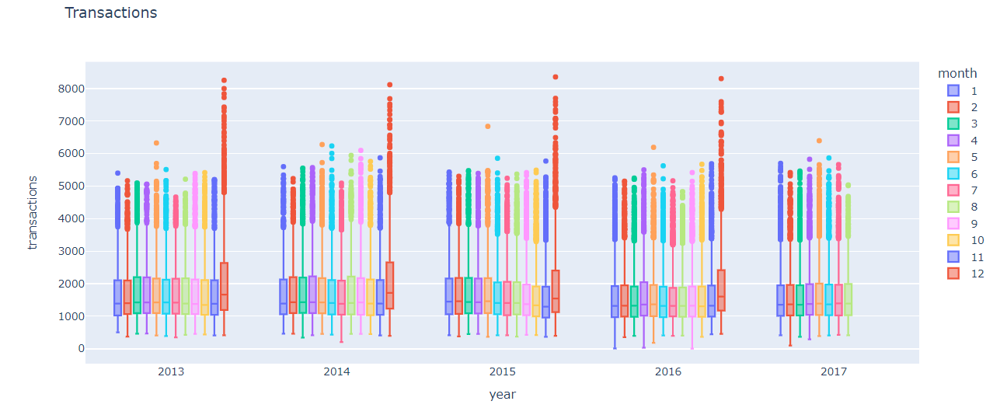
Approach and Result
From this graphical
analysis we got a
concrete data regarding
total transaction per month
for different year.

Slide 7
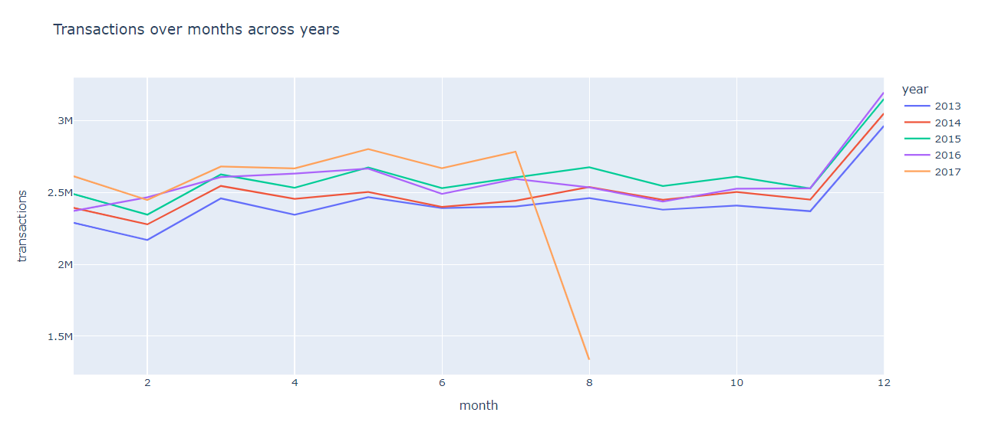
Approach and Result
From this graphical analysis
we got to know that the total
potential transaction data with
respective years.

Slide 8
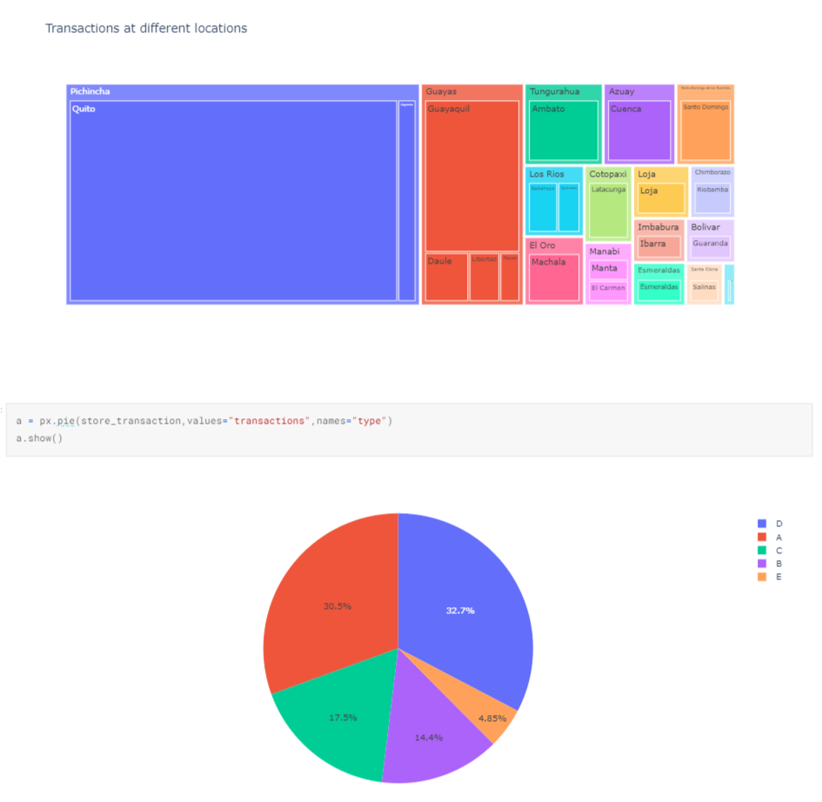
Approach and Result
With this graphical data we have
categorize the certain transactions
modul.
This new category indicates which
city did more and less transactions
or an average transactions.

Slide 9
Future Goals
We will make model which can be prepared for test any dataset.
With the help of linear regression and other process, we’ll complete our project.

Slide 10
Contribution
Each member has contributed equally.

Slide 11
References:
Udemy. 2022. Exploratory Data Analysis (EDA) for Machine Learning. [online] Available at: <https://www.udemy.com/course/exploratory-data-analysis-for-ml/> [Accessed 20 March 2022].
Kaggle.com. 2022. Store Sales - Time Series Forecasting | Kaggle. [online] Available at: <https://www.kaggle.com/c/store-sales-time-series-forecasting/overview/description> [Accessed 20 March 2022].

Slide 12
Thank You

