Slide 1
Store Sales - Time Series Forecasting
Group-19
Dhruv Prajapati AU1940192
Harshil Doshi AU1940279
Aaryan Mori AU1940194
Dhaval Chaudhary AU1940180

Slide 2
Introduction
Every grocery store keeps the stock of a certain product according to its demand.
Many factors affects the sales of the stores such as work days, holidays, events, natural calamities etc.
As they do not have any accurate predictions of sales, many times their can be shortage of products or the theirs is a bunch of products which remained unsold.
With the help of Historical data and various other parameters, we can predict the sales for a certain period of time.
The data comes from an Ecuador company as known as Corporacion Favorita.

Slide 3
Problem Statement
Sales prediction is an important part of modern business intelligence. Sales can be considered as a time series.
Time-series forecasting in simply refers to forecast or to predict the future value over a period of time.
We have been provided with time series of gross sales of 54 Favorita grocery stores over four years.
The time series starts from 2013-01-01 and finishes in 2017-08-31.
More accurate forecasting can decrease food waste related to overstocking and improve customer satisfaction.

Slide 4
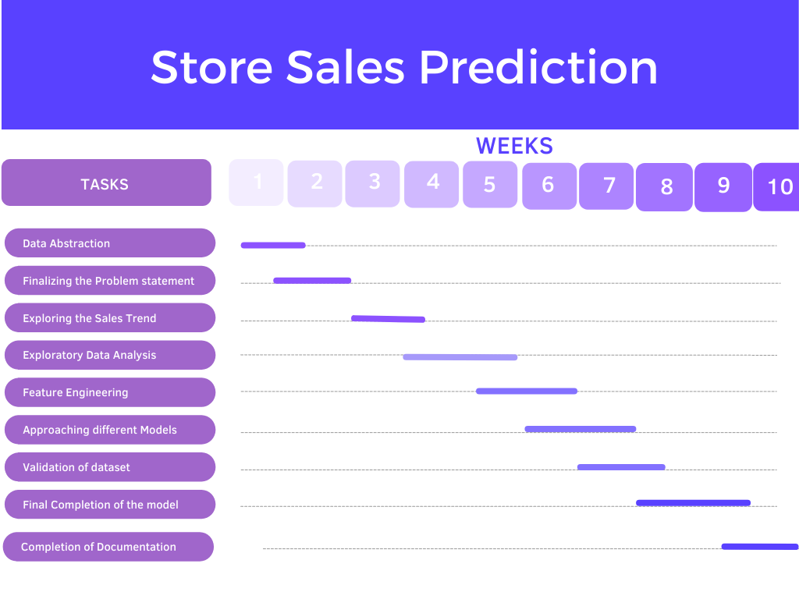

Slide 5
Existing body of works
Motivation for choosing the problem: Personal Story
The factor that motivated us to choose this project is that two of our group members’ father have grocery stores.
Data Analysis
Five types of Data for 54 stores and 33 Product Families
(1) Train (2) Stores (3) Transaction (4) Holidays and events (5) Daily Oil Price
Additional Notes:
Public wages paid after every two weeks
Earthquake on 16th April,2016

Slide 6
Work Done So Far
It was a necessary job of getting a clear understanding of the data. We can derive that the store sales have grown significantly.
We implemented exploratory Data Analysis. We began with plotting graphs with respect to various time feature to get an understanding of overall sales trend.
We began with plotting graphs with respect to various time feature to get an understanding of overall sales trend.
We got the following graphs of the sales trend shown below:

Slide 7
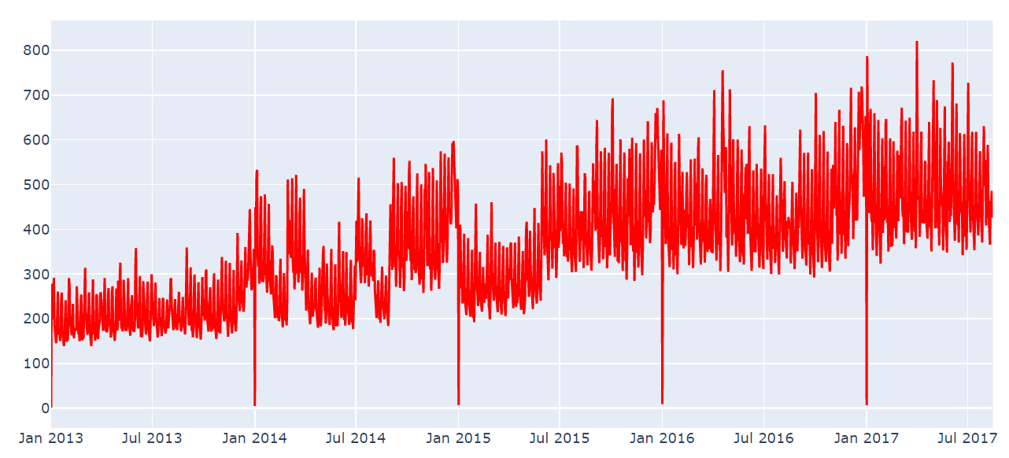
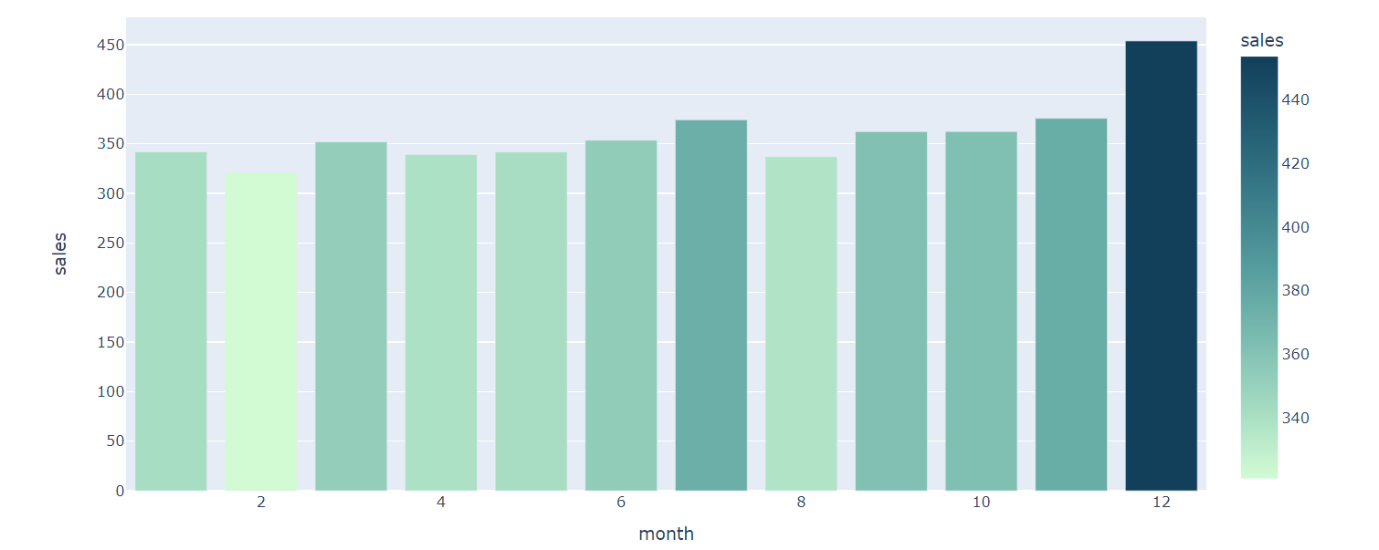
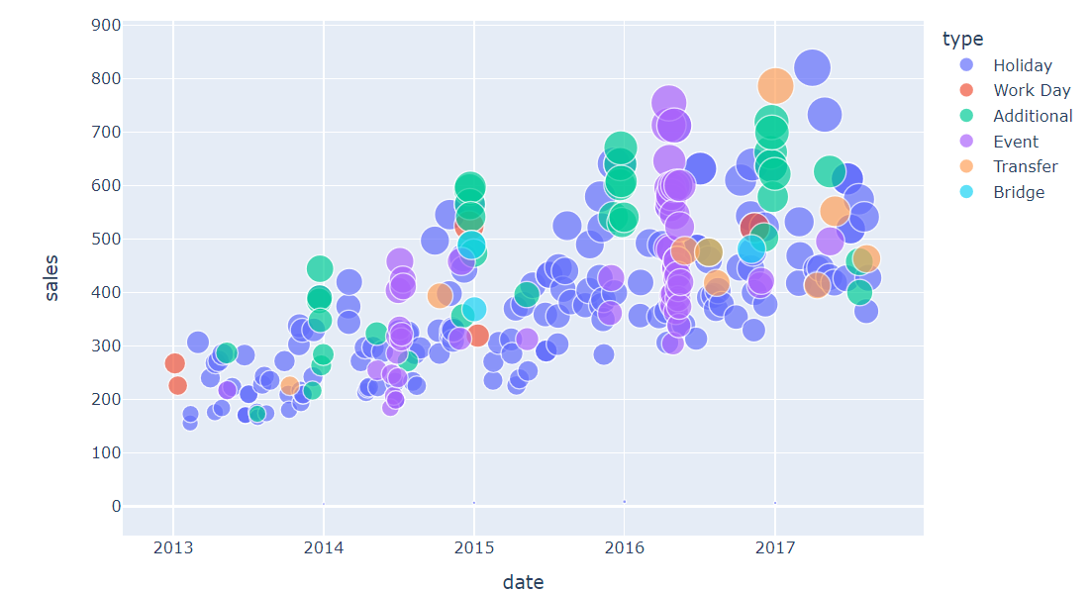
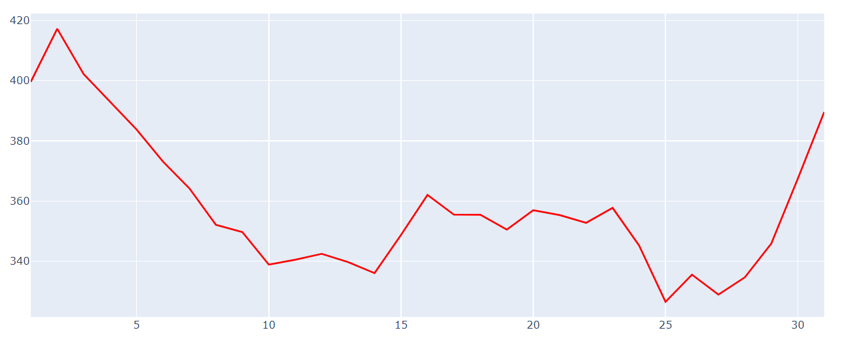
Exploratory Data Analysis
Sales over months
Sales over years
Sales over holidays and events
Sales over days

Slide 8
Relation between Oil, Economy and Sales
Ecuador is an oil-dependent country and it’s economical health is highly vulnerable to shocks in oil prices.
Changing oil prices in Ecuador will cause a variance in the model.
We have plotted the change in oil price over the period to analyze the trend.
There are some missing data points in the daily oil data. We can treat the data by using various imputation methods.
We have used Linear Interpolation for the time series. We have plotted the correlation of oil prices with transactions and sales.

Slide 9
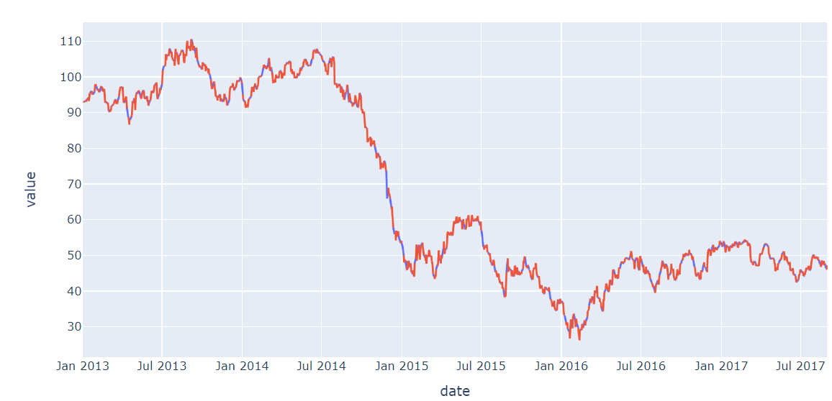
Oil Price Trend

Slide 10
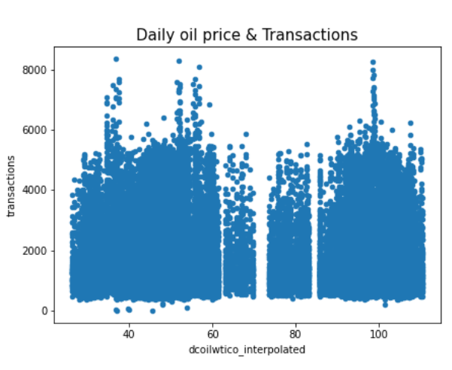
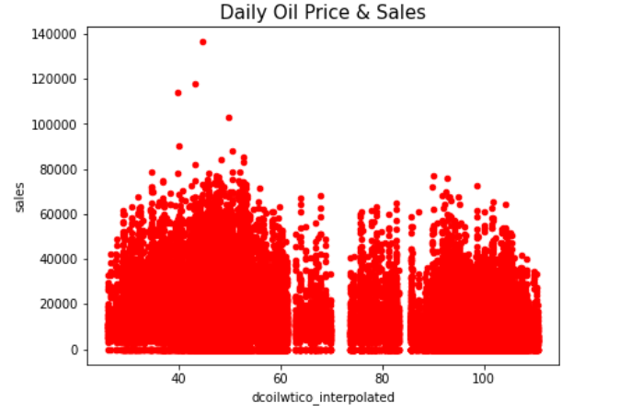
Oil Prices’ Correlation
The correlation values are not strong but the sign of sales is negative.
We can derive that, if daily oil price is high, we expect that the Ecuador’s economy is bad and it means the price of product increases and sales decreases.
There is a negative relationship here.

Slide 11
Feature Engineering
Feature engineering refers to select and transform the most relevant variables while creating a predictive model.
We have transformed 3 features in our data with respect to holidays, date and oil price trend:
Only keeping national holiday for simplicity
Dropping duplicated holiday
last 7 day avg oil price
leave the holiday with higher avg sales, which means more important holiday
Then we merged our entire data and divided it into three parts for modelling:
Train Data: 01/04/2017 to 31/07/2017
Test Data: 16/8/2017 to 31/8/2017
Validation Data: 1/8/2017 to 15/8/2017

Slide 12
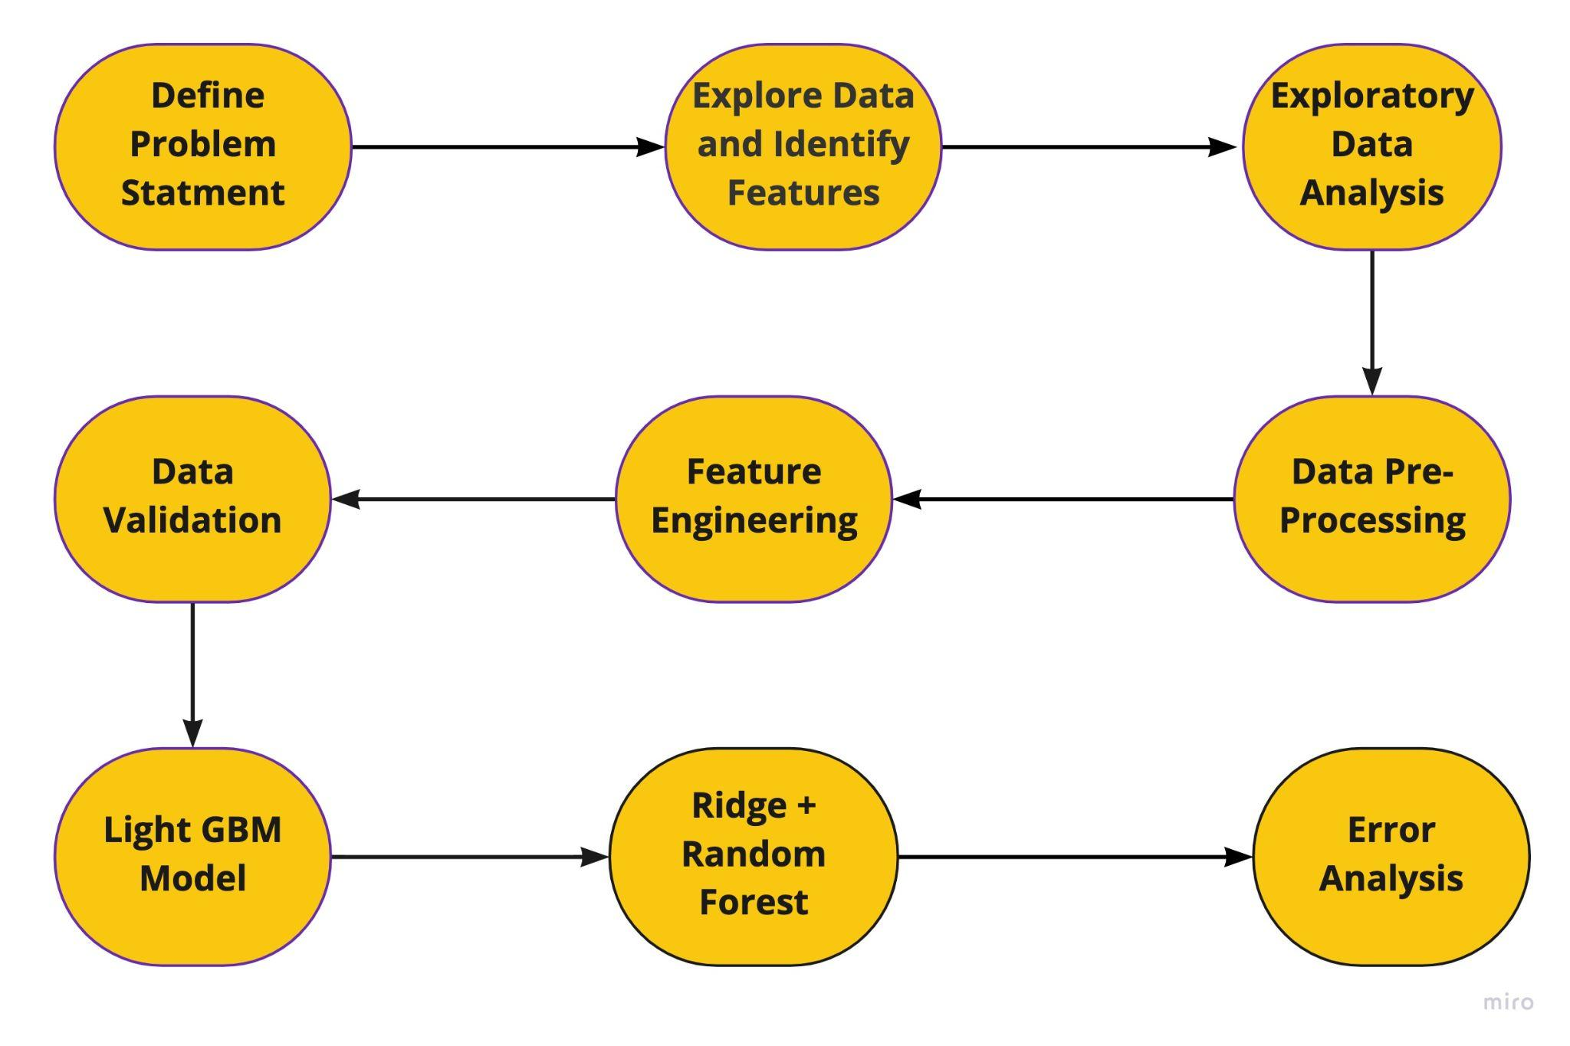
Approach

Slide 13
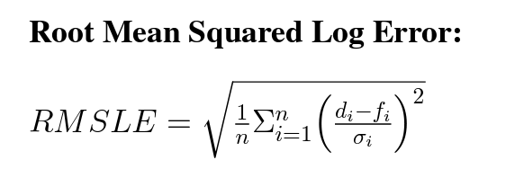
Approach
Initially, We have used Optuna for tuning hyper-parameters. To control the behaviour of our machine learning model.
If we don’t correctly tune our hyper-parameters, our estimated model parameters produce suboptimal results, as they don’t minimize the loss function.
After tuning hyper-parameters, we implemented our both models. We applied Root Mean Squared Log Error to minimize the loss and maximize the accuracy.

Slide 14
Light GBM Model
Light GBM is a gradient boosting framework based on the decision tree technique that may be used for ranking, classification, and a variety of other machine learning applications.
It selects the leaf that it believes will result in the most significant loss reduction.
We have implemented Light GBM model and didn’t get good accuracy.
We got RMSLE=0.3232 which is very high compared to Ridge + RF model.
https://en.wikipedia.org/wiki/LightGBM

Slide 15
Ridge Regression + Random Forest
Ridge regression is a method of estimating the coefficients of multiple-regression models in scenarios where linearly independent variables are highly correlated.
Including all parameters leads to a high level of overfitting in Linear Regression.
Therefore, We have used Ridge Regression over Linear regression.
We have implemented Random Forest only for School and Office supply, and got RMSLE = 0.2395, Which is better than Light GBM.
Hilt, Donald E.; Seegrist, Donald W. (1977). Ridge, a computer program for calculating ridge regression estimates. doi:10.5962/bhl.title.68934

Slide 16
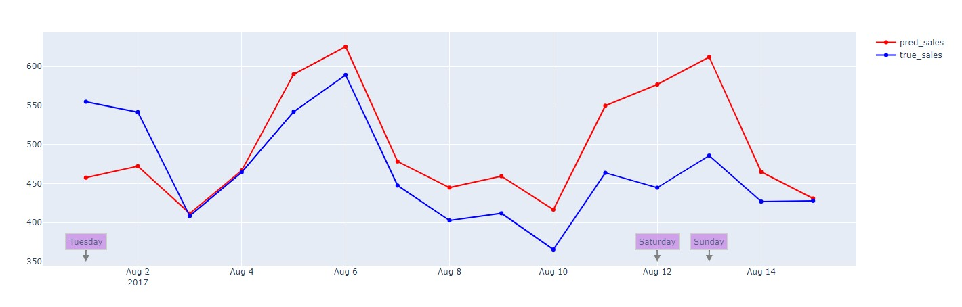
Results
We have annotated the days on which our model has predicted bad. The Final scatter plot is shown below:

Slide 17
Conclusion
Correlation of Sales and Oil Prices. Negative sign of Sales represent the negative relation between them.
Random forest algorithm provides a higher level of accuracy in predicting outcomes over the decision tree algorithm(Light GBM).
We obtained the lowest RMSLE value of 0.2395 through our Ridge + RF model which significantly better than Light GBM which was 0.3232.

Slide 18
Contribution
Each member has contributed equally for the project.
Dhruv: Worked on EDA , Feature Engineering (Specifically on Oil Price trend), Implemented Light GBM Model
Harshil: Explored various research papers for implementation and worked on EDA
Aaryan: Worked on Feature Engineering and Ridge+RF Model
Dhaval: Worked on EDA for Sales over Various Time Features and Ridge+RF Model

Slide 19
References:
Papacharalampous G, Tyralis H., Koutsoyiannis D, ”Univariate time series forecasting of temperature and precipitation with a focus on machine learning algorithms: A multiple-case study from Greece” Water Resour. Manag. 2018, 32, 5207–5239
B. Pavlyshenko, “Machine-Learning Models for Sales Time Series Forecasting,” Data, vol. 4, no. 1, p. 15, Jan. 2019, doi: 10.3390/data4010015.
S. Chopra, P. Meindl Supply chain management: Strategy, planning, and operation Community.tableau.com (2016) [online] Available at https://community.tableau.com/docs/DOC-1236
J. Huber, A. Gossmann, H. Stuckenschmidt Clusterbased hierarchical demand forecasting for perishable goods Expert Systems with Applications, 76 (2017), pp. 140-151]
H. Yang, X. Li, W. Qiang, Y. Zhao, W. Zhang, C. Tang A network traffic forecasting method based on SA optimized ARIMA–BP neural network Computer Networks, 193 (2021), Article 108102
Kaggle.com. 2022. Store Sales - Time Series Forecasting Use machine learning to predict grocery sales. [online] Available at: https://www.kaggle.com/competitions/store-salestime-series-forecasting/overview.

Slide 20
Thank You

