Slide 1

iOS App Development Using Swift
Summer Camp 2016

Slide 2
First Let’s open Xcode
Create a project
Choose iOS devices
Click on Sprite Kit application
Sprite Kit is used to make 2D games!!

Slide 3
Introduction to iOS App Development
Swift: a new language created by Apple Computers to develop apps for iOS, OS X, tvOS and watchOS
This language is easy to understand and is a great way to start off coding
This language is built on the foundation of Objective - C

Slide 4
Lets Get Started!
Open Xcode (Integrated Development Environment)
Create a new Xcode project
Under iOS, choose single view
Make sure language is swift

Slide 5
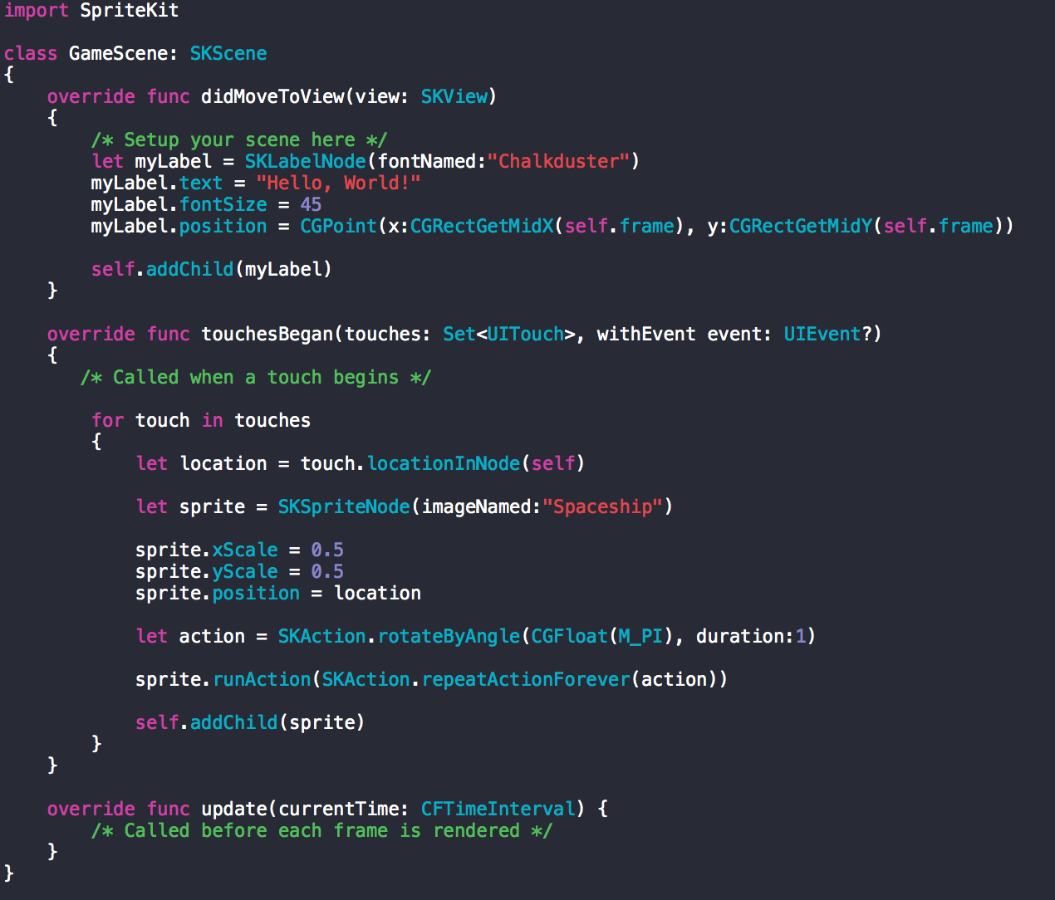
In the story board, choose ‘GameScene.swift’
Current GameScene.

Slide 6
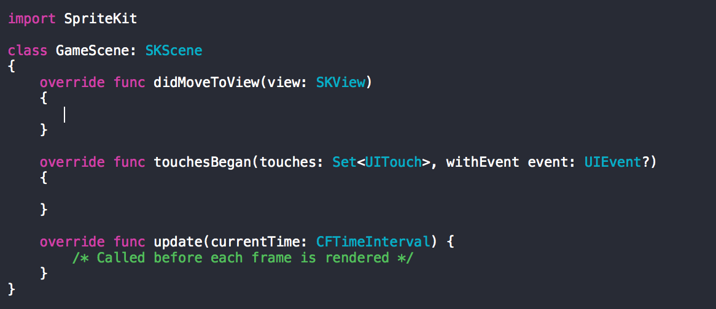
Now, lets clear everything between the two functions.
Current script.

Slide 7
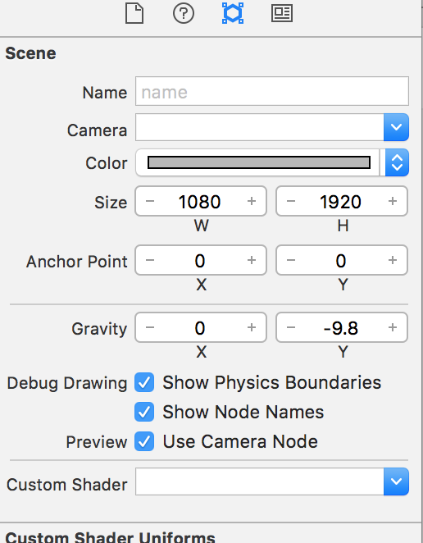
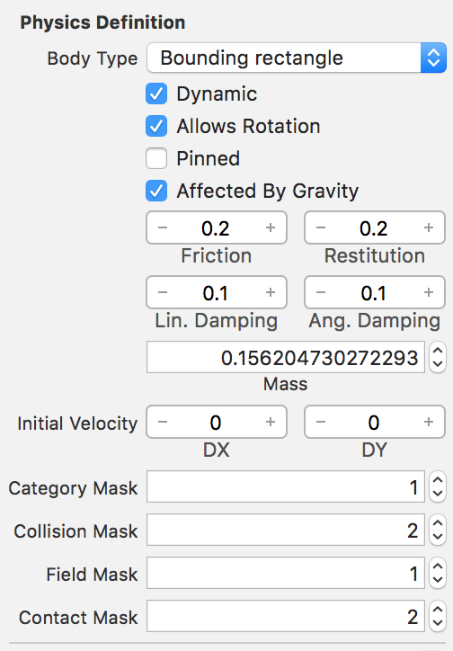
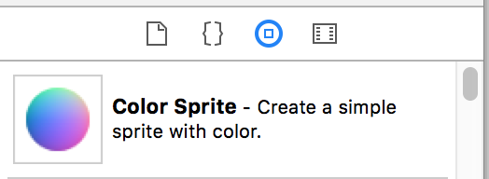
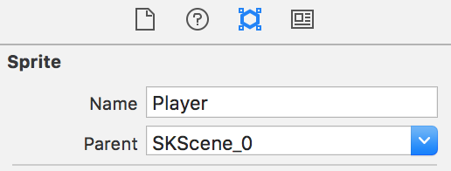
Change size in attribute inspector
1080-1920
Scroll down in the Attribute Inspector.
Choose:
Physics Definition
Body Type (boudning rectangle)
Add a color sprite from the object library and then make it the ‘Player’.
Go to the attribute inspector and the change the random name to ‘player’

Slide 8
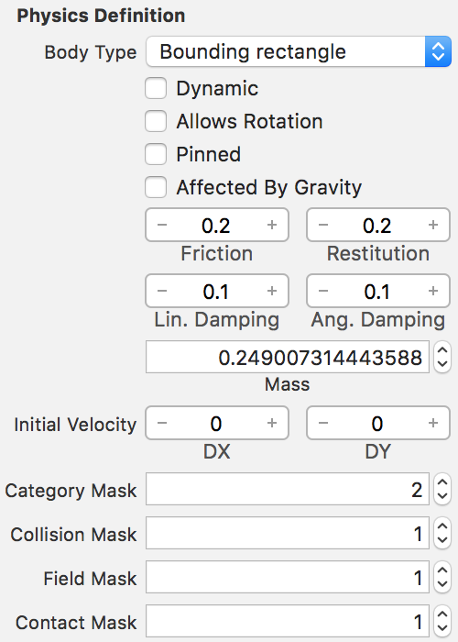
Choose color sprite again and now this time lets create some walls.
For the walls, we change the body type.
Go the Attribute Inspector and scroll down to ‘Physics Definition’
Click Body Type and choose
bounding rectangles and unselect all properties

Slide 9
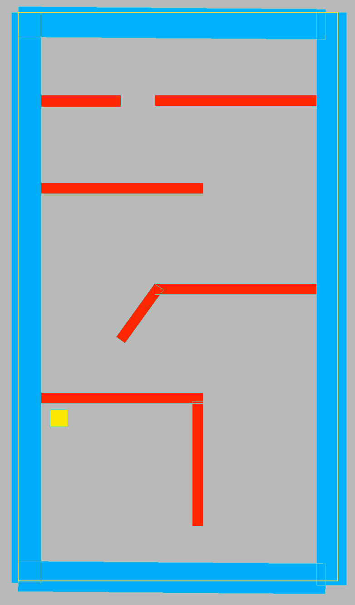
Now, that we have the color sprite ready!
Let’s build our own maze!!
Drag and drop a few color sprites and in the Dimensions we mentioned earlier.

Slide 10
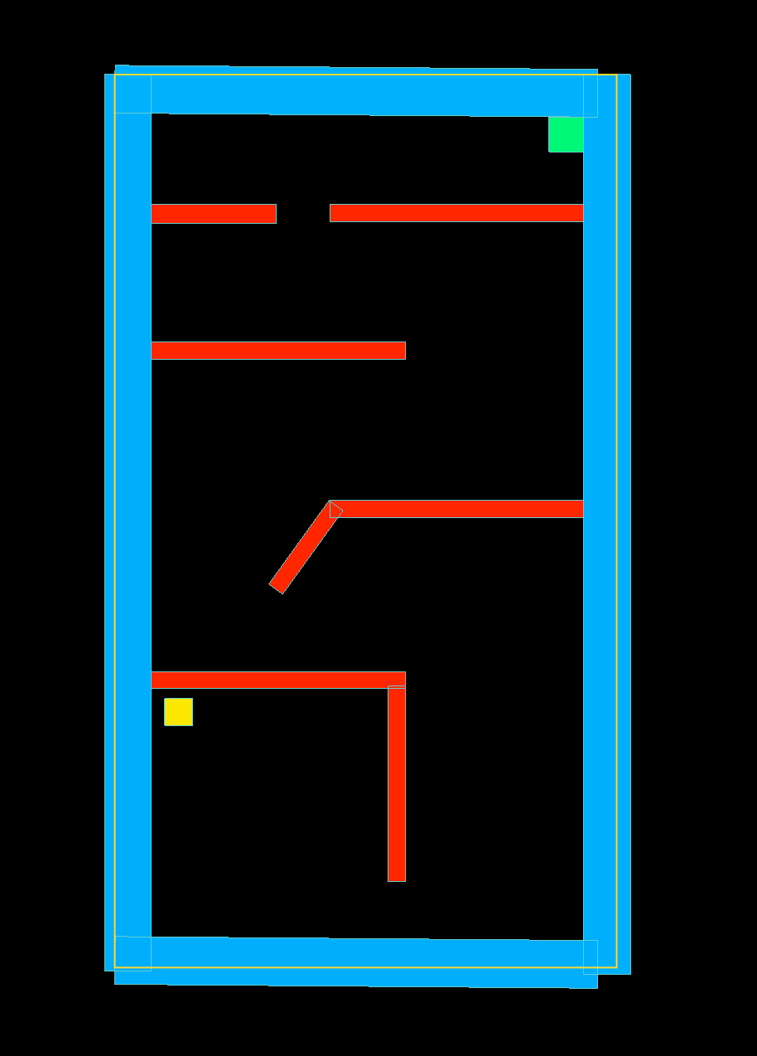
Final Maze Scene!!

Slide 11


Slide 12
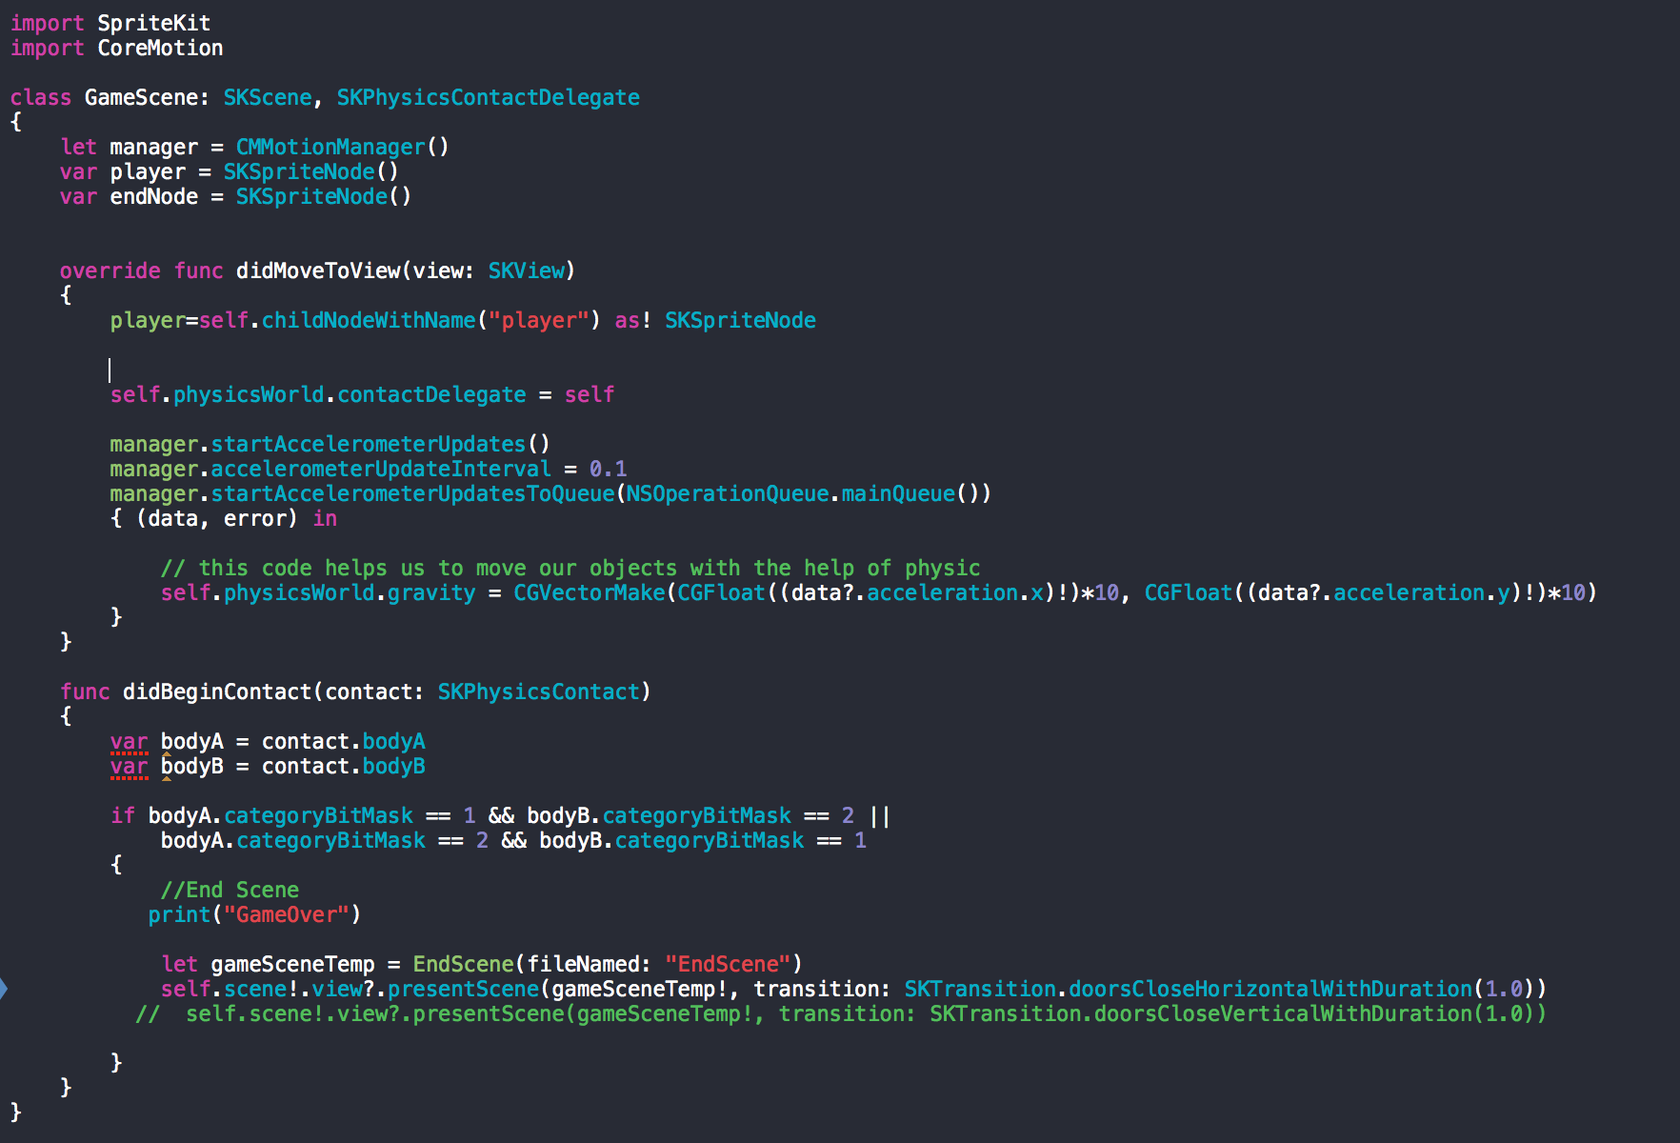

Slide 13
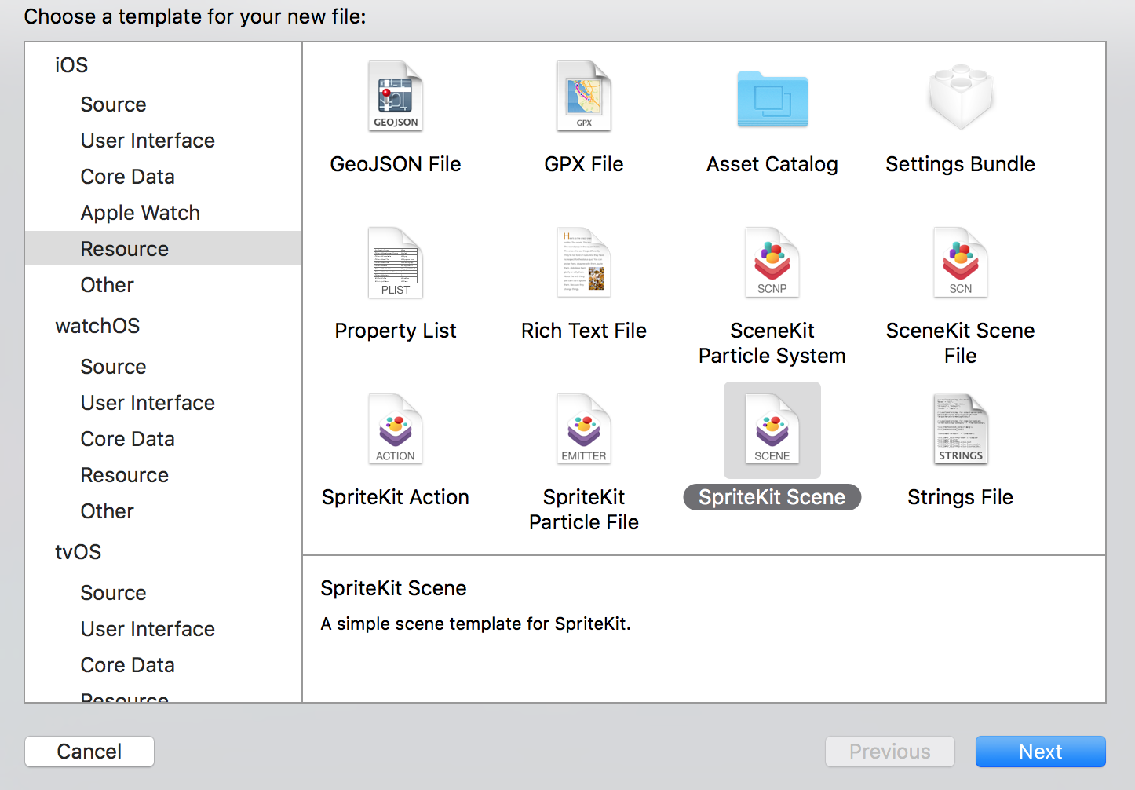
Let us add an End Scene to our game!
- Click on ‘File’ --> New --> File
Save The File as ‘EndScene’

Slide 14
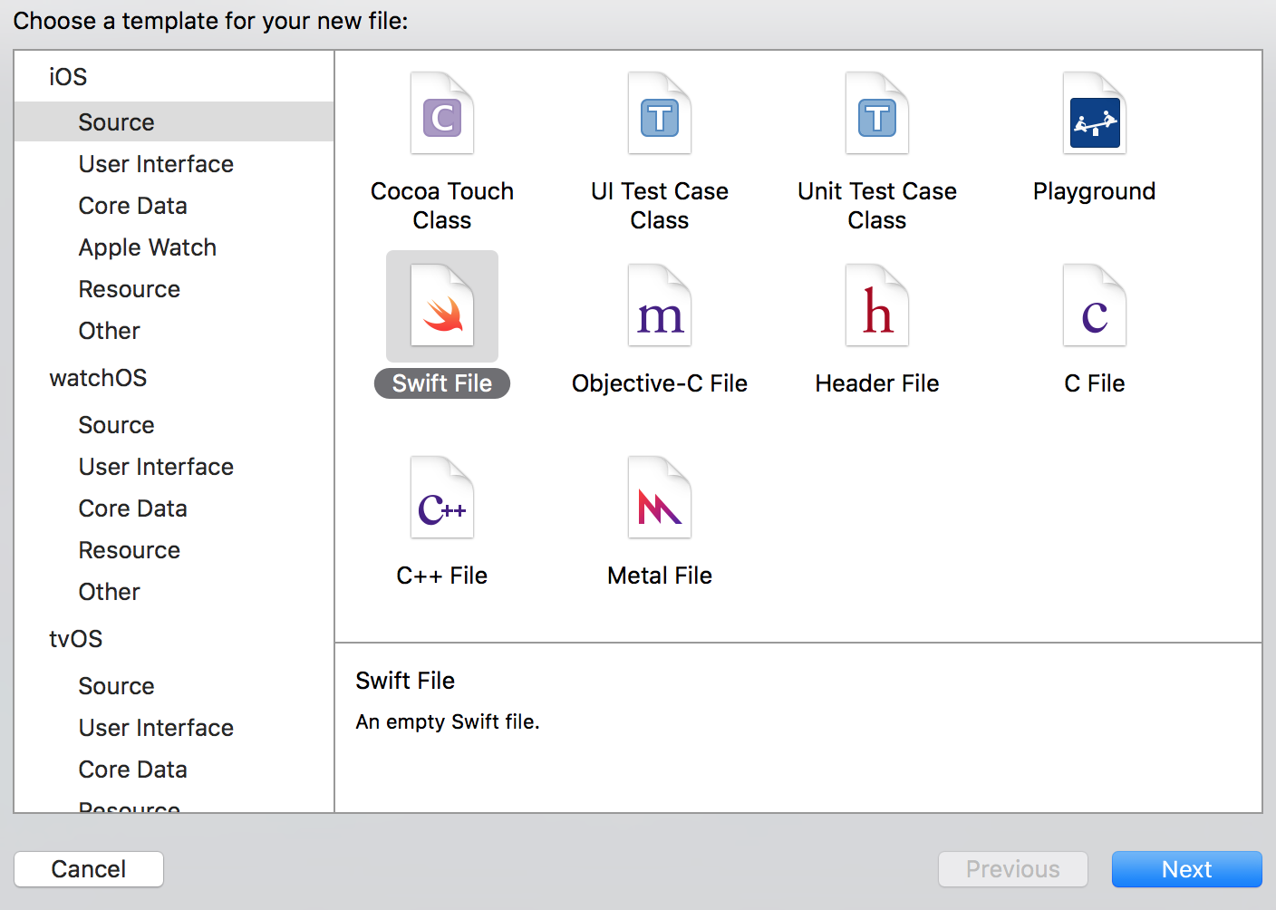
- Click on ‘File’ --> New --> File
Save this file as ‘EndScene’

Slide 15
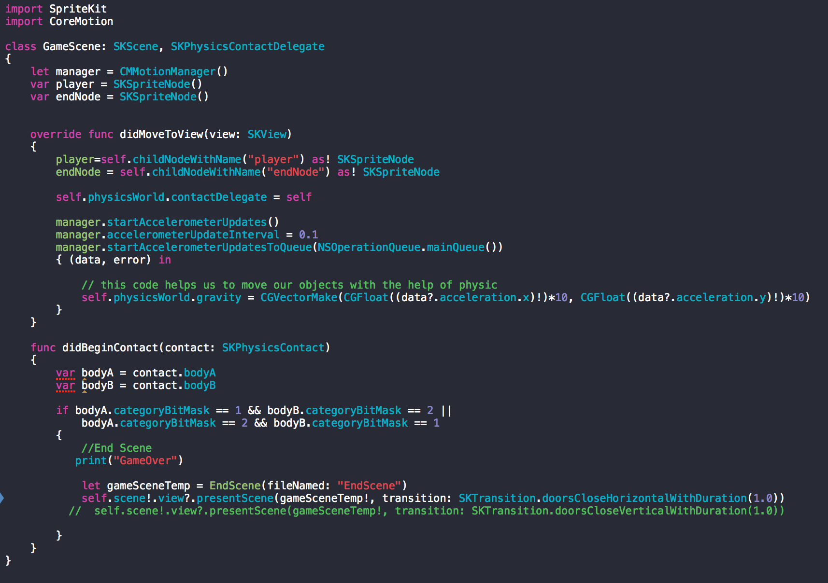

Slide 16
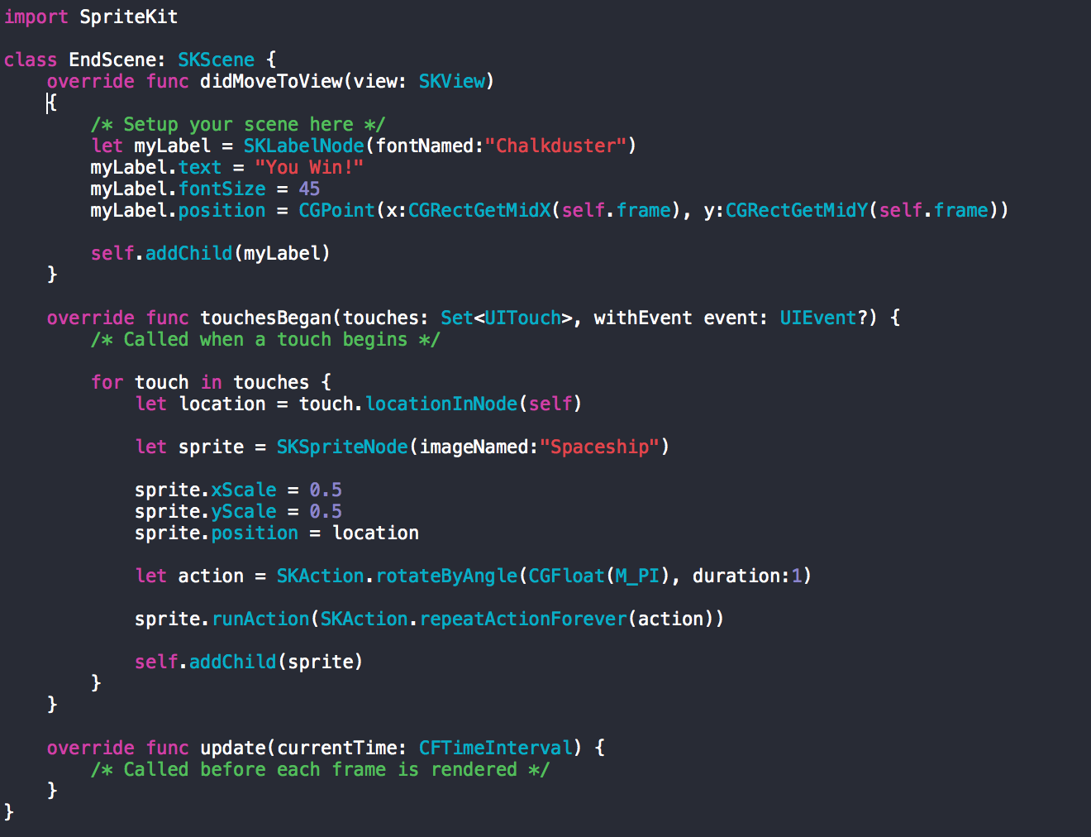
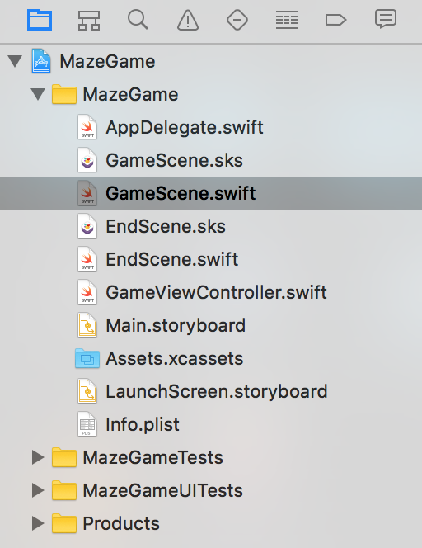
On our Left, the two new files we created, will look something this.
Click on EndScene.swift

Slide 17
Now, add this code to your
‘GameScene.swift’

Slide 18
Add a new color sprite in your GameScene.sks and name this ‘endNode’

Slide 19
Lets build and run our game!!

