Slide 1
Image Presentation
Generated using Python-pptx

Slide 2
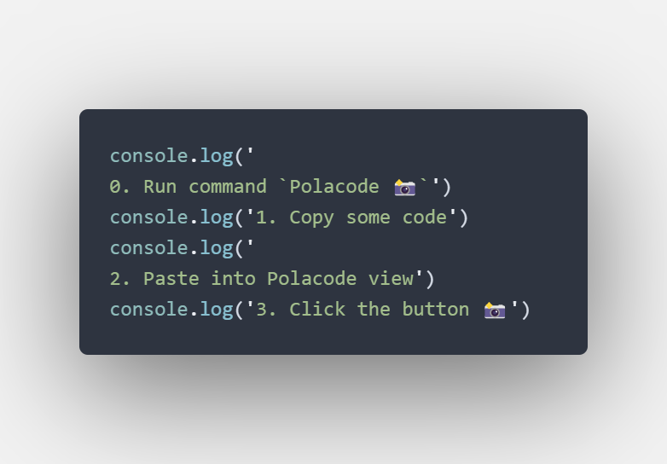
Selected Image
This is an auto-generated slide containing the selected image.

