Slide 1

French Revolution

Slide 2
The Revolution and Everyday Life
Impact of revolution on France
One important law that came into effect soon after the storming of the Bastille in the summers of 1789 was the abolition of censorship. In the old regime all written material and cultural activities could be only published or performed only after they had been approved by the censors of the king.
Now the Declaration of Rights of man and citizen proclaimed freedom of speech and expression to be a natural right. Newspaper, pamphlet, books and printed pictures flooded the towns of France from where they travelled rapidly to the country side. They all described and discussed the events and changes taken place in France.
Freedom of press also meant that opposing views of events could be expressed. Each side sought to convince the other of its position through the medium of print.
Plays, songs and festive processions attracted large number of people.

Slide 3
Impact of the Revolution on the World
Impact of revolution on World
The French Revolution is a milestone in the history of mankind.
It inspired revolutionary movements in almost every country of Europe and South America.
The social and political changes that took place in different parts of Europe can be traced to the French Revolution.
When France occupied many areas of Europe, then spread new ideas among the people of the occupied areas.
The greatest effect was the starting of mass movements all over the world and instilling a spirit of nationalism among the people.

Slide 4
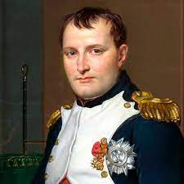
Napoleon Bonaparte (1769-1821) & The Civil Code (1804)
Napoleon Bonaparte
Napoleon Bonaparte was a French military leader and emperor who conquered much of Europe in the early 19th century. Born on the island of Corsica, Napoleon rapidly rose through the ranks of the military during the French revolution (1789-1799). After seizing political power in France in a 1799 cocep d’etat, he crowned himself emperor in 1804.
The Civil Code of 1804
Feudal system was abolished.
Equality before the law was established.
Right to property was given.
Serfdoms and manorial does was abolished.
Abolished all privileges based on birth.

Slide 5
Rise and Fall of Napoleon
Rise and Fall of Napoleon
The instability and clashes between the directory and legislative councils gave rise to Napoleon. In 1804 Napoleon Bonaparte crowned himself the Emperor of France.
He set out to conquer neighboring European countries dispossessing dynasties and creating kingdoms where he placed his family members.
He introduced many reforms such as the protection of private property and a uniform system of weights and measures provided by decimal system.
Initially many saw Napoleon as a liberator but soon his armies came to be viewed everywhere as an invading force.Serfdoms and manorial does was abolished.
He was finally defeated at waterloo in 1815.

Slide 6
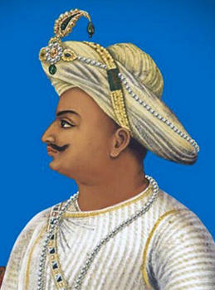
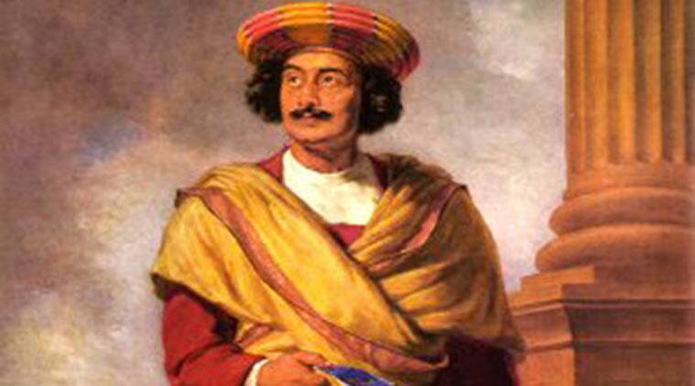
What inspiration did Indians get form French revolution?
What inspiration did Indians get from French Revolution?
Raja Ram Mohan Roy, the father of Indian renaissance and Tipu Sultan, the king of Mysore were Indian individuals who responded to the ideas coming from revolutionary France.
These two Indian leaders were inspired by the ideals of nationalism and social equality of French Revolution.
Raja Ram Mohan Roy
Tipu Sultan

Slide 7

THE END

