Slide 1

French revolution
By Group-5

Slide 2
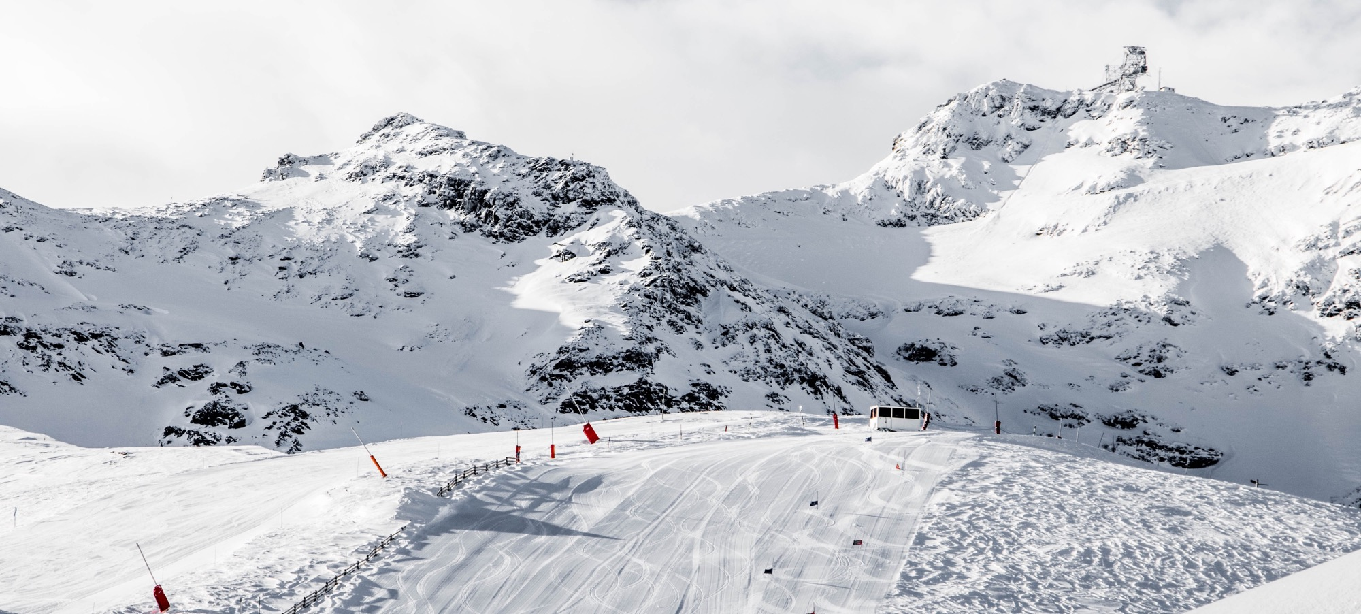
introduction
FRENCH REVOLUTION
Notes:
© Copyright Showeet.com – Free PowerPoint Templates

Slide 3
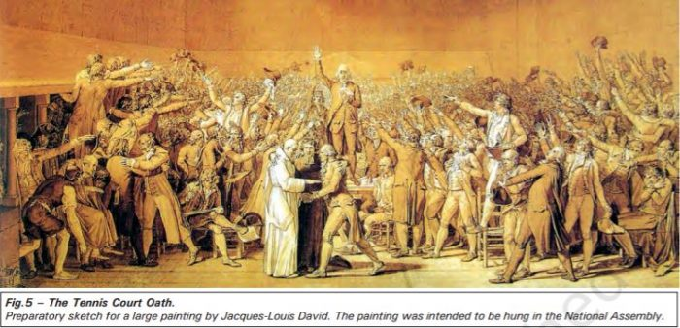
FRENCH REVOLUTION
The French revolution led to the end of monarchy in France. A society based on privileges gave way to a new system of governance. The Declaration of the Right of Man and Citizen during the revolution announced the coming of a new time.
On 14th July 1789 a group of several hundred people marched towards eastern part of the city and stormed the fortress prison, the Bastille. The fortress was demolished and its fragments sold in the market. The days that followed saw more rioting both in Paris and the countryside and it saw a begining of chain of events that ultimately led to the execution of the king in France.
Notes:
© Copyright Showeet.com – Free PowerPoint Templates

Slide 4
Cause of the French Revolution
(1) Wars and Economic Crisis
In 1774 Louis XVI of Bourbon family of kings ascended the throne of France. The new king found an empty treasury. Long years of war had drained the financial resources of France. Added to this was the cost of maintaining an extravagant court at the immense palace of Versailles.
The war with Britain added more than a billion livres to a debt that has already risen to more than 2 billion livres. Lenders who gave the state credit now began to charge 10 percent interest on loans. So the French government was obliged to spend an increasing percentage of its budget on interest payment alone.
To meet its regular expenses such as the cost of maintaining an army, the court, running the government offices or universities, the state was forced to increase the tax.
Notes:
© Copyright Showeet.com – Free PowerPoint Templates

Slide 5
Cause of the French Revolution
(2) Excessive Taxation
The system of taxation was unjust and unreasonable. The expenditure of the government was ever increasing on account of useless wars and extravagance of rulers. With every increase in the demand for money, fresh taxes were imposed on the common people. To meet its regular expenses such as the cost of maintaining an army, the court, running the government offices or universities, the state was forced to increase the tax.
The upper class which consisted of the nobles and the clergy were exempted from all sorts of taxes.
The burden of taxation was passed on to the masses. People were forces to pay all kinds of taxes. These included a direct tax called taille, the land tax, road tax, church tax, salt tax, and tariff duties charged for moving goods from one province to another, up or down or across a river and so on.
The Church too extracted its share to taxes called tithes from the peasants. Sometimes four-fifth of the total income of a farmer would go towards the payment of taxes.
Notes:
© Copyright Showeet.com – Free PowerPoint Templates

Slide 6
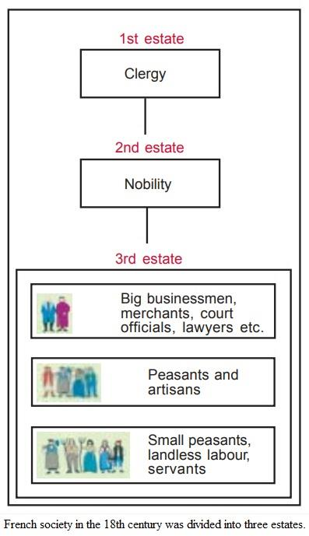
Cause of the French Revolution
(3) Social Disparity
The society of estates was part of the feudal system that dated back to the middle ages. The term Old Regime is usually used to describe the society and institutions of France before 1789.
Fig. 2 shows how the system of estates in French society was organised. Peasants made up about 90 per cent of the population. However, only a small number of them owned the land they cultivated. About 60 per cent of the land was owned by nobles, the Church and other richer members of the third estate. The members of the first two estates, that is, the clergy and the nobility, enjoyed certain privileges by birth. The most important of these was exemption from paying taxes to the state. The nobles further enjoyed feudal privileges. These included feudal dues, which they extracted from the peasants. Peasants were obliged to render services to the lord – to work in his house and fields – to serve in the army or to participate in building roads.
Notes:
© Copyright Showeet.com – Free PowerPoint Templates

Slide 7
Cause of the French Revolution
(4) Subsistence crisis
An extreme situation where the basic means of livelihood are endangered.
Causes of Subsistence Crisis
The population of France rose from 23 million to 28 million in 1789, this led to a rapid increase in the demand for foodgrains. Production of grains could not keep pace with the demand, so the prices of bread which was the staple diet of majority, rose.
Most workers were employed as labourers in workshops, whose owners fixed their wages. But wages did not keep pace with rise in prices, so the gap between the rich and poor widened.
Things become worse wherever drought or hail reduced the harvest and this led to subsistence crisis.
Notes:
© Copyright Showeet.com – Free PowerPoint Templates

Slide 8
Cause of the French Revolution
(5) Growing Middle Class
The eighteenth century witnessed the emergence of social groups, termed as middle class, who earned their wealth through an expanding overseas trade and from manufacture of goods.
In addition to merchants and manufacturers the third estate included professionals such as lawyers or administrative officials. All of these were educated and believed that no group in the society should be priviliged by birth. A person’s social position must depend on his merit.
Notes:
© Copyright Showeet.com – Free PowerPoint Templates

Slide 9
Cause of the French Revolution
(6) ROLE OF PHILOSOPHERS
John Locke
In his ‘Two Treatises of Government’, Locke sought to refute the docterine of divine and absolute rightof the monarch.
Rousseau
Roussean in Social contract carried the idea forward, proposing a government based on social contract between people and the representatives.
Montesquieu
In The Spirit Of Laws, Montesquieu proposed a division of power within the government between the legislature, the executive and the judiciary.
Ideas of these philosophers were discussed and spread among people through books and newspapers. These were frequently read aloud in group for the benefit of those who could not read and write.
Notes:
© Copyright Showeet.com – Free PowerPoint Templates

