Slide 1



Smart AQI Forecasting Using Machine Learning and Gradio

Slide 2

Learning Objectives
Understand the relationship between air pollutants (PM2.5, PM10, NO₂, SO₂, CO) and AQI
Preprocess, clean, and split environmental data for ML model training
Build an ML-based AQI predictor to forecast pollution levels
Deploy a user-friendly Gradio interface for real-time predictions
Promote awareness of air quality and its health impacts
GOAL
Source :
www.freepik.com/

Slide 3
Tools and Technology used
Languages: Python
Libraries: Pandas, NumPy, Matplotlib, Scikit-learn
ML Model: Random Forest Regressor
Interface: Gradio (for interactive web-based prediction UI)
Environment: Google Colab

Slide 4
Methodology
Data Collection: Used real AQI datasets (city_day.csv, station_day.csv)
Data Preprocessing: Cleaned missing values, selected key pollutant features
Train-Test Split: Prepared dataset for model training and validation
Model Training: Built and trained Random Forest Regressor
Evaluation: Measured performance using MSE and R² score
Deployment: Created Gradio interface for real-time AQI prediction

Slide 5
Problem Statement:
Rising air pollution levels in cities are a serious public health concern
People lack easy access to accurate AQI predictions
Need for early warnings to plan outdoor activities and minimize exposure

Slide 6
Solution:
Developed an AI-driven AQI prediction system using ML
Interactive Gradio web app lets users input pollutant levels
Predicts AQI value and categorizes air quality (Good → Hazardous)
Provides an intuitive and accessible tool for citizens, policymakers, and researchers

Slide 7
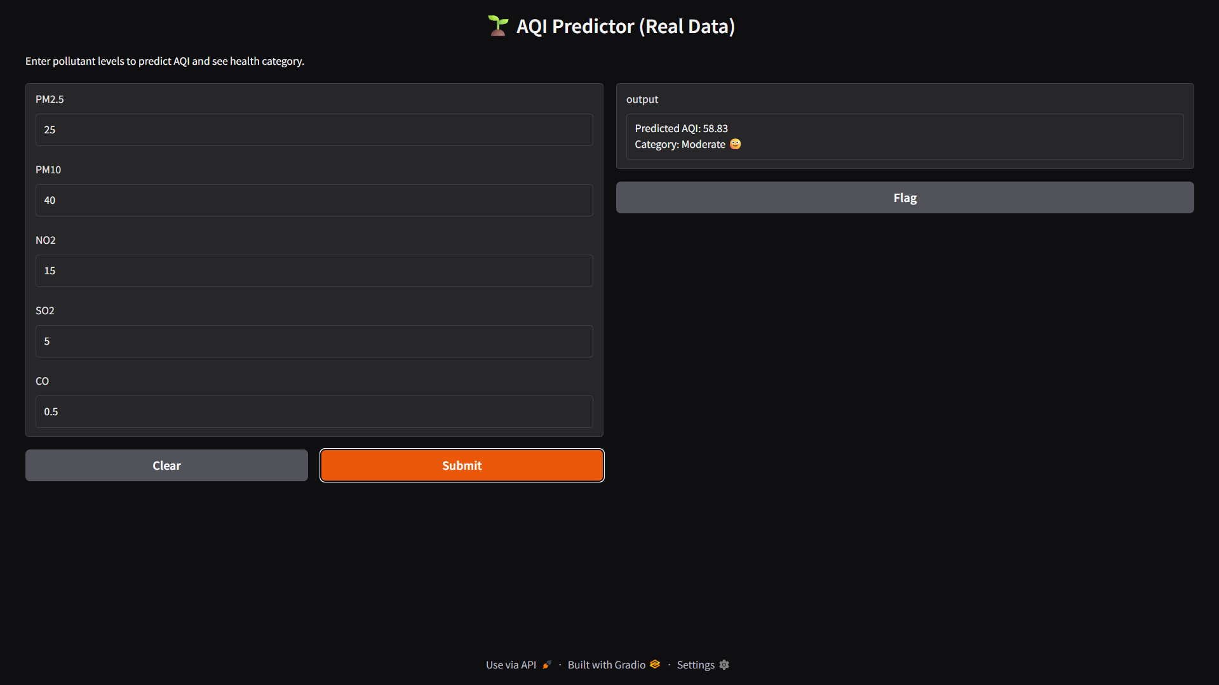
Screenshot of Output:

Slide 8
Conclusion:
Successfully prepared and split real AQI dataset for ML modeling
Built the foundation for a data-driven, scalable AQI forecasting system
Planned future work:
Model fine-tuning & feature importance visualization
Adding real-time data ingestion for live AQI predictions
Integrating alerts into smart city dashboards

