Slide 1


Smart Policy Document Explainer & Generator
Making complex documents easy to read & easy to work with
Dhruv Thejas

Slide 2

Simplifying Policy Documents & File Handling:
This project helps users convert files and understand technical content in a simple format.
Designed for technical and non-technical users.
A lightweight, user-friendly tool.

Slide 3
Why This Tool?
Confusing policy documents.
The Problem
Unreadable system files.
Time wasted for all users.
Employees: review policies.
Real-World Use Cases
IT teams: manage documents.
Non-tech staff: need clarity.
Anyone struggling with complexity
Converts policy files.
What the Tool Does
Extracts policy content.
Translates technical jargon.
Runs fast and lightweight.

Slide 4
Built With Simplicity and Power
Python: Main language.
Streamlit: App interface.
NLP Models: Explanations.
utils.py: File processing.
policy_explainer.py: Core module.

Slide 5
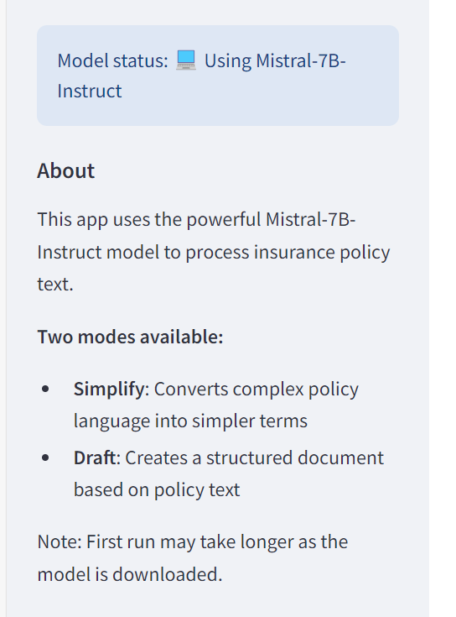
How It Works
User uploads a document.
Tool parses the file.
Policy terms are detected.
Summaries are generated.
Two options: Summarize, or create a draft out of the prompt.

Slide 6
From Complex to Clear
Before
In accordance with the Comprehensive Data Governance and Digital Accountability Framework (CDGDAF) of 2025, all entities operating within the jurisdiction of the Unified Digital Compliance Zone (UDCZ) are mandated to implement federated data stewardship protocols by Q3 of the fiscal year. These protocols must include, but are not limited to, zero-trust access models, cryptographic attestation for cross-border data exchange, and adaptive AI auditing layers that dynamically adjust to risk thresholds and sector-specific regulatory parameters. Furthermore, organizations must establish Data Ethics Oversight Boards (DEOBs), composed of interdisciplinary professionals, to ensure alignment with the Multilateral AI and Data Usage Accord (MADUA), particularly with respect to algorithmic transparency, purpose limitation, and biometric data minimization. Non-compliance beyond the transition grace period will invoke escalating penalties under Article 17(b) of the Digital Sovereignty and Fair Processing Statute (DSFPS), including potential suspension of digital service licenses and mandatory third-party compliance audits. Entities must also publish annual Algorithmic Impact Statements (AIS) detailing model provenance, fairness interventions, and redressal mechanisms, which will be subject to peer review under the Open Compliance Verification Scheme (OCVS) administered by the Global Digital Trust Consortium (GDTC).
After

Slide 7

Processed Result
Main Points
• All organizations in the Unified Digital Compliance Zone must implement data stewardship protocols by Q3 of the fiscal year. • These protocols include zero-trust access, cryptographic attestation, and adaptive AI auditing. • Organizations must also establish Data Ethics Oversight Boards to ensure alignment with the Multilateral AI and Data Usage Accord. • Non-compliance will result in escalating penalties, including potential license suspension and mandatory audits. • Annual Algorithmic Impact Statements must be published and reviewed under the Open Compliance Verification Scheme.
What This Means For You
• If your organization is in the Unified Digital Compliance Zone, you need to implement new data protocols and establish a Data Ethics Oversight Board by Q3 of the fiscal year. • Failure to comply will result in penalties, including potential loss of digital service licenses.
Important Details
• The transition grace period for compliance is not specified in the text. • The Global Digital Trust Consortium oversees the Open Compliance Verification Scheme for Algorithmic Impact Statements.
Examples
• Zero-trust access means requiring verification for every interaction with data, not just logins. • Cryptographic attestation is a way to ensure data security during cross-border exchange. • Adaptive AI auditing adjusts to changing risks and regulatory requirements. • The Data Ethics Oversight Board ensures transparency, purpose limitation, and biometric data minimization in the use of algorithms.

Slide 8
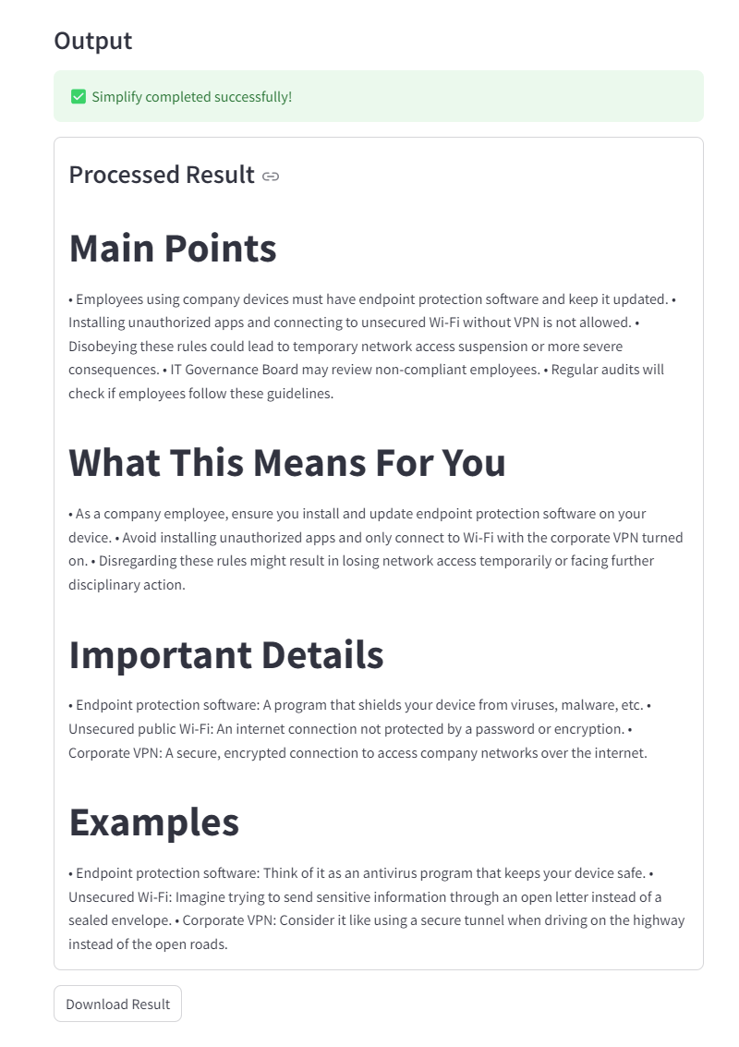
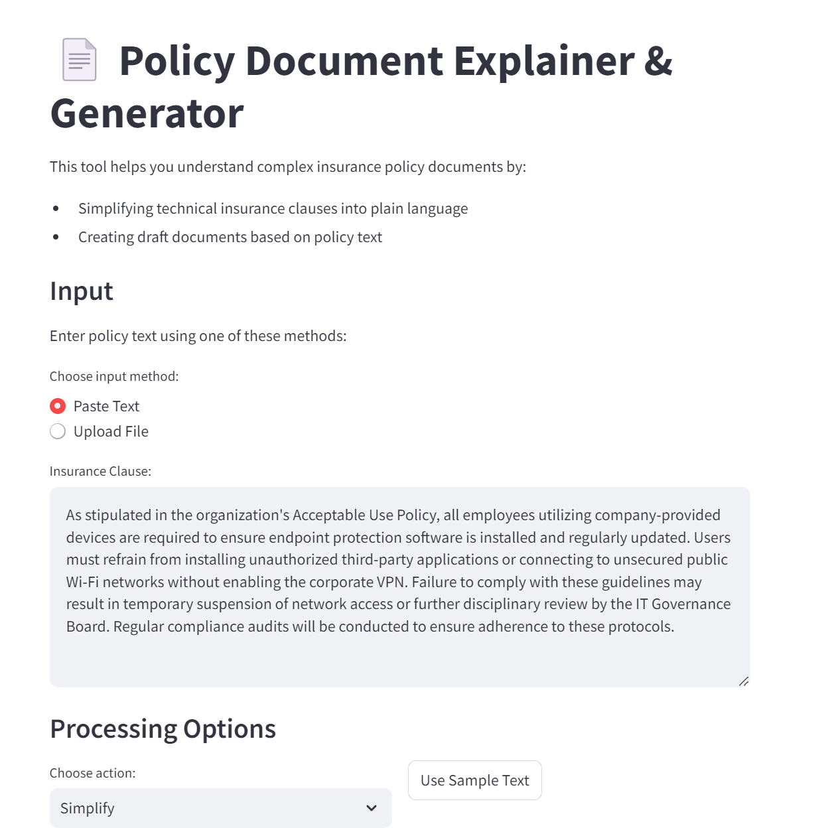
EXAMPLE USE CASE 1: SIMPLIFY

Slide 9
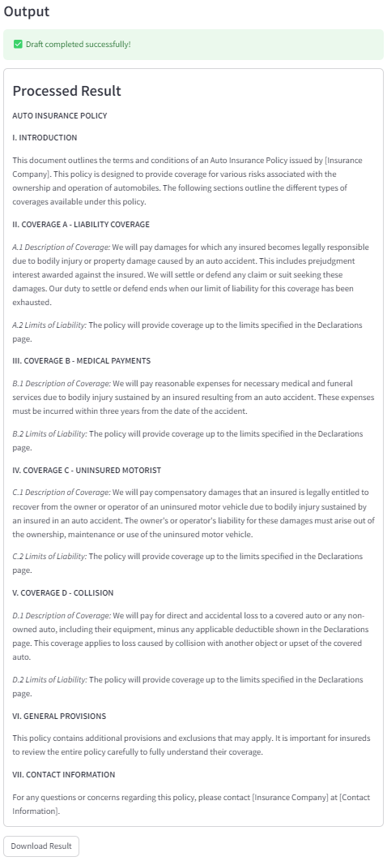
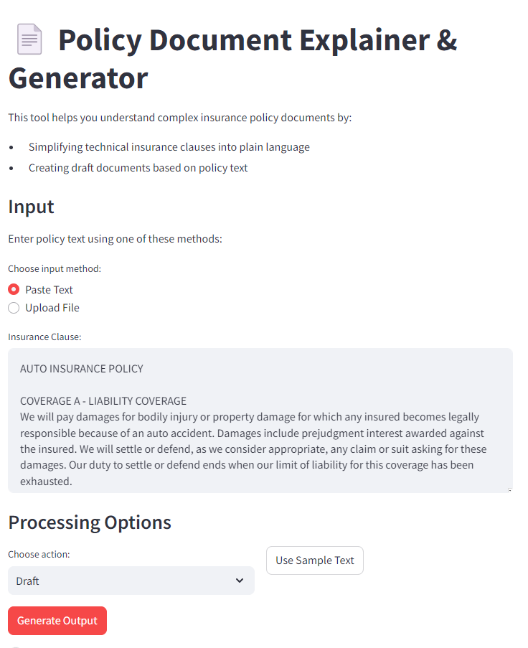
EXAMPLE USE CASE 2: DRAFT

Slide 10

What More Can We Do?
Smarter Models: BART for legal/policy simplification.
Accessibility: Text-to-speech, multi-language support.
Impact & Benefits
Saves time and confusion
Helps people take action on understandable documents.
Reduces dependence on IT
Bridges the tech-to-non-tech gap.

Slide 11
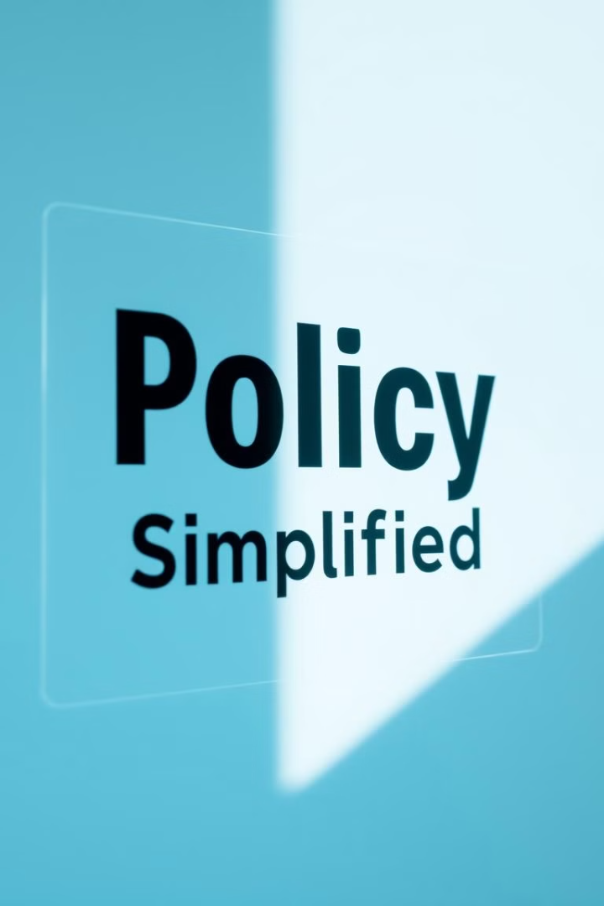
Final Thoughts
Small tool, big value.
Great for internal use, compliance, helpdesk automation.
Lightweight, extendable, and scalable.
Built to make complex content simpler — for everyone.

