Slide 1
ECE 313 Spring 2026 Project Task 2
<Team1>
<dhruvv4 , vmagow2, brianmk3>
<Dhruv Vohra, Vedaant Magow, Brian Keating>

Slide 2
Task 2
Q1: Restate the distribution name and its parameters? One of the TAs found that the exponential distribution is a good fit. Does your answer agree with the TA's? If not, please explain.
Exponential,
location = 0.011411905288696289,
scale = 1054.4761089655117,
lambda = 0.0009483382235952645 failures/second
Yes our answer is Exponential, agreeing with the TAs
Q2: (Skip if you answer Yes for Q1). Assuming interarrival time of XID are exponentially distributed, use Scipy Python Library to estimate the parameters and report them here.
Skipped

Slide 3
Task 2
Q3a: What is the MTBF in hours?
0.292909215787224 hours
Q3b: What is the MTBF in seconds and how did you convert MTBF in hours to seconds?
1054.4731768340064 seconds, we multiplied the MTBF in hours by (3600 seconds per hour)

Slide 4
Task 2
Q4a: What does this comparison suggest about the relationship between the fitted parameter(s) and MTBF of the actual data?
The two MTBFs are nearly identical, suggesting that the scale parameter (mean of the exponential distribution for interarrival times) is approximately equal to the MTBF of the actual data (empirical MTBF)
Q4b: Does the relationship you found in part (a) by itself establish that the exponential model is a good fit? Why or why not? If not, describe the additional evidence needed to conclude that the exponential model is appropriate
The relationship found in part a shows that the averages of the distribution and actual data are consistent, NOT that the exponential model is a good fit. We also need to confirm the shapes of the distribution, and the actual data are consistent. We know the shapes are consistent from the KS goodness of fit test from Task 1 part 6. Since for the exponential distribution the p-value > 0.05 and the KS statistic is the lowest, we know the shapes of the exponential distribution and the actual data match well.

Slide 5
Task 2
Q5a: How many unique inter-arrival time values are there?
Number of unique interarrival times: 73512
Q5b: What are the first ten values of your estimated Ĥ(𝑡)?
first ten values for the cumulative hazard are:
[1.3603036197679321e-05, 2.7206257440469614e-05, 4.080966373340536e-05, 5.441325508152126e-05, 6.801703148985221e-05, 8.162099296343331e-05, 9.522513950729989e-05, 0.00010882947112648744, 0.0001224339878260317, 0.00013603868961096856]

Slide 6
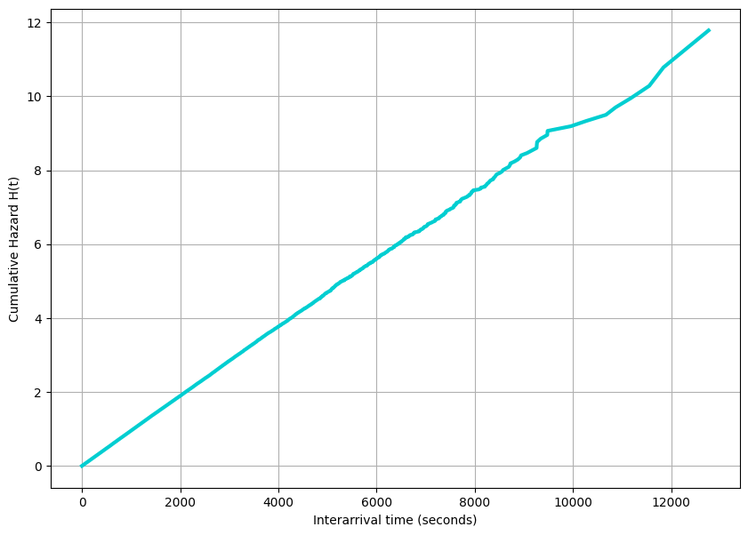
Task 2
Q5c: Plot the estimated cumulative hazard function. What can You conclude?
The graph is approximately linear, it increases at a linear rate, and the cumulative hazard is predictable. Since the slope is also constant the instantaneous failure rate can be viewed as constant
Q5d: Is the system at the initial mortality, normal life, or wear-out period of its life?
The system is in the normal life period of its cycle. This is seen by the flat, linear section in the middle of the reliability curve.

Slide 7
Task 2
Q5e: Estimate the average hazard rate from the cumulative hazard rate and report its value.
We can estimate the average hazard rate by taking the last point of the cumulative hazard rate (which the sum of all hazard rates) and dividing it by the max value of T over which those points were calculated.
Estimated average hazard rate = 0.0009236086705974977

Slide 8
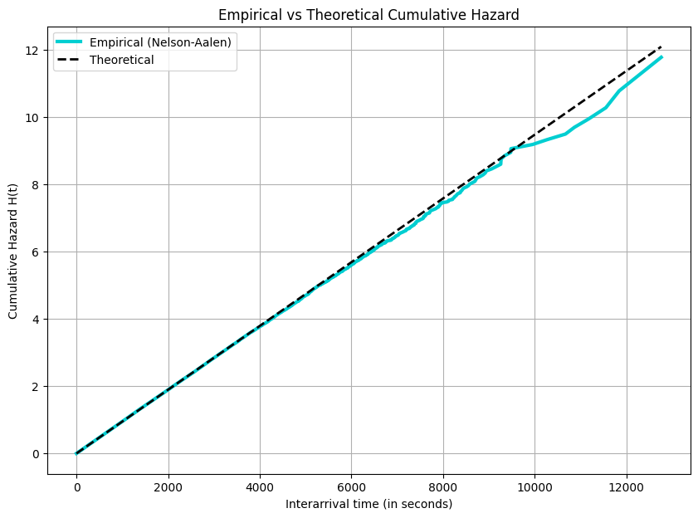

Task 2
Q5f: Write down the theoretical cumulated hazard function and plot it on the same plot as Q5-c.
Theoretical cumulative hazard H(t) = $λ$* t
Q5e: Compare the empirical hazard rate and cumulative hazard function with the theoretical ones. Are they consistent with each other? Why, or why not?
We can observe from the graph that the empirical Nelson-Aelen estimated cumulative hazard function and the theoretical cumulative hazard function represented with Th_Ht are pretty consistent
We can see this as the dotted line covers the solid curve almost perfectly till about the first half of the graph.
After which it follows the trend of the solid curve fairly well.
Overall conclusion - Consistent with each other

Slide 9
Team Member Assessment
Member 1 - Dhruv Vohra :
• Self Assessment – Worked on Task 2 parts 5 d, e, f, g
• Assessment of other team members – Brian and Vedaant finished their parts with great diligence and communicated very well.
Member 2 - Vedaant Magow :
• Self Assessment - Worked on Task 2 parts 5 a, b,c
• Assessment of other team members – Dhruv and Brian were great teammates. Good contribution and communication all around.
Member 3 - Brian Keating :
• Self Assessment - Task 2 part 1, 3, 4
• Assessment of other team members – Dhruv and Vedaant finished their work and were good at communicating.

