Slide 1

URL Phishing detection & Email Spam
Detection using machine learning model
Akash Singh – 22106065
Dhruv Wesavkar–22106016
Pranet Pednekar-22106098
Mohit Rajput –22106126
Project Guide
Prof. Monali Korde

Slide 2
Outline
Introduction
Literature Survey of the Existing Systems
Limitations of the Existing Systems
Problem Statement
Proposed System Design
Technologies Stack for Proposed System
Implementation
Conclusion
References

Slide 3
Introduction :-
Cyber threats like phishing attacks and spam emails pose significant risks to individuals and organizations, leading to financial and data losses. This project focuses on URL Phishing Detection using a Gradient Boosting Model and Email Spam Detection using XGBoost, leveraging machine learning for enhanced cybersecurity.
The phishing detection model analyzes various URL-based features to identify malicious links, while the spam detection model classifies emails based on text-based attributes. Performance evaluation using ROC-AUC, Precision-Recall curves, and confusion matrices ensures high accuracy. This project provides an automated, scalable, and efficient solution to combat cyber threats effectively.

Slide 4
Objectives :-
Develop an Effective Detection System – Implement machine learning models to accurately detect phishing URLs and spam emails.
Enhance Cybersecurity – Provide an automated solution to mitigate cyber threats and prevent data breaches.
Improve Model Performance – Use advanced algorithms like Gradient Boosting and XGBoost for high accuracy and reliability.
Scalability and Real-World Application – Ensure the models are efficient and scalable for real-time phishing and spam detection.
User-Friendly Implementation – Develop an easy-to-use system for cybersecurity professionals and organizations to integrate into their security frameworks.

Slide 5
Literature Survey of the existing system
Paper Title | Abstract | Findings | Method | Future Scope
Phishing URL Detection Using Machine Learning Methods | Research should focus on refining feature extraction, developing new features, and testing a wider range of machine learning models to improve phishing email detection. | Phishing, Cybercrime, Machine learning, URL, Light GBM | The study used machine learning algorithms such as Random Forests, Decision Trees, Light GBM, and SVM to detect malicious URLs. The model was trained on URL features such as domain name, length, and presence of special characters. | Further research is recommended to explore deep learning models and additional URL features for enhanced detection.
Detecting Phishing Websites Using Machine Learning | This paper proposes a machine learning-based phishing website detection system using Random Forest, integrated as a browser plugin for real-time alerts. | Phishing, URL, Machine learning, Random Forest, Feature extraction | The study proposed a machine learning-based browser extension for phishing website detection. The Random Forest classifier was trained using a set of 26 URL features to distinguish phishing sites from legitimate ones. | Future research could focus on experimenting with additional classifiers and exploring different feature sets for improved performance.
Phishing Website Detection Using Machine Learning | The paper explores the use of Random Forest and Decision Tree classifiers for phishing website detection, focusing on URL-based features. The classifiers process the URLs to identify whether they are legitimate or phishing sites. | Phishing, Classification, Machine learning, Random Forest, Decision Tree | The study applied Random Forest and Decision Tree classifiers to detect phishing websites using URL data. The URL features included domain age, character length, and special characters. | To improve performance, further research could explore the use of other machine learning algorithms like XGBoost or Neural Networks.
A New Method for Detection of Phishing Websites: URL Detection | This research presents a URL detection model using the Random Forest algorithm for phishing detection. It involves parsing, heuristic classification, and performance analysis to classify URLs effectively. | Phishing, URL detection, Random Forest, Classification algorithms | The paper used a URL detection approach with the Random Forest algorithm to classify phishing sites. The process involved parsing URL data, applying heuristic classification, and analyzing the performance using multiple algorithms. | The next step is to explore other feature extraction methods and enhance the heuristic classification process to achieve better detection rates.

Slide 6
Limitations of Existing Systems
High False Positives & False Negatives – Many legitimate emails/URLs are misclassified, reducing reliability.
Inability to Detect New Threats – Existing systems struggle to identify zero-day phishing attacks.
Lack of Contextual Understanding – Rule-based and simple keyword-based detection lacks NLP-based intelligence.
Limited Scalability – Some phishing detection methods are resource-intensive and not scalable for large datasets.
Narrow Focus on Single Phishing – VectorsSome systems focus only on URLs or emails; our platform detects both URL and email phishing.
Limited Customizability – Current solutions are rigid; our models can be tailored for specific user needs and environments.

Slide 7
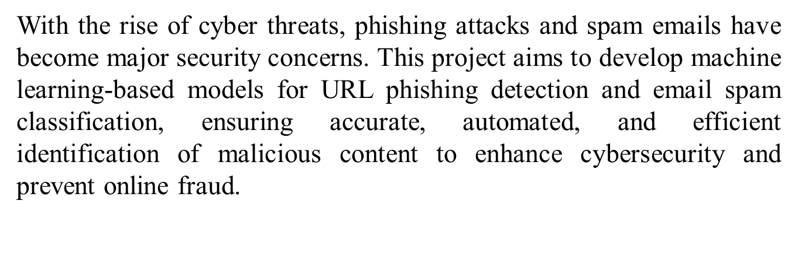
Problem statement

Slide 8
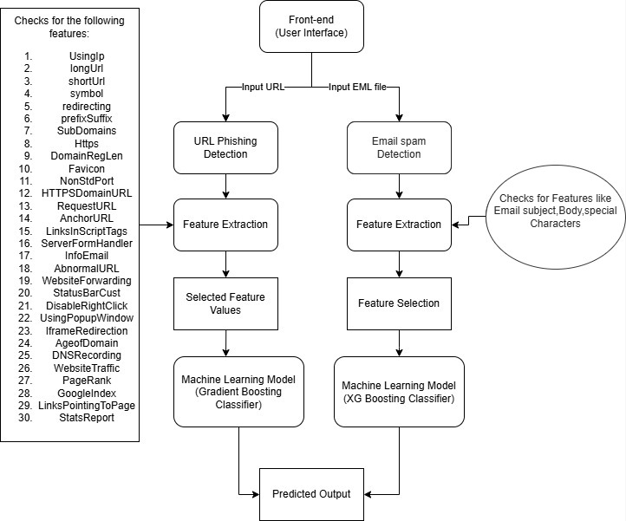
Proposed System Design
URL Phishing

Slide 9
Technologies Stack for Proposed System
Frontend (User Interface)
HTML – Structure of the website.
CSS – Styling and layout.
JavaScript – Basic interactivity and form handling.
Backend (Server-side Logic)
Python – Runs the phishing detection model using machine learning.
Machine Learning & Data Processing
Scikit-learn – Used for training and running ML models (Gradient Boosting Classifier , SVM, Naïve Bayes).
NLTK – Natural Language Processing for analyzing email content.
Pickle – Serializing and loading trained ML models.
NumPy – Handling numerical data in feature extraction.

Slide 10
Libraries Used in the Project
beautifulsoup4 (v4.12.3) – Web scraping for URL analysis.
Flask (v3.0.3) – Optional for integrating Python directly into the web interface.
googlesearch_python (v1.2.3) – Used for searching URLs.
numpy (v1.26.4) – For numerical data handling in feature extraction.
pandas (v2.2.2) – For data manipulation and analysis.
python_dateutil (v2.8.2) – Parsing and handling dates in data.
Requests (v2.31.0) – Making HTTP requests to gather data.
scikit_learn (v1.3.1) – For ML models and algorithms.
urllib3 (v2.2.1) – For working with URLs and HTTP requests.
whois (v0.9.27) – Used for extracting domain information.
gunicorn – WSGI server for Python applications

Slide 11
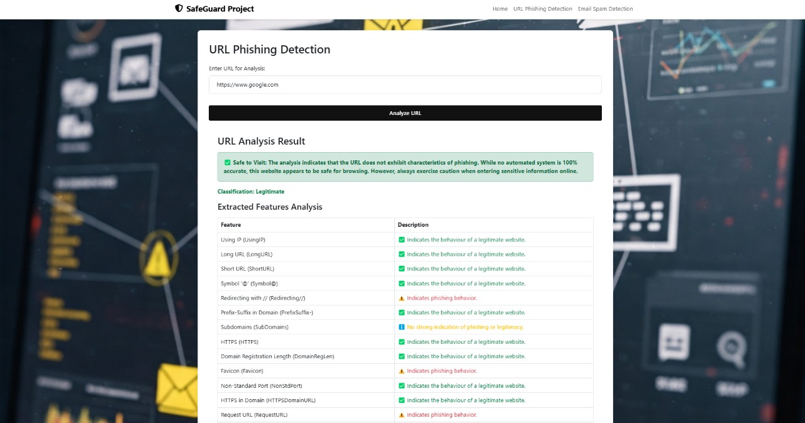
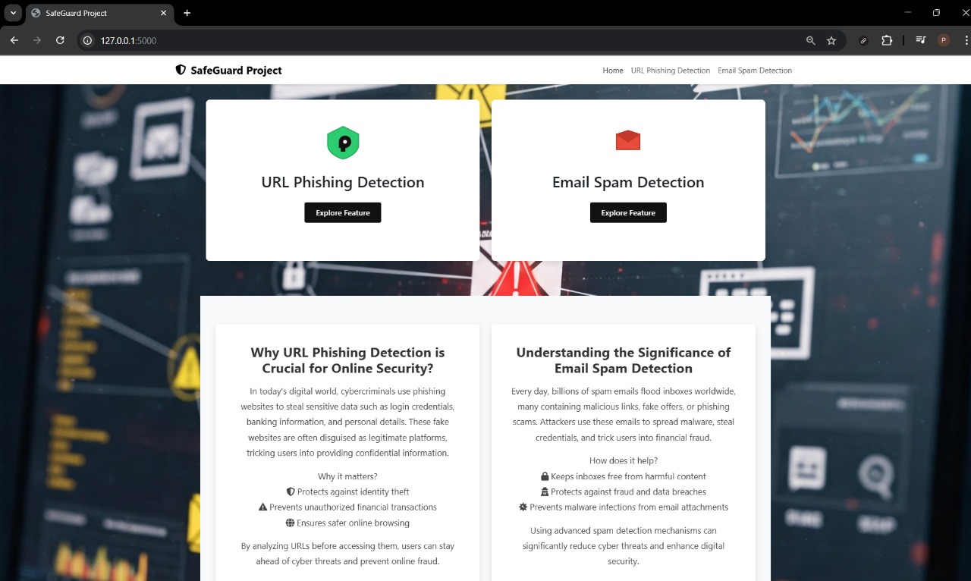
Implementation

Slide 12
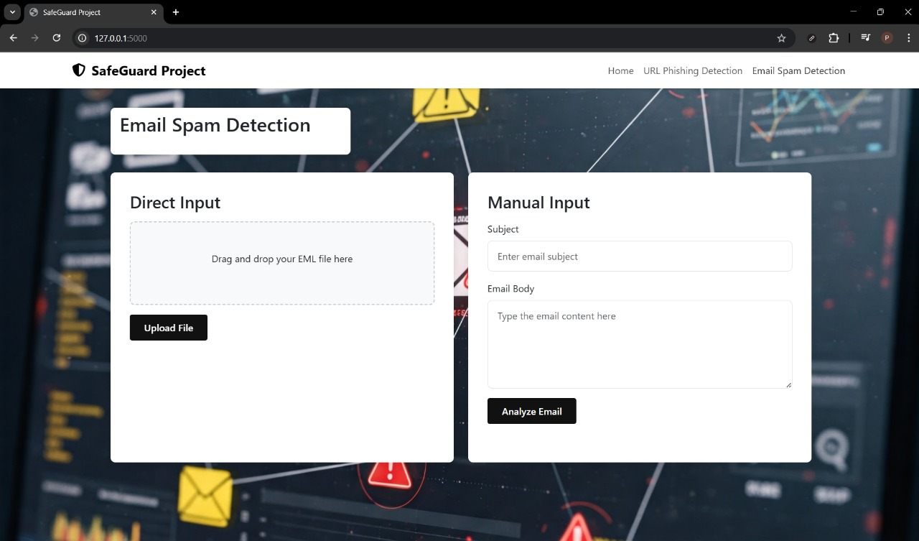
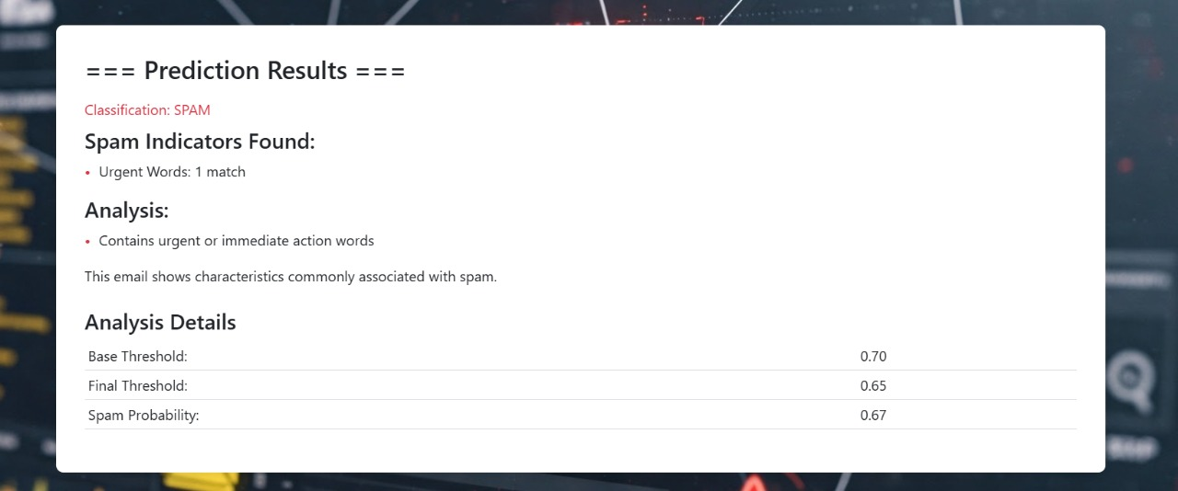

Slide 13
Conclusion:
In this project, we successfully developed and evaluated machine learning models for URL Phishing Detection and Email Spam Detection using Gradient Boosting and XGBoost, respectively. Through extensive experimentation, we compared multiple models, including Random Forest, SVM, Naïve Bayes, and Neural Networks, using key performance metrics such as AUC-ROC, Precision-Recall, Accuracy, Precision, Recall, and F1-score.
Overall, this project demonstrates the power of machine learning in enhancing cybersecurity by automating threat detection with high precision and recall. Future enhancements could include deep learning models, ensemble techniques, and real-time deployment for dynamic threat prevention.

Slide 14
References :-
[1]Chien and P. Khethavath, "Email Feature Classification and Analysis of Phishing Email Detection Using Machine Learning Techniques," 2023 IEEE Asia-Pacific Conference on Computer Science and Data Engineering (CSDE), Nadi, Fiji, 2023, pp. 1-8, doi: 10.1109/CSDE59766.2023.10487729.
[2]S. Parekh, D. Parikh, S. Kotak and S. Sankhe, "A New Method for Detection of Phishing Websites: URL Detection," 2018 Second International Conference on Inventive Communication and Computational Technologies (ICICCT), Coimbatore, India, 2018, pp. 949-952, doi: 10.1109/ICICCT.2018.8473085
[3]A. Mandadi, S. Boppana, V. Ravella and R. Kavitha, "Phishing Website Detection Using Machine Learning," 2022 IEEE 7th International conference for Convergence in Technology (I2CT), Mumbai, India, 2022, pp. 1-4, doi: 10.1109/I2CT54291.2022.9824801.
[4]A. Alswailem, B. Alabdullah, N. Alrumayh and A. Alsedrani, "Detecting Phishing Websites Using Machine Learning," 2019 2nd International Conference on Computer Applications & Information Security (ICCAIS), Riyadh, Saudi Arabia, 2019, pp. 1-6, doi: 10.1109/CAIS.2019.8769571.
[5]Shaik, Hasane. (2022). Phishing URL detection using machine learning methods. 103288.

Slide 15
Thank You...!!

