Slide 1
MINI PROJECT / REPRODUCE + EXTEND
Predicting Bazel
Build Times
COMMIT METADATA
prefix + file type
Linear
Regression
Random
Forest
Reproducing the reference pipeline and testing a Random Forest extension
REFERENCE MODEL • LINEAR REGRESSION
ADD-ON • RANDOM FOREST
RMSE • LOWER IS BETTER
Reference paper: Muhammad Umar Nadeem & Sarah Raza
Dataset: 500 Bazel commit/build examples
REPRODUCE → EXTEND → COMPARE
Notes:
Introduce the project. The reference predicts Bazel build CPU time from two commit-level categorical features. We first reproduced its linear-regression experiments, then added Random Forest as a different model family.

Slide 2
01 / PROBLEM STATEMENT
Can a commit hint at the cost of a build?
Goal: estimate the CPU time required for a Bazel build from lightweight information about changed files.
FROM COMMIT TO PREDICTION
THE PROBLEM
Build time is a resource cost.
Changed files
Extract features
ML model
Foo.java
Bar.java
src/main
JAVA
Regression
The reference explores whether a commit’s changed-file metadata can predict CPU time, helping developers reason about build cost and efficiency.
CPUTime
Predicted CPU time (milliseconds)
Input: most common file-path prefix
Input: most common file type
Target: CPUTime in milliseconds
REGRESSION TASK
Evaluate with RMSE • Lower is better
PREDICTING BAZEL BUILD TIMES • MINI PROJECT
02
Notes:
The model predicts a continuous numeric value, so this is a regression problem. The inputs are not raw source code; they are compact categorical summaries of the changed files: the most common path prefix and the most common file type.

Slide 3
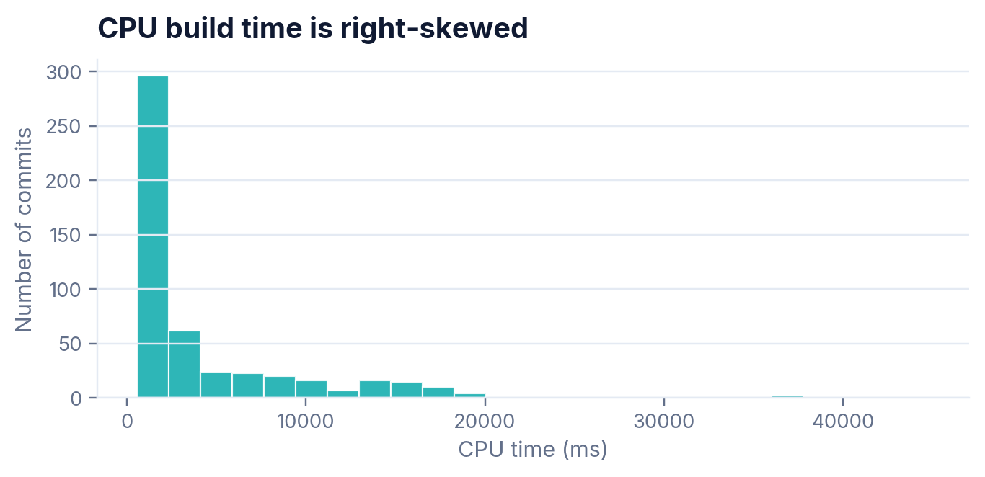
02 / DATASET
500 commit/build examples, two categorical inputs
The supplied processed data comes from the open-source bazelbuild/bazel project.
500
300 / 100 / 100
8
4
COMMIT EXAMPLES
TRAIN / VALIDATION / TEST
OBSERVED PREFIX CATEGORIES
OBSERVED FILE TYPES
What each row contains
PREFIX
src/main
Most common path prefix in the commit
TYPE
JAVA
Most common file type in the commit
TARGET
CPUTime (ms)
Each sample maps those two features to a build CPU-time measurement.
Mean: 4,299.40 ms
Median: 1,837.5 ms
Range: 564–44,863 ms
Data linkage assumption: the two CSVs have no shared commit key, so input and target rows were paired in order (target IDs 1–500).
PREDICTING BAZEL BUILD TIMES • MINI PROJECT
03
Notes:
We used the two supplied CSVs. Each has 500 rows. InputData contains ID, prefix, and type; CPUTimes contains commitID and CPUTime. Because there is no shared commit key in the supplied processed files, the implementation pairs rows by order. The target distribution is right-skewed: the mean is much larger than the median due to a long tail of costly builds.

Slide 4
03 / REFERENCE APPROACH
The reference compares two linear-regression pipelines
Feature crossing gives the model an explicit signal for a prefix/type combination.
EXPERIMENT A
INPUT FEATURES
Categorical
encoding
Linear
Regression
RMSE
No crossing
Prefix
Prefix and type enter as separate categorical features.
src/main
File type
EXPERIMENT B
JAVA
Add prefix × type
feature
Linear
Regression
RMSE
With crossing
Target: CPUTime (ms)
Example: src/main × JAVA becomes its own feature.
Reference settings
SGD
Learning rate 0.01
Batch size 16
9 training periods
RMSE
PREDICTING BAZEL BUILD TIMES • MINI PROJECT
04
Notes:
The paper compares linear regression using separate categorical features against linear regression with an extra crossed feature. For example, the combination src/main and JAVA can be represented as an additional category. The reference reports stochastic gradient descent, learning rate 0.01, batch size 16, nine periods, and RMSE.

Slide 5
04 / PART 1
Reproduce the experiment, not just the reported number
We independently rebuilt the pipeline from the paper and the supplied CSVs.
1
2
3
4
Load & align
Encode categories
Train the model
Measure error
Read 500 rows from each CSV; pair rows in the supplied order.
One-hot encode prefix and type; add prefix × type block for experiment B.
Linear regression trained with mini-batch SGD over 9 periods.
Calculate training, validation and test RMSE at each period.
EXPERIMENT SETTINGS
SPLIT
LEARNING RATE
BATCH SIZE
PERIODS
METRIC
300 / 100 / 100
0.01
16
9
RMSE
Reproducibility note
The paper omits the exact split seed and grid-search candidates; we used row order and the reported selected hyperparameters.
PREDICTING BAZEL BUILD TIMES • MINI PROJECT
05
Notes:
This is an independent implementation of the method described by the reference. The split follows the reported 300, 100, and 100 sizes, using row order because the paper gives no split seed or shuffling rule. We use the stated learning rate and batch size, and calculate RMSE for nine periods.

Slide 6
05 / PART 1 RESULTS
Our reproduced training RMSE is close to the paper
Values below are average training RMSE over the 9 periods shown in the reference paper.
EXPERIMENT
PAPER
REPRODUCED
DIFF.
REPRODUCTION CHECK
Linear Regression
without crossing
~0.5%
5,735.84
5,707.02
−0.50%
difference without crossing
Linear Regression
with prefix × type crossing
5,628.09
5,685.62
~1.0%
+1.02%
difference with feature crossing
RMSE is in milliseconds
Takeaway
Both reproduced averages are within about 1% of the paper’s reported training RMSE.
Important: these are training-set averages, not the held-out test values used for the Part 2 comparison.
PREDICTING BAZEL BUILD TIMES • MINI PROJECT
06
Notes:
The reference reports 5735.84 milliseconds without feature crossing and 5628.09 milliseconds with crossing, averaged across the training periods. Our independently reproduced averages are 5707.02 and 5685.62 milliseconds. The differences are approximately minus 0.50 percent and plus 1.02 percent. These are close, but remember they are training averages and not the test-set values used for the add-on comparison.

Slide 7
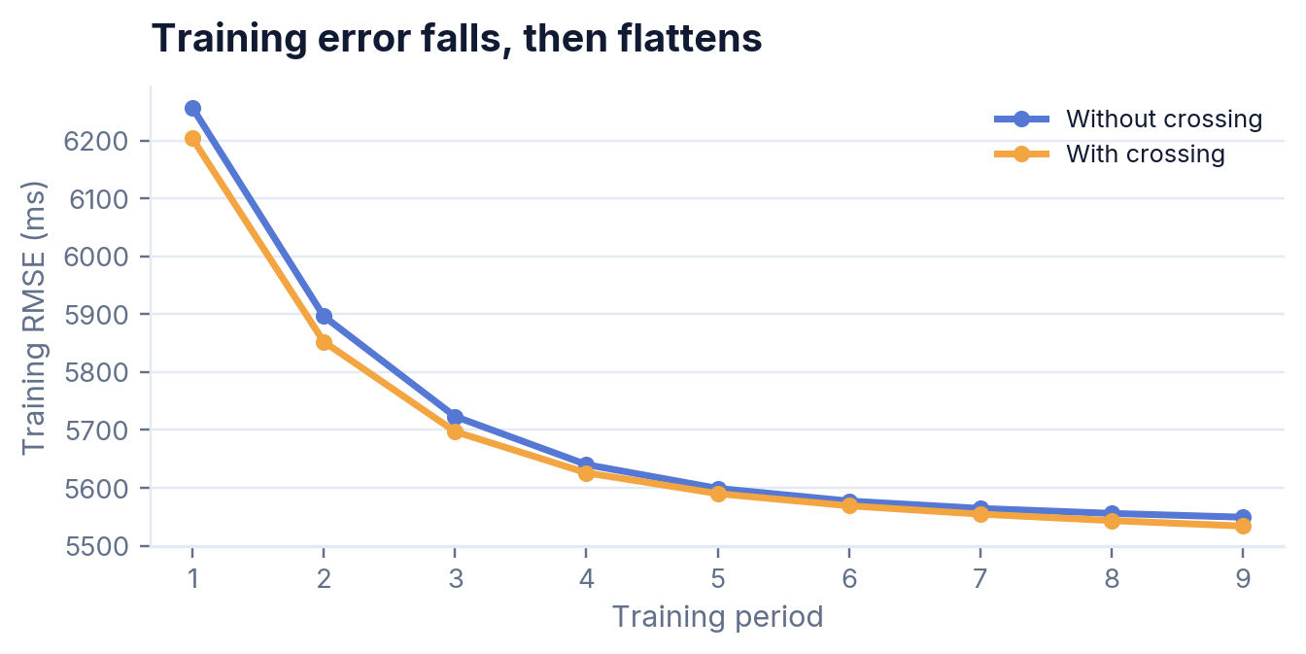
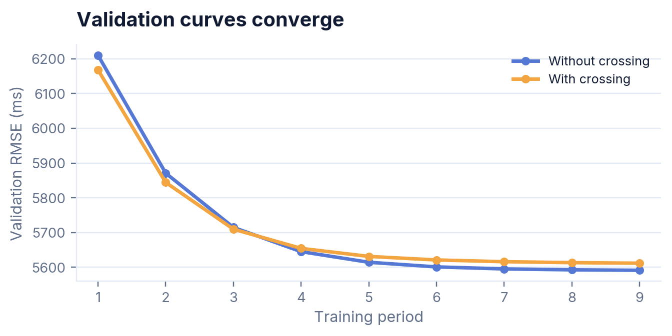
06 / TRAINING BEHAVIOUR
Error drops quickly, then starts to plateau
The curves show how the linear models behave over the 9 training periods.
WHAT TO NOTICE
Crossing lowers training RMSE, but validation curves are close and favour the non-crossed model slightly in later periods.
PREDICTING BAZEL BUILD TIMES • MINI PROJECT
07
Notes:
Both models improve substantially in the first few periods and then flatten. The crossed model stays lower on the training curve, which is consistent with it fitting the training representation better. The validation curves are close; by the last period, the non-crossed model has slightly lower validation RMSE. This difference foreshadows why we should compare models on held-out data rather than training error alone.

Slide 8
07 / PART 2 EXTENSION
Add-on model: Random Forest Regressor
A different model family gives us a meaningful extension beyond the linear reference model.
WHY RANDOM FOREST?
EXPERIMENT SETUP
A nonlinear, tree-based alternative
TREES
RANDOM STATE
300
42
Can represent nonlinear relationships and feature interactions.
MAX FEATURES
MIN LEAF SIZE
1.0
1
Works with a compact tabular representation of categorical inputs.
Chosen for methodological contrast — not because it was expected to win.
Same 300 / 100 / 100 split
Same prefix + type + prefix × type representation
Same target (CPUTime) and same metric (RMSE)
TRAIN RMSE
5,382.47 ms
VALIDATION RMSE
5,858.90 ms
TEST RMSE
5,881.74 ms
PREDICTING BAZEL BUILD TIMES • MINI PROJECT
08
Notes:
For the extension, we chose Random Forest Regressor. It is tree-based and can represent nonlinear relationships and interactions between categorical features, unlike the linear reference method. It uses 300 trees and random state 42. Crucially, it uses the same data split, feature representation, target, and RMSE metric.

Slide 9
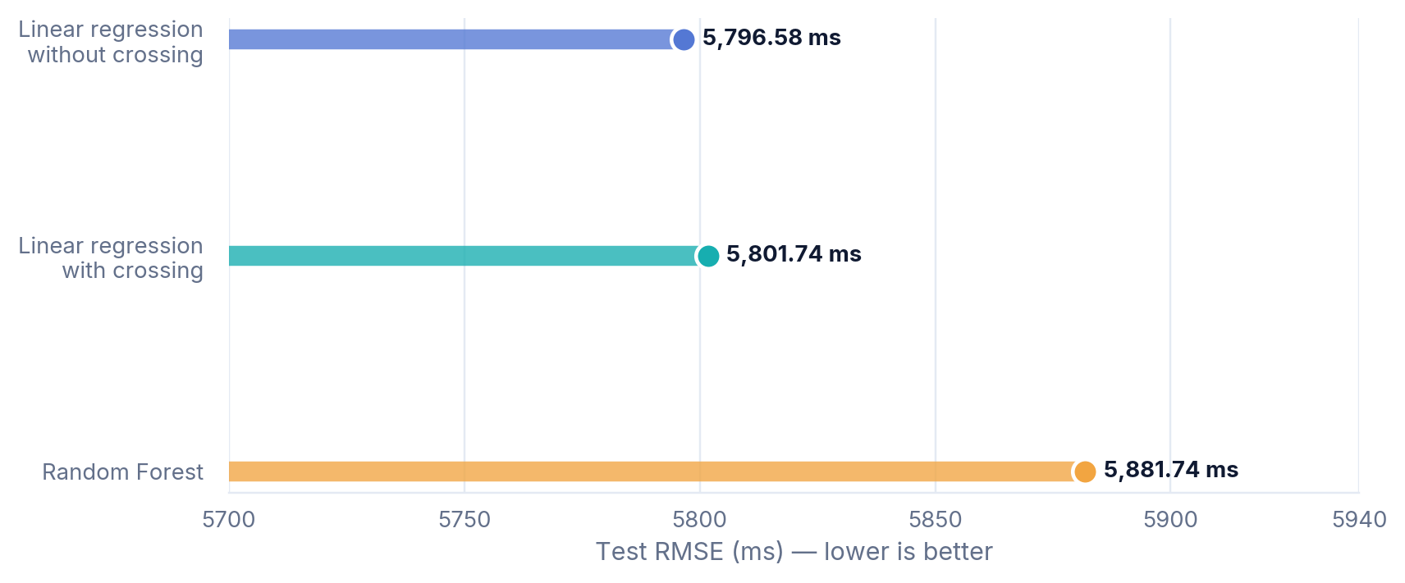
08 / PART 2 RESULTS
On the shared test set, Random Forest was worse
All three scores use the same 100-example test split; lower RMSE indicates better prediction.
RANDOM FOREST RESULT
5,881.74
ms test RMSE
+85.16 ms / +1.47%
vs. Linear Regression without crossing
+79.99 ms / +1.38%
vs. Linear Regression with crossing
Zoomed axis: 5,700–5,940 ms
Fair-comparison note: the paper’s headline numbers are 9-period training averages; this chart uses final-period test RMSE.
PREDICTING BAZEL BUILD TIMES • MINI PROJECT
09
Notes:
The shared test set tells a different story from training averages. At period 9, the non-crossed linear model reaches 5796.58 ms, the crossed model reaches 5801.74 ms, and Random Forest reaches 5881.74 ms. Random Forest is about 85 milliseconds or 1.47 percent worse than the non-crossed model and about 80 milliseconds or 1.38 percent worse than the crossed model. The slide deliberately separates these held-out test scores from the paper’s reported training averages.

Slide 10
09 / DISCUSSION
What the results do — and do not — tell us
The extra model is a valid extension even though it did not outperform the reference models.
KEY FINDINGS
LIMITATIONS
The reproduction closely matches the paper’s training-RMSE averages (differences: about 0.50% and 1.02%).
Only 500 examples are available, and the inputs summarize commits with just two categorical features.
Feature crossing lowered average training RMSE by about 21 ms in our run, but its final test RMSE was 5.16 ms higher than the non-crossed model.
The supplied CSVs do not share a commit key; row-order alignment is an assumption.
The paper omits the exact data-split rule/seed and the candidates used in its grid search.
Random Forest had the highest test RMSE; extra model flexibility did not improve generalization on this split.
Interpret results for this dataset, feature representation and split — not as a universal ranking of models.
PREDICTING BAZEL BUILD TIMES • MINI PROJECT
10
Notes:
The main lesson is that reproduction means comparing comparable values and documenting assumptions. Our training averages are close to the paper. Feature crossing helped the training curve, but this did not translate to a lower final test RMSE. Random Forest was also worse on the same test split. This is a result for this dataset and split, not proof that Random Forest is always worse. Important limits include the small dataset and missing details in the paper.

Slide 11
10 / CONCLUSION
Reproduce carefully.
Extend fairly.
REFERENCE PAPER
Muhammad Umar Nadeem & Sarah Raza
The value is in a transparent comparison — not in forcing the add-on model to win.
“Predicting Bazel Build Times Using Machine Learning”
01
Reproduction
Both reproduced training-RMSE averages are within about 1% of the paper.
DATA / ORIGINAL MATERIALS
github.com/umar-nadeem/CS229-Final-Project
02
Feature crossing
It helped training fit; final test RMSE was nearly the same, slightly higher.
Evaluation metric: RMSE (milliseconds)
03
Extension
Random Forest was worse on this shared test set by about 1.4%.
Thank you • Questions?
PREDICTING BAZEL BUILD TIMES • MINI PROJECT
11
Notes:
To conclude: we independently reproduced the reference’s linear-regression experiments with close training-RMSE averages, then added Random Forest as an extension using the same dataset split and RMSE metric. Random Forest did not outperform the linear models on our held-out test set. This is still a valid extension and demonstrates why evaluation methodology matters. The reference paper and repository are cited on the slide.

