Slide 1
GreenSight
helping the visually impaired navigate through cluttered environments
By: Dhruva Bansal, Sukhjit Singh, Shubh Desai, Elvin yang

Slide 2
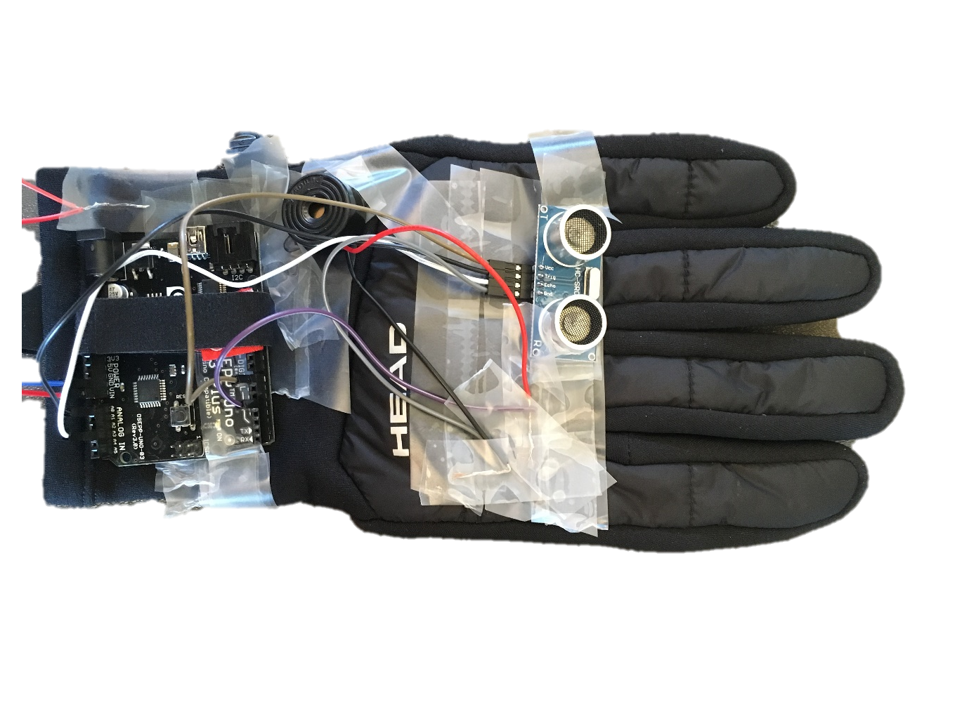
What is GreenSight?
Uses Ultrasonic sensor to obtain distance
User friendly
Energy Efficient
Precise
Varies buzzer frequency based on distance
Fast

Slide 3
Motivation
Reduce battery replacements to make it user-friendly
Faster and more precise than using sticks to navigate

Slide 4
Motivation
Minimize the number of times the battery has to be replaced
Increase reliability and travel range
Reduce carbon footprint

Slide 5
Thank You!

