Slide 1

Bank Analytics
"A Closer Look at Banking Data: Analysis and Strategies"

Slide 2


Group No. 4
Dhruva Darshan C
Shivarathri Karthik
Adla Malasri
Lakshmi RS
Shubham Kumar
Lingala Sai Teja Goud

Slide 3


Project Objective
The Bank Loan of Customers project involved analyzing the growth of a bank's loans over a period of years using two datasets with 39k rows each.
The analysis involved using MS-Excel, MySQL, Tableau, and PowerBI tools for cleaning, calculations, merging, and creating interactive dashboards.

Slide 4
Contents
Year wise loan amount Stats
Grade and Sub-Grade wise revolving balance
Total Payment for Verified and Non-Verified Status
State wise loan status
Month wise loan status
Home ownership Vs last payment date stats

Slide 5

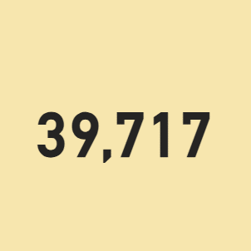

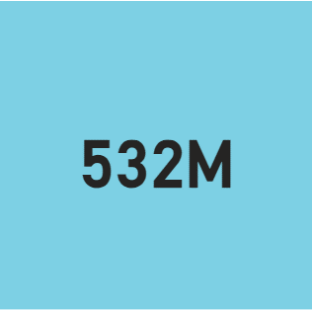
CARDS
Total Loan Amount
Total Revol_Bal
Total Customers

Slide 6
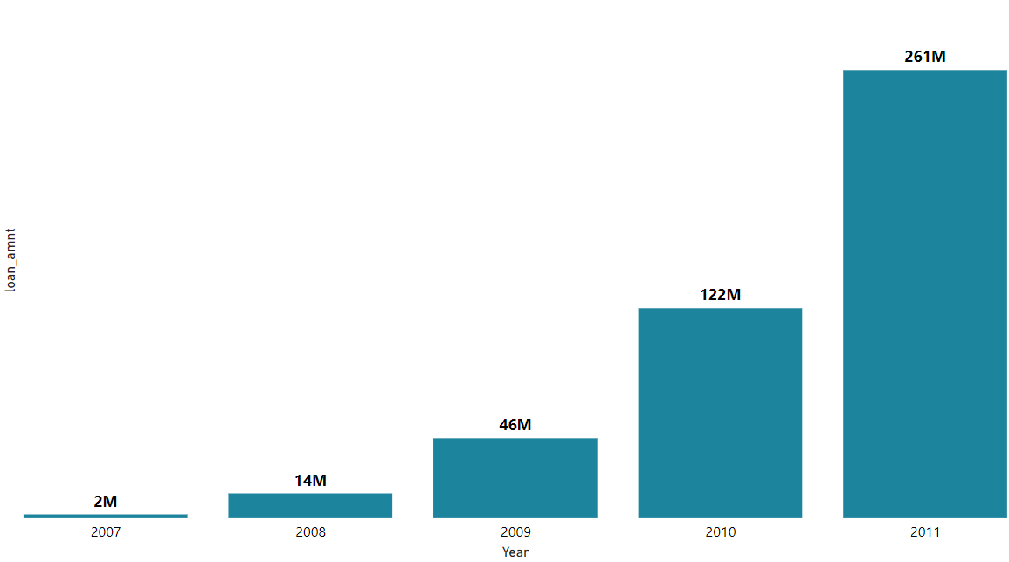
KPI 1 Year wise Loan Amount
2007: Loan Amount - 22,19,275
2011: Loan Amount - 26,05,06,575
Increase: 258,287,300 over 4 years
Grand Total (All Years): 44,56,02,650.00
Observation :
The bank should explore key drivers, customer segments, and market conditions to gain valuable insights for strategic planning.
Suggestion :
The chart shows significant growth in loan amounts from 2007 to 2011, indicating a robust bank's performance. Future optimization requires a deeper analysis of underlying factors.
Conclusion :

Slide 7
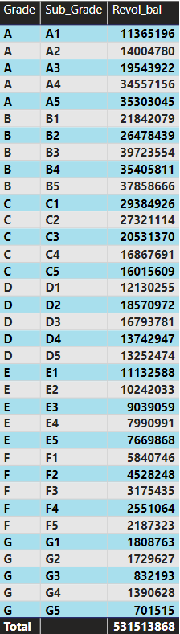
KPI 2 Grade & Sub-grade wise Revol_bal
22%
30%
21%
14%
9%
3%
1%
A
B
C
D
E
F
G
Grade-B has the highest revolving balance, attracting more loan applicants due to substantial annual incomes and long employment histories, and this pattern persists across other grades.
Observation :
To make lending better, it's important to know how much people earn, how much debt they have compared to their income. This helps us make sure our loan investments are doing well.
Suggestion :
This information suggests that the bank can manage loans better and attract more customers by focusing on Grade B customers and tailoring its strategies to their needs.
Conclusion :

Slide 8
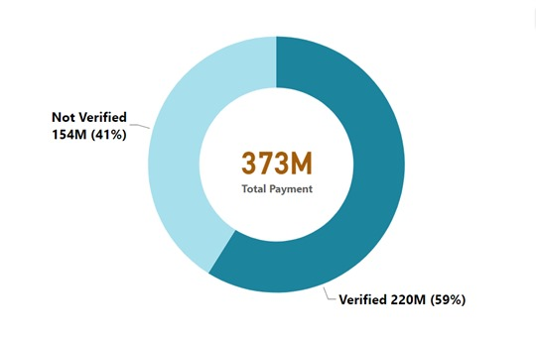
KPI 3 Total Payment for Verified & Non-Verified Status
The analysis reveals that Verified Status accounts for 59% of total payments, while Non-Verified Status comprises 41%, indicating a significant portion of the loan application verification process.
Observation :
Improving the verification rate through robust and efficient procedures can enhance the proportion of Verified Status applications and potentially reduce risks associated with Non-Verified Status.
Suggestion :
The analysis shows that the majority of payments come from Verified Status applicants, emphasizing the need for improved verification processes to enhance lending efficiency.
Conclusion:

Slide 9
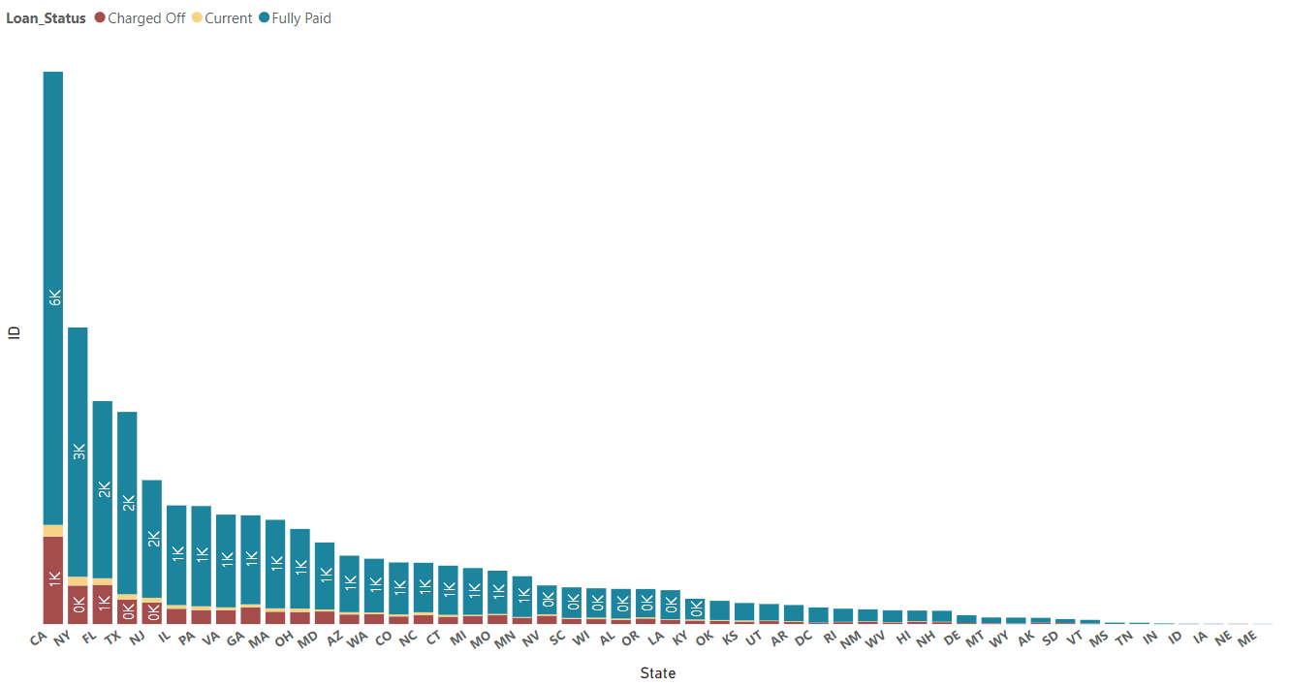
KPI 4 State wise Loan Status
Observation :
California has the highest number of accounts across all loan statuses, particularly in the "Fully Paid" category, compared to Maine's lowest number.
Suggestion :
State-specific analysis can reveal regional economic factors, customer behavior, or market dynamics influencing loan status, guiding risk management, collections, and marketing strategies.
Conclusion :
The dataset highlights the significance of state-level factors in loan status assessment, with California contributing significantly to "Fully Paid" status, while Maine's lower account numbers indicate regional dynamics.

Slide 10
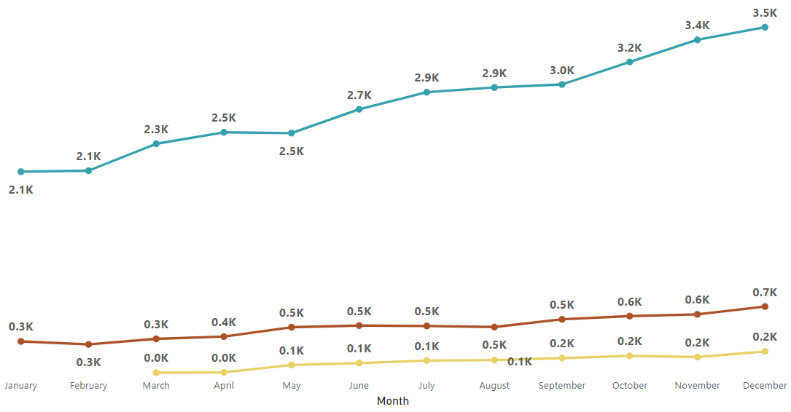
KPI 4 Month wise Loan Status
Observation :
The visualization shows three loan statuses: Charged Off, Current, and Fully Paid, with December having the highest number of Fully Paid accounts and January having the lowest.
Suggestion :
Understanding monthly loan variations is crucial for managing and strategizing, and investigating factors like external economic events or operational changes can optimize loan management and customer engagement strategies.
Conclusion :
The visual representation reveals fluctuating loan status accounts over 12 months, with December having the highest number of Fully Paid accounts and January having the lowest.

Slide 11
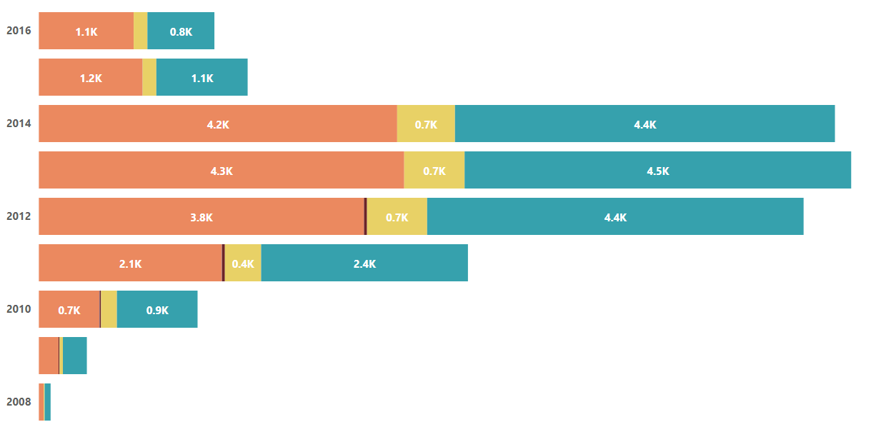
KPI 5 Home Ownership VS Last Payment Date Status
The bar plot shows three types of home ownership: mortgage, own, and rent, with 2013 being the highest and 2008 the lowest.
Observation :
Understanding housing trends requires analyzing fluctuations in home ownership, examining underlying factors like economic conditions, government policies, and demographic shifts, to make informed decisions.
Suggestion :
The bar plot reveals the dynamic nature of home ownership from 2008 to 2016, with 2013's peak indicating a housing boom and 2008's lower figure possibly due to the global financial crisis.
Conclusion :

Slide 12

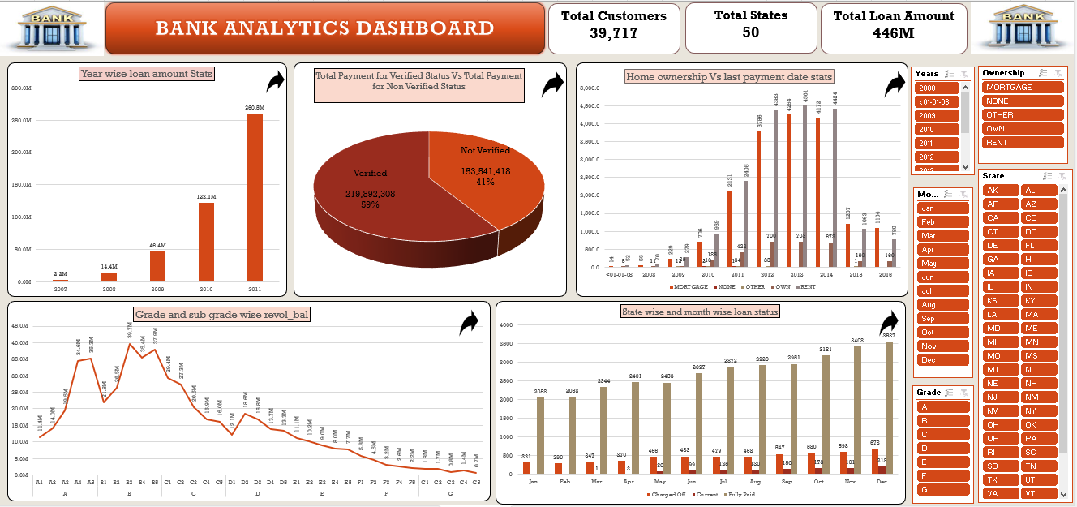

Slide 13

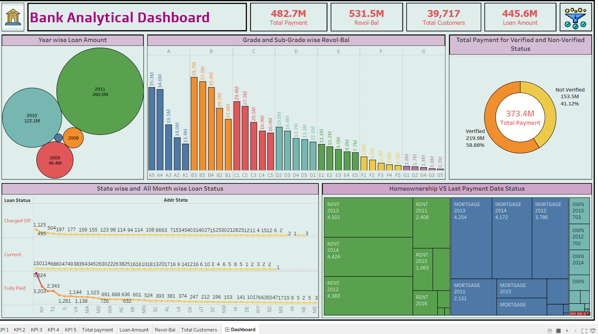

Slide 14

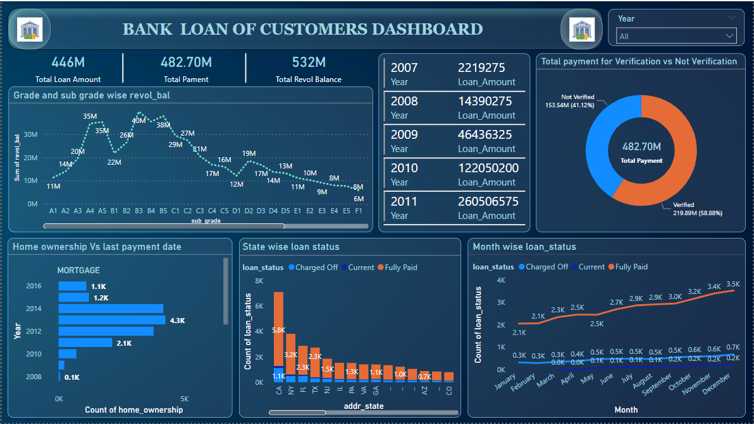

Slide 15

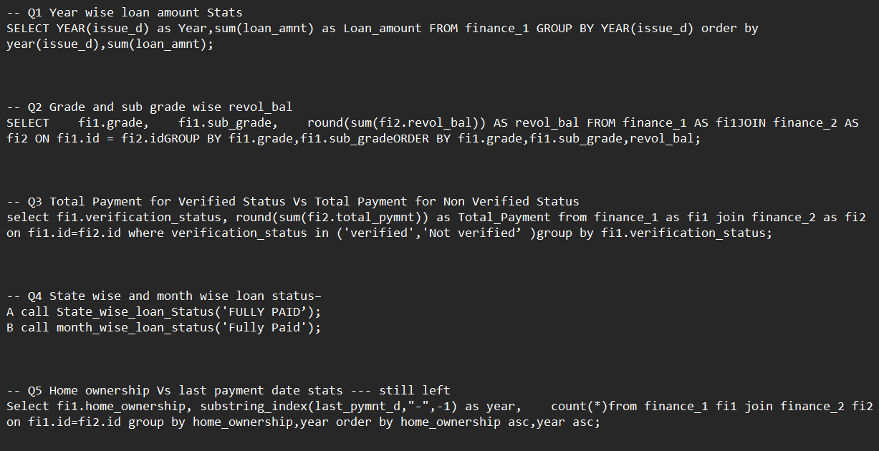

Slide 16
Conclusion
We use data analysis to find important insights from dashboards and reports, helping organizations make smart decisions. By looking at key indicators in finance data, we enable precise and strategic choices, revealing current operations and ensuring business health. This data-driven approach keeps businesses adaptable and confident in a changing world.

Slide 17

THANK YOU!

