Slide 1
Fraud Detection Analytics
Problem Statement: Digital financial systems process millions of transactions daily, making it difficult to detect fraudulent activities in real time. Fraudsters often mimic legitimate transaction behavior, making detection challenging.

Slide 2
Dataset
51,000 transactions
Multiple behavioral features including:
Device used
Payment method
Transaction type
Transaction amount
Account history
Goal
Identify fraud risk patterns and behavioral indicators that help detect suspicious transactions.

Slide 3
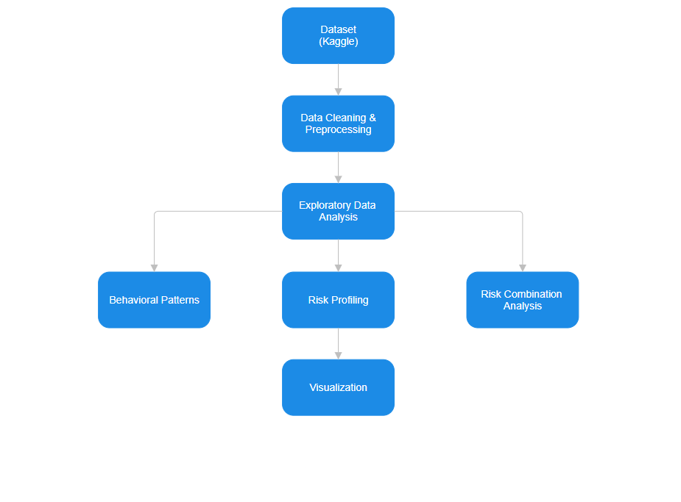
Architecture

Slide 4
Key Insights
The Transaction Strategy
Mid-Range Values: Fraudulent transactions are around mid-range values rather than extreme highs. This suggests an attempt to mimic normal spending behavior to bypass automated triggers that flag unusually large amounts.
Consistency over Time: Fraud risk remains relatively stable throughout a 24-hour cycle. While minor peaks occur in the afternoon and late evening, there is no "safe" time for a system to lower its guard.

Slide 5
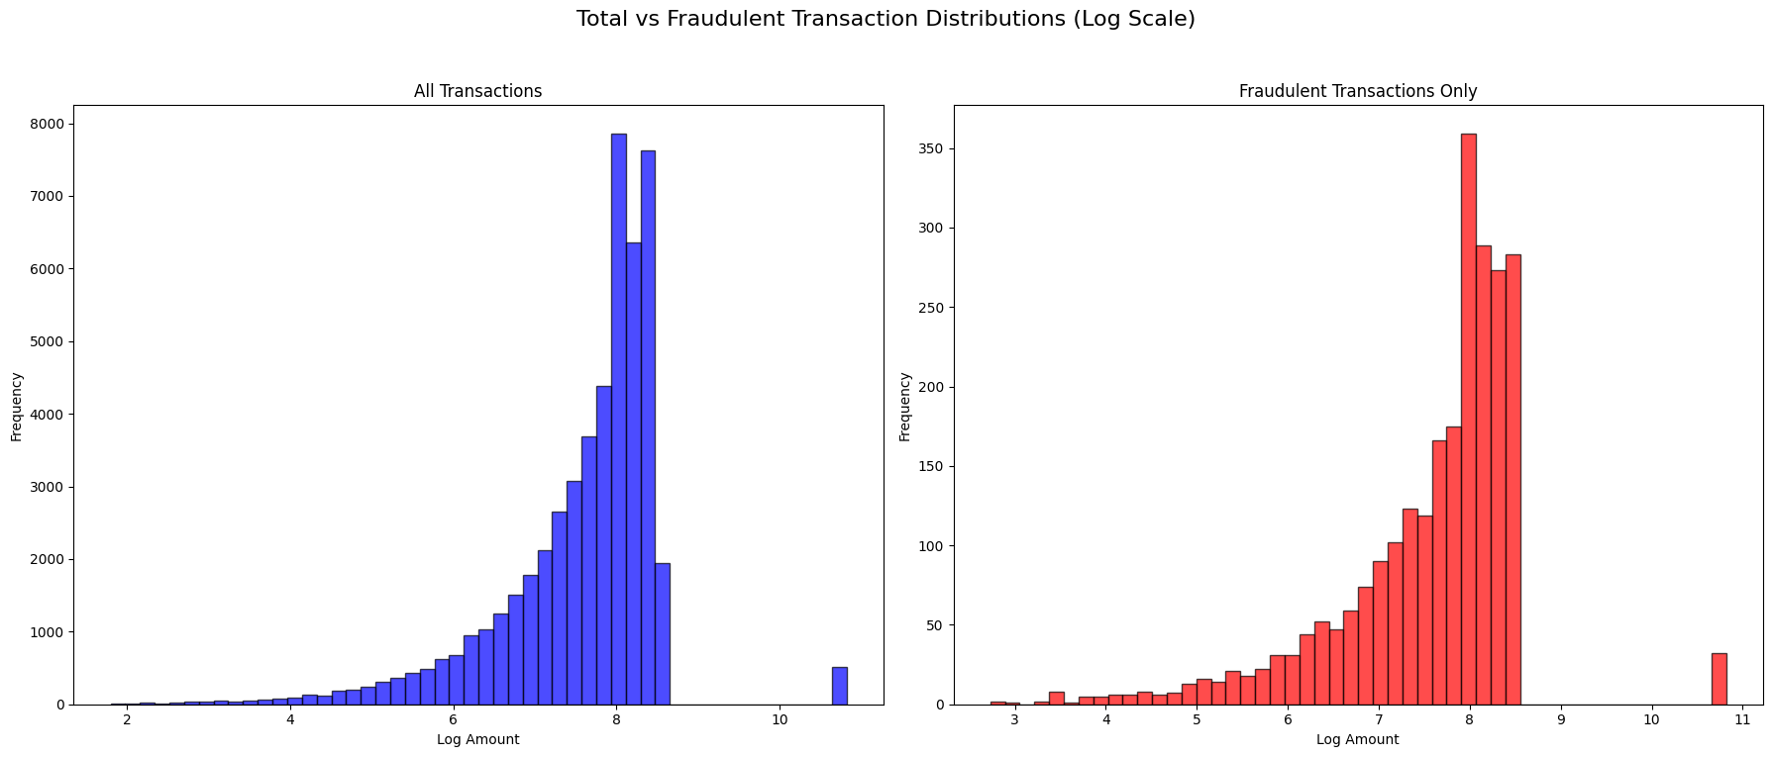
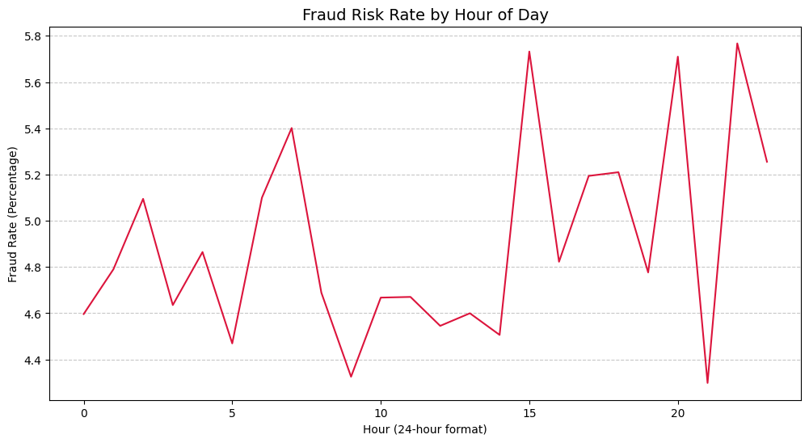

Slide 6
Key Insights
2. High-Risk Digital Profiles
Online purchases and mobile-based bill payments are significantly more vulnerable than traditional ATM or Point-of-Sale (POS) transaction
Net banking and UPI transactions show higher risk configurations compared to legacy banking methods.

Slide 7
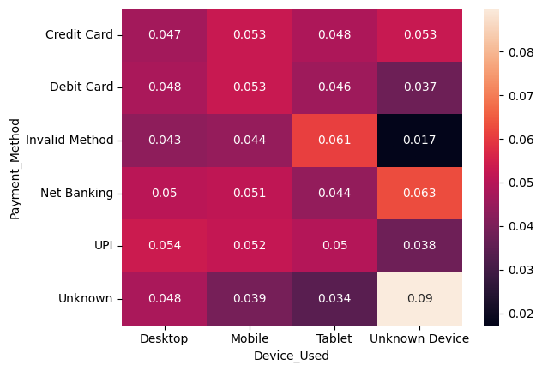
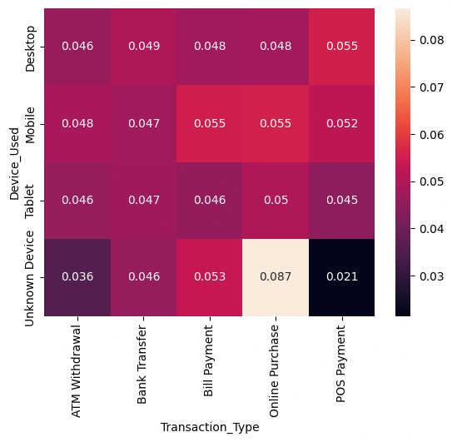
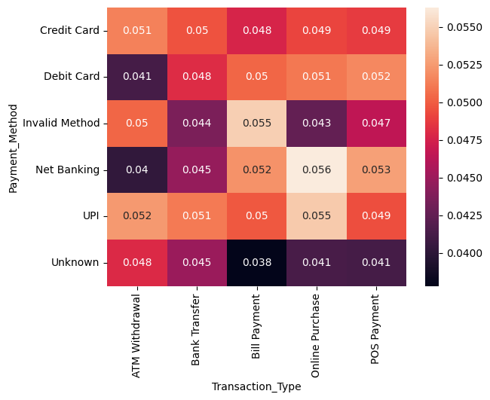

Slide 8
Key Insights
3. Historical Indicators
Surprisingly, transaction frequency (number of transactions in the last 24 hours) was similar for both legitimate and fraudulent users. High activity alone is not a strong enough indicator of fraud.
There is no significant correlation between how old an account is and its likelihood of being defrauded. This suggests that account compromise (taking over an old account) is just as prevalent as "synthetic fraud" (creating a new account for fraud).

Slide 9
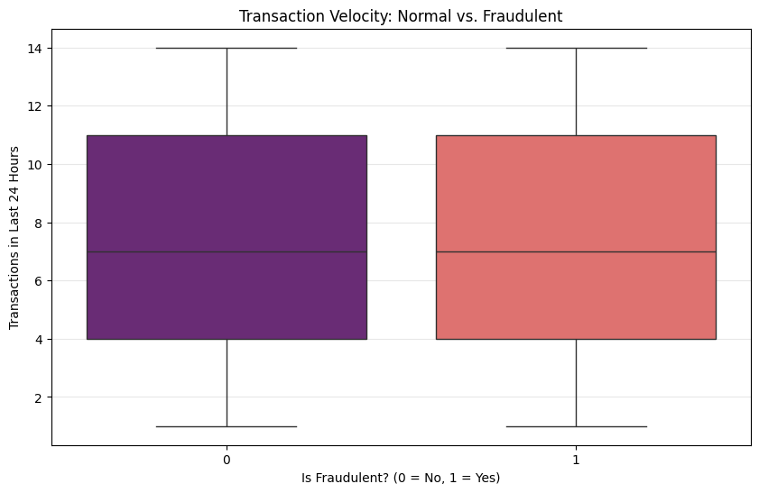
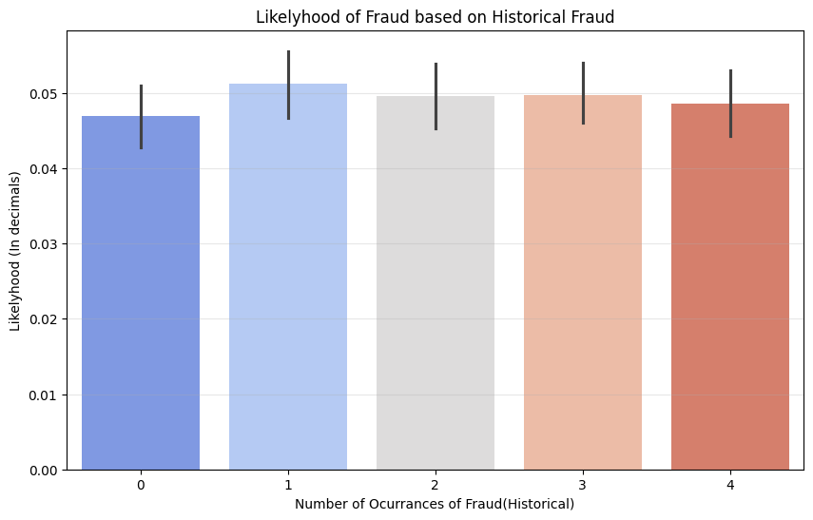

Slide 10
THANK YOU

