Slide 1
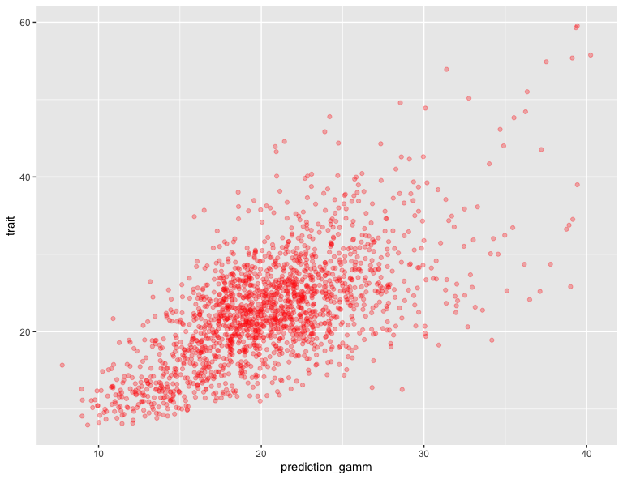
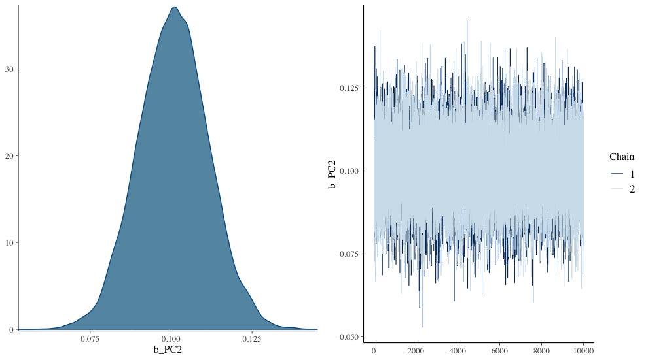
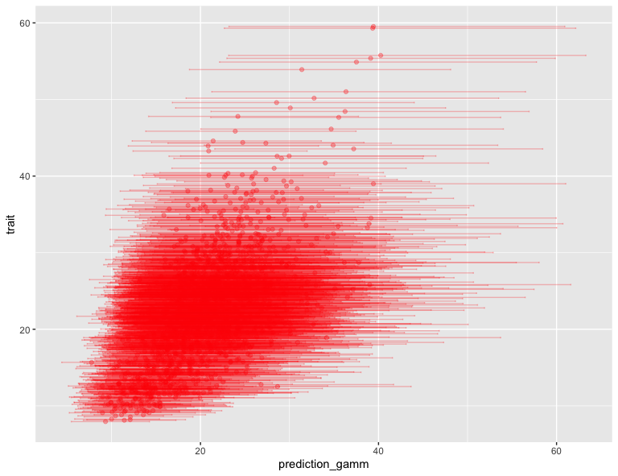
Comparison between PLSR and Bayesian algorithm-Full Spectra
(a)
Trait
Point parameters of linear PLSR regression based on least squares
Projection of spectra into orthogonal components
Selection of number of PLSR components to be used based on cross-validation
PLSR Linear Regression
Observed Trait
Input Spectra
Point prediction
Prediction
Parameter Uncertainty
(b)
Trait
Posterior parameter probability distributions
Informative priors
Use all spectra on original scale to fit the model
Use predictive projection to find reduced model
Bayesian Linear Regression
Posterior predictive distribution
Observation
Input Spectra
Prediction

Slide 2
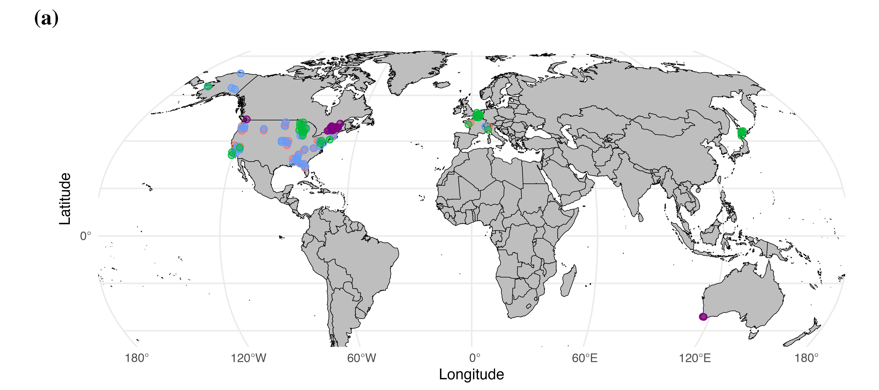
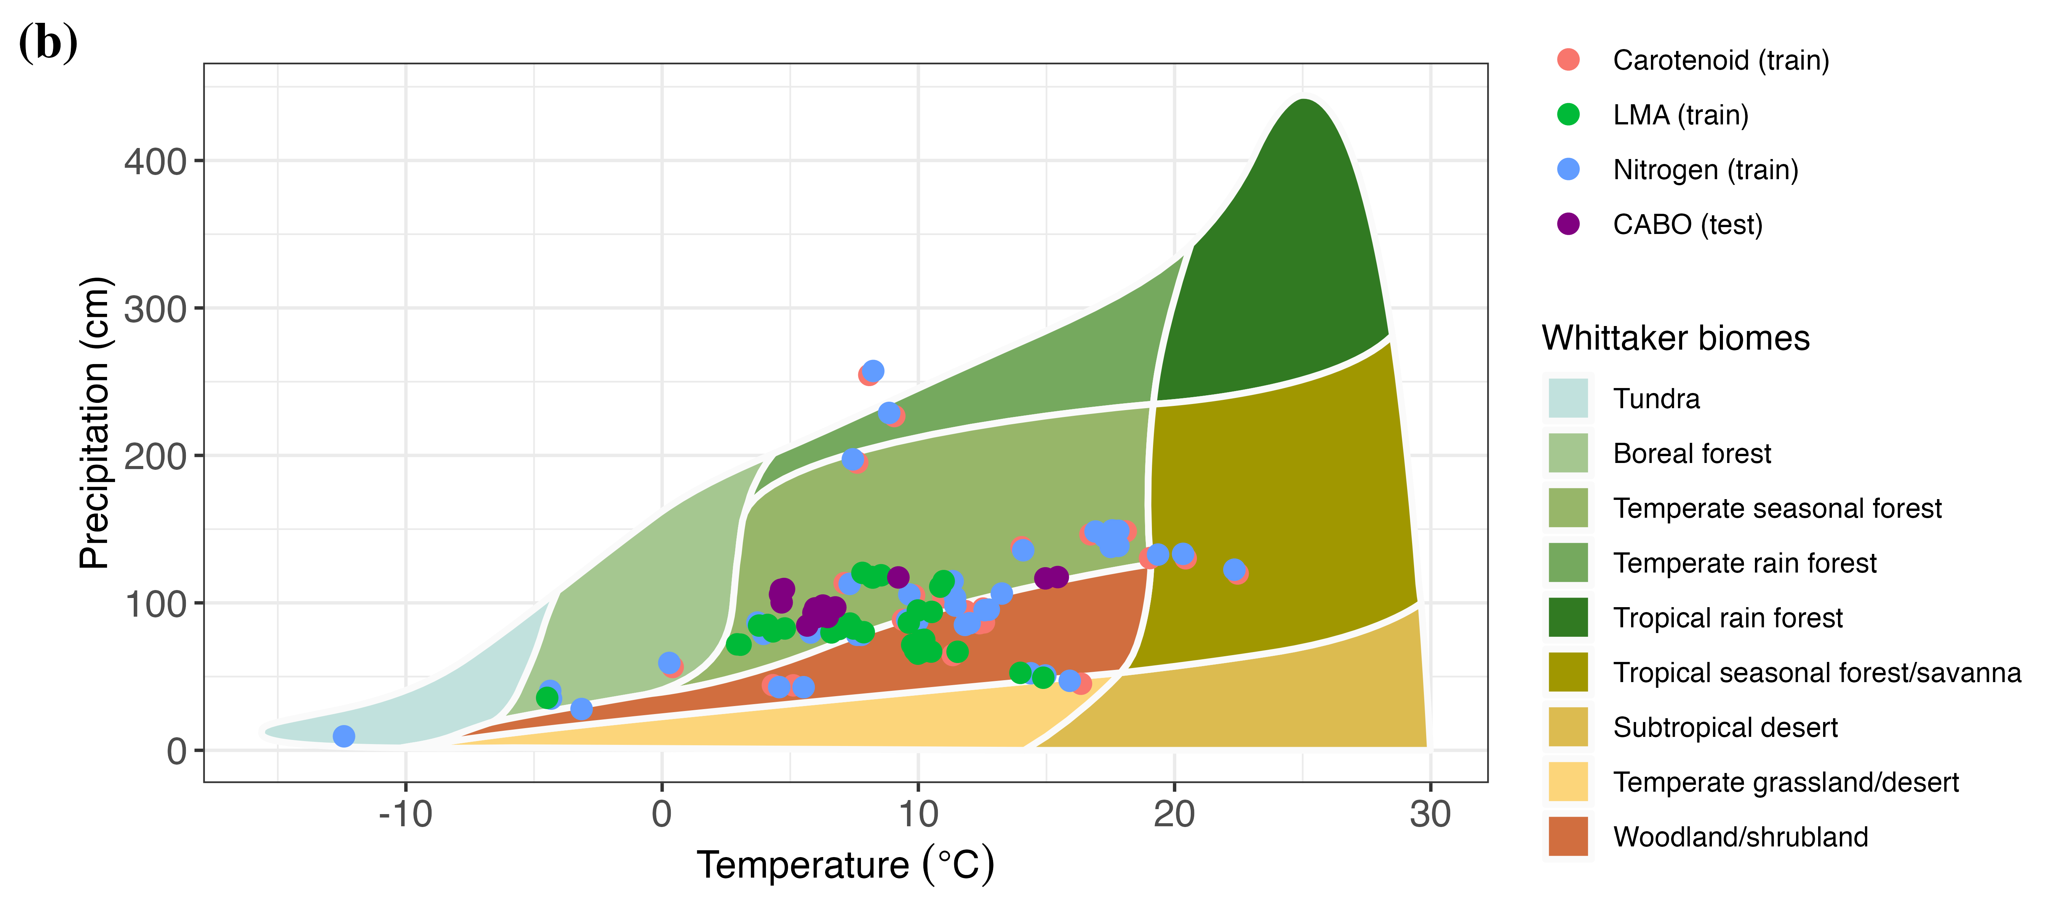

Slide 3
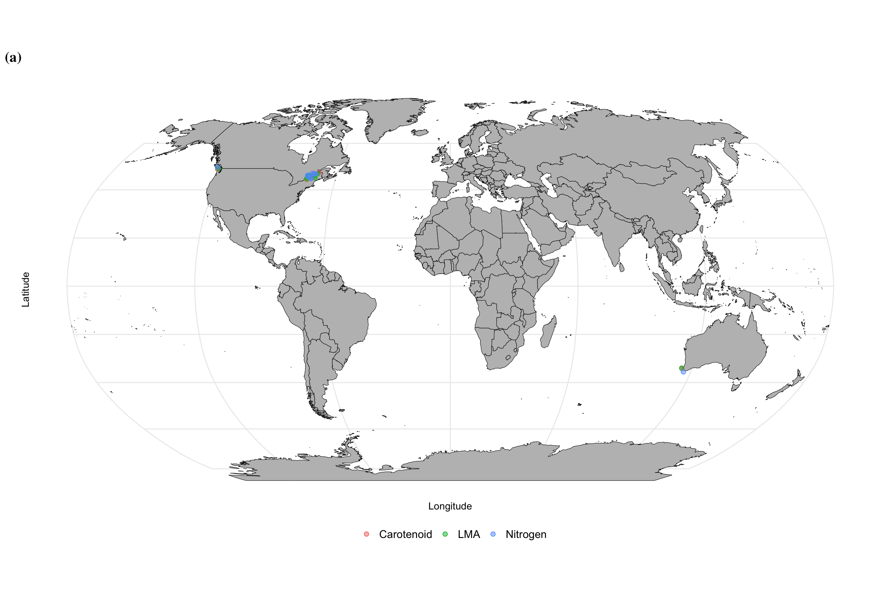

Slide 5
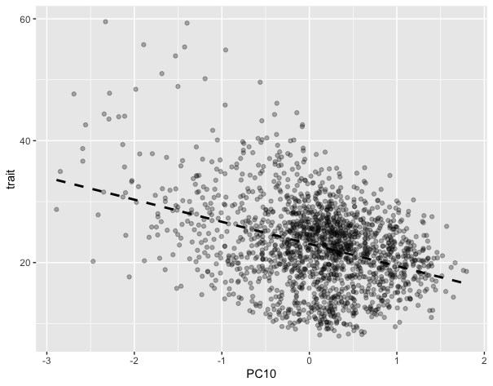
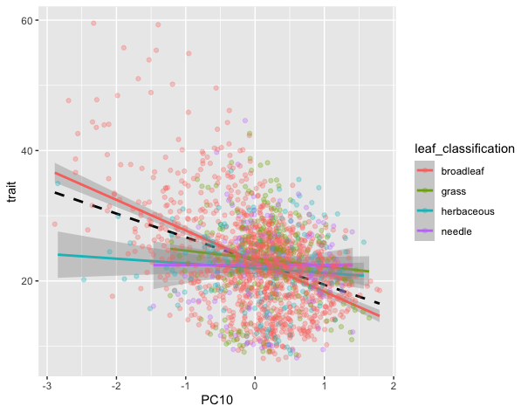
(a)
(b)
Trait
broadleaf tree
Trait
grass
herb
needle tree
713 nm
713 nm

