Slide 1
An Answer Set Programming based Approach To Representing and Querying Textual Knowledge
By
Dhruva Pendharkar

Slide 2
Outline
Motivation
System Architecture
Software Development Approach
Answer Set Programming
NLP Resources
6. Knowledge Representation
7. Other Knowledge Sources
8. Query Generation
9. Demo
10. Question Answering
11. Hurdles and Future Work
12. Contributions

Slide 3
Motivation
Why Answer Set Programming?

Slide 4
Automated Reasoning
Intelligent reasoning by computers has been a goal of computer scientists ever since computers were first invented in the 1950s.
Decision making and the ability to reason are important attributes of human intelligence
Machines possessing artificial intelligence need to be able to reason and act according to the changing environment.
Understanding the environment and its abilities to interact with the environment thus plays a vital role when building intelligent machines
Automated reasoning and representation of information are important fields that lie at the intersection on computer science, formal logic and philosophy.

Slide 5
Human Reasoning
The goal of Automated Reasoning Systems is to try and mimic the human cognitive process
Humans in their day to day tasks considerably simplify reasoning by dividing it into different techniques like using defaults, exceptions, alternatives, assumptions, preferential patterns and so on.
One of the important features of human reasoning is that it is non monotonic in nature.
Scenario :
You see your friend enter the lab drenched in water
Default Conclusion: It was raining outside
Exception: The Student Union was hosting a water fight
**Such defaults can be modelled using negation as failure**

Slide 6
Classical Logic for Reasoning
Classical logic was used for many years to build Automated Reasoning systems.
Although some of these attempts were successful, they were not able to build truly intelligent systems
Some of the reasons for that lie in the fact that classical logic is monotonic, incomplete and undecidable
Due to the above mentioned shortcomings classical logic is not a suitable candidate to model human thinking.
We can observe from the previous examples that humans do not use classical logic while reasoning.

Slide 7
ASP for Reasoning
From the previous examples we established that human reasoning is non monotonic in nature and has the ability to deal with incomplete information.
Answer set programming is one of the popular formalisms that exhibits non monotonicity.
ASP paradigms also includes both classical negation as well as default negation or negation as failure. (discussed in later slides)
ASP is a well developed paradigm having applications in planning, constraint satisfaction and optimization.
It has known implementations like CLASP, DLV and s(ASP) (ALPS, UTD)
Common sense reasoning thus can be effectively modelled using ASP

Slide 8
Knowledge Representation
Many of the knowledge resources available today are in an unstructured format
These are either in the form of written documents or in the form of articles on websites like Wikipedia.
Many tasks that need automation like many of the tasks in NLP would benefit from having this information in the form of structured data.
With the help of formalisms like event calculus as mentioned in this thesis, ASP could prove to be a helpful paradigm for representing textual knowledge and reasoning with it.
Thus, in the rest of the presentation there has been an attempt to represent unstructured data into a generic but some what structured format.

Slide 9
Related Work
Cyc (Cycorp)
Cyc is one of the oldest artificial intelligence project, that tries to collect information about basic concepts and about how the world works.
This knowledge is presented in the form of a vast knowledge base or ontology that consists of implicit knowledge and rules about the world that we as humans call common sense knowledge.
Cyc's language CycL made it efficient to represent common sense knowledge in the project and decided how this knowledge is represented in the project.
Cyc used a community-of-agents architecture where it employed various types of reasoning agents call heuristic modules to solve the inference problem.

Slide 10
System Architecture
What makes up the system?

Slide 11
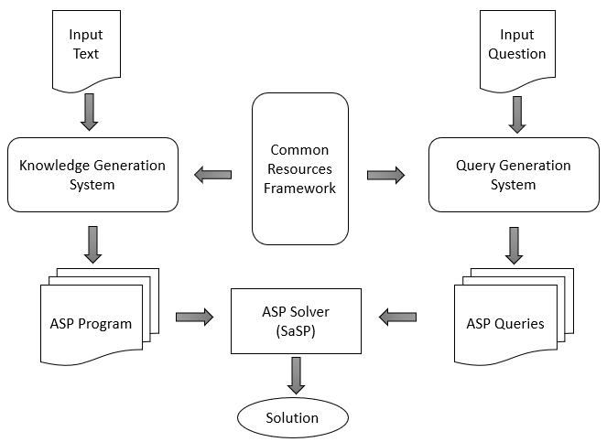
Components of the System
Common Resources Framework
Knowledge Generation System
Query Generation System
Architecture

Slide 12
Components of the System
Common Resources Framework
Knowledge Generation System
Query Generation System
Architecture

Slide 13
Components of the System
Common Resources Framework
Knowledge Generation System
Query Generation System
Architecture

Slide 14
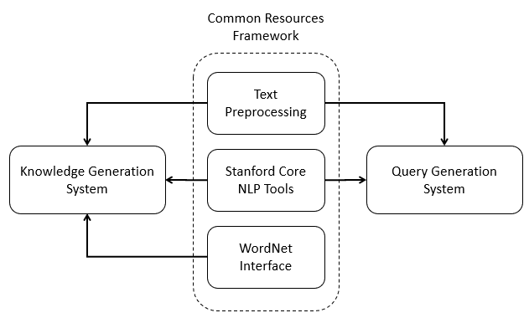
Common Resources Framework
Text Preprocessing Module
Handles compound nouns
Assumes co-reference resolution.
Corrects mis-tagged entities
Stanford Core NLP Tools
Analyze and understand text
Pipelining of sub-tools
Stanford-Core-NLP v3.9.1
WordNet API
Lexical DB for English
Extracts semantic relations
Java WordNet Interface (JWI)

Slide 15
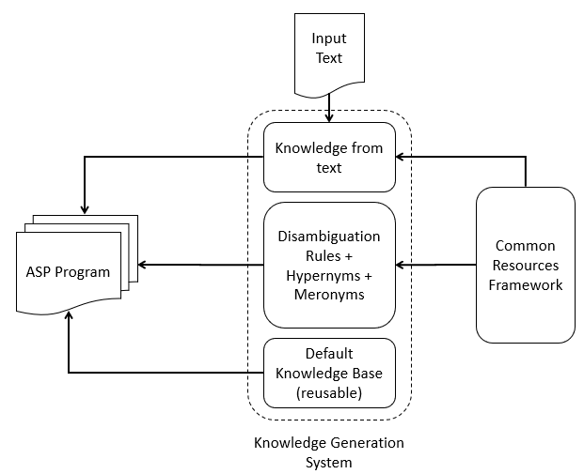
Knowledge Generation System
Knowledge Extraction from text
Generates facts and rules
Works on preprocessed text
Uses dependency parser
WordNet Ontology Generator
Hypernym Rules
Disambiguation Rules
Uses default reasoning patterns
Default Knowledge Base
Hand generated rules
Encodes implicit information

Slide 16
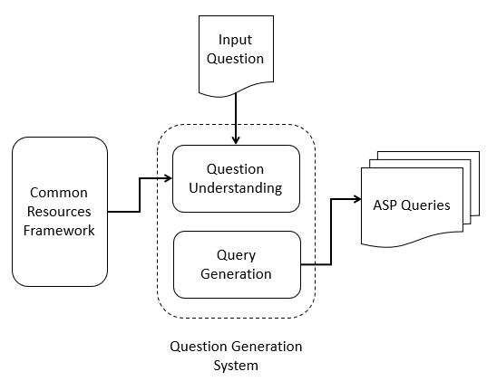
Query Generation System
Question Understanding
Extracts information from natural language question
Understands question type
(Wh-question), focus of the question
Query Generation
Uses information from previous module
Generates a set of queries representing the input question
Relaxes constraints on the queries to generate less accurate queries to make the system robust.

Slide 17
Software Development Approach
How is it built?

Slide 18
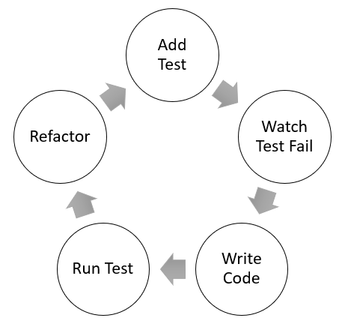
Test Driven Development
Development Cycle

Slide 19
Sample Demo

Slide 20
Nikola Tesla
“Nikola Tesla (10 July 1856 – 7 January 1943) was a Serbian American inventor, electrical engineer, mechanical engineer, physicist, and futurist best known for Nikola Tesla's contributions to the design of the modern alternating current (AC) electricity supply system.”
_abbreviation(ac, alternating_current).
_is(nikola_tesla, electrical_engineer).
_is(nikola_tesla, engineer).
_is(nikola_tesla, futurist).
_is(nikola_tesla, inventor).
_is(nikola_tesla, mechanical_engineer).
_is(nikola_tesla, physicist).
_is(nikola_tesla, serbian_american_inventor).
_mod(engineer, electrical).
month('10_july_1856', july).
month('7_january_1943', january).
_mod(engineer, mechanical).
_mod(inventor, serbian_american).
_mod(know, best).
_mod(system, alternating_current).
_mod(system, modern).
_possess(nikola_tesla, contribution).
_property(2, contribution, to, design).
_property(2, design, of, system).
_property(2, know, for, contribution).
_relation(futurist, 2, _clause).
_end_date(nikola_tesla, '7_january_1943').
_start_date(nikola_tesla, '10_july_1856').
engineer(nikola_tesla).
event(2, know, null, null).
futurist(nikola_tesla).
inventor(nikola_tesla).
physicist(nikola_tesla).
time('10_july_1856').
time('7_january_1943’).
day('10_july_1856', 10).
day('7_january_1943', 7).
year('10_july_1856', 1856).
year('7_january_1943', 1943).

Slide 21
Nikola Tesla
“Nikola Tesla (10 July 1856 – 7 January 1943) was a Serbian American inventor, electrical engineer, mechanical engineer, physicist, and futurist best known for Nikola Tesla's contributions to the design of the modern alternating current (AC) electricity supply system.”
Q1. When did Tesla die?
_end_date(S2, X1), _similar(tesla, S2), time(X1).
Q2. Who was Nikola Tesla?
_is(S1, X1), _similar(nikola_tesla, S1), person(X1, _).
Q3. When was Nikola Tesla born?
_start_date(S2, X2), _similar(nikola_tesla, S2), time(X2).

Slide 22
Answer Set Programming
What is ASP?

Slide 23
Answer Set Programming
Answer-Set Programming is a declarative problem-solving paradigm that uses non-monotonic reasoning and logic programming.
It is used in tasks such as modeling reasoning agents, non-monotonic inferences, common sense reasoning, planning problems, constraint satisfaction problem and so on.
An answer set program is a collection of statements that describe the objects of a domain and model relations between them.
The semantics of an ASP Program defines a set of possible beliefs that an agent has associated with the program called the answer set of the program
The basic constituents of an ASP program are the rules, facts and constraints that describe the problem.

Slide 24
Syntax
Atom
The most basic constituent of the ASP program is an atom.
It has the form p (t₁,…, tn)
Example, ‘parent (mary, alice)’ and ‘alice’ are both atoms, whereas ‘parent (mary, girl(alice))’ is not an atom.
Literal
A literal is an atom of the form p (t₁,…, tn) or its negation -p (t₁,…, tn).
An atom is called as a ground literal if every term t_{i} in the atom is ground.
For example, ‘parent (X, Y)’ is a literal whereas ‘parent (mary, alice)’ is called as a ground literal.
Rule
An ASP Program consists of a collection of rules of the form
l₀ l_{i} ← l_{i+1}, …, l_{m}, not l_{m+1},…, not l_{n}
An ASP rule is divided into two parts viz. head and a body.
A rule with an empty head is called as a constraint whereas a rule with an empty body is called as a fact.
Example, :- queen(i), queen(j), i = j is a constraint and parent(mary, alice) is a fact.

Slide 25
Semantics
1. Modelling Implications:
Head of the rule succeeds only if every literal in the body succeeds.
parent (A, B) :- father (A, B).
The above rule states that if A is the father of B then A is a parent of B
3. Constraints:
These are used to model that some predicate is always false in the current model.
:- color (B, red), color (B, yellow).
The above rule states that the block B can never have red as well as yellow color.
2. Classical Negation:
Here we use negative literal to show falsehood
-eat (P, F) :- allergic (P, F).
The above rule states that if P is allergic to F then P does not eat F
4. Default Negation:
Default Negation also called as Negation as Failure helps make conclusions based on absence of information
like (P, F) :- not -like (P, F)
The above rule states that P may like F if not explicitly proved otherwise.

Slide 26
Default Reasoning
Default reasoning is very useful in modelling human reasoning
We can draw conclusions from the default rule in the absence of information.
Example: “Normally elements of class C have property P” is represented as the following rule
p(X) :- c(X),
not ab(d(X)),
not -p(X).
Default Assumption
flies(X) :- bird(X),
not ab(bird(X)),
not -flies(X).
Weak Exception
Strong Exception
Here, ab(d(X)) can be read as “X is abnormal with respect to the default assumption d” and not-p(X) can be read as “We can’t successfully prove that p(X) is false” or “p(X) may be true”.

Slide 27
Natural Language Resources
What NLP tools were used?

Slide 28
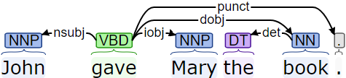
Stanford Core NLP Toolset
Stanford Dependency Parser
A dependency parser analyses the grammatical structure of a sentence and returns a set of relations between different words of the sentence.
Dependency Relations :
root(ROOT-0, gave-2)
nsubj(gave-2, John-1)
dobj(gave-2, book-5)
iobj (gave-2, Mary-3)
det(book-5, the-4)
punct(gave-4, .-6)
Example: “John gave Mary the book.”

Slide 29

Stanford Core NLP Toolset
Parts of Speech Tagger
A Parts of Speech Tagger is responsible for assigning parts of speech to words in a sentence.
The English language has eight parts of speech: noun, verb, pronoun, preposition, adverb, conjunction, particle, and article.
The English tagger in the Stanford POS Tagger uses the Penn Treebank tag set.
Example: “John gave Mary the book.”
Penn Treebank Tag Set
NNP : Proper Noun, Singular
VBD : Verb, Past tense
DT : Determiner
NN : Noun, Singular or Mass

Slide 30

Stanford Core NLP Toolset
Named Entity Recognizer
A Named Entity Recognizer is a module used to label a sequence of words in a sentence with predefined tags of Named Entities
Named Entities are names of things, such as person, company, organization, locations, cities and many more.
The various training models for the Stanford Named Entity Tagger are given as follows:
3 class: LOCATION, PERSON, ORGANIZATION
4 class: LOCATION, PERSON, ORGANIZATION, MISC
7 class: LOCATION, PERSON, ORGANIZATION, MONEY, PERCENT, DATE, TIME
Example: “John, who works at UTD, lives in Dallas.”.

Slide 31
Stanford Universal Dependencies
Core Arguments
Contain relations that talk about the participants in the events. Play an important role in understanding the sentence
Some of the core argument relations can be given as follows
Nominal Subject (nsubj)
Clausal Subject (csubj)
Direct Object (dobj)
Indirect Object (iobj)
Clausal Complement (ccomp)
Open Clausal Complement (xcomp)
Non Core Dependents
These relations contain information about modifiers and clausal relations. They provide more information about core arguments.
Some of the non-core dependents can be given as follows
Adverbial Clause (advcl)
Adverbial Modifier (advmod)
Auxiliary (aux)
Copula (cop)
Marker (mark)
Nominal Dependents
Nominal relations describe about the properties of verbs, adverbs and nouns in the sentence.
Some of the nominal dependency relations can be given as follows
Nominal Modifier (nmod)
Appositional Modifier (appos)
Numerical Modifier (nummod)
Adjective Clause (acl)
Adjective Modifier (amod)
Determiner (det)
Case Marker (case)

Slide 32

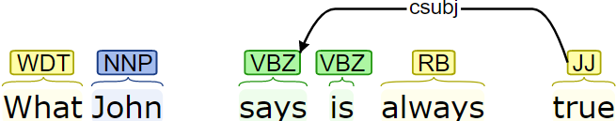

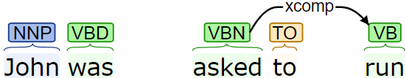
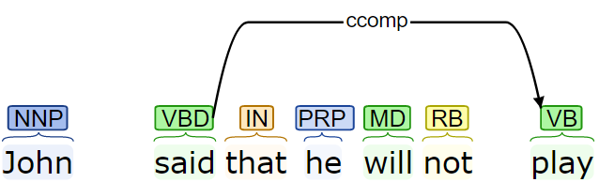

Core Arguments
1. Nominal Subject (nsubj)
4. Clausal Subject (csubj)
2. Direct Object (dobj)
5. Open Clausal Complement (xcomp)
3. Indirect Object (iobj)
6. Clausal Complement (ccomp)

Slide 33
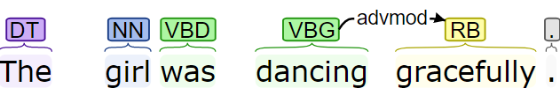
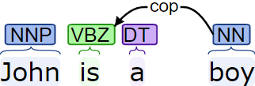
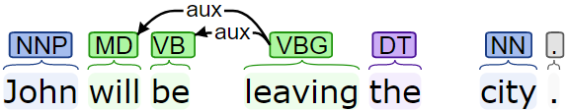
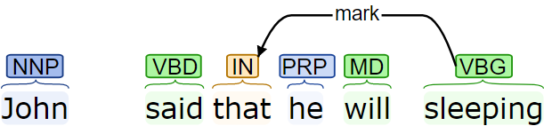
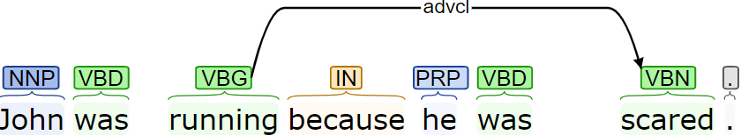
Non Core Dependents
1. Adverbial Modifier (advmod)
4. Copula (cop)
2. Auxiliary (aux)
5. Marker (mark)
3. Adverbial Clause (advcl)

Slide 34
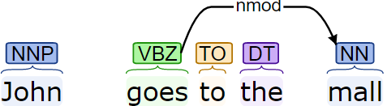


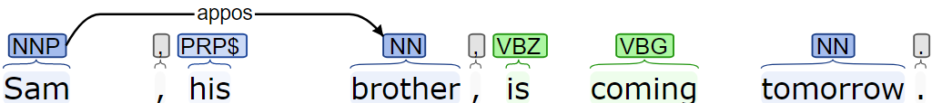
Nominal Dependents
1. Nominal Modifier (nmod)
4. Adjective Clause (acl)
2. Numerical Modifier (nummod)
3. Appositional Modifier (appos)

Slide 35

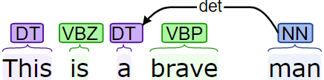

Nominal Dependents
5. Adjective Modifier (amod)
6. Determiner (det)
7. Case Marker (case)

Slide 36


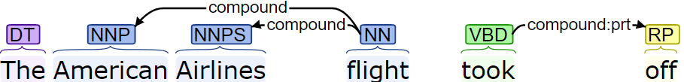
Other Dependencies
1. Conjunct (conj)
2. Coordinating Conjunction (cc)
3. Compound (compound)

Slide 37
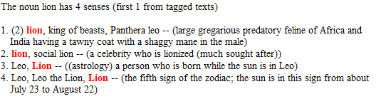
WordNet
WordNet is one of the most commonly used resources in English.
It is a lexical database consisting of sense relations between English words.
A typical entry for the noun “lion” in WordNet yields the following different senses.

Slide 38
WordNet Relations
WordNet contains various relations depending upon the word type.
Noun relations include Hypernym, Hyponym, Instance Hypernym, Instance Hyponym, Meronyms.
Verb relations include Hypernyms, Troponyms, Antonyms
Examples
Hypernyms: (IS_A) car → motor vehicle → vehicle
Meronyms: (Part-Whole) cars have horns, man has foot
Synonyms: car/automobile, eat/consume/take in, quickly/rapidly
Antonyms: fast ←→ slow, long ←→ short

Slide 39
WordNet Senses
WordNet has defined 45 lexical categories for synsets.
The synsets are divided based on NOUN, VERB, ADJECTIVE and ADVERB.
Following are some of the lexical categories for nouns along with their meaning.
Name | Content
noun.Tops | unique beginner for nouns
noun.act | nouns denoting acts or actions
noun.animal | nouns denoting animals
noun.artifact | nouns denoting man-made objects
noun.attribute | nouns denoting attributes of people and objects
noun.body | nouns denoting body parts
noun.cognition | nouns denoting cognitive processes and contents
noun.location | nouns denoting spatial position
noun.event | nouns denoting natural events
noun.feeling | nouns denoting feelings and emotions
noun.food | nouns denoting foods and drinks

Slide 40
Knowledge Generation
How to generate predicates?

Slide 41
Semantic Graph
Building a directed acyclic graph from the Stanford dependencies
Example: “NASA carried out the Apollo program.”
Stanford Dependencies
nsubj (carried-2, NASA-1)
root (ROOT-0, carried-2)
compound:prt (carried-2, out-3)
det (program-6, the-4)
compound (program-6, Apollo-5)
dobj (carried-2, program-6)

Slide 42
Event Graph
The previous example only had a singular event triggered by the verb and its particle “carried out”
So the graph only represented a single event.
Let us take a more complicated example to see how various events are interacting with each other
Example:
“Miitomo, which Nintendo introduced globally in 2016, features the company's, Mii, avatar-system and lets the users communicate by exchanging personal information such as favorite movies.”

Slide 43
Event Graph
Event Region Triggers:
Feature (root)
Introduce
Let
Communicate
Exchange
PREP
VERB
CONJ
OTHER

Slide 44
Predicate Generation
Types of Predicates
Event Predicate
Property Predicate
Modifier Predicate
Possessive Predicate
Instance Predicate
Relation Predicate
Named Entity Predicates
Special Predicates

Slide 45
Event Predicate
Event predicate marks events that happen in a sentence
Predicate Signature
event (event_id, trigger_verb, actor, participant)
Example: “The American_Football_Conference's (AFC) team, Denver_Broncos, defeated the National_Football_Conference's (NFC) team, Carolina_Panthers, by 24_10 to earn AFC’s third Super_Bowl title”
event (1, defeat, denver_broncos, carolina_panthers)
[denver_broncos defeated carolina_panthers]
event (2, earn, afc, title)
[afc earned title]

Slide 46
Event Predicate
Signature : event (event_id, trigger_verb, actor, participant)
Terms in predicate
event_id : Integer that uniquely identifies events in a sentence or paragraph
Used create event regions and differentiate between properties of events
trigger_verb : Represents the lemma of the trigger word
actor : Subjects found to the trigger_verb. (default: null)
Subjects can be found using dependencies like nsubj, nsubj:xsubj
participant : Can be obtained from the dobj relation i.e. represents objects of the trigger_verb (default: null)
Modified events - Duplicate event predicates are created to give better answers
event (2, earn, afc, third_super_bowl_title)
[afc earned their third super bowl title]

Slide 47
Property Predicate
Property predicate elaborates on properties of the modified noun or verb.
In general the modifier here is a prepositional phrase
Predicate Signature
_property (event_id, modified_entity, preposition, modifier)
Example: “The game was played on February 7 2016, at Levis_Stadium, in the San_Francisco_Bay_Area, at Santa_Clara in California”
_property (2, play, on, 'february_7_2016’) [played on february 7 2016]
_property (2, play, at, levis_stadium) [played at levis stadium]
_property (2, play, in, san_francisco_bay_area) [played in san francisco bay area]
_property (2, play, at, santa_clara) [played at santa clara]
_property (2, santa_clara, in, california) [santa clara is in california]

Slide 48
Property Predicate
Signature : _property (event_id, modified_entity, preposition, modifier)
Terms in predicate
event_id : Integer that uniquely identifies the event associated with the property
This is propagated from the modified word
modified_entity : It’s the head of the predicate and can be either a noun or a verb
preposition : Helps identify the kind of relation between the modifier and the modified.
Can be found using dependencies like case
modifier : Can be obtained from the nmod relation i.e. the nominal modifier relation of the modified word
Using property predicates we can understand more about events like their time, place etc.
While generating property predicates we omit the nmod relations having specifics like poss, mwe as they are handled specially.

Slide 49
Modifier Predicate
Modifier predicate is used to model relationships between adjectives and nouns and between verbs and their modifying adverbs.
Predicate Signature
_mod (modified_word, modifier_word)
Example: “The Amazon_rainforest, also known in English as Amazonia or the Amazon_Jungle, is a moist broadleafed forest that covers most of the Amazon_basin of South_America.”
_mod (forest, broadleafed) [broadleafed modifies forest]
_mod (forest, moist) [moist modifies forest]
_mod (know, also) [also modifies know]

Slide 50
Modifier Predicate
Signature : _mod (modified_word, modifier_word)
Terms in predicate
modified_word : This can either be a noun or a verb
modifier_word : The modifier word can either be an adjective in cases of a noun, obtained from the amod dependency. In the case of a verb the modifier is an adverb obtained using the advmod dependency.
Using the modifier predicate we can understand about quantities of nouns.
These predicates come in handy when answering the “How” questions in question answering.

Slide 51
Possessive Predicate
Possessive predicate is used to model the genitive case in English.
It is used to show possession or a possessive relation between two entities.
Predicate Signature
_possess (possessor, possessed)
Example: “The American_Football_Conference's (AFC) team, Denver_Broncos, defeated the National_Football_Conference's (NFC) team, Carolina_Panthers, by 24_10 to earn AFC’s third Super_Bowl title”
_possess (american_football_conference, team) [afc possesses a team]
_possess (national_football_conference, team) [nfc possesses a team]
_possess (american_football_conference, denver_broncos) [afc possesses denver_broncos]
_possess (national_football_conference, carolina_panthers) [nfc possesses carolina_panthers]

Slide 52
Possessive Predicate
Signature : _possess (possessor, possessed)
Terms in predicate
possessor : This is a generally noun
possessed : The possessed word is also a noun, obtained from the poss specific of the nmod dependency i.e. nmod:poss.
The _possess relation can be extended to the appositional modifiers of the possessed
As mentioned in the previous slide carolina_panthers and denver_broncos are teams and share an appositional relation with the word ‘team’. Hence, we can also generate the following facts.
_possess (american_football_conference, denver_broncos) [afc possesses denver_broncos]
_possess (national_football_conference, carolina_panthers) [nfc possesses carolina_panthers]

Slide 53
Instance Predicate
Instance predicate is used to model the relation of a concept being an instance of another concept. E.g. Red is an instance of color. “color(red)”
Predicate Signature
_is (instance, concept)
Terms in predicate
instance : This is a noun which is an instance
concept : The concept word is also a noun, but it a higher level concept.
This relation can be modelled using the cop dependency along with its
related nsubj dependency
Modelling the relation in the format _is (red, color) as opposed to color (red) helps in querying both the concept as well as the instance.

Slide 54
Instance Predicate
Example: “Nikola_Tesla was a serbian-american inventor, electrical engineer, mechanical engineer, physicist, and futurist”
_is (nikola_tesla, inventor). [Nikola Tesla is an instance of inventor]
_is (nikola_tesla, serbian_american_inventor).
We can extend the definition of the predicate to also include other concepts with the help of the conjunction (conj) dependency
_is (nikola_tesla, electrical_engineer).
_is (nikola_tesla, engineer). [Nikola Tesla is an instance of engineer]
_is (nikola_tesla, futurist). [Nikola Tesla is an instance of futurist]
_is (nikola_tesla, mechanical_engineer).
_is (nikola_tesla, physicist). [Nikola Tesla is an instance of physicist]

Slide 55
Instance Predicate
Another case where we can use the instance predicate is in the case of multiword expressions.
Expressions including such as, like are used to compare two concepts to be equivalent
Example : “Miitomo, which Nintendo introduced globally in 2016, features the company's, Mii, avatar-system and lets the users communicate by exchanging personal information such as favorite movies.”,
_is (movie, personal_information)
[movie is an instance of a personal information]
_is (favorite_movie, personal_information)
[favorite movie is an instance of a personal information]

Slide 56
Relation Predicate
Relation predicate is used to model the relations between dependent clauses and conjunctions.
Predicate Signature
_relation (independent_entity, dependent_clause_id, relation_type)
Example: “The American_Football_Conference's (AFC) champion team, Denver_Broncos, defeated the National_Football_Conference's (NFC) champion team, Carolina_Panthers, by 24_10 to earn AFC third Super_Bowl title”
_relation (1, 2, _clause) [e1 has a subordinate event e2]
event (1, defeat, denver_broncos, carolina_panthers) [denver_broncos defeated carolina_panthers]
event (2, earn, afc, title) [afc earned title]

Slide 57
Relation Predicate
Signature : _relation (independent_entity, dependent_clause_id, relation_type)
Terms in predicate
independent_entity : This is a generally noun or the event that is modified
dependent_clause_id : Id of the verb that is the head of the dependent clause.
relation_type : 3 types of relations viz. _clause, _clcomplement and _conj
Dependent clauses can be of two types depending upon their governors i.e. adjective clauses or adverb clauses. Adjective clauses are dependent clauses that modify a noun, whereas adverb clauses modify a verb.
The relation predicate can be modelled using the advmod, acl, ccomp and the xcomp dependency

Slide 58
Named Entity Predicates
The Named Entity Tagger marks various classes like LOCATION, PERSON, ORGANIZATION, MONEY, PERCENT, TIME in the text.
We make use of these tags to generate facts of the form concept(instance).
Time Predicate
Location Predicate
Organization Predicate
Person Predicate

Slide 59
Special Predicates
Special predicates have been used in the system, to model concepts that are patterns and are understood by humans implicitly.
Time Span Predicates
Time spans are sometimes expressed in text using the bracketed notion.
A timespan is generally of the format “(DATE - DATE)”.
Signature for time stamps
_start_date (entity, date)
_end_date (entity, date)
Example: “Project_Mercury was followed by the two-man Project_Gemini (1962 – 1966)”
_start_date (project_gemini, 1962)
_end_date (project_gemini, 1966)

Slide 60
Special Predicates
Date Part Predicates
The time predicates can be utilized to get the day, month, and year parts from the time
Can use simple information extraction techniques to find out the year, month, and day predicates from the time predicate
Signature for time stamps
day (time, day)
month (time, month)
year (time, year)
Example:
time ('10_november_1483')
day ('10_november_1483', 10)
month ('10_november_1483', november)
year ('10_november_1483', 1483)

Slide 61
Special Predicates
Appositional Predicates
Appositional modifiers directly follow the noun they describe.
Most appositional modifiers follow the instance_of pattern
Example:
“Jim's brother, Sam, is coming to town today.”
brother(Sam)
“Jim met Sam, Jim's brother, today.”
brother(Sam)
These predicates help in associating properties to instances with the help of WordNet

Slide 62
Special Predicates
Abbreviation Predicates
Texts sometimes contain abbreviation of words.
Queries asked can sometimes contain short forms for organizations and projects rather than their long forms.
Abbreviations can be detected by either doing pattern matching i.e. looking for the pattern “CONCEPT (ABBREVIATION)” or by using the appos dependency relation.
Signature of the predicate
_abbreviation (short_form, long_form)
Example: “The Apollo program was the third United_States human spaceflight program carried out by the National_Aeronautics_and_Space_Administration (NASA)”
_abbreviation (nasa, national_aeronautics_and_space_administration)

Slide 63
Other Knowledge Sources
How to get more information?

Slide 64
Other Knowledge Sources
The knowledge that we extracted in previous slides comes from input text
We can make use of knowledge sources like WordNet to gain additional information
Humans use such knowledge, often referred to as “Common World Knowledge”, subconsciously while reasoning.
This system uses the Hypernym relation from WordNet to build its ontology.
We will also see how a default preferential pattern can be implemented for WSD
Before building an Ontology we convert all the nouns to concepts.
In the rest of the slides in this section we will model as concept as follows
concept (concept_instance, instance_sense)
Example: lion (lion1, noun.animal)

Slide 65
Hypernym Processing
Hypernyms can be used to model the principle of transferring properties from general concepts to more specific ones.
Steps in processing hypernyms
Generate Hypernym Lists
Aggregate List into a Graph
Generate Hypernym Rules
The figure shows the rules generated that represent the animal branch of the “lion” concept.

Slide 66
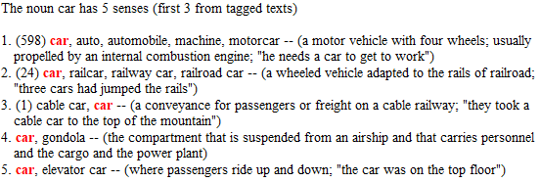
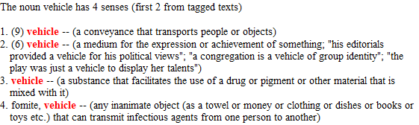
Generate Hypernym Lists
Here we see the senses for the words car and vehicle from WordNet
We know that a car is_a vehicle
So some properties of vehicles like capacity, mass, color, it can be driven and so on can be transferred to car
But only the properties of sense V.1 can be to the sense C.1 of car.
is_a
Car (sense1) Vehicle (sense1)

Slide 67
Generate Hypernym Lists
Algorithm for Generating the Hypernym Lists
Steps in generating lists
Get all senses
Rank senses according to usage
For each sense
Generate the hypernym List

Slide 68
Generate Hypernym List
Algorithm for Generating a Hypernym List
Steps in generating lists
Get all hypernym senses
If hypernym senses contain the current_sense
Get hypernym with current_sense
Else if hypernym senses contain “Noun.Tops”
Get hypernym with sense “Tops”
Add hypernym to the concept bag
Recursively continue the algorithm till no more hypernyms are found

Slide 69
Generate Hypernym Lists
The algorithm below can be explained better with an example of the concept of “lion”.
Let us run the algorithm for the following 4 senses

Slide 70
Generate Hypernym Lists
If we track the 4 senses of the word to ‘entity’ we get the following hypernym relations
Sense 1: (animal)
lion →big_cat →feline →carnivore →placental →mammal →vertebrate →chordate →animal → organism →living_thing →object →physical_entity →entity
Sense 2: (person)
lion → celebrity → important_person → adult → person → organism → living_thing → object → physical_entity → entity
Sense 3: (person)
lion → person → organism → living_thing → object → physical_entity → entity
Sense 4: (location)
lion → sign_of_the_zodiac → region → location → object → physical_entity → entity

Slide 71
Aggregate Lists into Graph

Slide 72
Generate Hypernym Rules
There are two different ways of representing a hypernym relationship in answer set programming
One of the approaches uses classes where as the other involves instances
The first approach is as follows
is_superclass (big_cat, lion),
is_superclass (feline, big_cat),
is_superclass (carnivore, feline),
… ,
is_superclass (entity, physical_entity)
We can then infer from these facts using the superclass predicate defined as follows
superclass (X, Y) :- is_superclass (X, Y).
superclass (X, Y) :- is_superclass (Z, Y), superclass (X, Z).

Slide 73
Generate Hypernym Rules
The previous approach can be used if the domain of classes is infinite, but in this case as the number of classes is finite we consider a simpler representation.
big_cat (X) :- lion (X).
feline (X) :- big_cat (X).
…
animal (X) :- vertebrate (X).
big_cat (X, noun.animal) :- lion (X, noun.animal).
feline (X, noun.animal) :- big_cat (X, noun.animal).
…
animal (X, noun.tops) :- vertebrate (X, noun.animal).
+ senses
Given the sentence “Sam is a lion”, if we can prove that the predicate “lion (sam)” holds then using the above rules we can prove that “animal (sam)”.
When extracting information from WordNet we need to deal with multiple senses as well.
Adding the sense term to the predicate makes the hypernym rule representation more accurate

Slide 74
Representation of Word Senses
Word Sense Disambiguation is a task of selecting the best sense out of a collection of senses applicable to a concept.
Word senses are represented using two different logic patterns.
Using both these patterns in union, senses are selected for the various concepts in the text which activate their hypernym relations.
Signature template for concept sense
c (X, si) :- c (X),
properties_si (X),
not -c (X, si).
“X is an instance_of concept c with si”

Slide 75
Representation of Word Senses
Example of a tree concept. WordNet has 3 senses for the concept of “tree”
Using the previously mentioned template for senses the three rules generated for the tree concept can be given as follows
tree (X, plant) :- tree (X),
properties_plant (X),
not -tree (X, plant).
tree (X, diagram) :- tree (X),
properties_diagram (X),
not -tree (X, diagram).
tree (X, person) :- tree (X),
properties_person (X),
not -tree (X, person).

Slide 76
Preference Pattern for WSD
Humans use a preference pattern over word senses and choose the most preferential pattern to disambiguate between multiple senses
The system models this preferential pattern to decide a default sense to every concept, if a sense is not provided or it can’t be proved
Consider a concept c having three senses s1, s2 and s3 ordered according to the frequency of their use from the most used to the least used.
preferences can be modeled in the following template.
c (X, sp) :- c (X),
not -c (X, sp),
-c (X, s1), -c (X, s2), … -c (X, sp-1),
not c (X, sp+1), not c (X, sp+2), …, not c (X, sn).
The above rule is generated for the pth sense of the concept c such that 1 > p > n
n is the total number of senses of concept c.

Slide 77
Representation of Word Senses
We can see this pattern in action with the tree concept as an example.
tree (X, plant) :- tree (X),
not -tree (X, plant),
not tree (X, diagram),
not tree (X, person).
[If we cant prove X to be a diagram or a person, then by default X is a plant]
tree (X, diagram) :- tree (X),
not -tree (X, diagram),
-tree (X, plant),
not tree (X, person).
[If we cant prove X to be a person and X is proved to be not a plant, then by default X is a diagram]
tree (X, person) :- tree (X),
not -tree (X, person),
-tree (X, plant),
-tree (X, diagram).
[If X is proved to be not a plant, as well as a diagram then X is proved to be person]

Slide 78
Query Generation
How to represent questions?

Slide 79
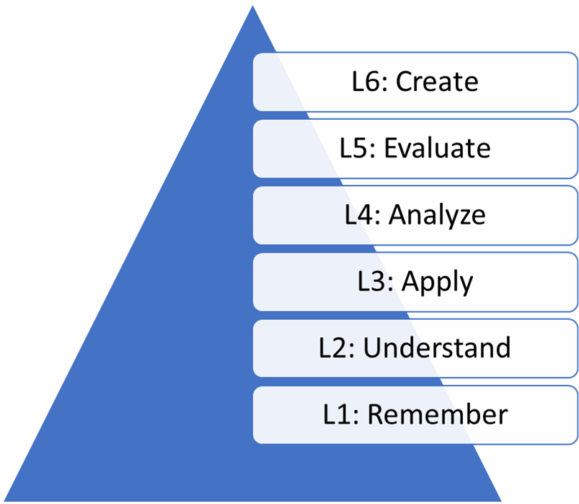
Question Classification
The different ways for question classification can be broadly classified into the following
A. Based on Bloom’s Taxonomy
B. Based on reading comprehensions
C. Based on the purpose of the question
D. Based on the question word
Three types of sub classifications
Starting with a Wh-word
Starting with How or Have
Starting with “Is”.

Slide 80
Steps in Query Generation
This module proposes a method for converting natural language questions to answer set queries.
As a question is also a sentence, it is processed in the same way that any other sentence would as mentioned before
Phases in Query Generation
Question Understanding
Four kinds of information from the question viz. the question word, the question type, the answer word or the focus of the question and the answer type.
2. Query Generation
Generating event, _property and other predicates from the question
3. Applying Base Constraints
eg. YEAR→ year (Tk, Xk), time (Tk),
PLACE → location (Xk) or location (Xk, noun_location)
4. Combining Constraints

Slide 81
Query Example
Example: what company owns the american_broadcasting_company ?
Question Understanding
questionType = "WHAT"
questionWord = "what-1"
answerType = "SUBJECT"
answerKind = "company-2"
2. Query Generation
“_similar(american_broadcasting_company, O1),event(E1, own, X1, O1)” [main clause]
“_property(E1, own, _by, X1),_similar(american_broadcasting_company, O1),event(E1, own, _, O1)” [agent]
“_relation(X1, E1, _clause),event(E1, own, _, _)” [subordinate clause]
3. Applying Base Constraints
company(X1, _)
Combining Constraints
_similar(american_broadcasting_company, O1),company(X1, _),event(E1, own, X1, O1)
_relation(X1, E1, _clause),company(X1, _),event(E1, own, _, _)
_property(E1, own, _by, X1),_similar(american_broadcasting_company, O1),company(X1, _),event(E1, own, _, O1)

Slide 82
Confidence Classes
Queries have 4 types of confidence classes depending upon their constraints
Class I: [Certain]
Have all the constraints mentioned in the question.
These may contain fact predicates, subordinate constraints, answer predicates and base constraints. This class has the highest confidence level.
2. Class II: [Likely]
These kinds of queries do not contain any fact predicates.
Fact predicates are all the predicates in the queries that do not contain any variables.
3. Class III: [Possible]
These kinds of queries only contain the answer predicates and base constraints.
This means that they don’t contain fact predicates and any subordinate constraints that do not contain the answer tag (Xk).
4. Class IV: [Guess]
These queries only contain the base constraints.
Answers from these queries are not very reliable as this class has the lowest confidence.

Slide 83
Relaxing Constraints
Example: Since what year did abc stylize abc’s logo , as abc ?
Class I: [Certain]
event(E2, stylize, _, O2), _similar(logo, O2), _property(E2, stylize, since, X2),
_property(E2, stylize, _by, S2), _similar(abc, S2), ,
, time(T2), year(T2, X2).
event(E2, stylize, _, _), _property(E2, stylize, since, X2),
_relation(S2, E2, _clause), _similar(abc, S2), ,
,time(T2),year(T2, X2).
event(E2, stylize, S2, O2), _similar(abc, S2), _similar(logo, O2),
_property(E2, stylize, since, X2), ,
,time(T2),year(T2, X2).
_possess(abc, logo)
organization(abc)
_possess(abc, logo)
organization(abc)
_possess(abc, logo)
organization(abc)

Slide 84
Relaxing Constraints
Example: Since what year did abc stylize abc’s logo , as abc ?
2. Class II: [Likely]
, _property(E2, stylize, since, X2),
, time(T2), year(T2, X2).
, _property(E2, stylize, since, X2),
, time(T2),year(T2, X2).
_property(E2, stylize, since, X2), time(T2),year(T2, X2).
event(E2, stylize, _, O2), _similar(logo, O2)
_property(E2, stylize, _by, S2), _similar(abc, S2)
event(E2, stylize, _, _)
_relation(S2, E2, _clause), _similar(abc, S2)
event(E2, stylize, S2, O2), _similar(abc, S2), _similar(logo, O2),

Slide 85
Relaxing Constraints
Example: Since what year did abc stylize abc’s logo , as abc ?
Class III: [Possible]
, time(T2), year(T2, X2).
_property(E2, stylize, since, X2)
4. Class IV: [Guess]
time(T2), year(T2, X2).

Slide 86
Question Answering

Slide 87
SQuAD Dataset
Question answering is used as a task to show the efficiency of answer set programming for representing knowledge
The SQuAD Dataset contains more than 100,000 reading comprehensions along with question and answers on those reading passages.
It uses the top 500+ articles from English Wikipedia.
A set of crowd workers generated the questions and the set of answers.
To make the evaluation from the dataset more robust, each question was also provided with at least two additional answers.
Out of the 48 different articles in the SQuAD dev set, I choose 20 articles from different domains to help build the system.
We can roughly categorize these articles into 5 different categories: People articles, Scientific articles, Project/Event articles, Region articles and Misc. articles.

Slide 88
SQuAD Dataset
Example of an article is as follows
The American Broadcasting Company (ABC) (stylized in its logo as abc since 1957) is an American commercial broadcast television network that is owned by the Disney–ABC Television Group, a subsidiary of Disney Media Networks division of The Walt Disney Company. The network is part of the Big Three television networks. The network is headquartered on Columbus Avenue and West 66th Street in Manhattan, with additional major offices and production facilities in New York City, Los Angeles and Burbank, California.
Question:
Q1. What company owns the American Broadcasting Company?
A. [The Walt Disney Company, Disney–ABC Television Group, Disney–ABC Television Group]

Slide 89
Results
No | Article | Result |  | %
 |  | Correct | Qn Cnt
1 | ABC | 5 | 5 | 100.00%
2 | AmazonRainforest | 12 | 14 | 85.71%
3 | Apollo | 4 | 5 | 80.00%
4 | Chloroplasts | 4 | 5 | 80.00%
5 | ComputationalComplexity | 3 | 3 | 100.00%
6 | Ctenophora | 9 | 12 | 75.00%
7 | European_Union_Law | 13 | 13 | 100.00%
8 | GenghisKhan | 3 | 5 | 60.00%
9 | Geology | 4 | 5 | 80.00%
10 | ImmuneSystem | 13 | 15 | 86.67%
No | Article | Result |  | %
 |  | Correct | Qn Cnt
11 | Kenya | 5 | 5 | 100.00%
12 | Martin_Luther | 2 | 5 | 40.00%
13 | NikolaTesla | 6 | 7 | 85.71%
14 | Normans | 4 | 5 | 80.00%
15 | Oxygen | 8 | 15 | 53.33%
16 | Rhine | 5 | 8 | 62.50%
17 | Southern_California | 3 | 5 | 60.00%
18 | SteamEngine | 4 | 5 | 80.00%
19 | SuperBowl50 | 25 | 29 | 86.21%
20 | Warsaw | 3 | 5 | 60.00%
Answered 135 out of 171 questions correctly i.e. 78.95% accuracy
With an average of 77.76% average accuracy.
Able to give first choice answers 89.63% of the time

Slide 90
Demo

Slide 91
Nikola Tesla (contd.)
“Nikola Tesla (10 July 1856 – 7 January 1943) was a Serbian American inventor, electrical engineer, mechanical engineer, physicist, and futurist best known for Nikola Tesla's contributions to the design of the modern alternating current (AC) electricity supply system.”
Q4. Which scientist was a futurist?
_is(X1, futurist), scientist(X1, _).
Certain
scientist(X1, _).
Guess
answer(nikola_tesla, certain)

Slide 92
Nikola Tesla (contd.)
“Nikola Tesla (10 July 1856 – 7 January 1943) was a Serbian American inventor, electrical engineer, mechanical engineer, physicist, and futurist best known for Nikola Tesla's contributions to the design of the modern alternating current (AC) electricity supply system.”
Q5. Which scientist was a computer engineer?
_mod(engineer, computer), _is(X1, engineer), scientist(X1, _).
Certain
_is(X1, engineer), scientist(X1, _).
Likely
scientist(X1, _).
Guess
answer(nikola_tesla, likely)

Slide 93
Nikola Tesla (contd.)
“Nikola Tesla (10 July 1856 – 7 January 1943) was a Serbian American inventor, electrical engineer, mechanical engineer, physicist, and futurist best known for Nikola Tesla's contributions to the design of the modern alternating current (AC) electricity supply system.”
Q6. Which scientist was a politician?
_is(X1, politician), scientist(X1, _).
Certain
scientist(X1, _).
Guess
answer(nikola_tesla, guess)

Slide 94
Super Bowl 50
“Super Bowl 50 was an American football game. Super Bowl 50 was to determine the champion of the National Football League (NFL) for the 2015 season. The American Football Conference's (AFC) team, Denver Broncos, defeated the National Football Conference's (NFC) team, Carolina Panthers, by 24 10 to earn AFC third Super Bowl title. As Super Bowl 50 was the 50th Super Bowl, the league emphasized the 'golden anniversary' with various gold themed initiatives, as well as temporarily suspending the tradition of naming each Super Bowl with roman numerals, under the tradition the game would have been known as Super Bowl L, so that the logo could prominently feature the Arabic numerals 50. The game was played on February 7 2016, at Levis Stadium, in the San Francisco Bay Area, at Santa Clara in California.”
-------------------- Generated 97 Facts from the text ------------------
Q1. Which NFL team represented the AFC at Super Bowl 50?
Q2. Where was Super Bowl 50 played?
Q3. What day was the game played on?
Q4. What is the NFL short for?

Slide 95
Super Bowl 50
_abbreviation(afc, american_football_conference).
_abbreviation(nfc, national_football_conference).
_abbreviation(nfl, national_football_league).
_is('super_bowl_50', '50th_super_bowl').
_is('super_bowl_50', american_football_game).
_is('super_bowl_50', game).
_is('super_bowl_50', super_bowl).
_is(carolina_panthers, team).
_is(denver_broncos, team).
_mod(anniversary, golden).
_mod(feature, prominently).
_mod(game, american_football).
_mod(initiative, gold_themed).
_mod(initiative, various).
_mod(season, 2015).
_mod(super_bowl, '50th').
_mod(suspend, temporarily).
_mod(title, super_bowl).
_mod(title, third).
_possess(american_football_conference, denver_broncos).
_possess(american_football_conference, team).
_possess(national_football_conference, carolina_panthers).
_possess(national_football_conference, team).
_property(10, name, with, roman_numerals).
_property(13, know, as, super_bowl_l).
_property(13, know, with, initiative).
_property(16, play, at, levis_stadium).
_property(16, play, at, santa_clara).
_property(16, play, in, san_francisco_bay_area).
_property(16, play, on, 'february_7_2016').
_property(16, santa_clara, in, california).
_property(3, champion, of, national_football_league).
_property(3, national_football_league, for, '2015_season').
_property(4, defeat, by, '24_10').
_property(7, emphasize, null, know).
_property(7, emphasize, null, suspend).
_property(7, emphasize, null, tradition).

Slide 96
Super Bowl 50
_relation(13, 9, _conj).
_relation(13, tradition, _conj).
_relation(2, 3, _clcomplement).
_relation(4, 5, _clause).
_relation(7, 14, _clause).
_relation(tradition, 10, _clause).
anniversary(anniversary).
california(california).
champion(champion).
day('february_7_2016', 7).
event(1, be, null, null).
event(10, name, null, super_bowl).
event(11, have, null, null).
event(12, be, null, null).
event(13, know, null, game).
event(15, be, null, null).
event(14, feature, logo, 'arabic_numerals_50’).
event(16, play, null, game).
event(2, be, 'super_bowl_50', null).
event(3, determine, 'super_bowl_50', champion).
event(3, determine, 'super_bowl_50', champion_of_national_football_league).
event(4, defeat, denver_broncos, carolina_panthers).
event(4, defeat, team, team).
event(5, earn, afc, third_super_bowl_title).
event(5, earn, afc, title).
event(6, be, null, null).
event(7, emphasize, league, anniversary).
event(7, emphasize, league, golden_anniversary).
event(9, suspend, null, game).
event(9, suspend, null, tradition).
game('super_bowl_50').
game(game).

Slide 97
Super Bowl 50
initiative(initiative).
league(league).
logo(logo).
month('february_7_2016', february).
number('24_10').
organization(national_football_league).
organization(nfl).
organization(afc).
organization(american_football_conference).
santa_clara(santa_clara).
season(season).
team(carolina_panthers).
team(denver_broncos).
team(team).
time('february_7_2016').
time(2015).
title(title).
tradition(tradition).
year('february_7_2016', 2016).
year(2015, 2015).
location(san_francisco_bay_area).
location(santa_clara).
location(levis_stadium).

Slide 98
Super Bowl 50
“Super Bowl 50 was an American football game. … The American Football Conference's (AFC) team, Denver Broncos, defeated the National Football Conference's (NFC) team, Carolina Panthers, by 24 10 to earn AFC third Super Bowl title….”
Q1. Which NFL team represented the AFC at Super Bowl 50?
In the passage we do not have the term ‘represented’, so we need to help the system understand it.
Here, can define the term representation as
[A team can represent an organization if the organization possesses the team]
This can be modelled as follows
event(E, represent, X, Y) :- _possess(Y, X), organization(Y), team(X).

Slide 99
Super Bowl 50
“Super Bowl 50 was an American football game. … The American Football Conference's (AFC) team, Denver Broncos, defeated the National Football Conference's (NFC) team, Carolina Panthers, by 24 10 to earn AFC third Super Bowl title….”
Q1. Which NFL team represented the AFC at Super Bowl 50?
event(E1, X1, represent, O1),_similar(afc, O1), _property(E1, represent, at, 'super_bowl_50'), team(X1).
}
Certain
event(E1, X1, represent, O1),_similar(afc, O1), team(X1).
Likely
event(E1, X1, represent, O1),team(X1).
Possible
team(X1).
Guess
answer(denver_broncos,likely)
answer(carolina_panthers,guess)

Slide 100
Super Bowl 50
“Super Bowl 50 was an American football game. … feature the Arabic numerals 50. The game was played on February 7 2016, at Levis Stadium, in the San Francisco Bay Area, at Santa Clara in California.”
Q2. Where was Super Bowl 50 played?
event(E1, play, S1, O1),_similar('super_bowl_50', O1), _property(E1, play, in, X1), location(X1).
event(E1, play, S1, O1),_similar('super_bowl_50', O1), _property(E1, play, at, X1), location(X1).
}
Certain
_property(E1, play, in, X1), location(X1).
_property(E1, play, at, X1), location(X1).
}
Possible
location(X1).
Guess
answer(san_francisco_bay_area,certain);
answer(santa_clara,certain);
answer(levis_stadium,certain);

Slide 101
Super Bowl 50
“Super Bowl 50 was an American football game. … feature the Arabic numerals 50. The game was played on February 7 2016, at Levis Stadium, in the San Francisco Bay Area, at Santa Clara in California.”
Q3. What day was the game played on?
event(E1, play, S1, O1),_similar(game, O1), _property(E1, play, on, X1), time(X1).
event(E1, play, S1, O1),_similar(game, O1), _property(E1, play, on, T), day(T, X1), time(T).
}
Certain
_property(E1, play, on, X1), time(X1).
_property(E1, play, on, T), day(T, X1), time(T).
}
Possible
}
time(X1).
day(T, X1), time(T).
Guess
answer(7,certain)
answer(february_7_2016,certain)
answer(2015,guess)

Slide 102
Super Bowl 50
“Super Bowl 50 was an American football game. … Super Bowl 50 was to determine the champion of the National Football League (NFL) for the 2015 season….”
Q4. What is the NFL short for?
_abbreviation(O1, X1),_similar(nfl, X1).
Certain
answer(national_football_league,certain)

Slide 103
Hurdles
What were the challenges?

Slide 104
Hurdles
Accuracy of NLP Tools
Some sentences are parsed incorrectly
Some words are mis-tagged due to multiple possible POS Tags
System tries to solve this with the use of multiple tools i.e. also using tools having higher semantic information.
2. Use of similar words and concepts
Humans use the concept of similarity a lot when reasoning
Example use of last name for people instead of full name Tesla instead of Nikola Tesla
All of these implicit connections made by humans adversely affect the process of automated reasoning
One of the ways to solve this is to use a similarity measure and use it to find the nearest answer.

Slide 105
Hurdles
3. Absence of good resources for verbs
Verbs are important parts of the sentence
Its important to understand the exact meaning of verbs to understand the sentence
Humans have a complete understanding of how verbs behave in different contexts.
One way to overcome this is to manually add knowledge about verbs that is reusable.

Slide 106
Future Work
What's next?

Slide 107
Future Work
Support for Temporal Reasoning
Humans reasoning involves some temporal reasoning
Decision making requires reasoning about events related to each other w.r.t time
Predicates like happensAt (event_id, time_id) help in modelling time
2. Understanding Cause-Effect Relations
Cause Effect relations help with providing justifications to activities
Currently there are limited resources to detect such relations like FrameNet
Cause effect relations can be modelled as follow
cause (event_id1, event_id2).
effect (X, Y) :- cause (Y, X)
Causes follow transitivity
cause (X, Y) :- cause (X, Z), cause (Z, Y).

Slide 108
Future Work
3. Modelling more knowledge patterns
Knowledge patterns used in text depend on factors like authors, subject, style of writing etc.
Furthermore knowledge patterns keep on evolving with the language
More different kinds of texts are handled by the system better it is at describing and representing implicit information conveyed through knowledge patterns like time spans, appositionals etc.
4. Modelling Semantic Similarity Between Words
Similar concepts can be obtained from WordNet using Synonymy relation.
NLP has other similarity measures like path similarity and information content similarity

Slide 109
Future Work
5. Adding more information resources
The more the number of trusted information resources the better is the system at inferring.
Databases like YAGO which stores information about named entities like cities, countries from Wikipedia and WordNet can help the system reach better conclusions.
6. Marking facts with confidence metrics
As the number of information sources will increase we would need to add a confidence metric on facts coming from these sources
This will help us choose the best justification for a query

Slide 110
Future Work
7. Modelling Common Sense Reasoning Patterns
We can model some common sense reasoning principles other than the ones mentioned before, like hyponyms etc.
These may be logically weaker but, human reasoning uses weak assumptions to reason incase of absence of information.
8. Relaxing of Query Constraints
The query generation systems used removal of predicates to model query relaxation
There are other ways to relax queries like removal of constraints on terms.
We can thus use a combination of techniques to relax queries.

Slide 111
Contributions
What did we achieve?

Slide 112
Contributions
1. Generic Calculus Framework
Defines a calculus framework containing generic predicates
Framework is extendible to incorporate more predicates like cause, effect without much changes
Efficiently able to represent most data points mentioned in the passage
Can integrate with custom patterns like month, year predicate
2. Use of other Knowledge Sources
Incorporates secondary knowledge sources like WordNet
Able to build a custom ontology for the input passage
Helps efficiently reason about knowledge mimicking humans
Ontology can be built in an incremental fashion as well
Use of s(ASP)
Helped in working with an unbounded domain
Program does not need to be grounded to calculate answer set like in CLASP

Slide 113
Contributions
4. Preferential Pattern for WSD
Defines a preferential pattern that mimics humans
Preferential pattern allows inputs from external systems
Can disambiguate in the absence of knowledge from external sources
Only parts of the ontology required to reason are triggered
5. Converts questions into ASP queries
Proposed a method to convert questions into queries
Queries are built in such a way that alternate solutions are provided
Constraints on queries are relaxed to at least get some answer
Confidence metric is associated with every query that gauges the confidence on the answer

Slide 114
Contributions
6. Justification for answers provided
Answers generated by the system are interpretable
A justification tree help find the reasoning behind answer
Answers can have multiple justifications
Possible due to s(ASP)
7. Identifying Implicit Knowledge Patterns
Modelling implicit knowledge patterns like time spans, date parts etc.
Hypernym relations enable transferring properties from parents to children
8. Promising results on passages from SQuAD dataset
Able to answer close to 78% of questions on the set of ~200 questions from 20 passages taken 1 each from 20 different articles in the dataset.
Accuracy of answering increased when more custom knowledge was added

Slide 115
Thank you
Any Questions?

