Slide 1
An Answer Set Programming based Approach To Representing and Querying Textual Knowledge
By
Dhruva Pendharkar

Slide 2
Outline
Motivation
System Architecture
Software Development Approach
Demo
Answer Set Programming
NLP Resources
7. Knowledge Representation
8. Other Knowledge Sources
9. Query Generation
10. Applications in Question Answering
11. Future Work
12. Conclusion

Slide 3
Motivation
Why this topic?

Slide 4
Motivation

Slide 5
System Architecture
What makes up the system?

Slide 6
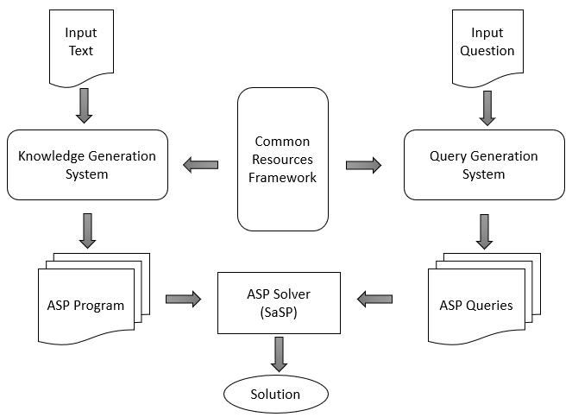
Components of the System
Common Resources Framework
Knowledge Generation System
Query Generation System
Architecture

Slide 7
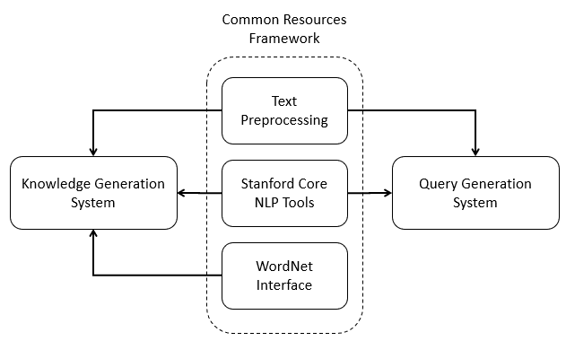
Common Resources Framework
Text Preprocessing Module
Handles compound nouns
Assumes co-reference resolution.
Corrects mis-tagged entities
Stanford Core NLP Tools
Analyze and understand text
Pipelining of sub-tools
Stanford-Core-NLP v3.9.1
WordNet API
Lexical DB for English
Extracts semantic relations
Java WordNet Interface (JWI)

Slide 8
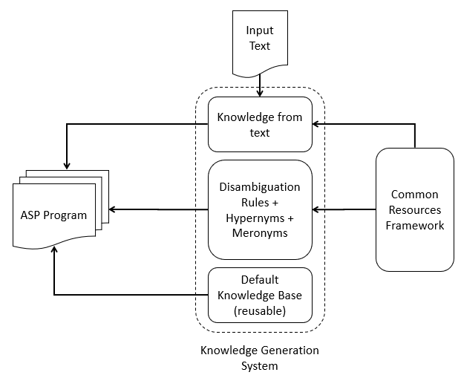
Knowledge Generation System
Knowledge Extraction from text
Generates facts and rules
Works on preprocessed text
Uses dependency parser
WordNet Ontology Generator
Hypernym Rules
Disambiguation Rules
Uses default reasoning patterns
Default Knowledge Base
Hand generated rules
Encodes implicit information

Slide 9
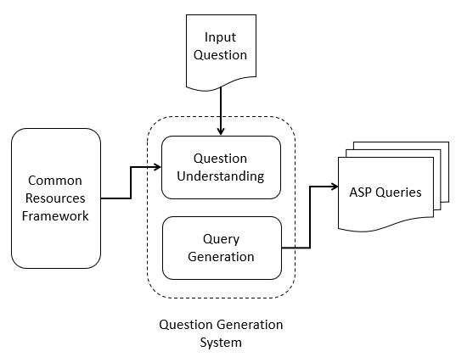
Query Generation System
Question Understanding
Extracts information from natural language question
Understands question type
(Wh-question), focus of the question
Query Generation
Uses information from previous module
Generates a set of queries representing the input question
Relaxes constraints on the queries to generate less accurate queries to make the system robust.

Slide 10
Software Development Approach
How is it built?

Slide 11
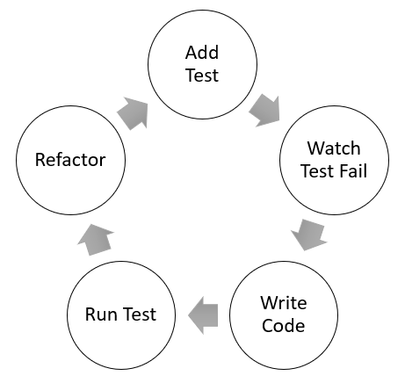
Test Driven Development
Development Cycle

Slide 12
Demo
Sample Article
“Nikola Tesla (10 July 1856 – 7 January 1943) was a Serbian American inventor, electrical engineer, mechanical engineer, physicist, and futurist best known for Nikola Tesla's contributions to the design of the modern alternating current (AC) electricity supply system.”
Q1. When did Tesla die?
Q2. Who was Nikola Tesla?

Slide 13
Answer Set Programming
What is ASP?

Slide 14
Answer Set Programming
Answer-Set Programming is a declarative problem-solving paradigm that uses non-monotonic reasoning and logic programming.
It is used in tasks such as modeling reasoning agents, non-monotonic inferences, common sense reasoning, planning problems, constraint satisfaction problem and so on.
An answer set program is a collection of statements that describe the objects of a domain and model relations between them.
The semantics of an ASP Program defines a set of possible beliefs that an agent has associated with the program called the answer set of the program
The basic constituents of an ASP program are the rules, facts and constraints that describe the problem.

Slide 15
Syntax

Slide 16
Semantics

Slide 17
Default Reasoning

Slide 18
Natural Language Resources
What NLP tools were used?

Slide 19
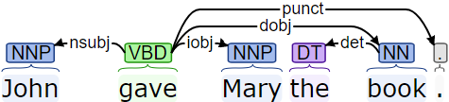
Stanford Core NLP Toolset
Stanford Dependency Parser
A dependency parser analyses the grammatical structure of a sentence and returns a set of relations between different words of the sentence.
Dependency Relations :
root(ROOT-0, gave-2)
nsubj(gave-2, John-1)
dobj(gave-2, book-5)
iobj (gave-2, Mary-3)
det(book-5, the-4)
punct(gave-4, .-6)
Example: “John gave Mary the book.”.

Slide 20

Stanford Core NLP Toolset
Parts of Speech Tagger
A Parts of Speech Tagger is responsible for assigning parts of speech to words in a sentence.
The English language has eight parts of speech: noun, verb, pronoun, preposition, adverb, conjunction, particle, and article.
The English tagger in the Stanford POS Tagger uses the Penn Treebank tag set.
Example: “John gave Mary the book.”.
Penn Treebank Tag Set
NNP : Proper Noun, Singular
VBD : Verb, Past tense
DT : Determiner
NN : Noun, Singular or Mass

Slide 21

Stanford Core NLP Toolset
Named Entity Recognizer
A Named Entity Recognizer is a module used to label a sequence of words in a sentence with predefined tags of Named Entities
Named Entities are names of things, such as person, company, organization, locations, cities and many more.
The various training models for the Stanford Named Entity Tagger are given as follows:
3 class: LOCATION, PERSON, ORGANIZATION
4 class: LOCATION, PERSON, ORGANIZATION, MISC
7 class: LOCATION, PERSON, ORGANIZATION, MONEY, PERCENT, DATE, TIME
Example: “John, who works at UTD, lives in Dallas.”.

