Slide 1
An Answer Set Programming based Approach To Representing and Querying Textual Knowledge
By
Dhruva Pendharkar

Slide 2
Outline
Motivation
System Architecture
Software Development Approach
Demo
ASP Syntax and Semantics
NLP Resources
7. Knowledge Representation
8. Other Knowledge Sources
9. Query Generation
10. Applications in Question Answering
11. Future Work
12. Conclusion

Slide 3
Motivation
Why Answer Set Programming?

Slide 4
Motivation

Slide 5
System Architecture
What makes up the system?

Slide 6
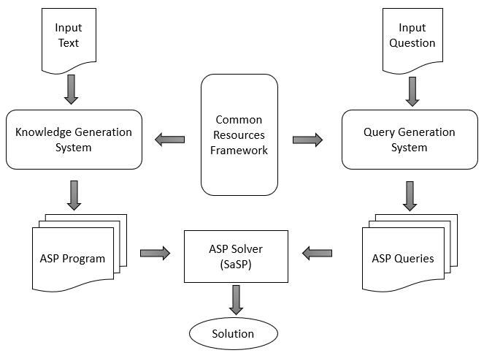
Components of the System
Common Resources Framework
Knowledge Generation System
Query Generation System
Architecture

Slide 7
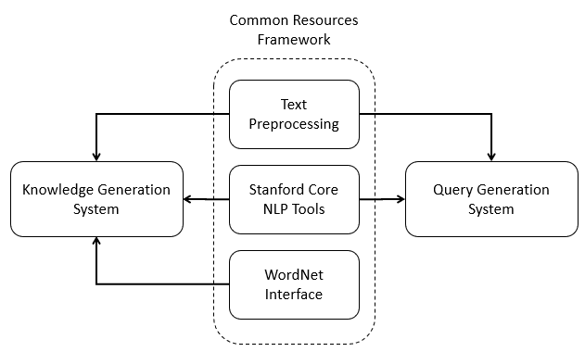
Common Resources Framework
Text Preprocessing Module
Handles compound nouns
Assumes co-reference resolution.
Corrects mis-tagged entities
Stanford Core NLP Tools
Analyze and understand text
Pipelining of sub-tools
Stanford-Core-NLP v3.9.1
WordNet API
Lexical DB for English
Extracts semantic relations
Java WordNet Interface (JWI)

Slide 8
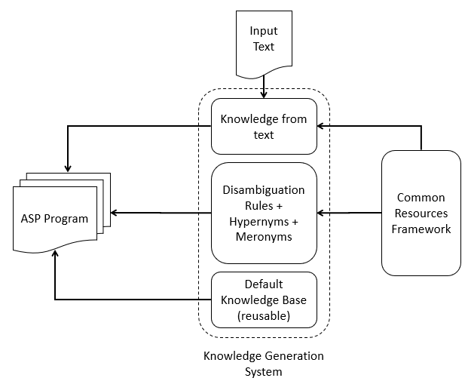
Knowledge Generation System
Knowledge Extraction from text
Generates facts and rules
Works on preprocessed text
Uses dependency parser
WordNet Ontology Generator
Hypernym Rules
Disambiguation Rules
Uses default reasoning patterns
Default Knowledge Base
Hand generated rules
Encodes implicit information

Slide 9
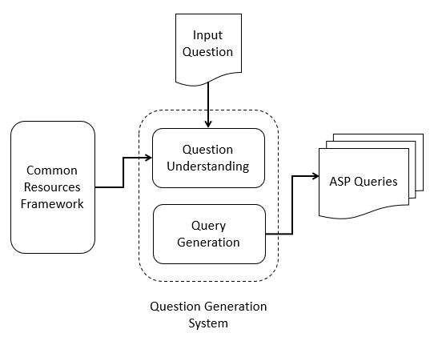
Query Generation System
Question Understanding
Extracts information from natural language question
Understands question type
(Wh-question), focus of the question
Query Generation
Uses information from previous module
Generates a set of queries representing the input question
Relaxes constraints on the queries to generate less accurate queries to make the system robust.

Slide 10
Software Development Approach
How is it built?

Slide 11
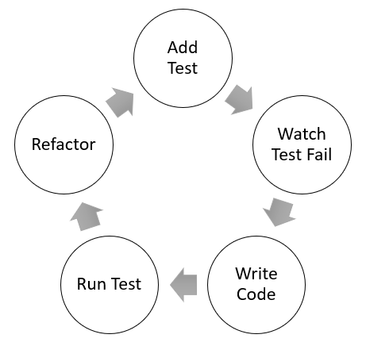
Test Driven Development
Development Cycle

Slide 12
Demo
Sample Article
“Nikola Tesla (10 July 1856 – 7 January 1943) was a Serbian American inventor, electrical engineer, mechanical engineer, physicist, and futurist best known for Nikola Tesla's contributions to the design of the modern alternating current (AC) electricity supply system.”
Q. When did Tesla die?
Q. Who was Nikola Tesla?

Slide 13
Natural Language Resources
What NLP tools were used?

