Slide 1


Bank of Baroda Hackathon - 2022
Technology Partner
Your Team Name : GLOGO
Your team bio : we develop solutions
Date :15/09/2022

Slide 2
Automated Cheque Processing
Why did you decide to solve this Problem statement?
After reading this problem statement, we expanded our investigation and produced facts and statistics.
So let's first discuss how important this solution is.
This technique will significantly reduce incidents where checks bounce for unfortunate reasons.
automation will accelerate the process to a very considerable extent.
an extremely stable synchronisation between the human and the machine to optimise output with a minimal number of clicks.
Interest
As CSE students, We are always ready to accept such a challenging task.Another important factor to choose this problem statement is that we have already worked on projects which can be used in this project such as corner edge detection model ,ocr and signature pattern recognition.

Slide 3
User Segment & Pain Points
Which user advertiser segment would be early adopter of your product & why?
Bank Employees - They finds difficulty to process every check and it’s very hard to understand every handwriting and their is high chance of cheque bounce which leads to penalty. So if this process is automated then there's less chance of cheque bouncing and save huge amount of time which will overall increase efficiency and quality of work.
Bank Account Users - Users will love to use this technology as an app to check is this is going to pass or it’ll bounce so they act accordingly before going to bank.

Slide 4
Pre-Requisite
What are the alternatives/competitive products for the problem you are solving?
Indirect Competition
Manual Cheque Checking
Alternatives
Online Net-Banking

Slide 5
Azure tools
Azure Tools:
Azure VMS to launch API’s on Public DNS
Azure GPU’s to train models

Slide 6
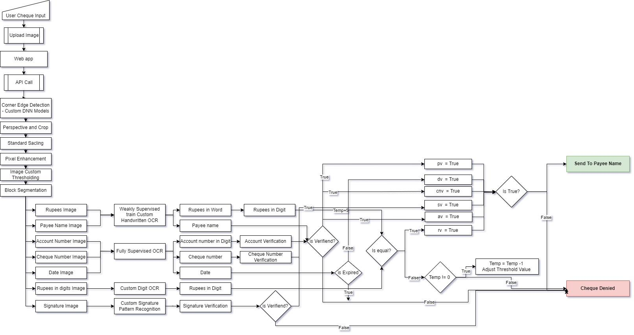
Supporting Functional Documents

Slide 7
Key Differentiators & Adoption Plan
advantage of our approach.
custom ai models with high accuracy.
strong pipeline.
custom filters (eg: can find out whose cheque get bounced).
Ai validated the check five times before cancellation .

Slide 8
GitHub Repository Link
https://github.com/Dhruvagwal/BOB---Cheque-Process-Automation/
https://github.com/Dhruvagwal/BOB---Cheque-Process-Automation/blob/main/archi.drawio.svg

Slide 9
Thank You
Team member names

