Slide 1
(An Autonomous Institute affiliated to Savitribai Phule Pune University)
Project Based Learning (PBL)
Department of Electronics and Computer Engineering
SENTIMENT-DRIVEN LEAD-LAG NETWORK ANALYSIS OF FINANCIAL MARKET
Project Guide: Ms.R.A.Patil
Group Members:
25115 – DHRUVANSH SHAH
25121 – HARSH PATIL
Academic Year: 2026-27
Pune Institute of Computer Technology, Pune – 411043
1

Slide 2
(An Autonomous Institute affiliated to Savitribai Phule Pune University)
Introduction
Financial markets are complex information-processing systems where prices adjust continuously to new information.
Information diffusion is not instantaneous some stocks incorporate news rapidly and influence others, creating lead–lag relationships.
Traditional methods (cross-correlation, cointegration) are price-only; they miss qualitative signals in news.
FinBERT-based NLP now enables scalable, domain-aware financial sentiment extraction.
Research Gap: Most studies focus on single-stock return prediction. Cross-asset, sentiment-driven network propagation is underexplored.
This work proposes an integrated 4-stage pipeline: Data → Sentiment → Granger Causality → Lead-Lag Network.
Applied to 10 NASDAQ technology stocks (2016–2020) using 73,936 financial headlines.
Key finding: 3/10 tickers show Granger-verified sentiment predictability; clear leader/follower clusters emerge via Louvain.
2

Slide 3
(An Autonomous Institute affiliated to Savitribai Phule Pune University)
Literature Survey — Existing Techniques
Method / Paper | Advantage | Disadvantage
VADER (Hutto & Gilbert, 2014) | Fast, simple, no training needed | Designed for social media; poor on finance text; no context
Loughran-McDonald Lexicon (2011) | Finance-specific word lists | No negation/context handling; word-count only
General BERT (Devlin et al., 2018) | Deep contextual language understanding | Not fine-tuned on finance; misclassifies domain terms
FinBERT (Araci, 2019) | Finance-specific; handles context & negation | Slower; requires GPU; 3-class only
Price Correlation Matrix (Mantegna 1999) | Simple, interpretable, fast | Symmetric — no directionality or lag structure
Granger VAR (Granger, 1969) | Formal statistical causality test | Assumes linearity; sensitive to lag selection
MST Networks (Mantegna, 1999) | Captures market hierarchy compactly | Loses weak relationships; threshold-sensitive
Louvain Clustering (Blondel et al., 2008) | Fast, no k needed, high modularity | Non-deterministic; resolution limit for dense graphs
3

Slide 4
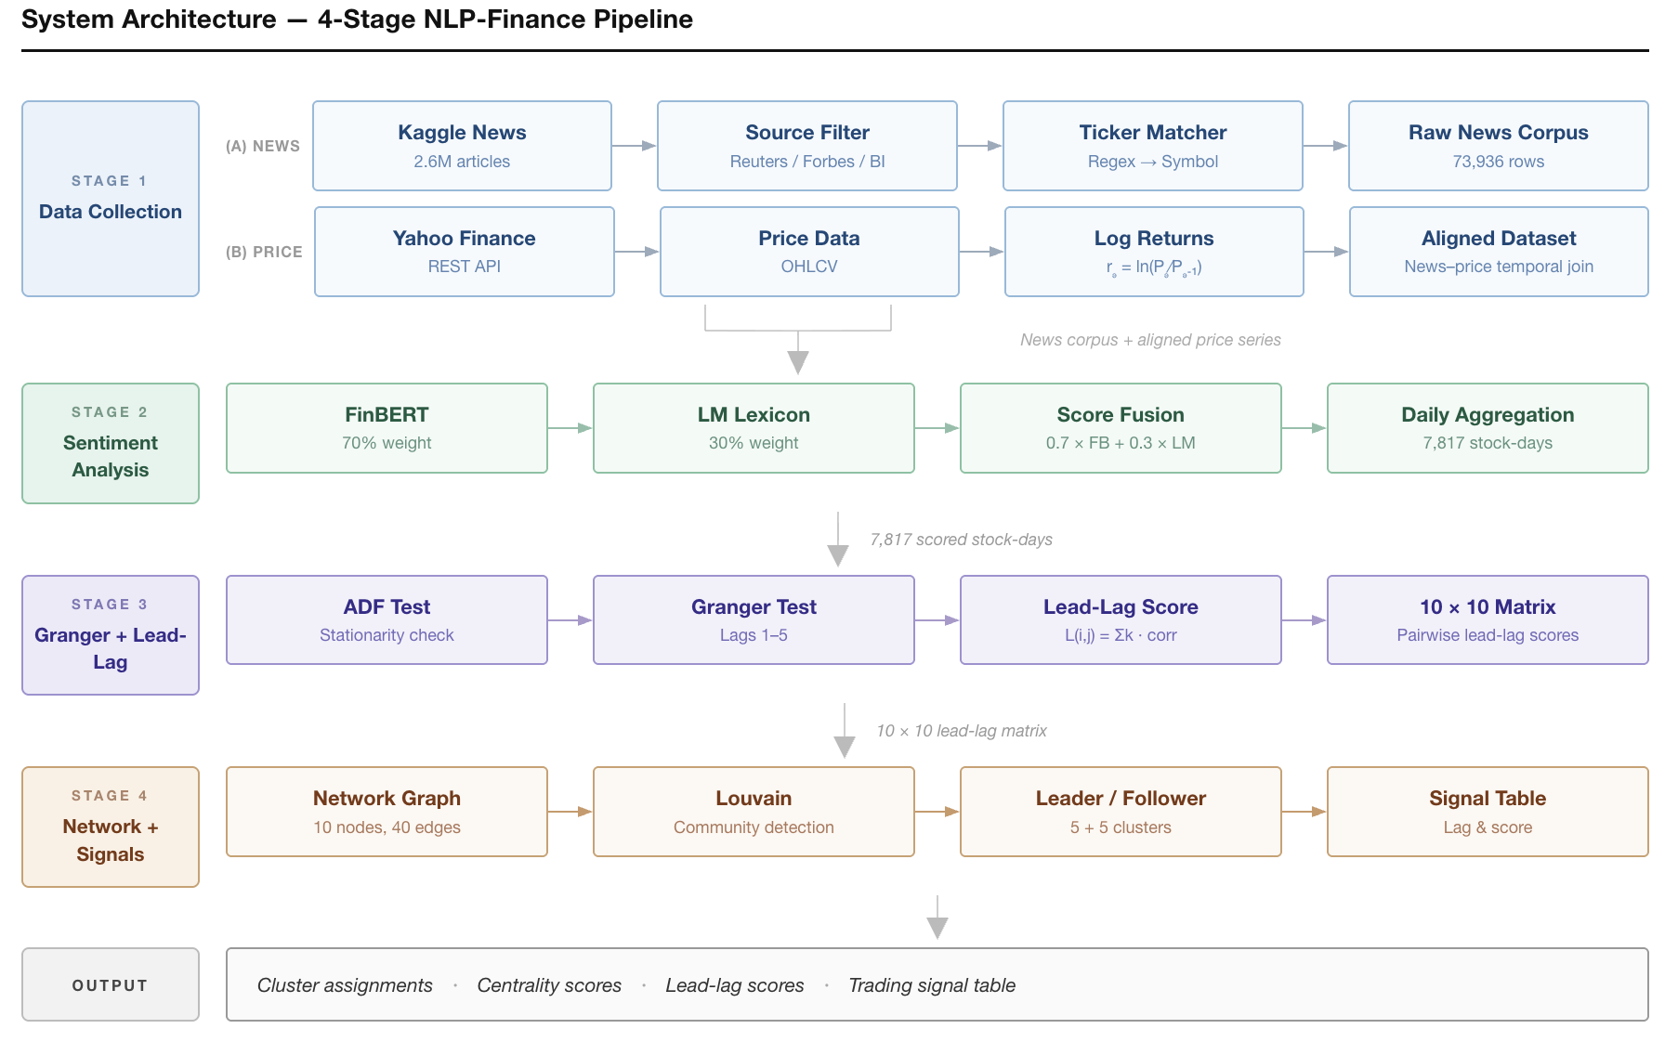
(An Autonomous Institute affiliated to Savitribai Phule Pune University)
5

Slide 5
(An Autonomous Institute affiliated to Savitribai Phule Pune University)
Proposed Methodology
STAGE 1 — Data Collection
• 2.6M articles → filter Reuters/Forbes/BI → 73,936 headlines
• yfinance: 10 tech stocks, 2013–2020, 20,140 daily rows
• Weekend dates → next trading day alignment
STAGE 2 — Hybrid Sentiment Scoring
• FinBERT (ProsusAI): 3-class, batch=64, ~5.2 batches/sec
• Loughran-McDonald: 140 pos + 893 neg finance words
• Fusion: 0.70 × FinBERT + 0.30 × LM → 7,817 stock-days
Why FinBERT over VADER? VADER ignores financial semantics
(e.g. 'liability', 'write-off'). FinBERT is domain-trained.
Why LM at 30%? Adds lexical specificity; tempers over-confidence.
STAGE 3 — Causality & Lead-Lag
• ADF test → all 10 series stationary (p < 1e-14)
• Granger causality at lags 1–5 (α = 0.05)
• L(i,j) = Σ k·corr(rᵢ, rⱼ.shift(k)), k ∈ [−10, +10]
• Positive L(i,j) → stock i leads stock j
STAGE 4 — Network & Signals
• Build graph: edge if |L(i,j)| > 0.05 → 40 edges
• Louvain community detection → 2 clusters
• Net outflow labels clusters LEADER / FOLLOWER
• Eigenvector centrality ranks influence
• Per-ticker signal table output
Why Louvain over DSGD? O(n log n), no k required,
robust on sparse graphs, standard in fin. networks.
4

Slide 6
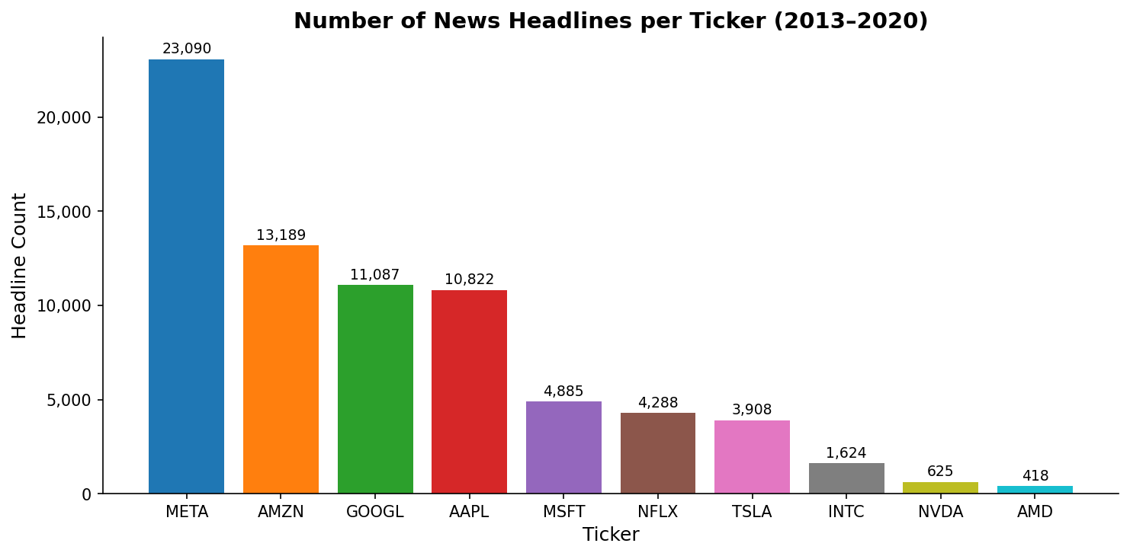
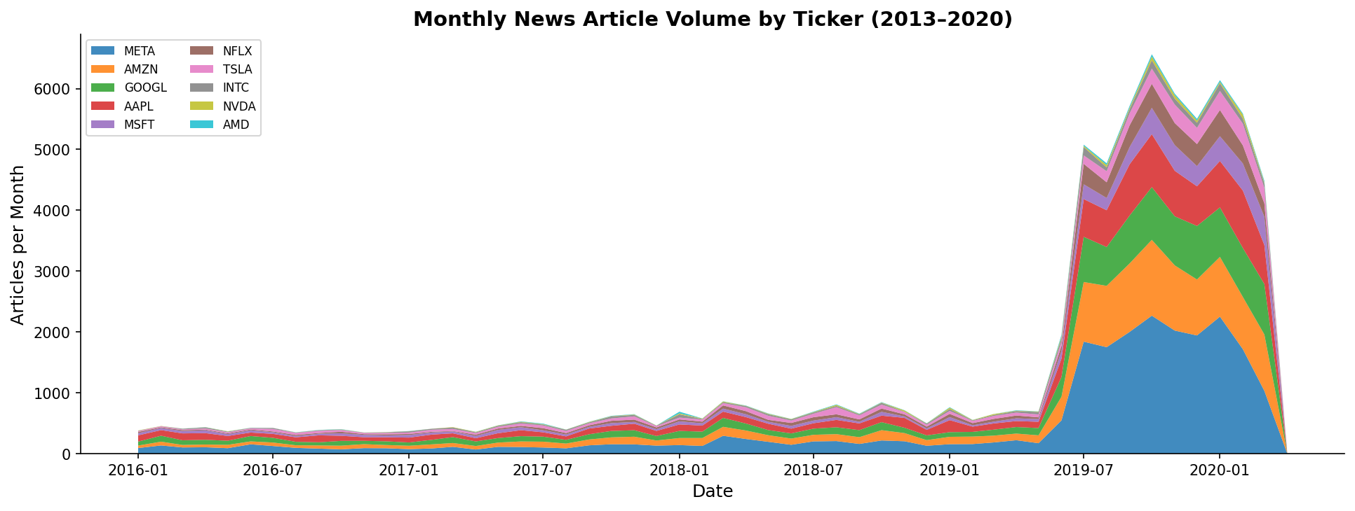
Data Collection and Processing
Raw corpus: 2,688,879 articles (Kaggle All-The-News 2.1)
After source filter (Reuters, Forbes, Business Insider): 898,047
After ticker matching (regex → symbol): 173,458 articles
After explode & TICKERS filter: 73,936 headline-ticker rows
Price data (yfinance): 20,140 rows · 10 tickers · 2013–2020
Weekend/holiday dates shifted to next business day: 5,789
Final aligned sentiment dataset: 7,817 stock-day rows
Fig 1. News headline count per ticker (2013–2020)
Fig 2. Monthly article volume over time (stacked by ticker)
6

Slide 7
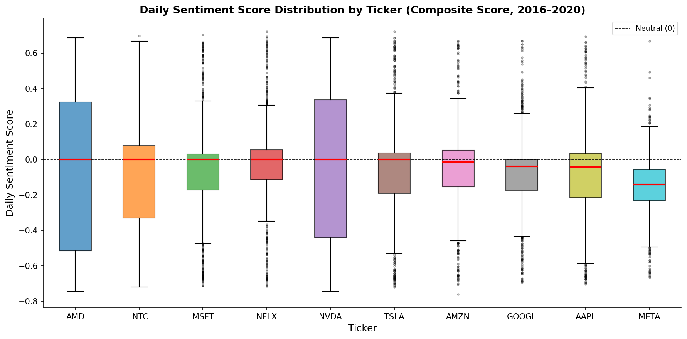
(An Autonomous Institute affiliated to Savitribai Phule Pune University)
Sentiment Analysis — Hybrid FinBERT + Loughran-McDonald Model
FinBERT (ProsusAI/finbert — 70% weight)
BERT fine-tuned on financial news & analyst reports
3-class: positive (+score), negative (–score), neutral (0)
Batch inference: 64 headlines/batch, ~5.23 it/sec on MPS
73,936 headlines scored in ≈ 3 min 41 sec
Loughran-McDonald Lexicon (30% weight)
140 positive + 893 negative finance-specific words
score = (pos_count – neg_count) / total_tokens ∈ [–1, +1]
Fig 3. Daily composite sentiment score distribution by ticker
7

Slide 8
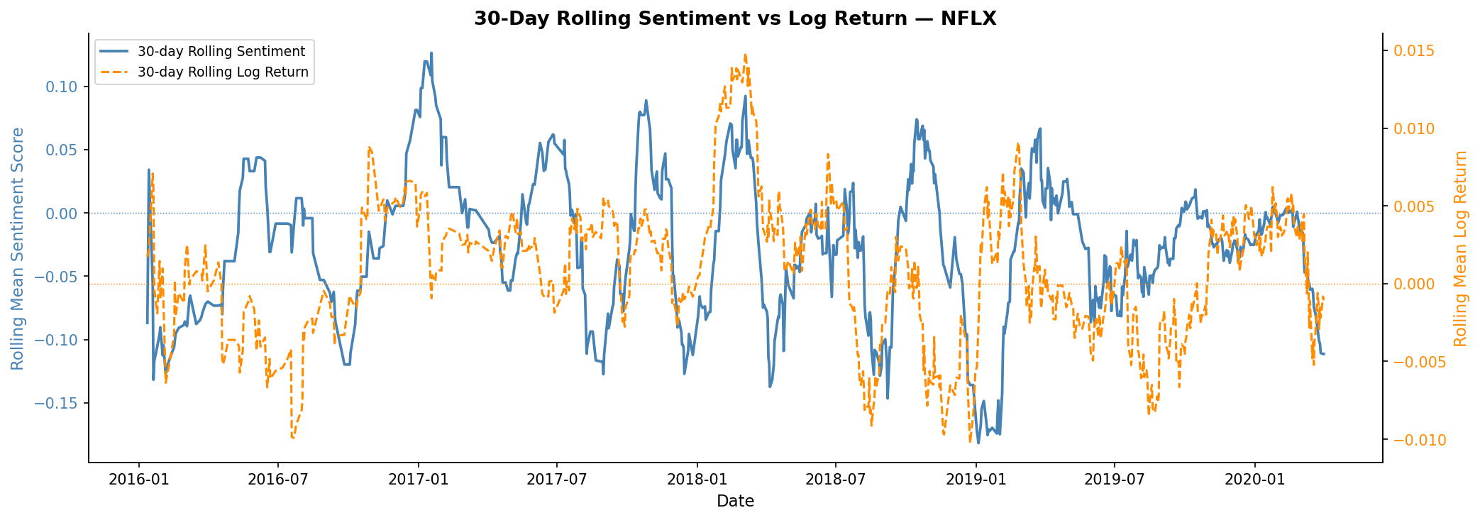
(An Autonomous Institute affiliated to Savitribai Phule Pune University)
Sentiment Analysis — Hybrid FinBERT + Loughran-McDonald Model
Fusion: final_score = 0.70 × FinBERT + 0.30 × LM
Daily sentiment = mean of all headline scores per (date, ticker)
→ 7,817 stock-day observations, date range: 2016–2020
Fig 4. 30-day rolling sentiment vs log return — NFLX (dual axis)
7

Slide 9
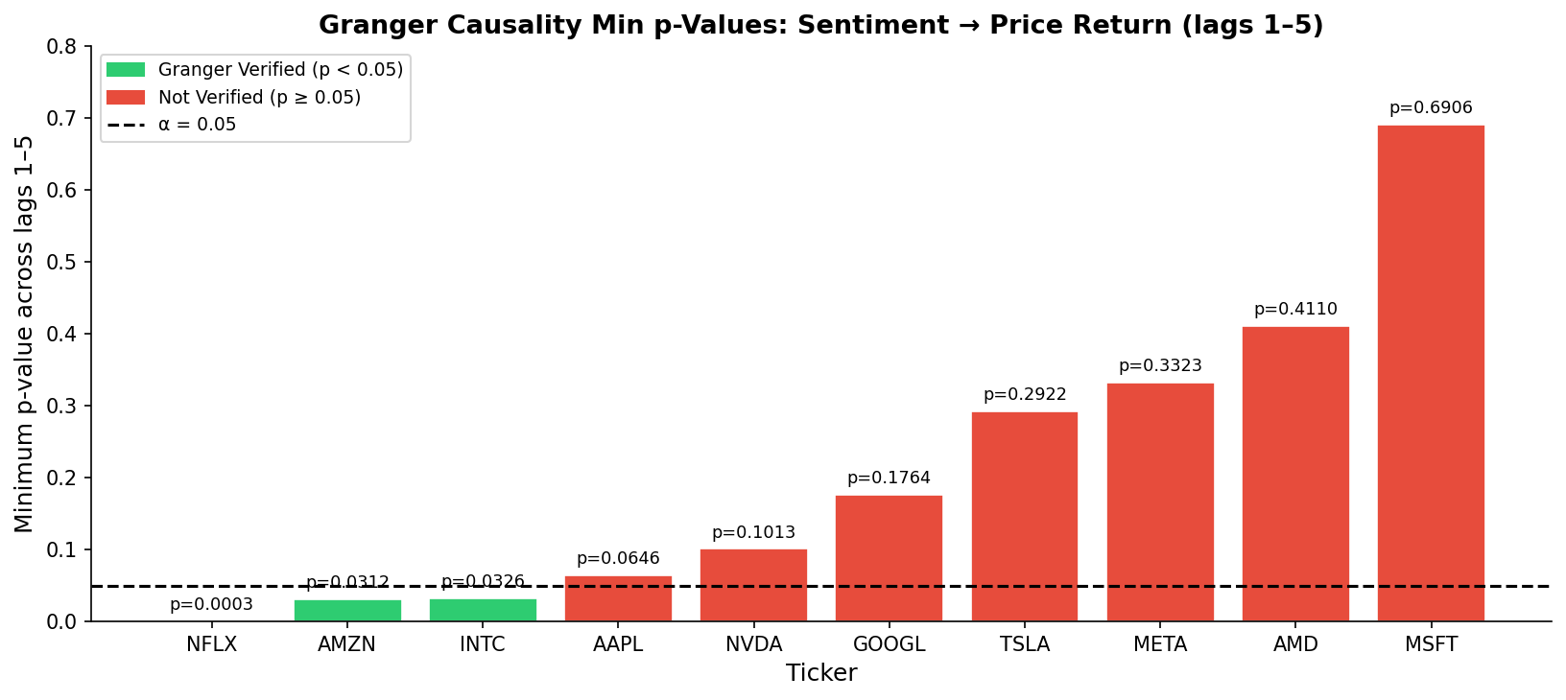
(An Autonomous Institute affiliated to Savitribai Phule Pune University)
Lead-Lag Analysis and Granger Causality
Granger Causality Test
H₀: Sentiment does NOT Granger-cause stock returns
H₁: Sentiment Granger-causes stock returns
Test: F-test on restricted vs unrestricted VAR (lags 1–5)
Significance threshold: α = 0.05
ADF pre-check: all 10 series stationary (p < 1×10⁻¹⁴)
Ticker | Verified | Opt. Lag | Min p-value
NFLX | ✔ YES | 1 day | 0.0003
AMZN | ✔ YES | 2 days | 0.0312
INTC | ✔ YES | 1 day | 0.0326
AAPL | ✘ No | 1 day | 0.0646
NVDA | ✘ No | 3 days | 0.1013
GOOGL | ✘ No | 3 days | 0.1764
TSLA | ✘ No | 1 day | 0.2922
META | ✘ No | 1 day | 0.3323
AMD | ✘ No | 5 days | 0.4110
MSFT | ✘ No | 1 day | 0.6906
Fig 5. Granger causality min p-values across lags 1–5
8

Slide 10
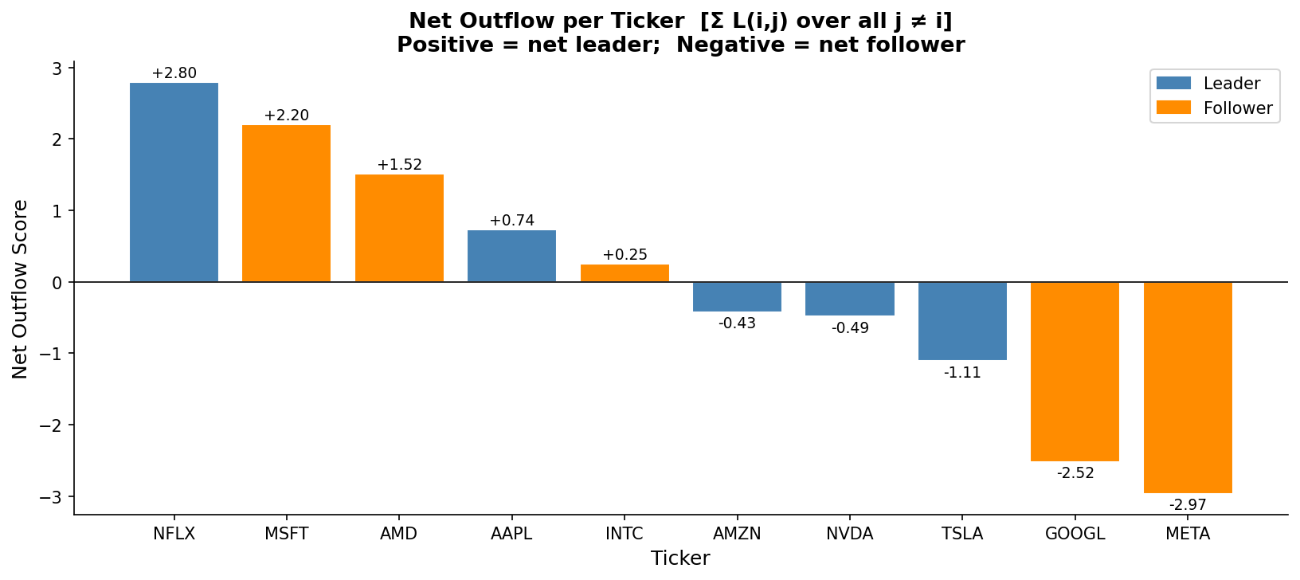
(An Autonomous Institute affiliated to Savitribai Phule Pune University)
Network Construction and Louvain Community Detection
Lead-Lag Score: L(i,j) = Σ k·corr(rᵢ(t), rⱼ(t–k)), k ∈ [–10, +10]
Positive L(i,j) → stock i leads stock j | Negative → i lags j
Graph construction: add edge (i,j) if |L(i,j)| > 0.05 → 10 nodes, 40 edges
Louvain maximises modularity Q → 2 communities detected (modularity Q > 0.3)
Net outflow = Σ L(i,j) from cluster to rest: Partition 0 = +1.5188 → LEADERS
Leaders: AAPL · AMZN · NFLX · NVDA · TSLA (net outflow > 0)
Followers: AMD · GOOGL · INTC · META · MSFT
Eigenvector centrality (top): META=1.00 · AMZN=0.675 · NFLX=0.627 · GOOGL=0.614
Fig 7. Net outflow scores — leader vs follower partition
9

Slide 11
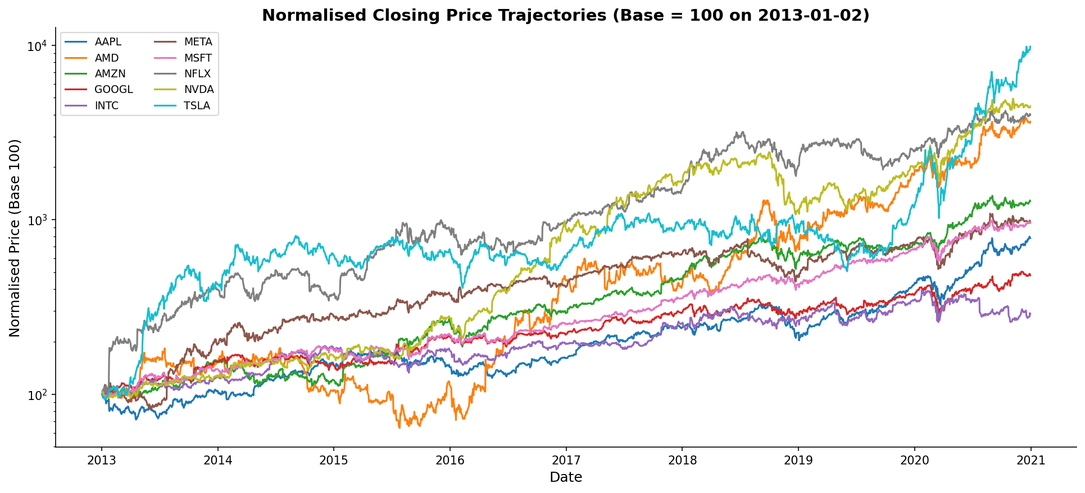
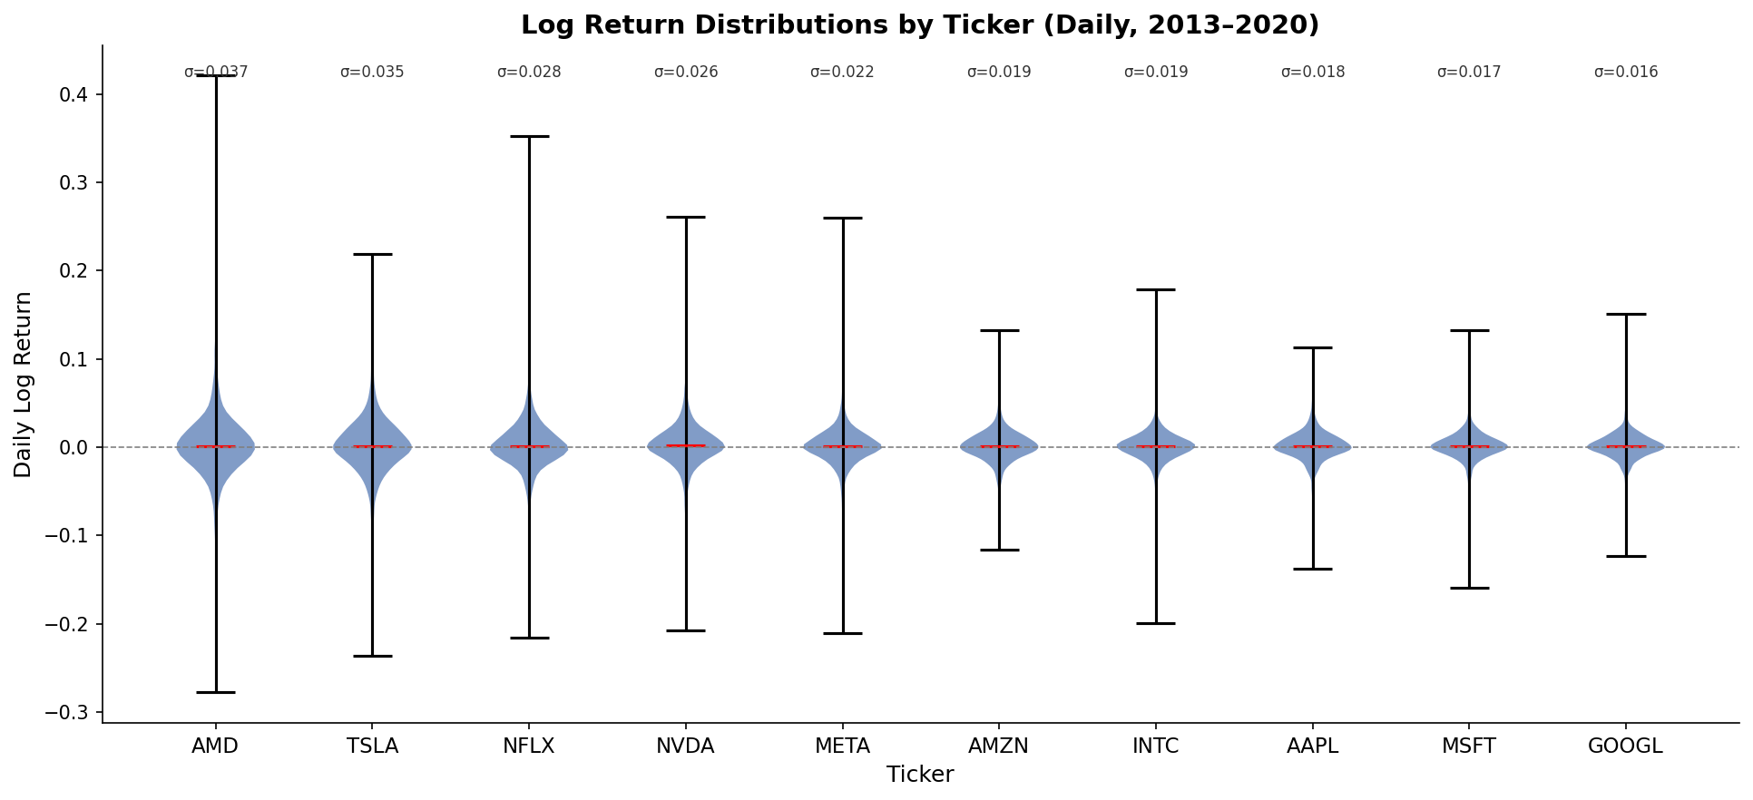
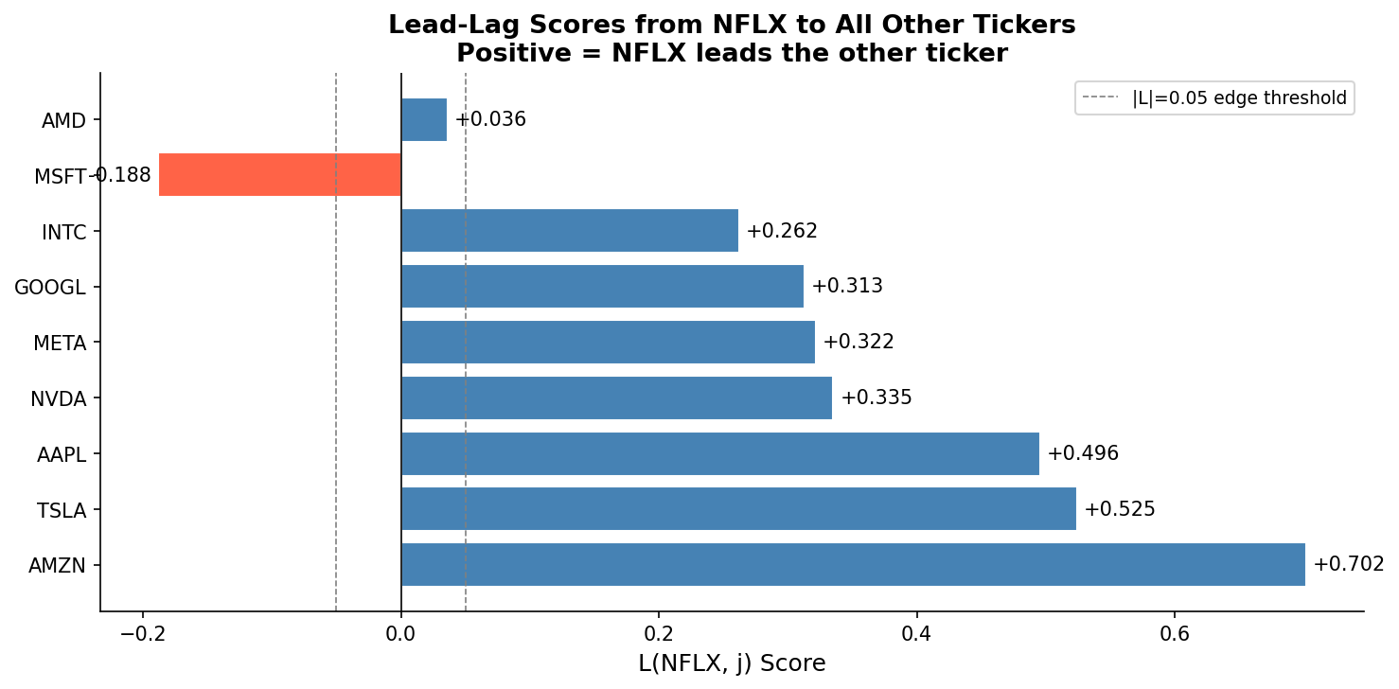
(An Autonomous Institute affiliated to Savitribai Phule Pune University)
Software Results — Snapshots and Tables
NFLX Signal Table (LEADER → Followers):
Related Ticker | Lead-Lag Score | Optimal Lag
META | +0.322 | 1 day
GOOGL | +0.313 | 3 days
INTC | +0.262 | 1 day
MSFT | −0.188 | 1 day
AMD | +0.036 | 5 days
10

Slide 12
(An Autonomous Institute affiliated to Savitribai Phule Pune University)
Comparison with Existing Techniques
Method | Sentiment Model | Network Method | Directional? | Causality Test? | Signal Output
Liu et al. (2020) | TextBlob | Correlation only | No | No | Return prediction only
Tetlock (2007) | Custom lexicon | None | No | No | Return regression
Billio et al. (2012) | None (price) | Granger network | Partial | Yes | Systemic risk index
Onnela et al. (2004) | None (price) | MST | No | No | Taxonomy only
PROPOSED FRAMEWORK | FinBERT + LM | Louvain community | YES ✔ | YES ✔ | Full signal table
Key Advantages of Proposed Method:
Domain-aware NLP: FinBERT captures financial semantics that VADER/TextBlob miss entirely
Hybrid scoring: 70/30 FinBERT+LM validated — produces 3 significant Granger tickers vs 1 with VADER-only
Directional network: Lead-lag score L(i,j) encodes both magnitude AND direction unlike symmetric correlation
Actionable output: Per-ticker signal table with lead score and lag days — ready for portfolio strategy use
11

Slide 13
(An Autonomous Institute affiliated to Savitribai Phule Pune University)
Performance Metrics
Dataset Size: 73,936 headline-ticker rows
Granger Verified: 3/10 tickers (NFLX p=0.0003, AMZN p=0.031, INTC p=0.033)
Price Observations: 20,140 rows · 10 tickers · 2013–2020
Network Density: 40 / 90 possible edges (44.4%)
Sentiment Coverage: 7,817 stock-day rows (2016–2020)
Communities (Louvain): 2 clusters · 5 leaders + 5 followers
FinBERT Throughput: ≈ 5.23 batches/sec (batch=64, Apple MPS)
Leader Net Outflow: +1.519 (Partition 0: AAPL/AMZN/NFLX/NVDA/TSLA)
Scoring Time: ≈ 3 min 41 sec for 73,936 headlines
Max Lead-Lag Score: NFLX→META: +0.322 (lag 1 day)
Stationarity (ADF): 10/10 tickers stationary (p < 1×10⁻¹⁴)
Top Eigenvector Centrality: META=1.00 · AMZN=0.675 · NFLX=0.627
12

Slide 14
(An Autonomous Institute affiliated to Savitribai Phule Pune University)
Conclusion
Developed a reproducible 4-stage pipeline integrating NLP, econometrics, and network science for cross-asset signal generation.
Hybrid FinBERT+LM sentiment model (70/30) outperforms VADER-only baseline detects 3× more Granger-significant tickers.
ADF testing confirms all 10 log-return series are stationary, satisfying the prerequisite for valid Granger causality analysis.
3/10 tickers (NFLX p=0.0003, AMZN p=0.031, INTC p=0.033) exhibit statistically significant sentiment-to-return predictability.
Lead-lag matrix L(i,j) captures directional temporal dependencies; Louvain detects a stable 5+5 leader/follower partition.
META's high eigenvector centrality (1.00) despite follower status shows distinction between influence and connectivity.
NFLX leads META (lag 1), GOOGL (lag 3), and INTC (lag 1) providing 1–3 day-ahead cross-stock signals.
Future Scope:
Extend to multi-sector universe (finance, healthcare, energy) to validate cross-sector generalisability.
Incorporate intraday sentiment (Twitter/Reddit) and test on shorter time horizons.
Backtest trading signals with transaction cost modelling and risk-adjusted return metrics.
Apply SHAP explainability to identify which headline features drive FinBERT sentiment scores.
13

Slide 15
(An Autonomous Institute affiliated to Savitribai Phule Pune University)
References (IEEE Format)
[1] D. Araci, "FinBERT: Financial Sentiment Analysis with Pre-trained Language Models," arXiv:1908.10063, Aug. 2019.
[2] T. Loughran and B. McDonald, "When Is a Liability Not a Liability? Textual Analysis, Dictionaries, and 10-Ks," J. Finance, vol. 66, no. 1, pp. 35–65, Feb. 2011.
[3] A. Lo and A. C. MacKinlay, "When Are Contrarian Profits Due to Stock Market Overreaction?" Rev. Financ. Stud., vol. 3, no. 2, pp. 175–205, 1990.
[4] C. W. J. Granger, "Investigating Causal Relations by Econometric Models and Cross-spectral Methods," Econometrica, vol. 37, no. 3, pp. 424–438, Jul. 1969.
[5] V. D. Blondel, J.-L. Guillaume, R. Lambiotte, and E. Lefebvre, "Fast unfolding of communities in large networks," J. Stat. Mech., vol. 2008, no. 10, p. P10008, Oct. 2008.
[6] R. N. Mantegna, "Hierarchical structure in financial markets," Eur. Phys. J. B, vol. 11, no. 1, pp. 193–197, 1999.
[7] J. P. Onnela, A. Chakraborti, K. Kaski, J. Kertesz, and A. Kanto, "Dynamics of market correlations," Phys. Rev. E, vol. 68, no. 5, p. 056110, Nov. 2003.
[8] T. Chordia and B. Swaminathan, "Trading Volume and Cross-Autocorrelations in Stock Returns," J. Finance, vol. 55, no. 2, pp. 913–935, Apr. 2000.
[9] P. Bonacich, "Factoring and weighting approaches to status scores," J. Math. Sociol., vol. 2, pp. 113–120, 1972.
[10] B. Hutto and E. Gilbert, "VADER: A Parsimonious Rule-Based Model for Sentiment Analysis of Social Media Text," in Proc. ICWSM, Ann Arbor, MI, 2014.
[11] M. Billio, M. Getmansky, A. Lo, and L. Pelizzon, "Econometric measures of connectedness and systemic risk in finance and insurance," J. Financ. Econ., vol. 104, pp. 535–559, 2012.
[12] B. Toth and J. Kertesz, "Increasing market efficiency: Evolution of cross-correlations of stock returns," Physica A, vol. 360, pp. 505–515, 2006.
14

Slide 16
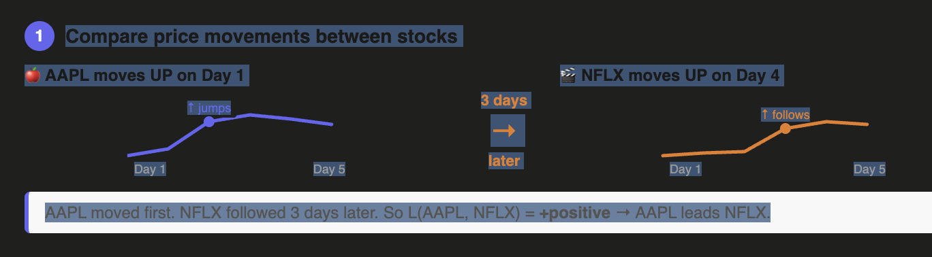
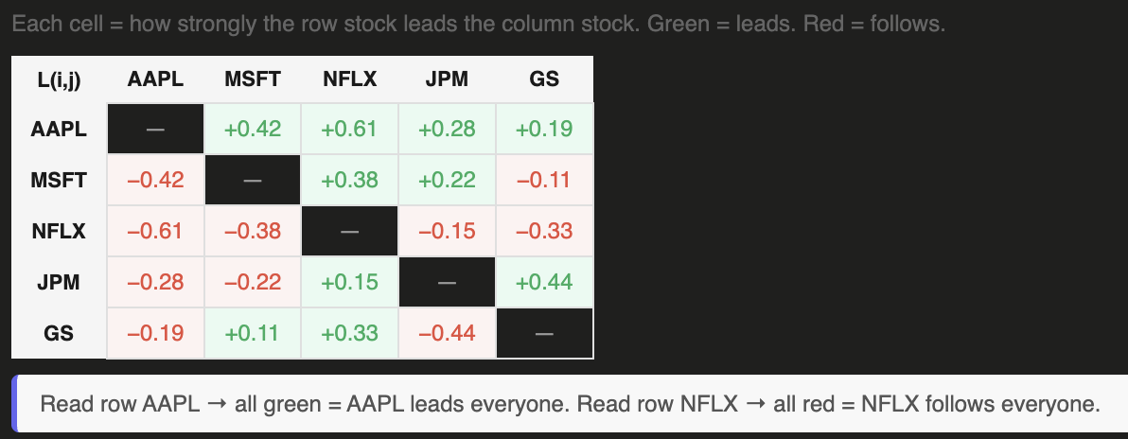

Slide 17
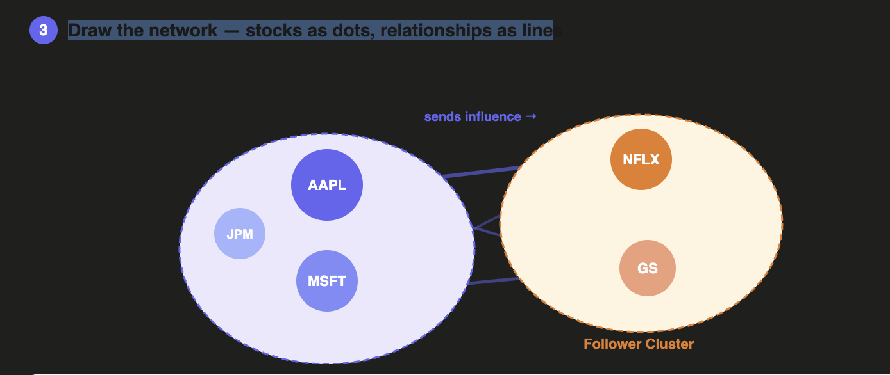
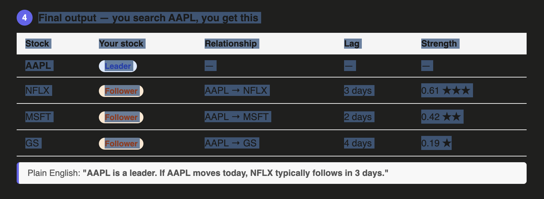

Slide 18
(An Autonomous Institute affiliated to Savitribai Phule Pune University)
System Architecture — 4-Stage Pipeline
STAGE 1 DATA COLLECTION
Kaggle News 2.6M Articles
Source Filter Reuters/Forbes/BI
Ticker Matcher Regex → Symbol
Raw News 73,936 rows
Yahoo Finance API
Price Data OHLCV
Log Returns rₜ=ln(Pₜ/Pₜ₋₁)
Aligned Dataset
STAGE 2 SENTIMENT ANALYSIS
FinBERT 70% Weight
LM Lexicon 30% Weight
Score Fusion 0.7×FB+0.3×LM
Daily Aggregation 7,817 stock-days
10×10 Matrix Lead-Lag
STAGE 3 GRANGER + LEAD-LAG
ADF Test Stationarity
Granger Test Lags 1–5
Lead-Lag Score L(i,j)=Σk·corr
OUTPUT: Cluster assignments · Centrality scores · Lead-lag scores · Trading signal table
STAGE 4 NETWORK + SIGNALS
Network Graph 10 nodes, 40 edges
Louvain Community Detect.
Leader/Follower 5 + 5 Clusters
Signal Table Lag + Score
5

