Slide 1
Smart attendance System based on facial Recognition
CSE523 Machine Learning
Course Instructor : Prof. Mehul Raval

Slide 2
Introduction
Any organization, either large or small, requires an employee attendance tracking system for effective maintenance of projects and tasks. It is essential for the management to have records of the time and attendance of each employee to handle discrepancies and variations within the organization.so we are making facial recognition attendance system.
A facial recognition system is a computerized biometric software which is suited for determining or validating a person by performing comparison on patterns based on their facial appearances.

Slide 3

Problem Statement
The purpose of this project is to create a model which integrates a camera that captures an input image, an algorithm for detecting face from an input image, encoding and identifying the face, marking the attendance in a spreadsheet.
Given still or video images of a scene identify or verify one or more person in the scene using a stored databases of faces.
The project can be divided into three parts, first part is face detection , second part is face recognition and the third part is marking attendance in spreadsheet.

Slide 4
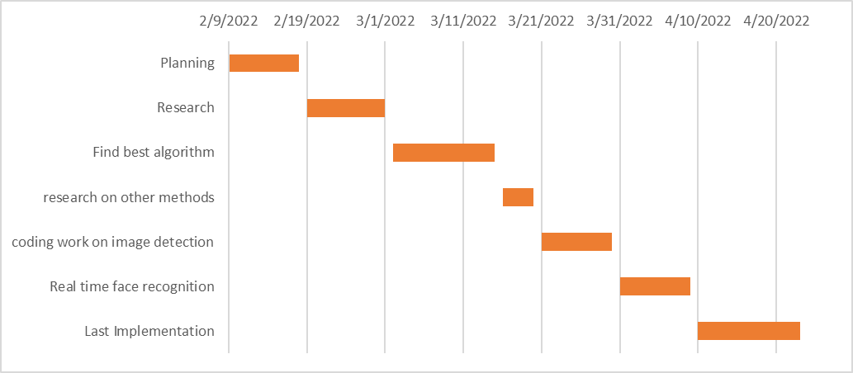
Gantt Chart:

Slide 5
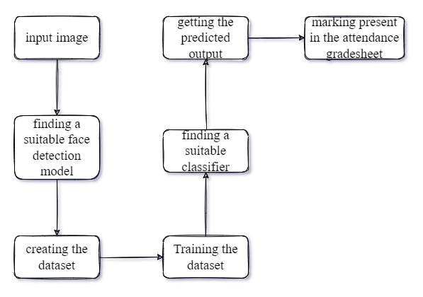
APPROACH

Slide 6
Approach:
Dataset:
Image size for best results :600x600
Here dataset is created with webcam’s image extraction fed .
classes: 3
Samples: 150
We explored many models such as viola jones,
Eigenface , and HOG for face detection and
datasets LFW,Caltech 101.
HOG provides more accurate results on frontal
image and utilises less compatibility

Slide 7
Face Detection using HOG:
Detecting a face from an image using HOG method requires the following steps to be followed :-
Calculate the Gradient Images
Compute the HOG
Feeding the vector into classifier

Slide 8
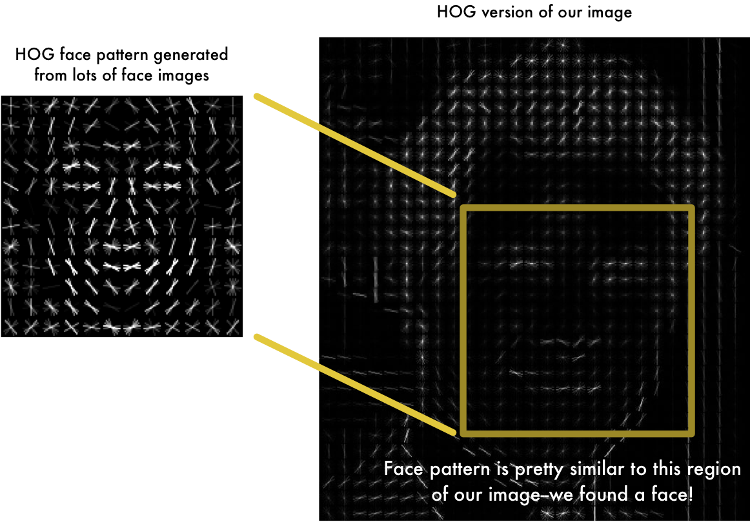
Face Detection :
After researching for processing video as input descriptor such as viola jones are more robust with its which reflects in processing time.

Slide 9
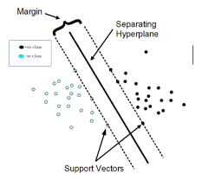
Face Recognition:
Establishing matches with SVM classifier

Slide 10
SVM Classifier:
SVM maps training examples to points in space so as to maximize the width of the gap between the two categories.
We demonstrate our SVM-based algorithm on both verification and identification applications. In identification, the algorithm is presented with an image of an unknown person. The algorithm reports its best estimate of the identity of an unknown person from a dataset of known individuals.

Slide 11

Results:
Here in less lights model is able to detect and recognise the image ,

Slide 12
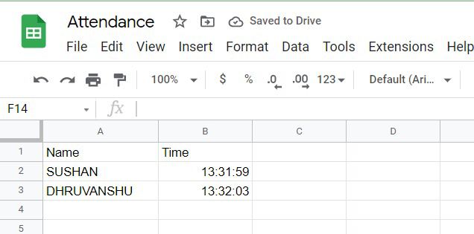
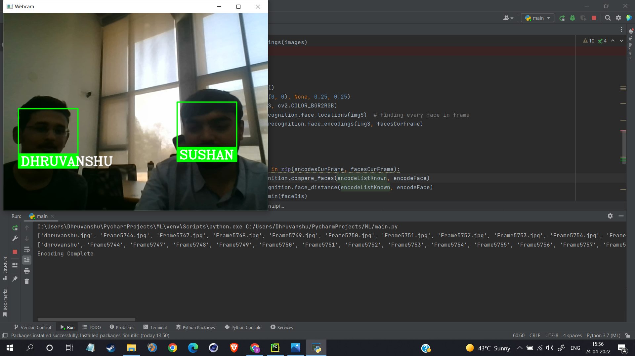

Multiple Detection at the same time:
Attendance Spreadsheet:

Slide 13
Conclusion
Our model supports face detection and recognition on real time webcam fed with time stamping and name from dataset and providing csv file of output ,drawbacks of frontal image side processing only while supporting multiple faces and side angles of faces.

Slide 14
Contribution
 | RESEARCH | IMPLEMENTATION | CODING | REPORT | PPT
SUSHAN | YES | NO | YES | NO | YES
PRIYA | YES | YES | YES | NO | NO
DHRUVANSHU | YES | NO | YES | YES | NO

Slide 15
References:
[1 ]
F. Schroff, D. Kalenichenko and J. Philbin, "FaceNet: A unified embedding for face recognition and clustering," 2015 IEEE Conference on Computer Vision and Pattern Recognition (CVPR), 2015, pp. 815-823, doi: 10.1109/CVPR.2015.7298682.
[2]
Taskiran, M., Kahraman, N. and Erdem, C.E., 2020. Face recognition: Past, present and future (a review). Digital Signal Processing, 106, p.102809.
[3]
N. Dalal and B. Triggs, "Histograms of oriented gradients for human detection," 2005 IEEE Computer Society Conference on Computer Vision and Pattern Recognition (CVPR'05), 2005, pp. 886-893 vol. 1, doi: 10.1109/CVPR.2005.177.
(Working of HOG as human detection descriptor)
[4]
Liya Ding and A. M. Martinez, "Precise detailed detection of faces and facial features," 2008 IEEE Conference on Computer Vision and Pattern Recognition, 2008, pp. 1-7, doi: 10.1109/CVPR.2008.4587812.
(How land estimation is key factor for achieving accuracy in video processing via precise detection of key facial
features.)

Slide 16
THANK
YOU!

