Slide 1
Financial Data Performance Analysis
Professional Data Insights & Visualizations
Presented by: Data Analyst AI

Slide 2
Dataset Overview
- Source: financial_data.csv
- Total Records: 700 entries
- Key Fields: Segment, Country, Product, Sales, Profit, Date, Units Sold.
- Period: 2013 - 2014.

Slide 3
Data Cleaning Summary
- Column names stripped of whitespace.
- Currency symbols ($, ,) removed and converted to floats.
- Handled negative values represented by parentheses.
- Date column converted to standard datetime format.
- String categories standardized.

Slide 4
Executive Summary: Key Metrics
- Total Sales: $118.7M
- Total Profit: $16.89M
- Total Units Sold: 1.12M units
- Average Profit Margin: 14.23%
- Leading Market: USA
- Top Selling Product: Paseo

Slide 5
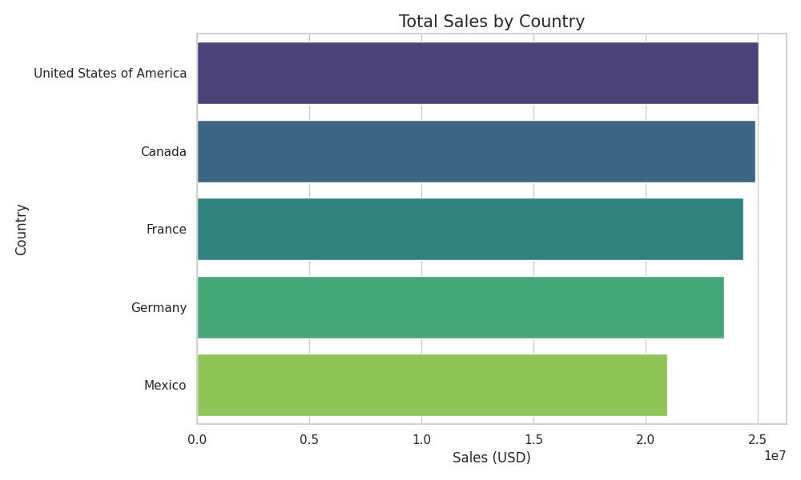
Sales by Country
- USA leads with the highest total sales volume.
- Canada and France show strong, competitive sales.
- Germany and Mexico also contribute significantly to the global revenue mix.

Slide 6
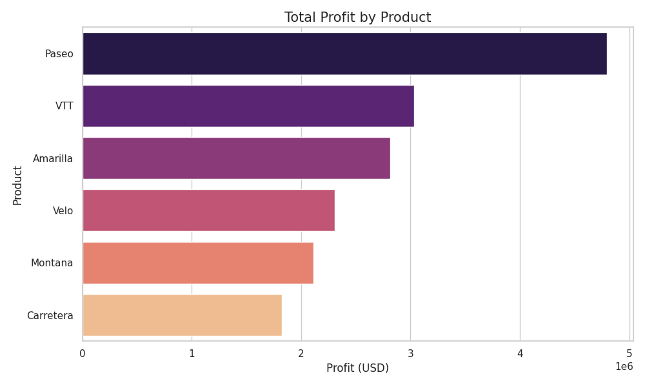
Profit by Product
- 'Paseo' is the most profitable product line.
- 'VTT' and 'Velo' are strong secondary contributors.
- Profitability varies significantly across the product portfolio.

Slide 7
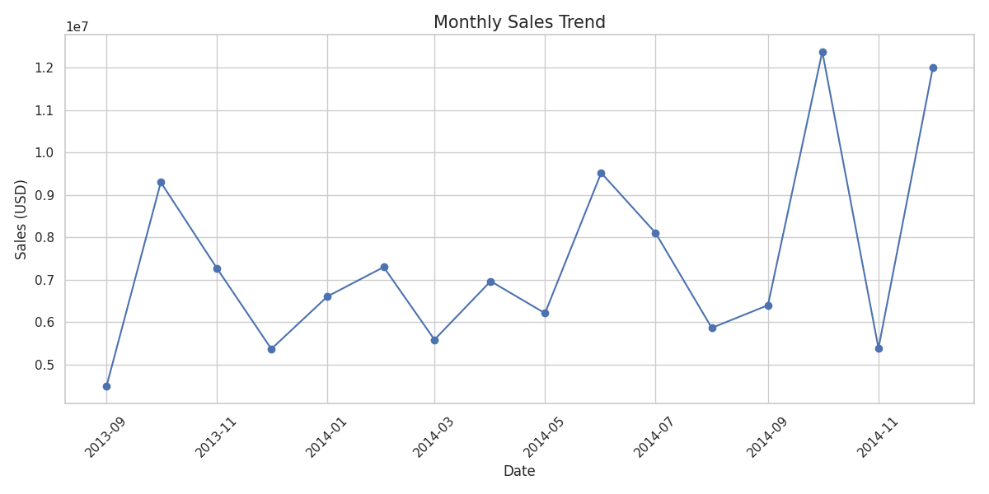
Monthly Sales Trend
- Notable spikes in sales volume during specific months (likely Q4 seasonality).
- Fluctuations suggest promotional periods or cyclical demand patterns.
- Overall growth trend observed across the timeframe.

Slide 8
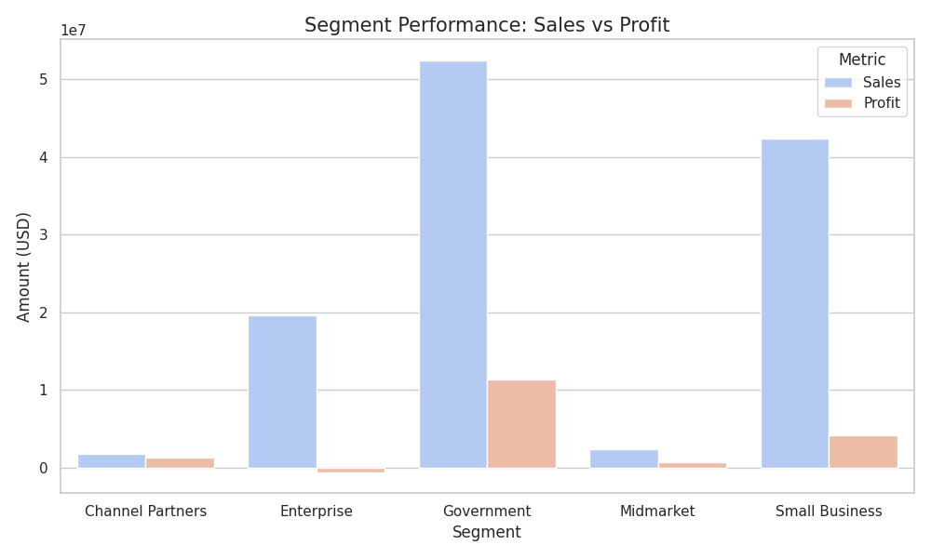
Segment Performance: Sales vs Profit
- The 'Government' segment represents the largest portion of sales and profit.
- 'Enterprise' shows high sales volume but lower relative profit margins.
- 'Small Business' and 'Midmarket' provide healthy margins despite lower volume.

Slide 9
In-Depth Insights
- Product Efficiency: Paseo leads both in units and profit, indicating strong product-market fit.
- Geographical Concentration: Sales are balanced across North America and Europe, with USA leading slightly.
- Discount Impacts: Higher discount bands are used to drive volume in competitive segments like Enterprise.

Slide 10
Strategic Recommendations
- Focus on Government: Double down on the Government segment as it's the most profitable.
- Optimize Enterprise: Review the cost structure or discount strategy for the Enterprise segment to improve margins.
- Product Expansion: Invest in marketing for Paseo and VTT in underperforming regions.

Slide 11
Conclusion
- The business is healthy with a 14.2% profit margin.
- Diverse product portfolio and strong international presence.
- Clear opportunities for margin improvement in large-scale segments.

Slide 12
Thank You
Questions & Discussion

