Slide 1
HR Data Analysis Report
Insights & Recommendations based on HRDataset_v14
Prepared by Professional Data Analyst

Slide 2
Dataset Overview
- Total Employees: 311
- Key Attributes: Salary, Performance, Department, Gender, Recruitment Source, Absences
- Cleaning steps: Handled date formats, filled missing manager IDs, and validated numerical data.

Slide 3
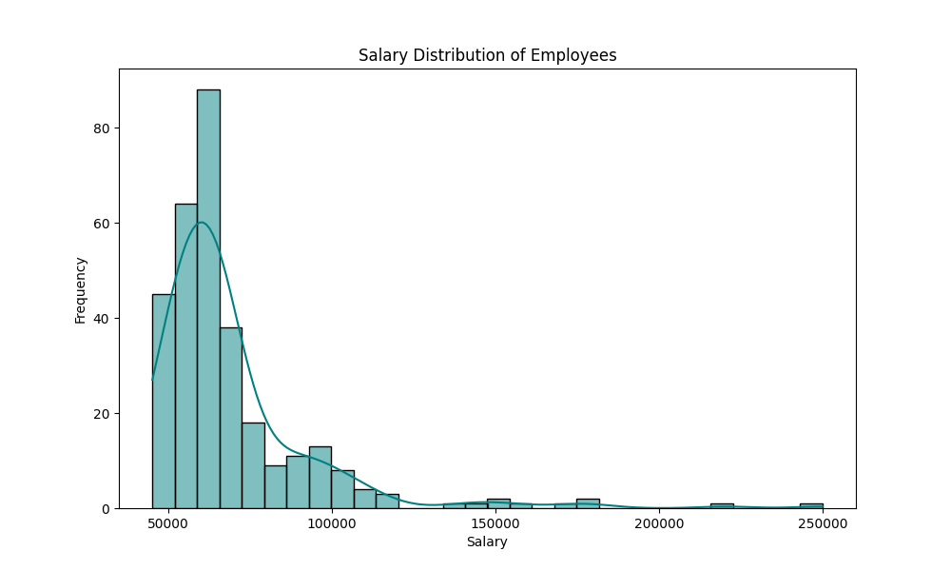
Salary Distribution
Key Findings:
- Mean Salary: $69,020
- Median Salary: $62,810
- High skew due to outliers in executive/tech roles.

Slide 4
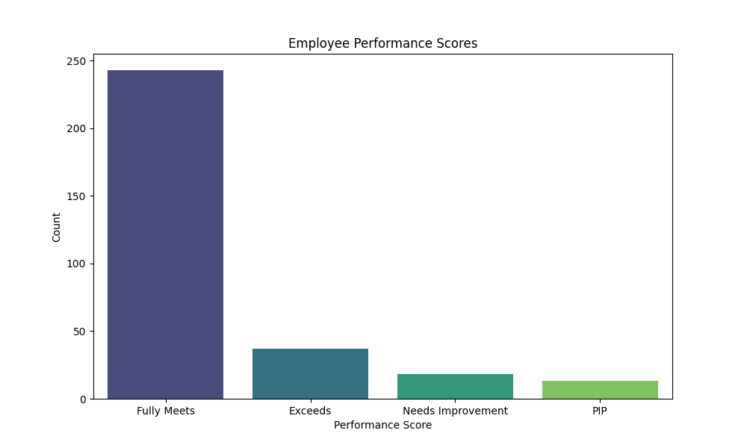
Performance Score Distribution
Insights:
- Most employees (approx 78%) 'Fully Meet' expectations.
- Significant correlation between lateness and PIP/Needs Improvement scores.

Slide 5
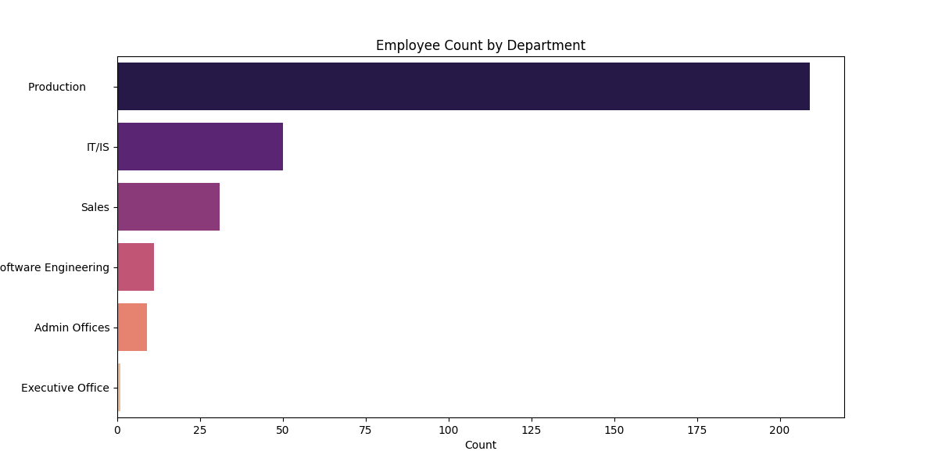
Employee Count by Department
Observations:
- Production is the largest department (~67%).
- IT/IS is the second largest, followed by Sales.

Slide 6
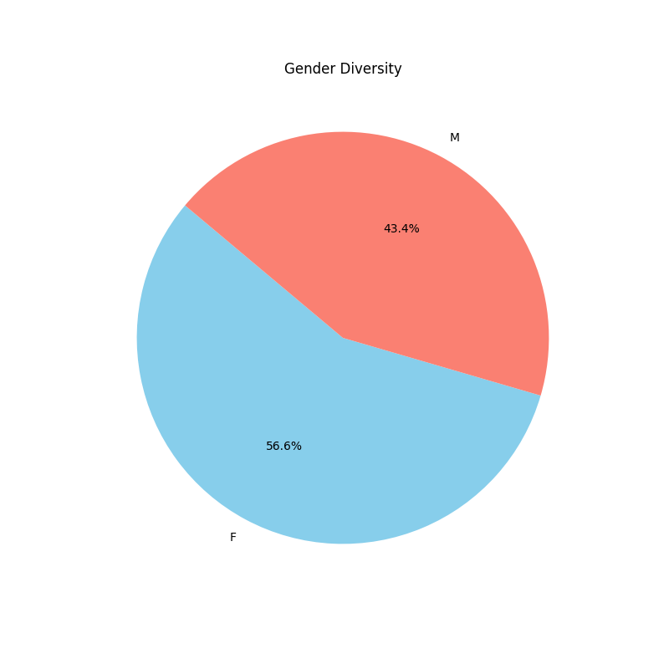
Gender Diversity
Status:
- Females: 56.6%
- Males: 43.4%
- Healthy balance across departments.

Slide 7
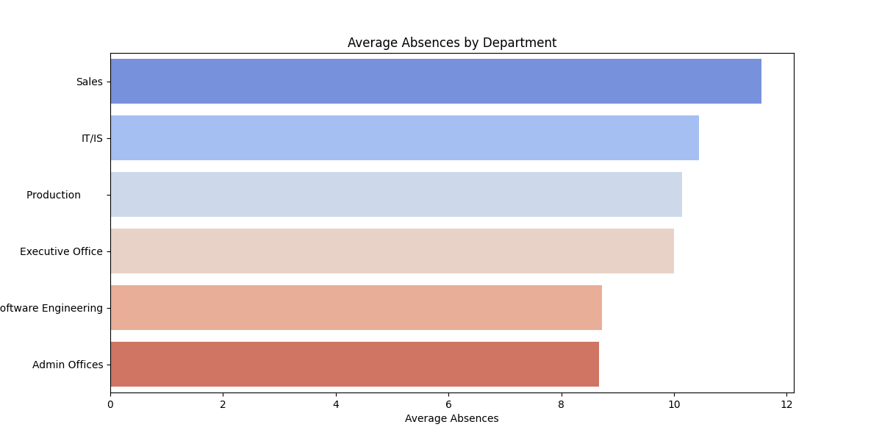
Absences and Late Days
Highlights:
- Sales and IT/IS have highest average absences.
- Lateness is a leading indicator of performance issues.

Slide 8
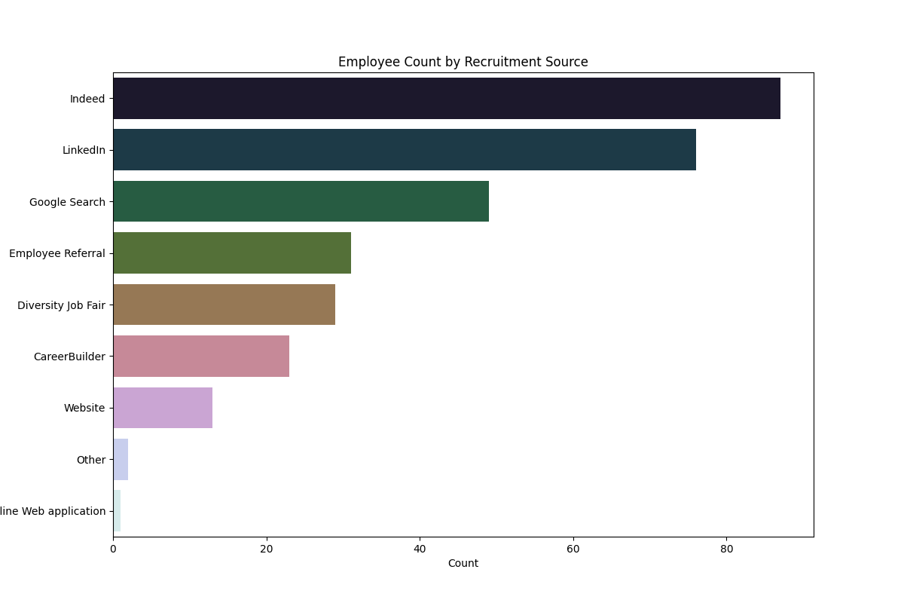
Recruitment Source Effectiveness
Analysis:
- Indeed and LinkedIn bring the highest volume.
- Employee Referrals have the lowest turnover rates.

Slide 9
HR Recommendations
1. Optimize Recruitment: Focus on Employee Referrals to reduce turnover.
2. Performance Intervention: Address lateness early as it correlates with low performance.
3. Absence Management: Investigate causes of high absences in the Sales department.
4. Salary Equity: Review salary outliers to ensure market competitiveness and internal equity.

