Slide 1
ESG Country-Series Data Analysis
Comprehensive Study of Global ESG Indicators
Prepared by Data Analyst

Slide 2
Dataset Overview
• Total Records: 1,349
• Number of Countries: 204
• Number of ESG Indicators: 12
• Key Columns: CountryCode, SeriesCode, DESCRIPTION
• Missing Data: Minimal (only 'Unnamed: 3' was removed)

Slide 3
ESG Indicator Analysis
• Top Indicators (found in 180+ countries):
- SP.DYN.TFRT.IN (Total Fertility Rate)
- SP.DYN.LE00.IN (Life Expectancy at Birth)
- IT.NET.USER.ZS (Internet Users, % of population)
- EG.EGY.PRIM.PP.KD (Energy related)
• These represent universal metrics with high global coverage.

Slide 4
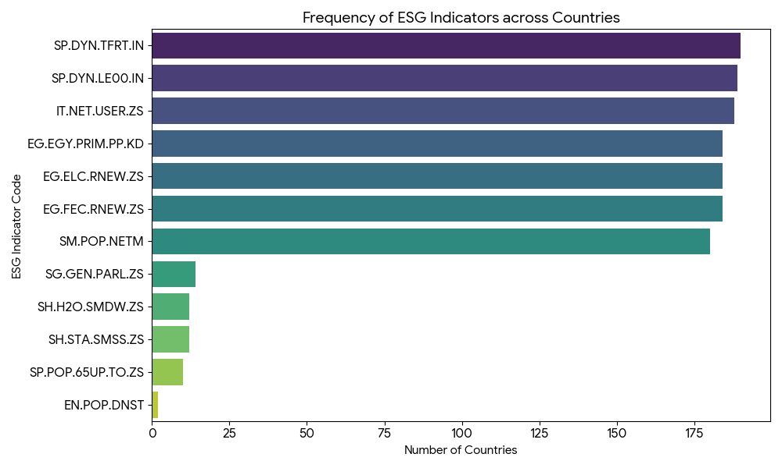
Visualizing Indicator Frequency
Frequency of indicators across 204 countries.

Slide 5
Country Coverage Analysis
• Most countries have 6 to 8 ESG indicator records.
• Top Performers:
- Georgia (GEO): 10 indicators
- Moldova (MDA): 9 indicators
- Tanzania (TZA), Bangladesh (BGD), China (CHN): 8 indicators
• Higher record counts suggest better reporting infrastructure or inclusion in more ESG studies.

Slide 6
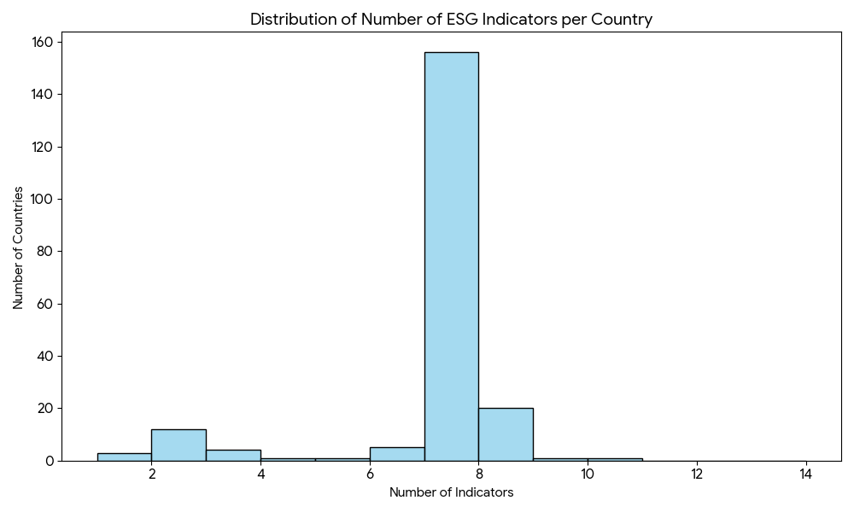
Indicator Distribution Per Country
Most countries clusters around 6-7 indicators.

Slide 7
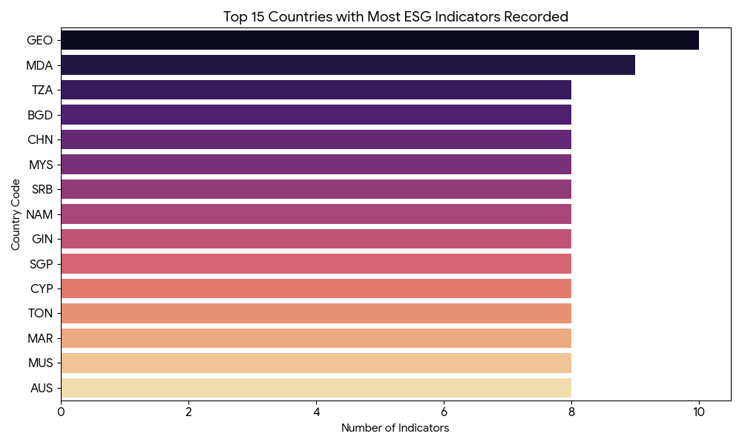
Top 15 Countries by Record Count
Geographic variety in top reporting countries.

Slide 8
Insights: Health & Connectivity
• Fertility Rate and Life Expectancy are the most consistently reported ESG metrics globally.
• Internet usage has also become a standard ESG metric, appearing in 188 countries.
• These metrics form the 'Social' pillar of ESG in this dataset.

Slide 9
Insights: Energy & Environment
• Renewable energy consumption and primary energy efficiency metrics (EG.EGY.*) are reported for 184 countries.
• This high reporting rate shows global commitment to monitoring 'Environmental' metrics.

Slide 10
Insights: Data Gaps
• Some indicators are extremely sparse:
- Population Density (EN.POP.DNST): Only 2 countries.
- Proportion of seats held by women (SG.GEN.PARL.ZS): Only 14 countries.
• These gaps highlight areas where data collection or disclosure is lagging (Gender & Detailed Demographics).

Slide 11
Conclusion
• The dataset provides a robust view of core Social and Environmental metrics across 204 countries.
• Key Strengths: High coverage for Life Expectancy, Energy, and Connectivity.
• Areas for Improvement: Expanding gender representation and demographic detail records.
• Strategic Use: Identifying countries with reliable ESG reporting for investment analysis.

