Slide 1

Problem Statement
To run GenAI on Intel AI Laptops and Simple LLM Inference on CPU and fine-tuning of LLM Models using Intel® OpenVINO™

Slide 2
Unique Idea Brief (Solution)
We have used the TinyLlama-1.1B-Chat-v1.0 model, we are building a chatbot as part of our project.
To improve speed, the model is optimised with OpenVINO and fine-tuned with INT 4 precision.
Gradio is used in the development of the chatbot interface, offering an intuitive platform for user interaction.

Slide 3
Features Offered
Interactive Chatbot:
Provides a responsive and interactive conversational experience.
Can handle a variety of user queries and provide helpful, respectful, and honest responses.
Fine-Tuned Model:
Utilizes the Tiny Llama 1B model, fine-tuned with INT4 compressed weights for optimized performance.
Size of model with INT4 compressed weights is 696.19 MB

Slide 4
Features Offered
Optimized for Efficiency:
Model is optimized using OpenVINO, ensuring faster response times and lower resource consumption.
Suitable for deployment on devices with limited computational resources.
User-Friendly Interface:
Developed using Gradio, offering an intuitive and accessible interface for users to interact with the chatbot.
Easy to set up and use, requiring minimal technical knowledge from the end-user.

Slide 5
Process flow
Model Selection : Select model for inference.
Model Fine-tuning : Fine-tune the Tiny Llama 1B model to reduce size with INT4 compressed weights is 696.19 MB to optimize performance.
Intel Open VINO Optimization: Apply OpenVINO to further optimize the model.
User Interface Development: Develop a user-friendly interface using Gradio to facilitate interaction with the chatbot.
Deployment: Deploy the optimized model with the Gradio interface for end-user interaction.

Slide 6
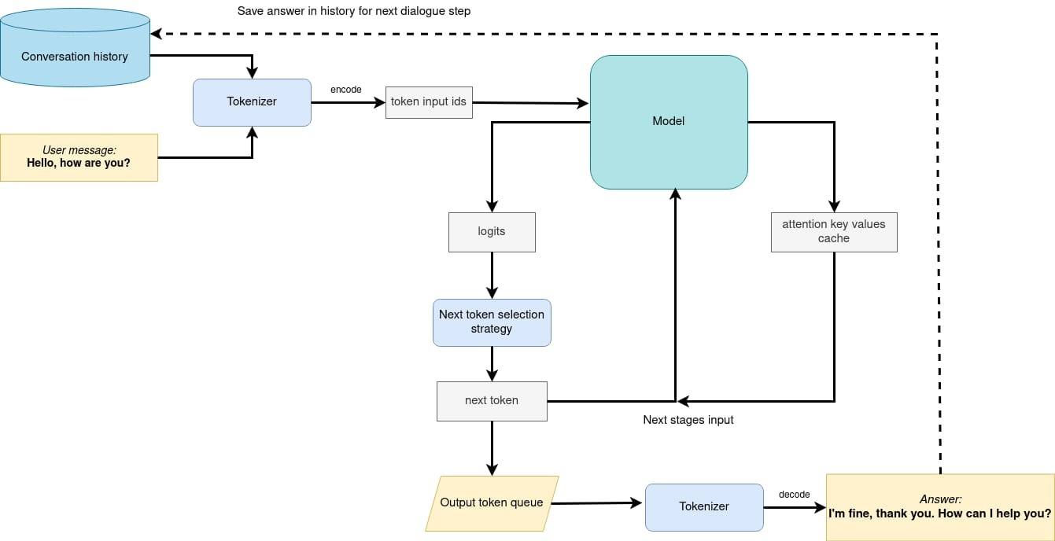
Architecture Diagram

Slide 7

Technologies used
TinyLlama-1.1B-Chat-v1.0: The base LLM model used for the project.
OpenVINO: For quantization and optimization of the model.
Gradio: For building the user interface for the chatbot .

Slide 8
Team members and contribution:
Contributions | Name
Fine tuning and Quantization | Sakshi Yadav
Helper functions for Running the model | Vinit Bahua
Gradio for User Interface | Diya Joshi
Inference for Original & OpenVino model | Dhruve Rathod

Slide 9
Conclusion
Our project successfully demonstrates the capability of running advanced GenAI applications on Intel AI Laptops, specifically through the implementation of an efficient and user-friendly chatbot.
This project underscores the potential for democratizing AI technology, bringing powerful language models to a broader audience without the need for specialized hardware. As we look to the future, this project serves as a stepping stone towards more accessible and integrated AI solutions in everyday computing environments.

